Slide 1


State Estimation using IMU, GPS and Ultrasonic sensor
MEEN 689 Robotic Perception Project
Under guidance of Dr. Srikanth Saripalli

Slide 2

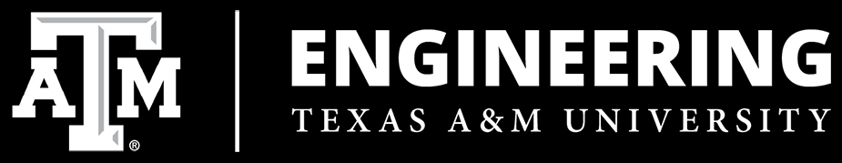
Group Members
Name | UIN
Pranav Natu | 430000211
Sumil Sood | 329006457
Siddharth Sane | 829009471
Jay Shah | 930001954
Aditya Bitra | 230002273

Slide 3
Contents of the Presentation
Problem Definition
Methodology
Equations of the Model
GPS and Accelerometer
Kalman Filter
Bayesian Filter
Particle Filter
Comparison between different filters
Conclusion
Future scope

Slide 4
Problem Definition and Objective
Objective- Estimation of state (Px,Py and Vx,Vy) of a robot using sensor fusion.
Filters used Kalman Filter, Bayes Filter and Particle Filter.
Compared the results of these filters.

Slide 5
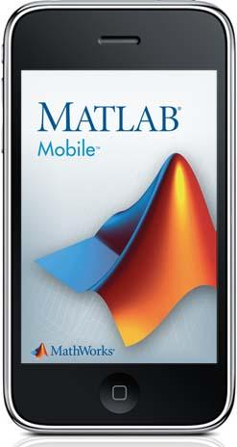
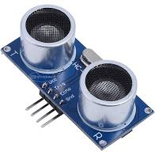
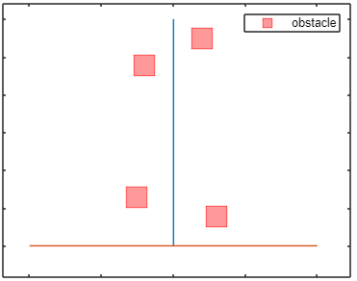
Methodology
Sensors - Accelerometer & GPS from MATLAB mobile app and ultrasonic sensor.
Procedure
Defined coordinate frames.
Walked along a straight line carrying the robot for 45 meters at constant velocity.
Placed obstacles at different distances from the straight line to be detected by the Ultrasonic Sensor.
Assumptions
Location (y coordinate) of obstacle is known.
Sequence of obstacle passed is known.

Slide 6
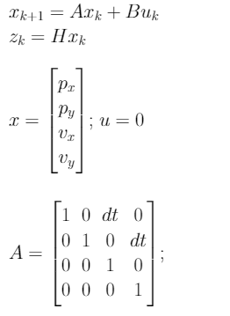
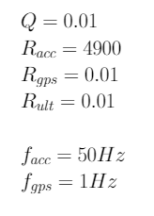
Equations of the Model

Slide 7
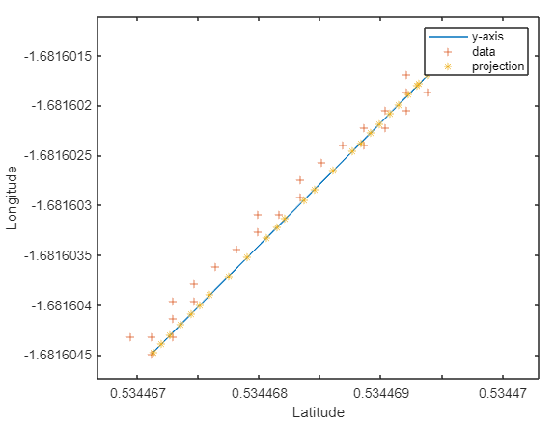
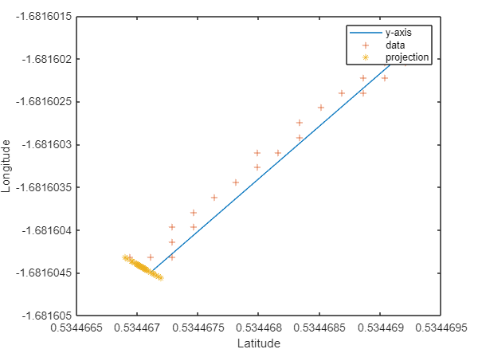
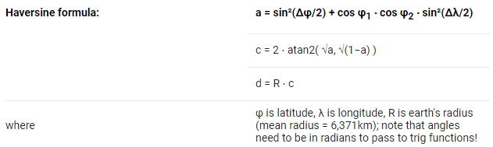
GPS
Took y-axis along the path and x-axis perpendicular to it.
Converted GPS data to these x-y coordinates by taking projections on these axes.
Used Haversine formula to calculate distance between two coordinates.

Slide 8
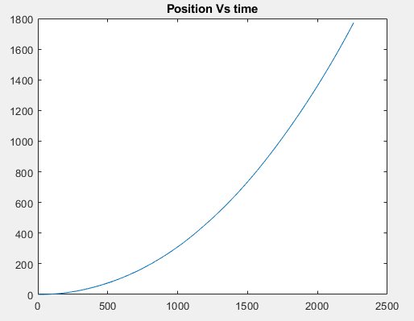
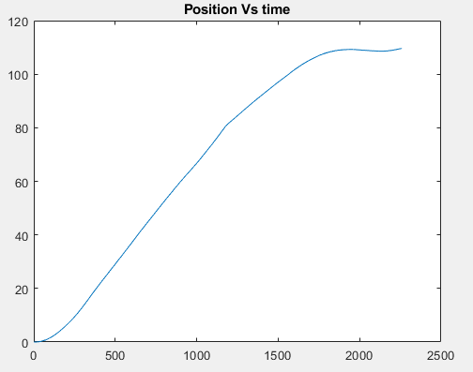

Accelerometer
The accelerometer data is collected using a mobile’s sensor.
The raw data from sensor has a lot of noise and gives an error of order 10^4.
Thus the data has to be refined using offset, scaling and bias.
The offset and scale is calculated by keeping the sensor still.
The bias of the sensor is modeled as a logarithmic function of time as bias tends to keep increasing as the time passes.

Slide 9
Kalman Filter
The filter estimates the position and velocity in two dimensions.
The data from Accelerometer, GPS and ultrasonic sensor are used to estimate position while only accelerometer and Gps to estimate velocity.
The covariance matrix and the kalman gain are initialized with suitable values and they convergy as the filter is running.
The position and velocity estimates matches closely with the actual values.
The results have saw like graph because the estimate tends to divert due the the noisy accelerometer measurements but is kept in check as soon as the GPS measurement comes in whose frequency is less.

Slide 10

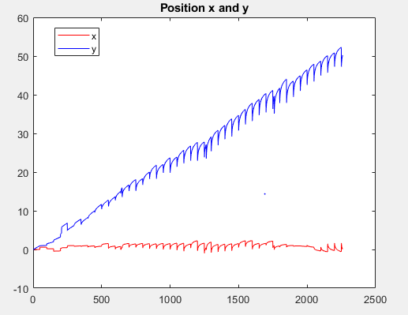
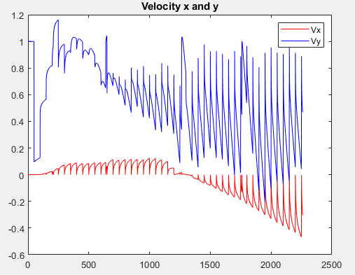

Slide 11
Bayesian Filter
Initialisation: The initial probability of occurrence of state is considered to be uniform.
Prediction: The measurements are assumed to be of Gaussian Distribution and the state is calculated by the probability equations.
Updation: The probability is updated by the normalisation procedure.
State estimate: The state with maximum probability is found out.
Sensor fusion: The same process is carried out for each sensor according to their sampling rates.
Variances: The same values of variances are used as the Kalman and the Particle filter to maintain uniformity in the results.
Results: The positions and velocities in X and Y direction are obtained. The resultant positions follow the actual system output well.

Slide 12
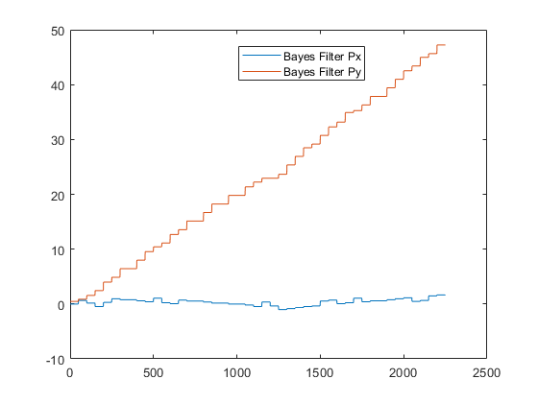
Output through Bayesian Filter

Slide 13
Particle Filter
Initialization: For the first time step, the actual state is assumed to be the same as the model.
Distribution: Process and Sensor noises are assumed to be gaussian
No. of particles sampled: 100
Propagation: From the previous time step, particles are propagated through the process and measurement equations and randomly sampled according to gaussian
Likelihood: Likelihood (weights) for each particle is calculated and normalized
Resampling: 2 methods are used: Multinomial and Residual

Slide 14
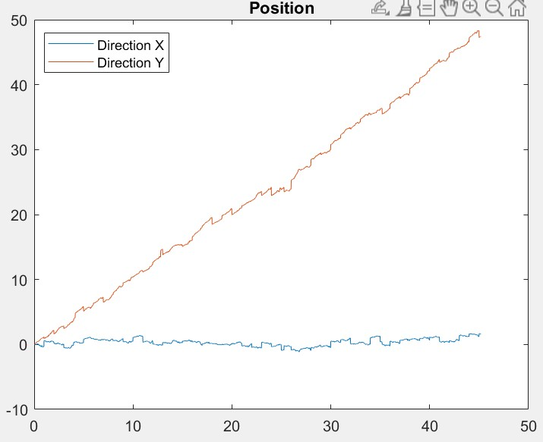
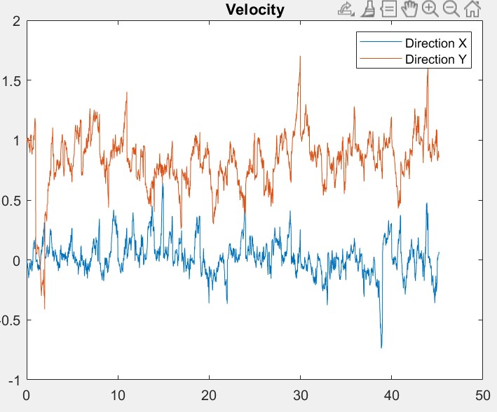

Slide 15
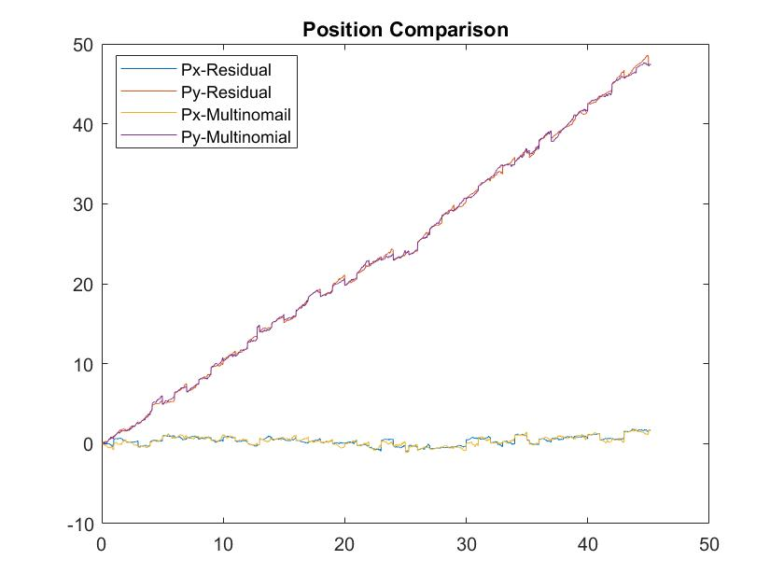
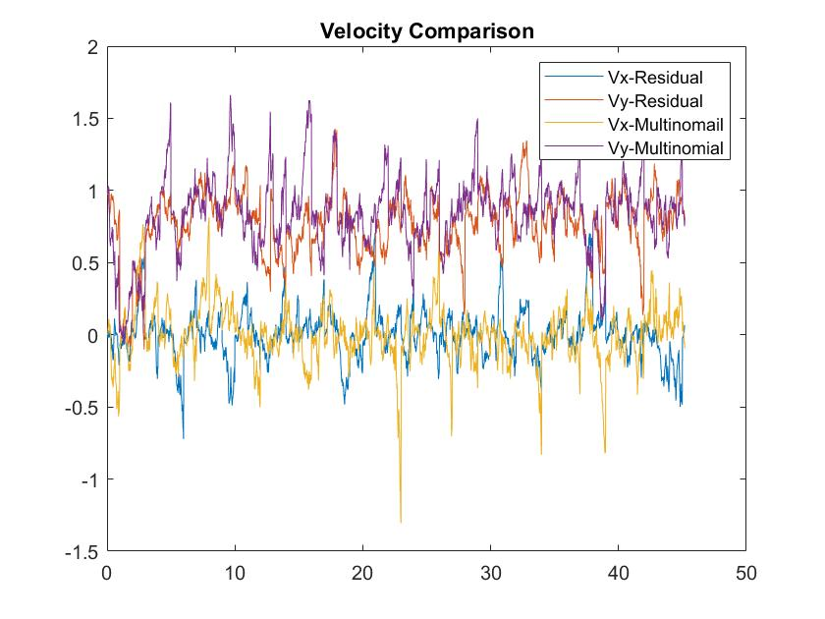

Slide 16
Comparison of Filters
The results from all the filters are presented on the next page for the same process and measurement noise.
Kalman filter differs more from bayes and particle filter as it’s estimates are more noisy and deviates from the true state at a higher rate.
Bayes and particle filter gives smoother estimates and deviate less from the true state.
Particle filter works the best when all the three filters are with same process and measurement noise and gives a very smooth estimate matching with true state.
But particle filter is more sensitive to noise and changing any of the process and measurement noise affects the estimates to a great extent and in this case kalman filter works better.

Slide 17
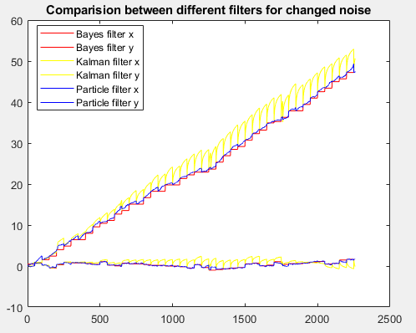

Slide 18
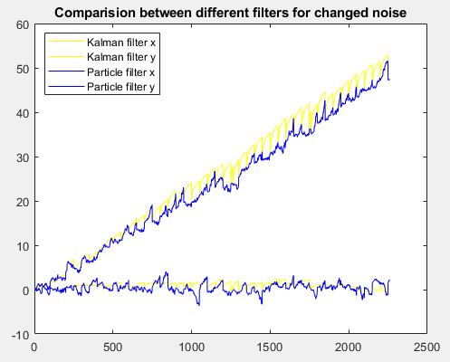

Slide 19
Conclusion
Particle Filter is the best choice when we have a robust value of covariances and/or cross-variances of the process and sensors
Kalman Filter gives the best result in a process where variances are subject to change and noises are gaussian
Bayes FIlter can be used in any case since it follows the actual state closely and is not very sensitive to change in covariances
Computation Cost: Kalman < Bayes < Particle (for a linear system)

Slide 20
Future scope
The sensors can be tested in an indoor environment.
The number of obstacles can be increased to obtain more readings from the Ultrasonic sensor to improve accuracy.
A nonlinear system can be considered and necessary changes made to the filter models to accommodate the nonlinearity.
The number of sensors can be increased to improve the response.
Switching filters and merging data obtained from the filters can be done. The output of one filter can be given to another filter having better accuracy.
Bias can be included in the state vector to for better data from accelerometer.

Slide 21
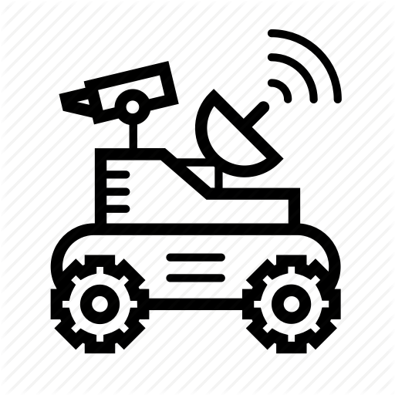
Thank You
_________________

