Slide 1
Aggregation, Not Architecture
What Actually Drives Noise Robustness in Wi-Fi Intrusion Detection
Pranav T N
Prof. Rajasekar Mohan
Department of Electronics and Communication Engineering, PES University, Bengaluru, India
ICCSIT 2026 | Paris, France | September 25–27, 2026
Notes:
Good [morning/afternoon]. I'm Pranav, presenting joint work with Prof. Rajasekar Mohan, PES University. Our paper is 'Aggregation, Not Architecture' — that title IS the punchline. We set out to build a better Transformer for Wi-Fi intrusion detection. What we found instead is more interesting than what we set out to prove. [~30s]

Slide 2
Wi-Fi Attacks Need Detection That Generalizes
1
The threat surface
Deauth, evil twin, rogue AP, botnet, malware, spoofing — WLANs are exposed by design.
13
attack categories
in AWID3
2
Classical ML falls short
Decision Trees, Random Forests classify packets independently — no notion of context.
254 → 18
raw features, reduced
via documented selection
3
The assumed fix
Recent work adopts Transformers, assuming attention over packet sequences is what's needed.
12,377
packet windows,
session-aware, non-overlapping
2
Notes:
Wi-Fi networks face deauth floods, evil twin APs, botnet traffic, and more. Classical ML classifies each packet in isolation. Recent work assumes Transformers/attention over packet sequences captures more. We test that assumption directly on AWID3, 13 attack categories. Pipeline: 254 raw features reduced to 18, 12,377 windows built. [~1 min]

Slide 3
A Confound Hiding in Plain Sight
In most published comparisons…
Classical Baselines
Transformer
See ONE packet at a time
VS
Sees a 10-packet WINDOW
18 features
180 features
Any performance gap could come from 10× more information — not a smarter architecture.
This is the confound our ablations were designed to isolate.
3
Notes:
Classical baselines see ONE packet, 18 features. Transformers see a TEN-packet window, 180 features — not a fair fight. Any advantage could come from 10x more information, not smarter architecture. This confound is exactly what our ablations were built to isolate. [~1 min]

Slide 4
Building a Pipeline That Can't Cheat
Raw AWID3
→
Feature
Selection
→
Session-Aware
Windowing
→
Noise
Protocol
13 attack
categories
254 → 18
features
10 packets,
same MAC
Train ≠ Test
distribution
Key fix: test-time noise is deliberately different from training augmentation — higher magnitude, different missing rate, plus a sign-flip corruption never seen in training.
This avoids the classic mistake: evaluating on noise the model has already memorized.
4
Notes:
Pipeline from raw AWID3 (not pre-balanced). 18 features via documented selection. Ten-packet windows grouped by device session — no mixing unrelated traffic. KEY POINT: test noise is NOT the same as train noise — stronger, different missing rate, plus a sign-flip corruption never seen in training. If train/test noise match, you measure memorization, not robustness. [~1.5 min]

Slide 5
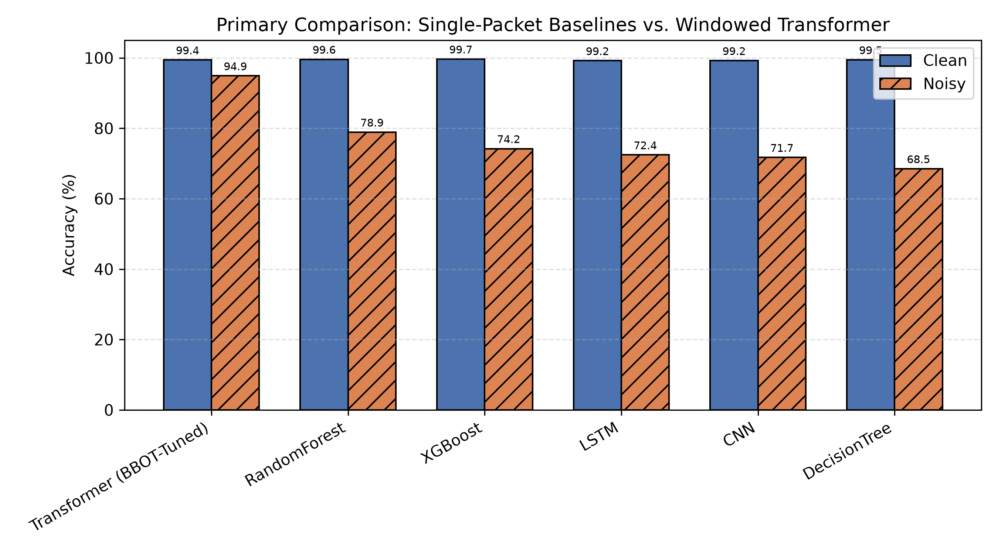
The Story So Far: Context Looks Like It Wins
Single-packet baselines collapse under noise (68–79%). The windowed Transformer holds at 94.9%.
5
Notes:
PAUSE 2-3 sec before speaking, let the chart register. Clean conditions: everyone above 99%, no real difference. Under noise: single-packet baselines collapse to 68-79%, windowed Transformer holds at ~95%. Read alone this says 'use a Transformer.' That's what we set out to publish. [~1.5 min]

Slide 6
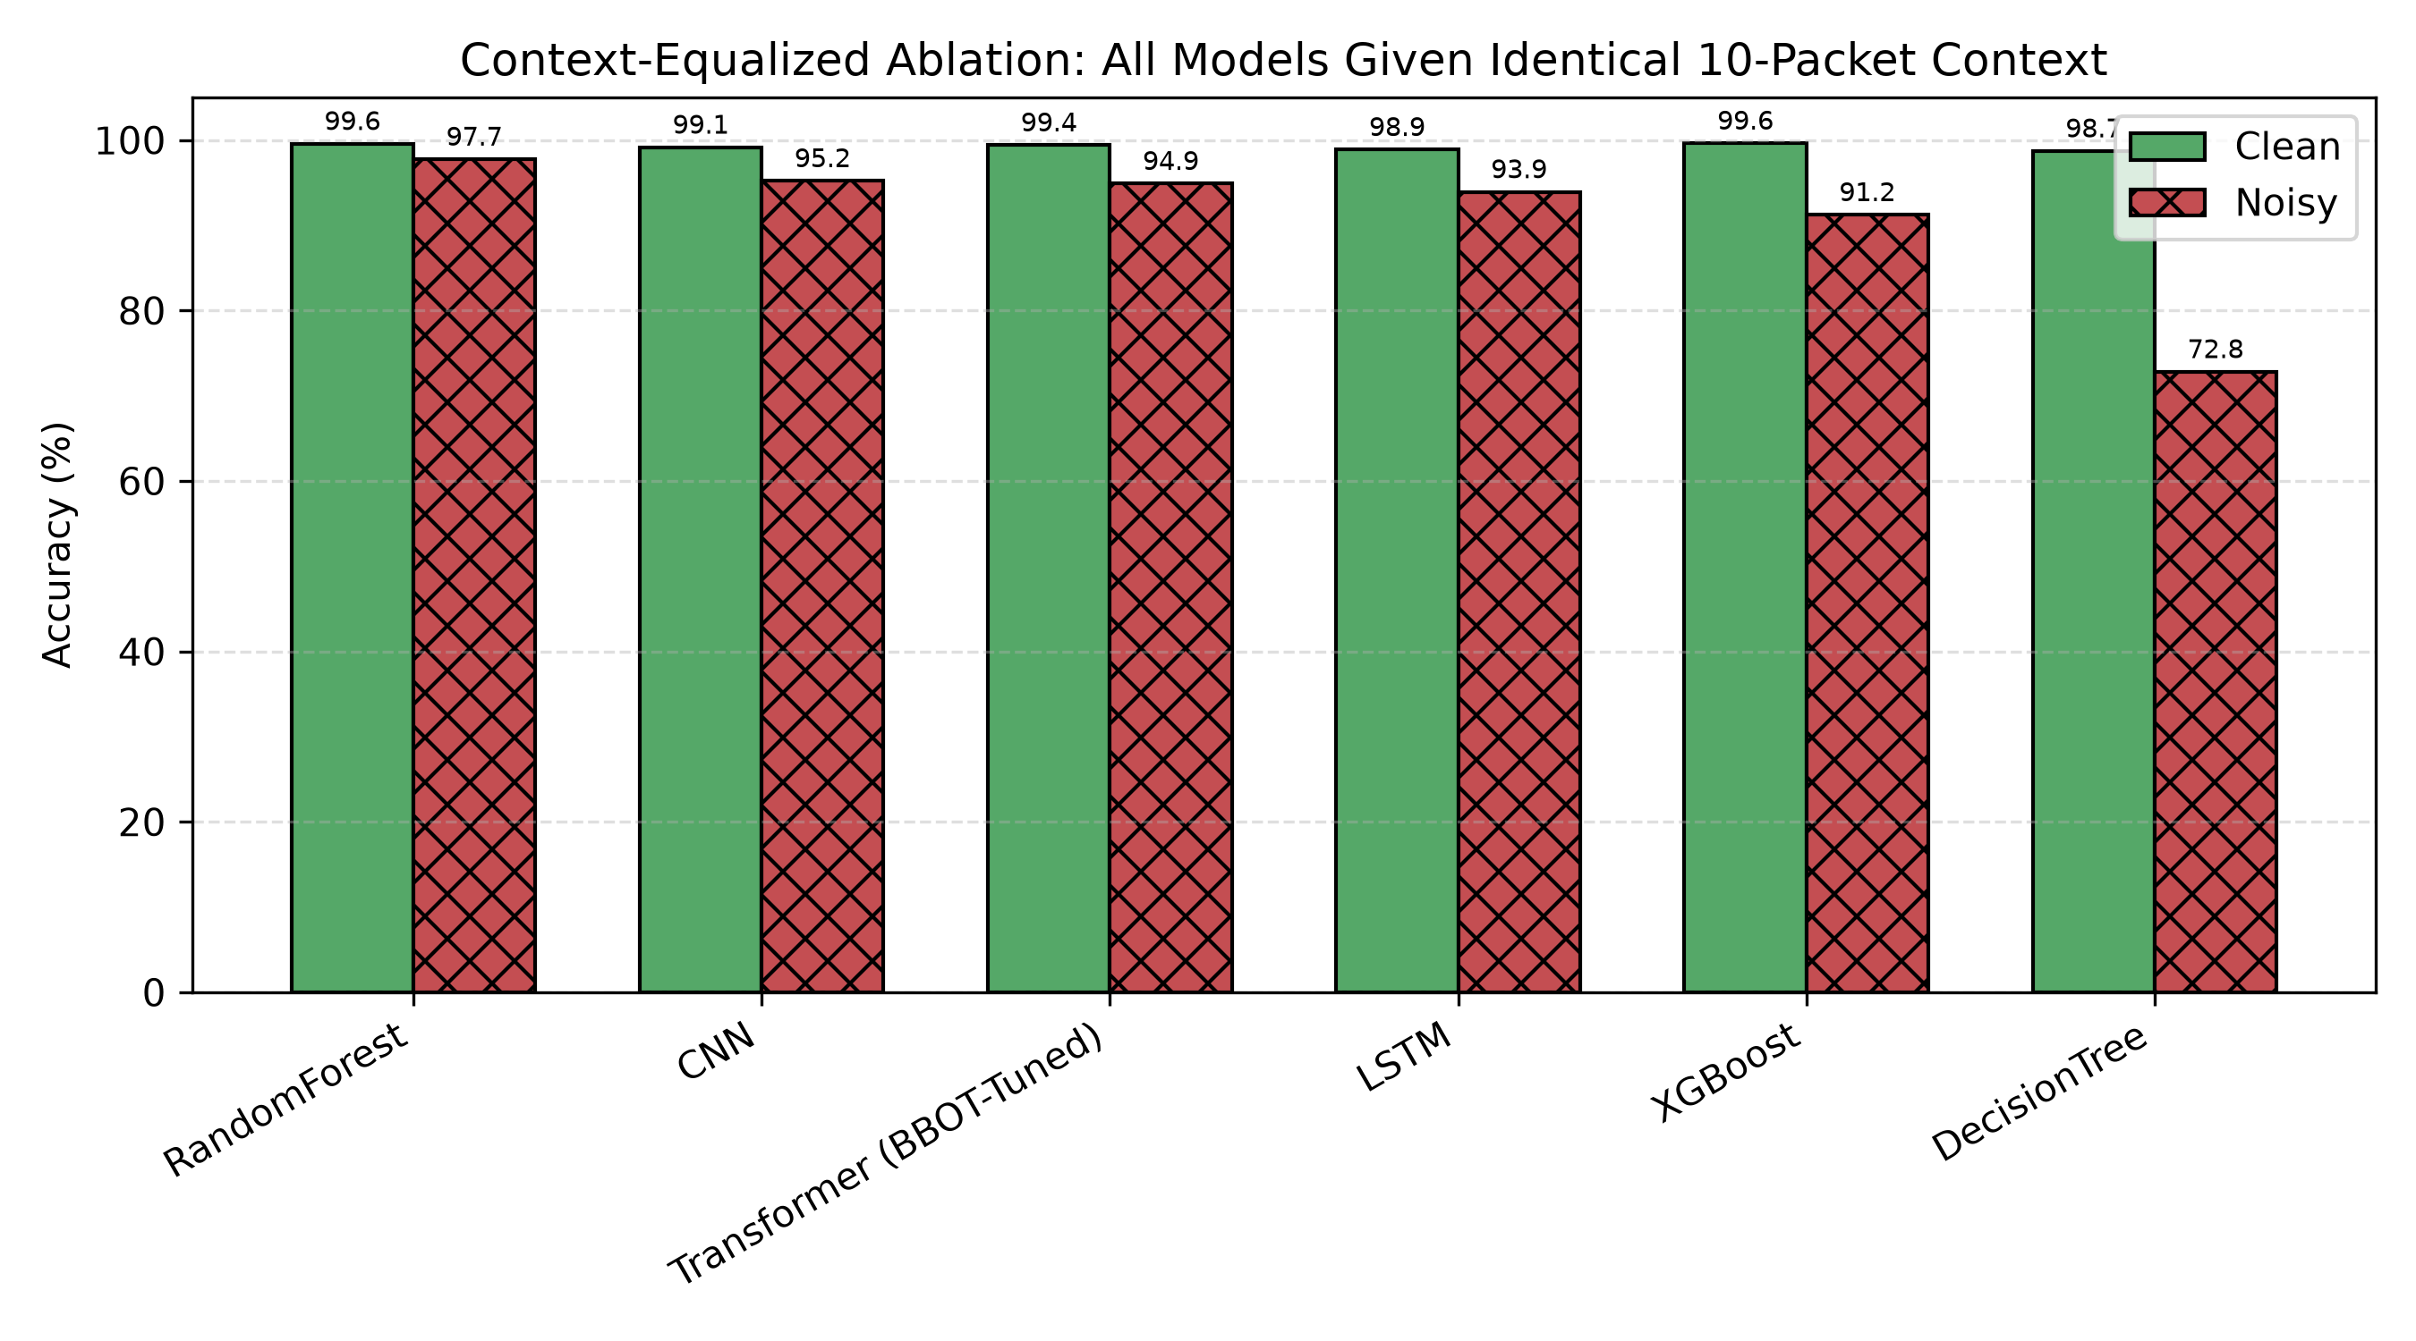
Give Everyone the Same Context…
Random Forest reaches 97.7%. The Transformer's advantage disappears entirely.
6
Notes:
PAUSE after title — this is the turn in the talk. That comparison was confounded. Re-run giving everyone the same 10-packet window: Random Forest jumps to 97.7%, CNN to 95.2%. Transformer's advantage — gone. Random Forest is now the best model in the whole comparison. [~1.5 min]

Slide 7
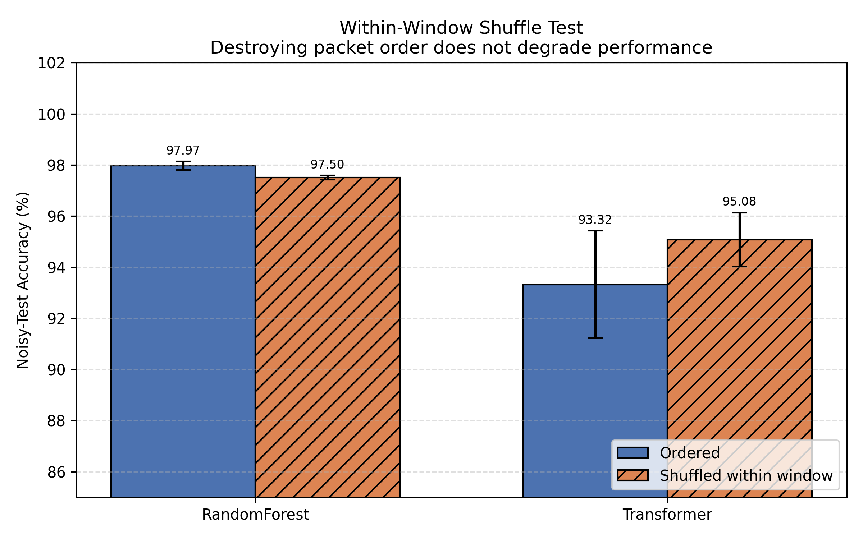
Does Packet Order Even Matter?
We randomly shuffled packet order within each window.
Random Forest: barely moves.
Transformer: gets better with order destroyed.
The model built to learn sequence… doesn't need it.
7
Notes:
Question: is the Transformer's edge about SEQUENCE/order, or just more data points? Direct test: shuffle packet order WITHIN each window, same packets same labels, order scrambled. Random Forest barely moves. Transformer — built specifically to learn position — gets BETTER with order destroyed. This is the moment we knew it wasn't sequence learning. [~1.5 min]

Slide 8
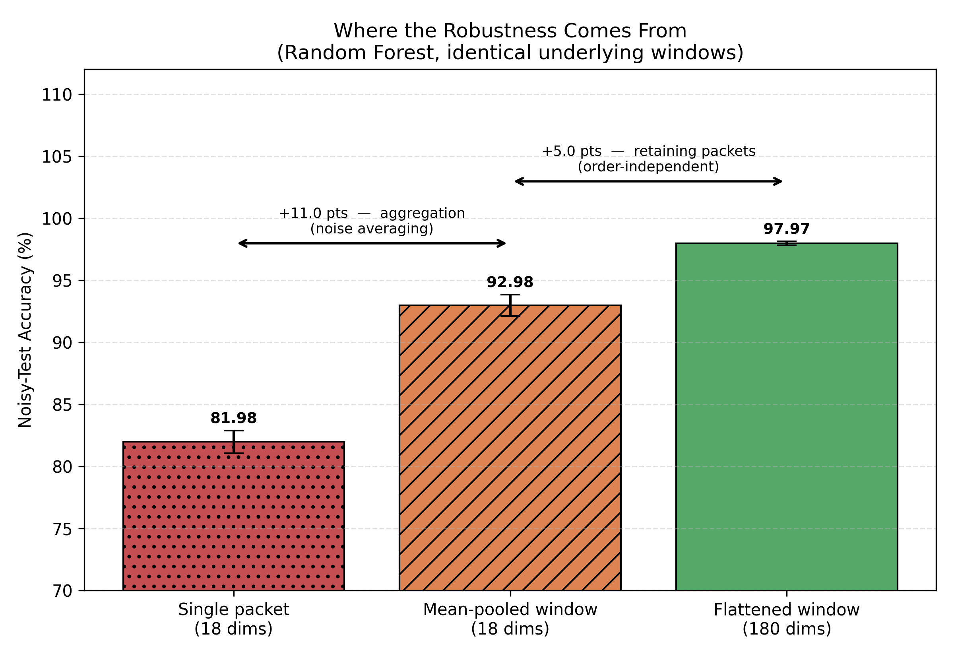
So Where Does the Robustness Come From?
11.0 pts
from averaging alone — same 18 features, just aggregated.
5.0 pts
from retaining individual packets — order-independent, confirmed by the shuffle test.
8
Notes:
Decompose it: single packet = 82% noisy accuracy. Just averaging the 10 packets (no extra detail) = 93% — 11 points from averaging alone. Keeping all 10 packets separately adds 5 more points — already shown order-independent. Story: aggregation drives robustness via noise-averaging; architecture processing it matters far less than assumed. [~1.5 min]

Slide 9
The Takeaway
Context matters more than architecture.
A Random Forest with equal context beats a tuned Transformer
— more accurate, more stable across seeds and splits, and far cheaper to train.
Limitations
Noise is synthetic — not calibrated to measured wireless interference
A protocol shortcut may inflate clean accuracy (ARP opcode ≈ 43% importance)
Findings apply to redundant, consecutive packet windows — not a general claim against sequence models
9
Notes:
Takeaway: context matters more than architecture. Random Forest with equal context beats tuned Transformer — more accurate, more stable across splits, far cheaper (seconds vs minutes + 30-trial search). Limitations, say plainly: noise is synthetic not calibrated to real interference; ARP opcode carries large importance share (possible protocol-ID shortcut); finding is specific to redundant consecutive-packet windows, not a blanket claim against sequence models. [~1 min]

Slide 10
Thank You
Questions?
Pranav T N
thotapranav24@gmail.com
Prof. Rajasekar Mohan (Corresponding Author)
rajasekarmohan@pes.edu
Paper ID: ZX1060 — ICCSIT 2026, Paris — ACM Int'l Conference Proceedings Series
Notes:
Thank you. Happy to take questions — contacts on screen; Prof. Mohan is corresponding author for any follow-up after today. [~1 min incl. Q&A buffer]

