Slide 1



Aggregation, Not Architecture
What Actually Drives Noise Robustness in Wi-Fi Intrusion Detection
Pranav T N
Prof. Rajasekar Mohan
Department of Electronics and Communication Engineering, PES University, Bengaluru, India
ICCSIT 2026 | Paris, France | September 25–27, 2026 | Paper ID: ZX1060

Slide 2
Agenda
1
Motivation — the Wi-Fi threat landscape
2
The confound in prior comparisons
3
Dataset and pipeline (AWID3)
4
Feature selection methodology
5
Session-aware windowing
6
Noise-evaluation protocol
7
Transformer architecture + BBOT (Optuna) tuning
8
Results: primary comparison → context-equalized ablation
9
Mechanism: shuffle test → aggregation decomposition
10
Variance, limitations, and takeaway
2

Slide 3







The Wi-Fi Threat Landscape
Deauthentication
Evil Twin AP
Rogue Access Point
Botnet Traffic
Malware
Krack / Kr00k
SQL Injection
SSDP / SSH Abuse
Website Spoofing
13 attack categories, captured in real enterprise Wi-Fi traffic (AWID3) — alongside normal operation.
3

Slide 4


From Independent Packets to Sequence Models
Classical ML
Sequence Models
Decision Trees, Random Forests classify each packet independently. Fast, interpretable — but no notion of context across packets.
Recurrent networks and Transformers assumed to capture patterns emerging across a sequence of packets, via attention.
This premise is widely adopted — but rarely tested in isolation.
Sequence models are usually given more context than classical baselines in the same comparison. Is the advantage architecture, or just more information?
4

Slide 5

A Confound Hiding in Plain Sight
In most published comparisons…
Classical Baselines
Transformer
See ONE packet at a time
VS
Sees a 10-packet WINDOW
18 features
180 features
Any performance gap could come from 10× more information — not a smarter architecture.
This is the confound our ablations were designed to isolate.
5

Slide 6
Related Work — Where This Fits
Wi-Fi IDS survey literature
Hamroun et al. survey 5G/Wi-Fi intrusion detection and note that performance depends as much on data representation as classifier complexity [1].
The AWID3 benchmark
Chatzoglou et al. introduced AWID3 — real enterprise Wi-Fi captures across 13 attack categories, now a standard benchmark [2].
Deep learning IDS approaches
CNN-based intrusion prevention [3], neural nets vs. rule-based systems [9], ensemble botnet detection [5], CNN de-authentication detection [8].
Two recurring gaps
1. Classical baselines get single packets while sequence models get windows — confounding architecture with input quantity.
2. Train/test noise is often identical — measuring memorization, not robustness.
This work is consistent with the broader tabular-ML literature: tree ensembles are often competitive with or superior to deep architectures on structured data [14, 15].
6

Slide 7
Dataset: Raw AWID3 Captures
Real enterprise Wi-Fi traffic
Not simulated — genuine captured 802.11 traffic across normal operation and attacks.
Attacks interspersed in background traffic
Attack rows are NOT at the start of files — our loader scans specifically for them rather than assuming uniform distribution.
No pre-balancing shortcuts
Unlike a pre-shrunk 9,000-row derivative, we build directly from the raw, full-scale captures.
13
attack categories + Normal
254 → 18
raw features, reduced
12,377
packet windows built
8,663 / 1,857 / 1,857
train / val / test split
7

Slide 8
Feature Selection: A Documented, 3-Stage Process
254
→
122
→
51
→
45
→
18
Raw protocol
columns
Numeric-coercible,
identifiers excluded
Survive missingness
+ variance filter
After correlation
pruning (>0.95)
Final set
(~95% importance)
frame, radiotap, 802.11,
ARP, TCP/UDP, DNS, HTTP…
MAC addrs, hardware clocks,
fixed channel/freq removed
drop near-constant,
mostly-empty columns
keep higher-importance
member of each pair
ranked via XGBoost
gain-based importance
Top feature: ARP opcode ≈ 43% of total importance — plausible given ARP manipulation's role in Evil Twin / Rogue AP attacks, but flagged as a possible protocol-identification shortcut (see Limitations).
8

Slide 9
Session-Aware, Non-Overlapping Windowing
Session A (MAC: aa:bb:cc…)
→ One window (10 consecutive packets, same session)
Session B (MAC: dd:ee:ff…)
→ Fewer than 10 packets — no window built from this remainder
Grouped by source MAC address (session)
Sorted by relative capture time within session
Non-overlapping — no packet appears in two windows (prevents train/test leakage)
Window label assigned by majority vote across its 10 packets
9

Slide 10
Noise Protocol: Train ≠ Test, By Design
The classic mistake: evaluating on noise drawn from the same distribution used for training augmentation measures memorization, not robustness.
Parameter
Train-Time Augmentation
Test-Time Evaluation
Gaussian noise level
0.10
0.25
Missing-value rate
0.08
0.15
Sign-flip corruption
Not applied
0.03 — never seen in training
Applied
On-the-fly, regenerated per batch/epoch
Once, to held-out test split
10

Slide 11
Transformer Architecture + BBOT (Optuna) Tuning
Input
Projection
→
+ Positional
Encoding
→
Multi-Head
Self-Attention
→
Feed-Forward
+ LayerNorm
→
Global Avg
Pooling
→
Softmax
Classifier
Repeated for 3 encoder layers (Optuna-selected)
BBOT: Optuna Tree-structured Parzen Estimator (TPE)
Adaptive Bayesian search — each new trial's hyperparameters are informed by the outcomes of previous trials, unlike undirected random search.
Hyperparameter
Search Space
Selected
Encoder layers
1 – 4
3
Attention heads
{2, 4, 8}
4
Model dimension
{32, 64, 128}
32
Feed-forward dim.
{64, 128, 256}
64
Dropout
0.0 – 0.4
0.018
Learning rate
1e-4 – 5e-3 (log)
3.57e-4
11

Slide 12

Two Context Conditions, Evaluated Fairly
Single-Packet
(Primary)
Context-Equalized
(Ablation)
Classify one packet at a time — matches real-time deployment. Models buffer nothing before deciding.
Every model gets the SAME 10-packet window as the Transformer. Trees see it flattened (180-dim); CNN/LSTM see it as a real sequence.
Evaluation metrics: accuracy, weighted precision/recall/F1, full per-class confusion matrices — not just aggregate accuracy.
12

Slide 13
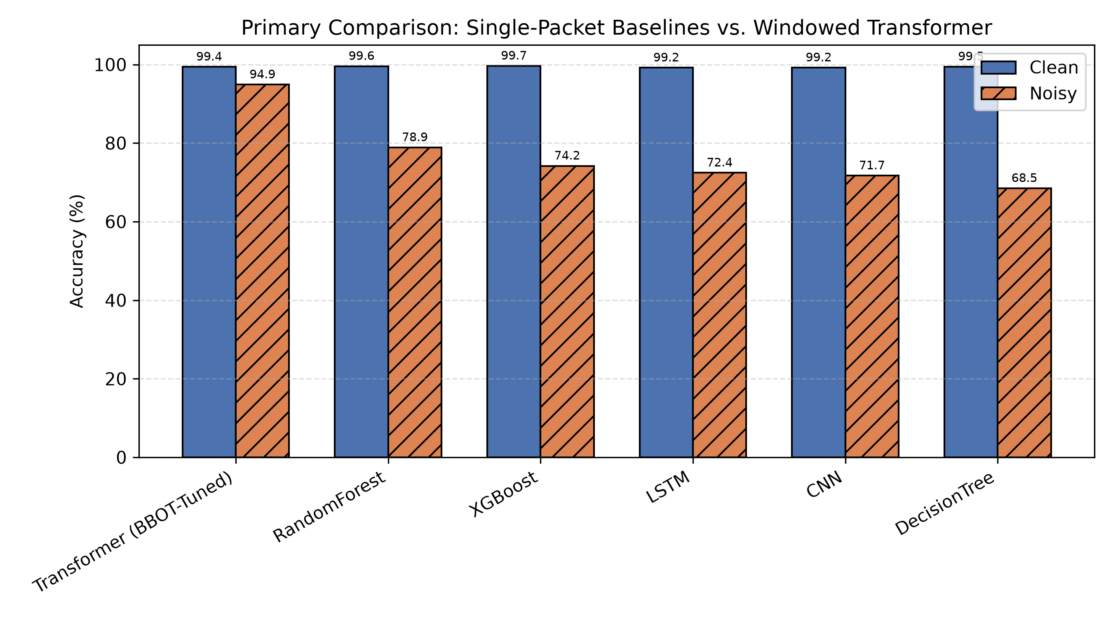
Result 1: Context Looks Like It Wins
Clean: everyone ≥99%, no meaningful separation. Noisy: single-packet baselines collapse to 68–79%; windowed Transformer holds at 94.9%.
13

Slide 14
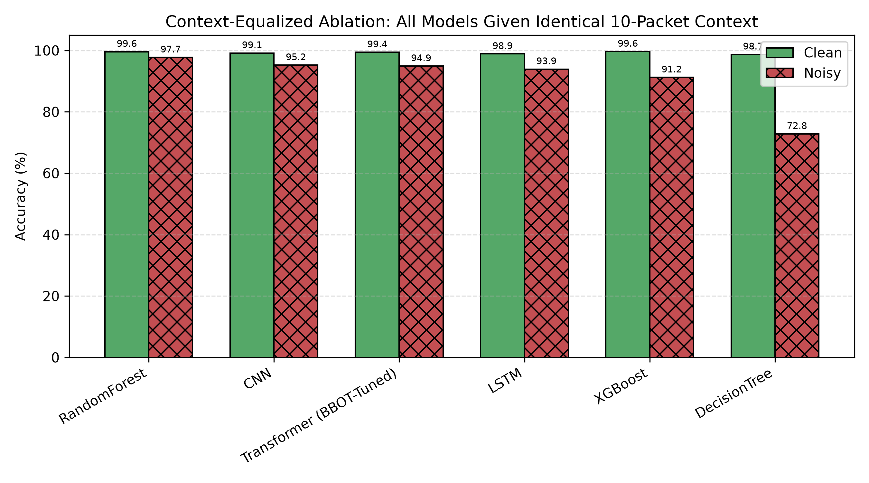
Result 2: Give Everyone the Same Context…
Random Forest reaches 97.7%. The Transformer's advantage disappears entirely — it's now mid-pack.
14

Slide 15
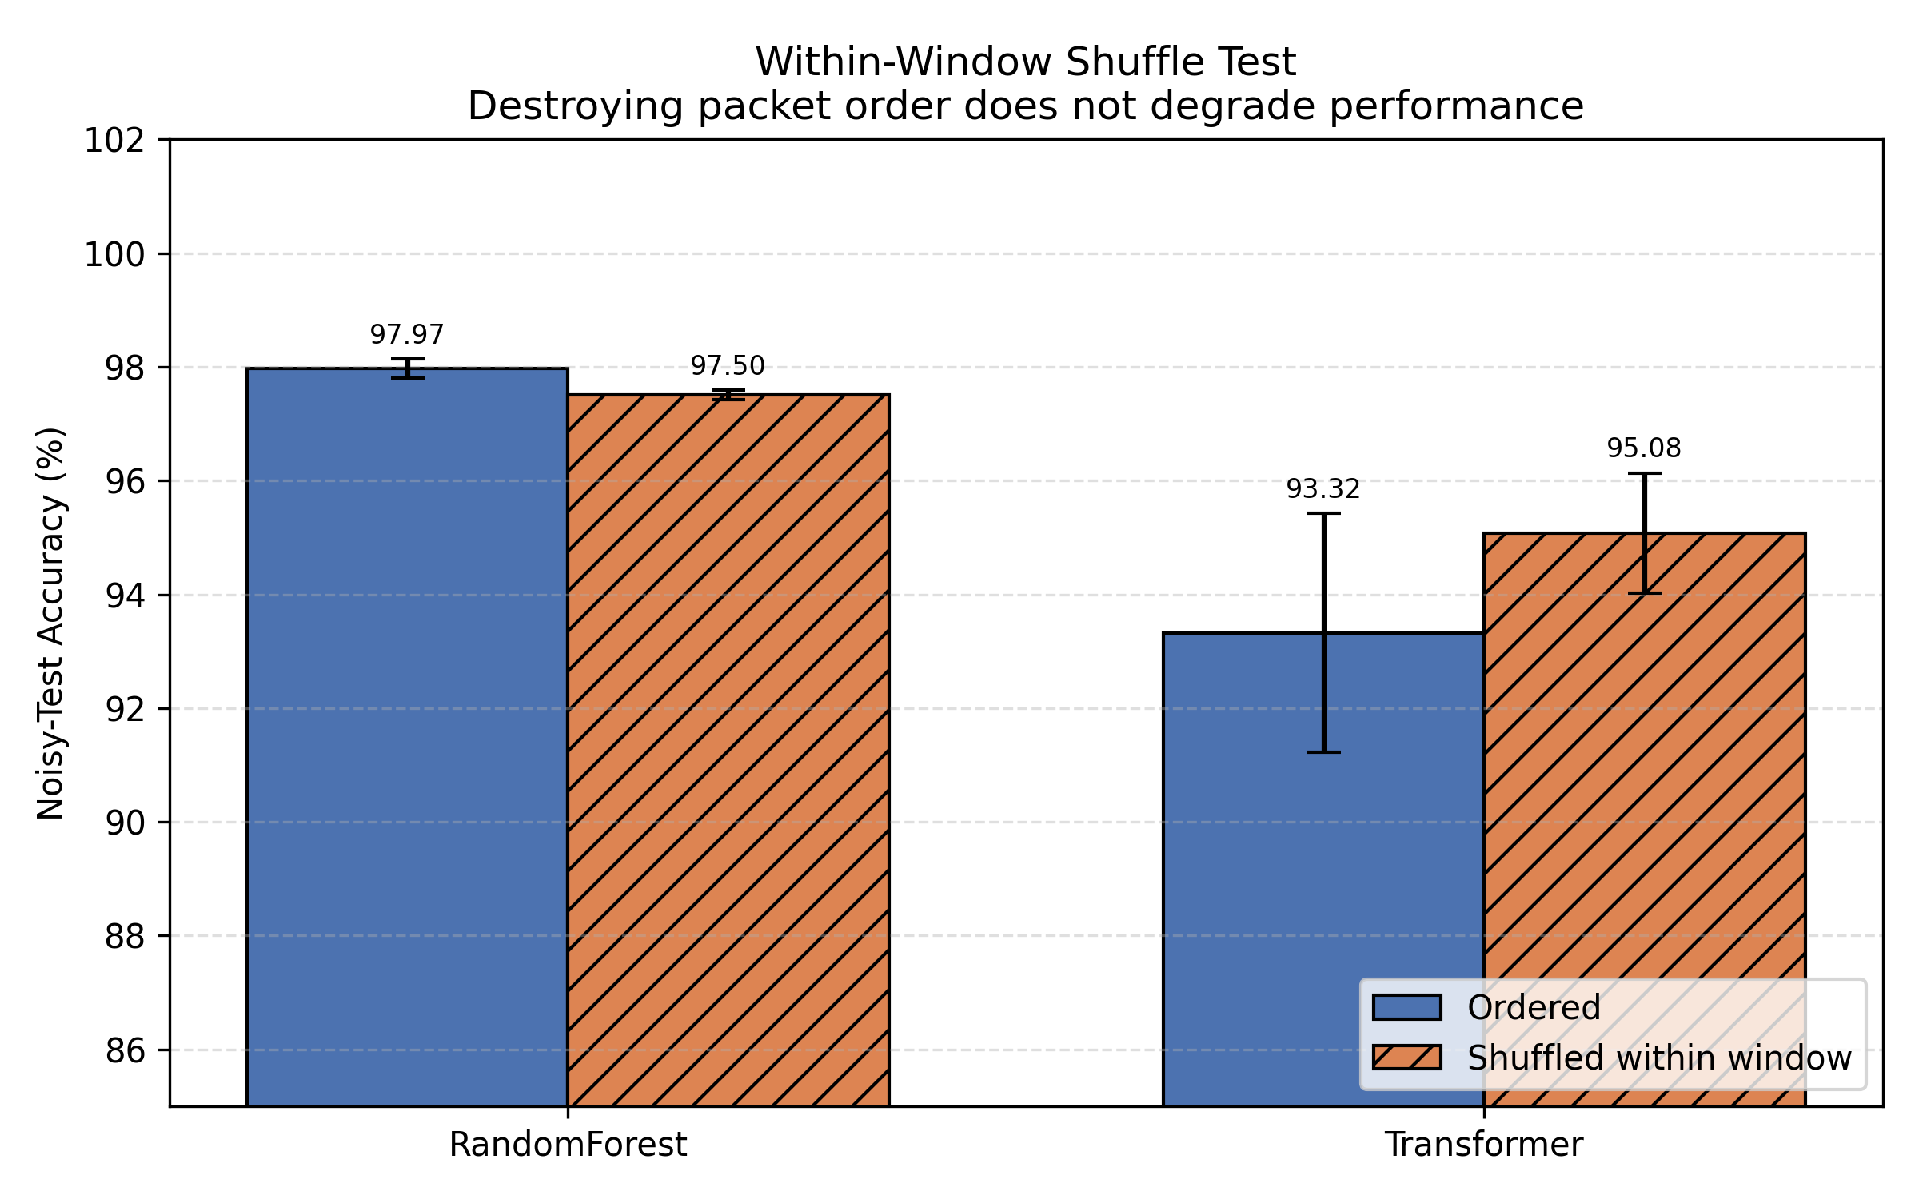
Result 3: Does Packet Order Even Matter?
We randomly shuffled packet order within each window.
Random Forest: barely moves (−0.47 pts).
Transformer: gets better (+1.76 pts) with order destroyed.
Diagnostic: packets within a window are ~17× more similar to each other than windows are to one another.
The model built to learn sequence… doesn't need it.
15

Slide 16
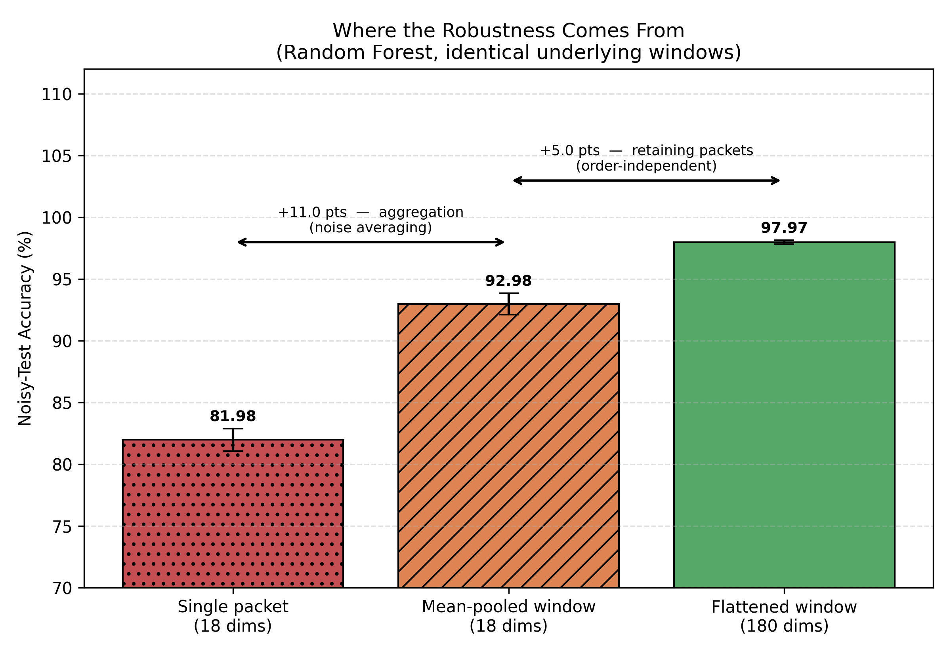
Result 4: So Where Does Robustness Come From?
11.0 pts
from averaging alone — same 18 features, just aggregated over the window.
5.0 pts
from retaining individual packets — order-independent, per the shuffle test.
16

Slide 17
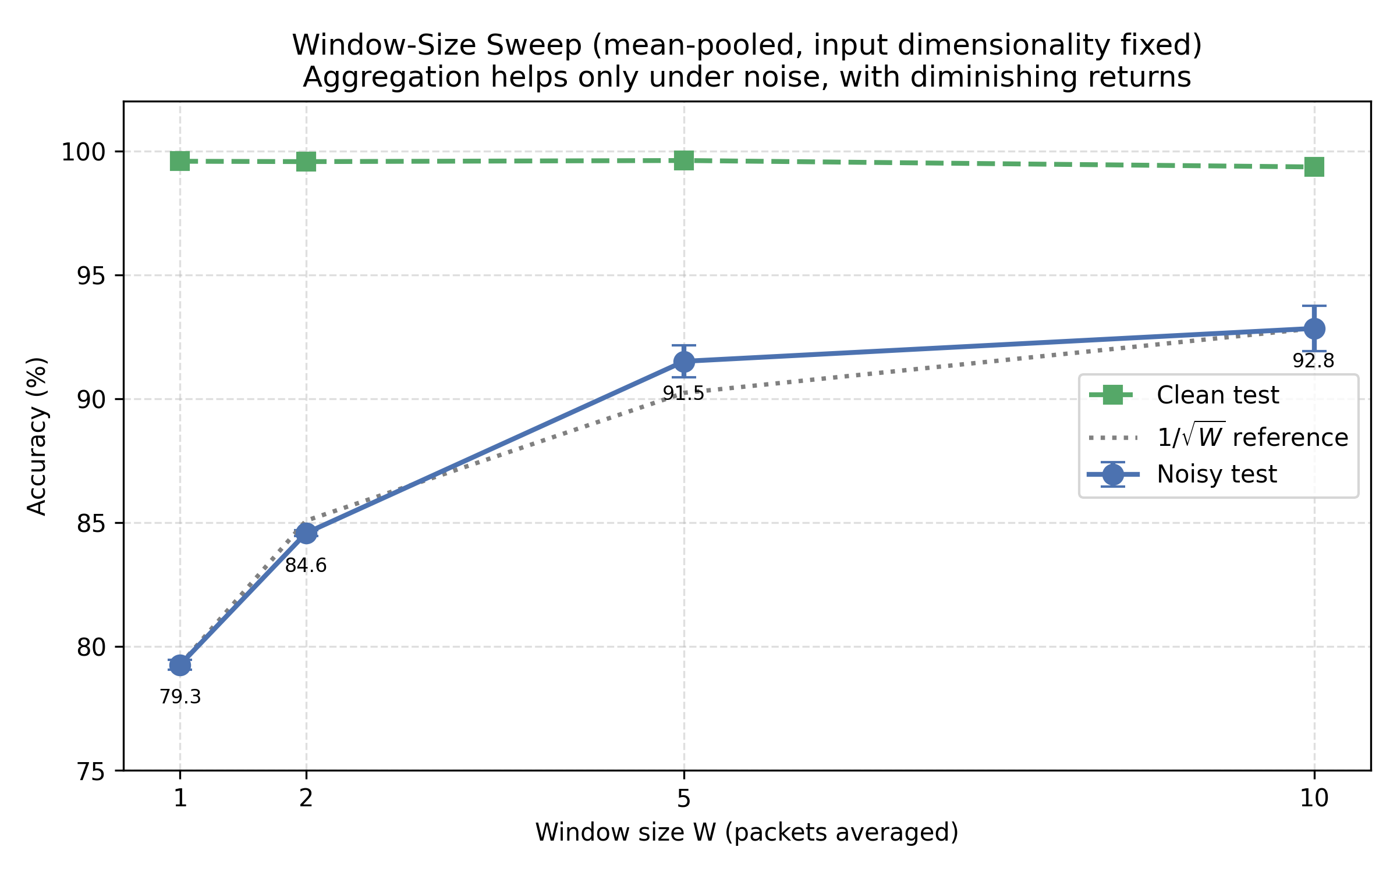
Confirming the Mechanism: Window-Size Sweep
Feature count held constant at 18 — only the number of averaged packets varies.
W=1: 79.3% W=2: 84.6%
W=5: 91.5% W=10: 92.8%
A decelerating curve — exactly what 1/√W noise reduction predicts. Independent confirmation of the averaging mechanism.
17

Slide 18
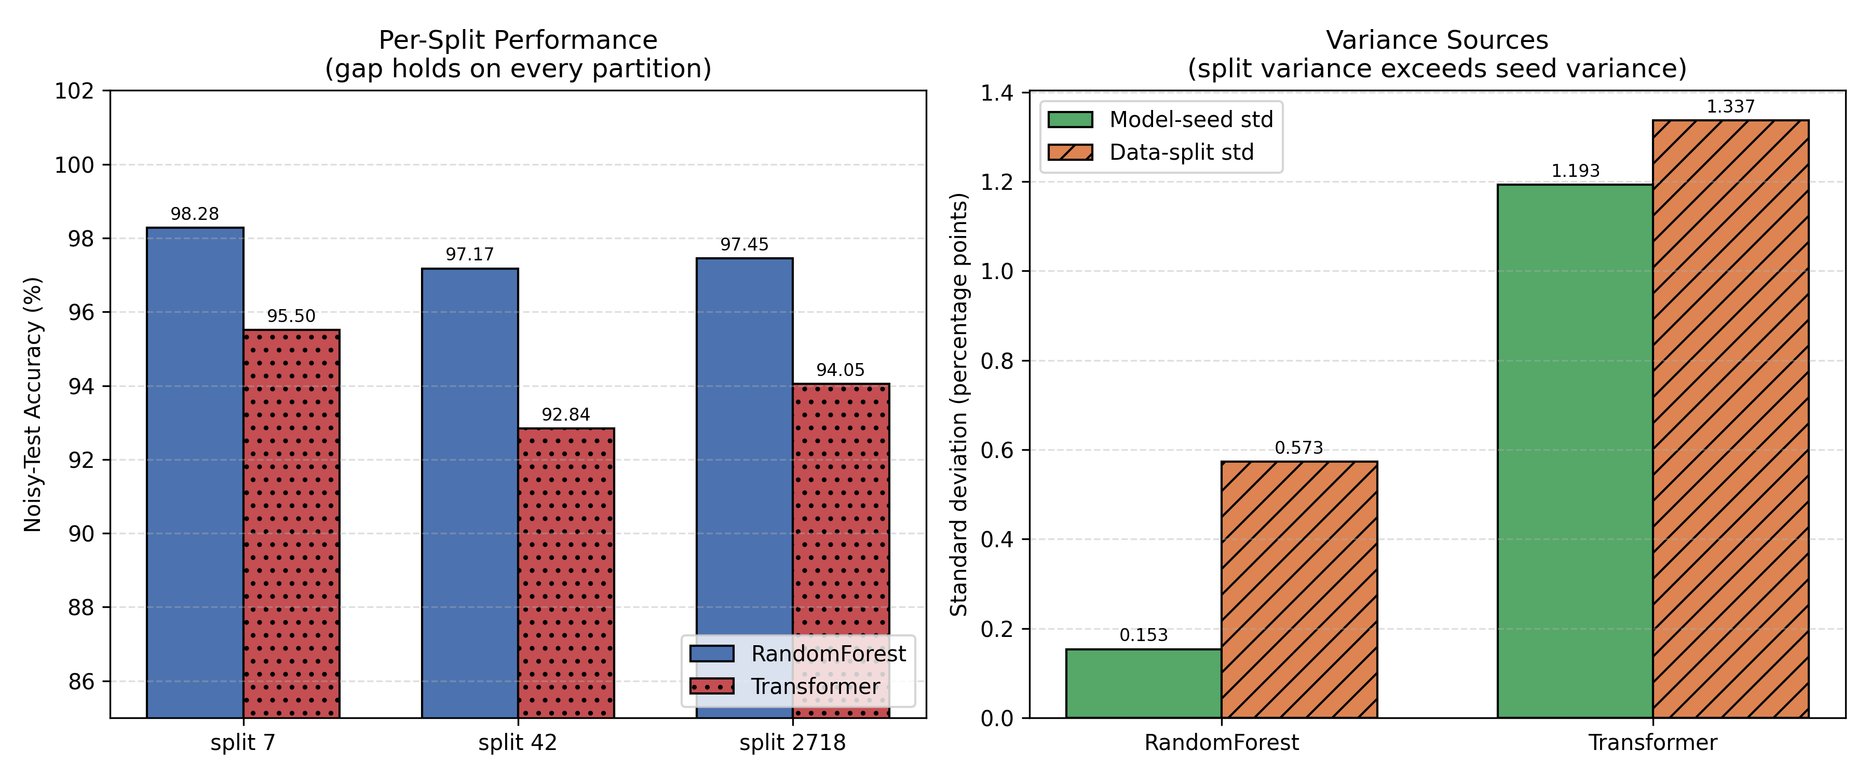
Is This Result Stable? Multi-Seed & Multi-Split
Random Forest wins on all 3 independent data splits — gap of 3.50 pts is ~2.4× the combined across-split standard deviation. This is a stable result, not a lucky draw.
18

Slide 19
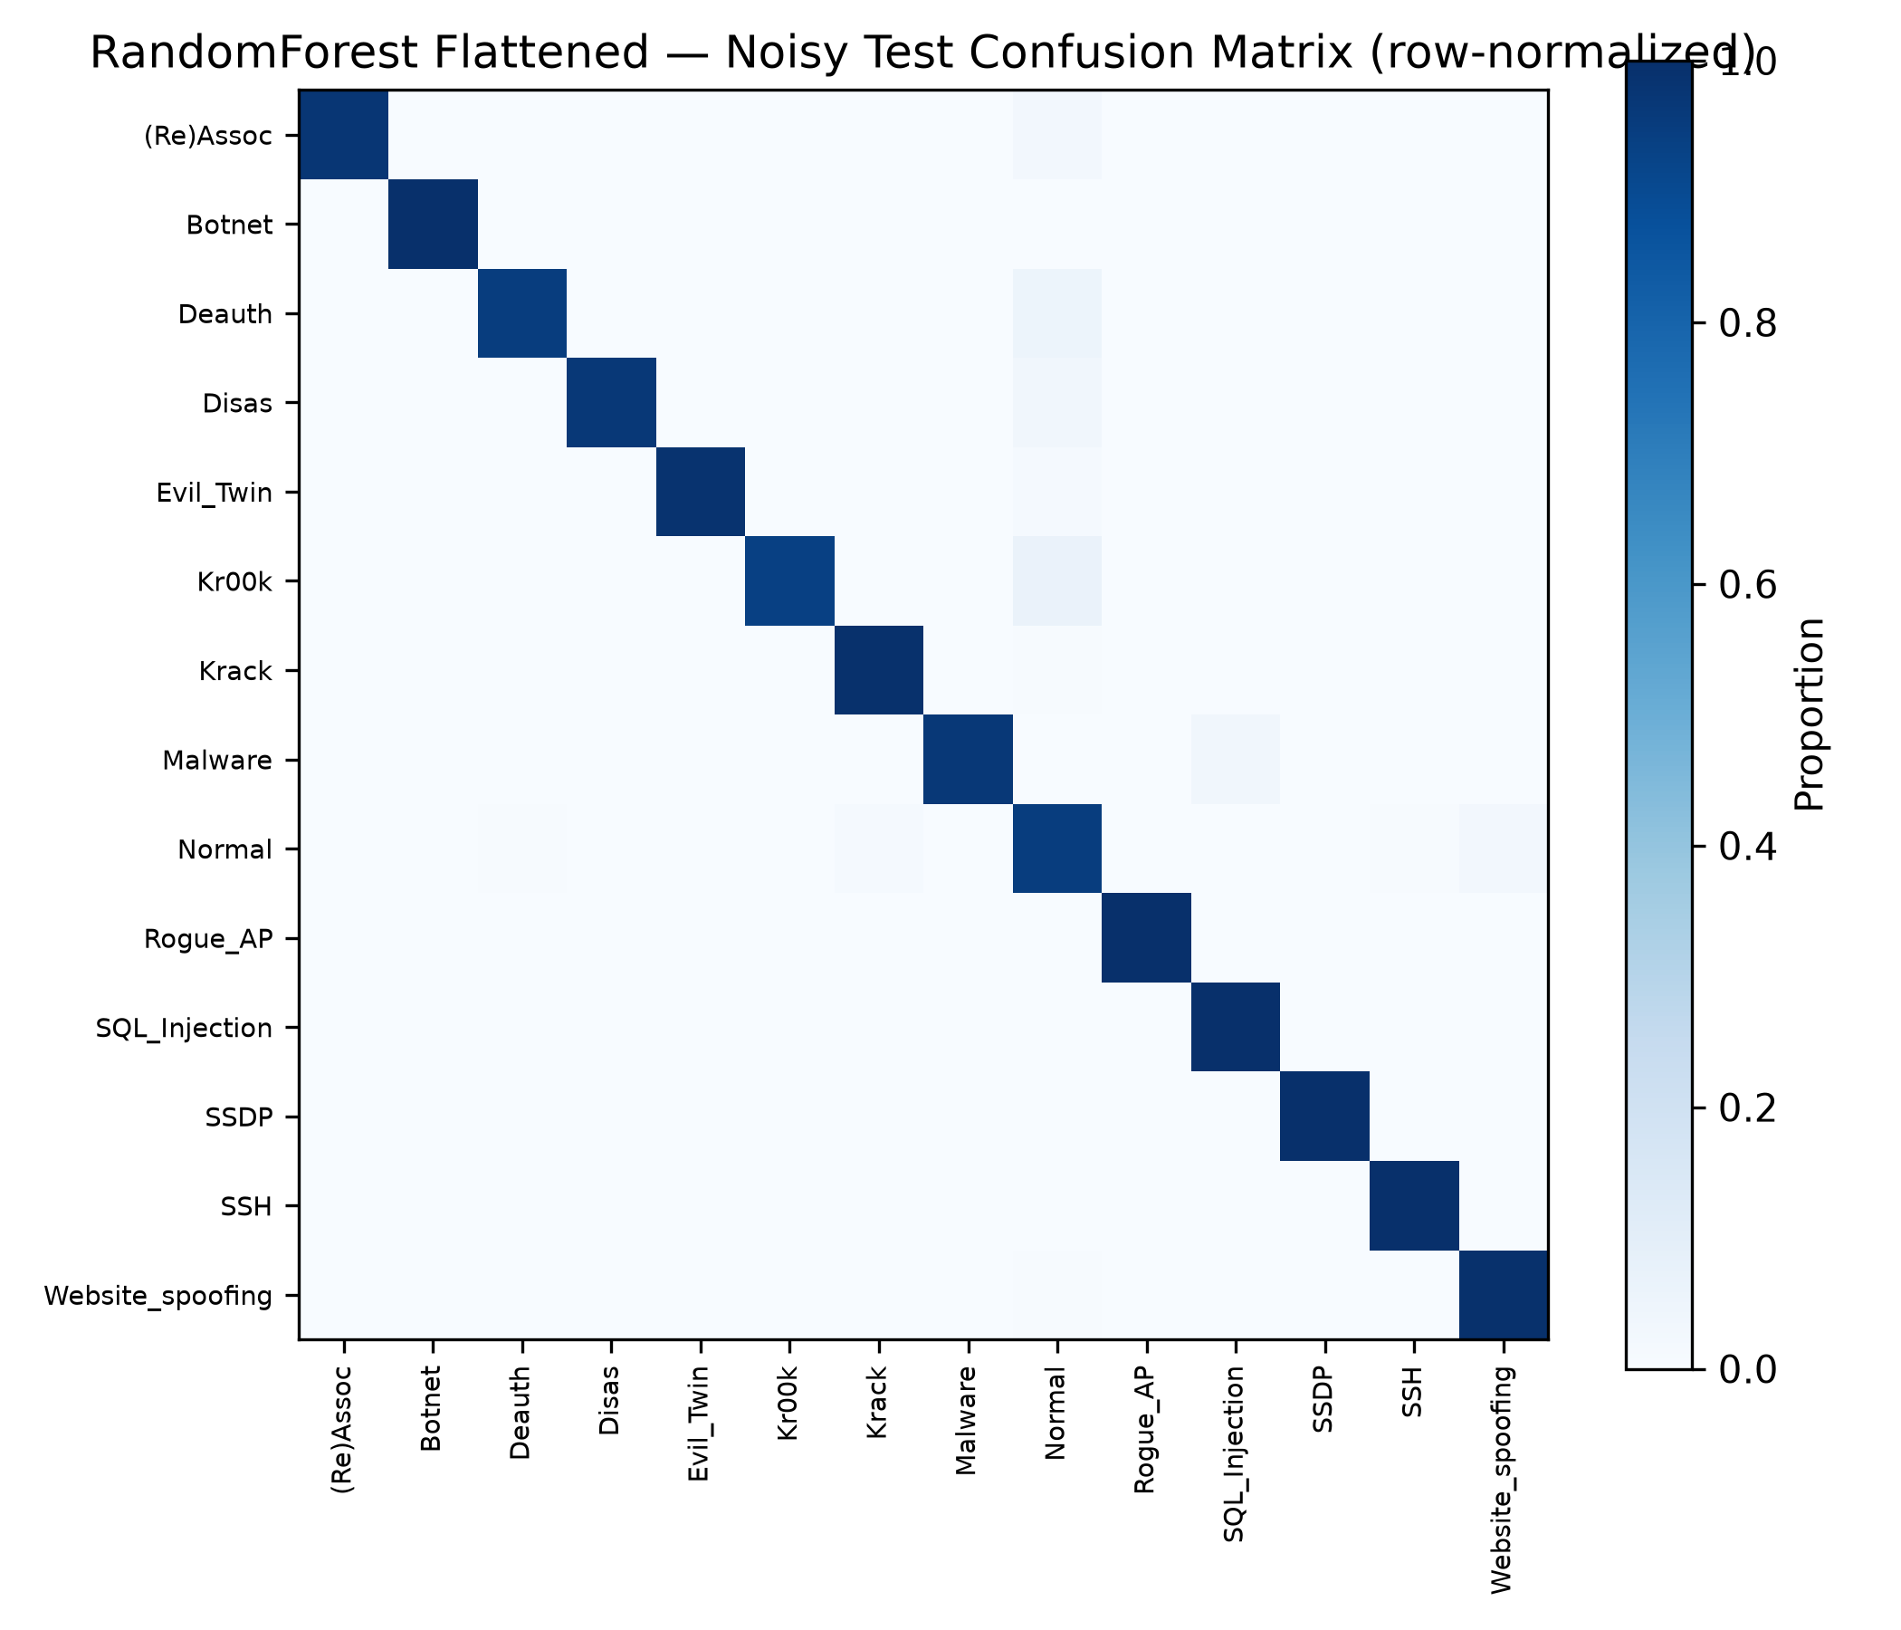
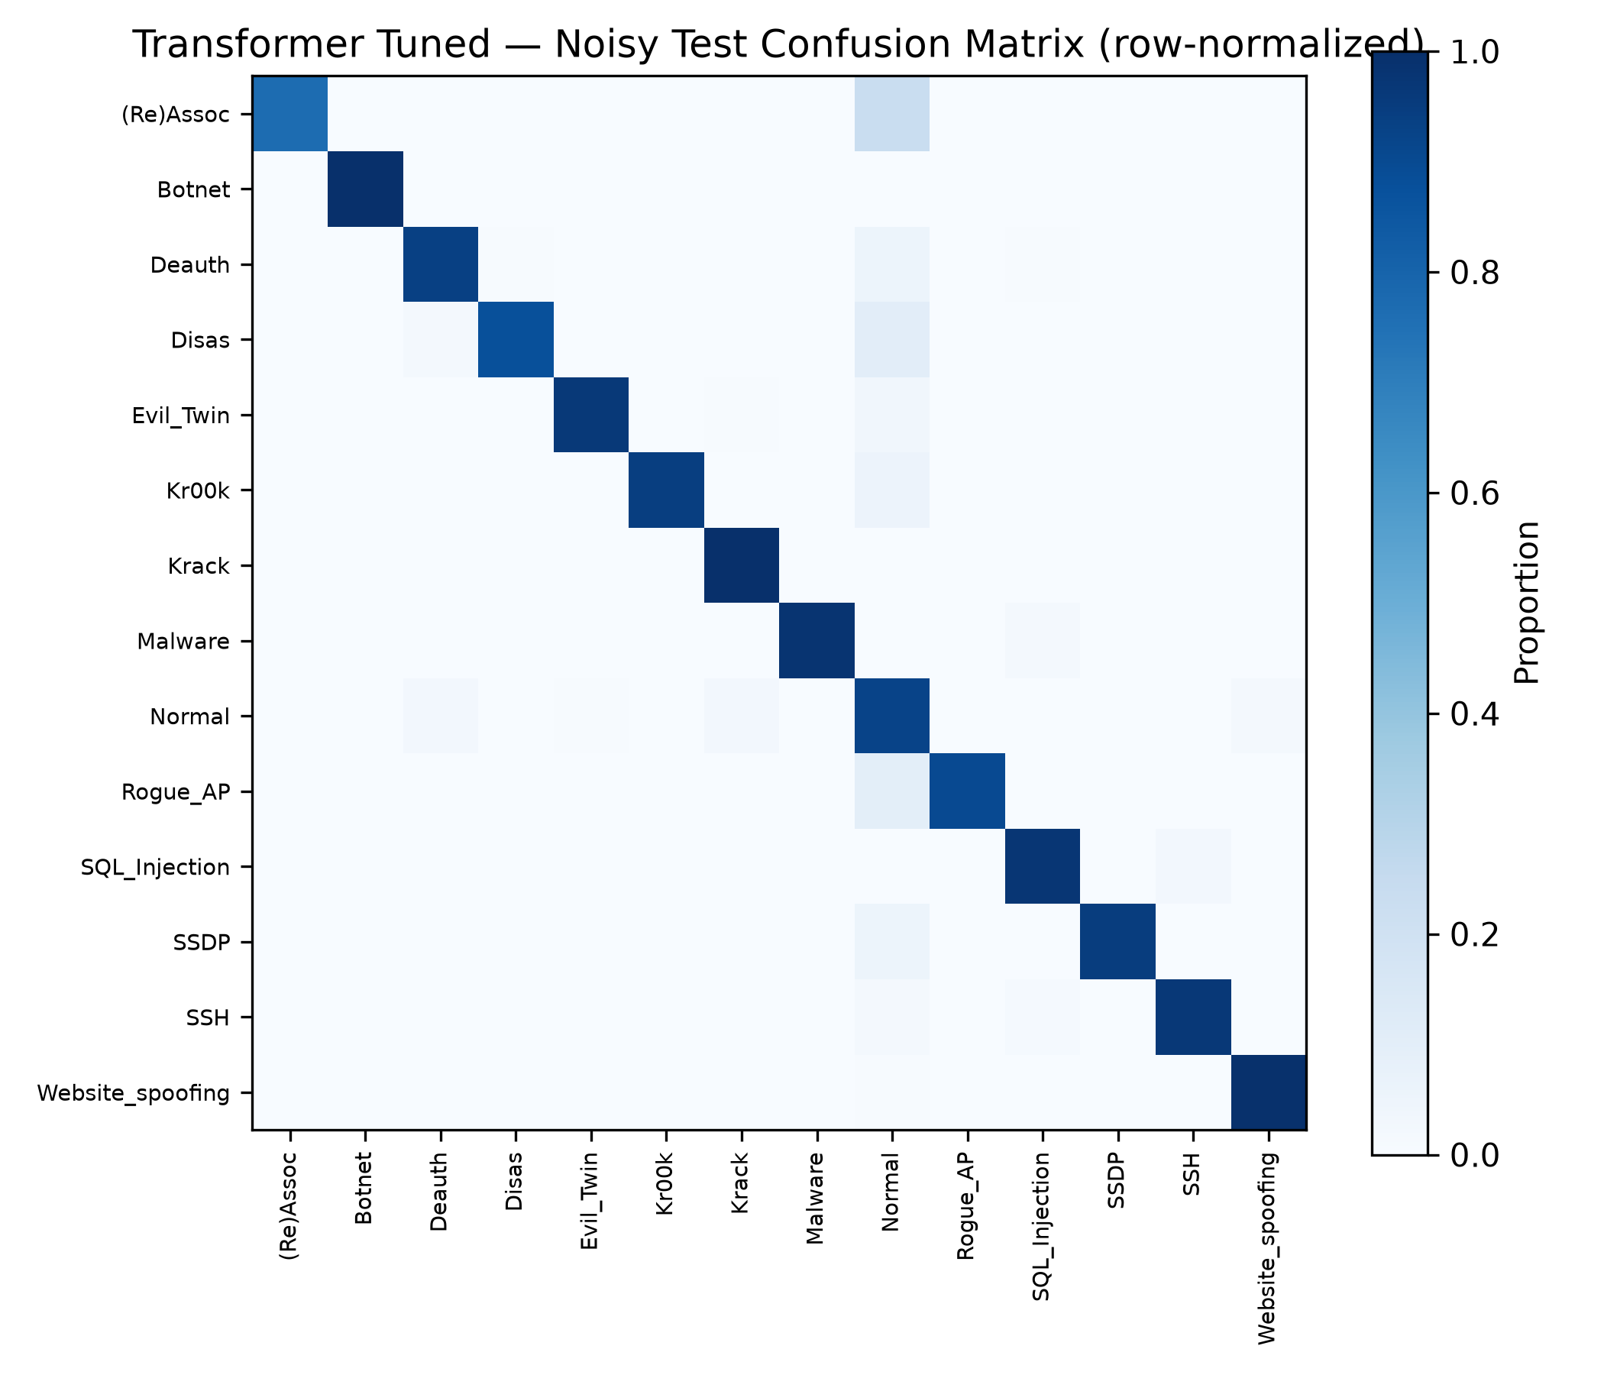
One More Thing: Where Errors Actually Land
Across every model, Normal traffic shows a distinctive noise-failure mode:
precision falls sharply while recall rises — meaning attack traffic increasingly gets misclassified AS Normal, not the reverse.
This is the operationally costly direction
for an intrusion detector: undetected attacks, not false alarms.
The pattern is worse for the Transformer than for Random Forest — consistent with the accuracy gap already shown.
Random Forest (context-equalized)
Transformer (BBOT-tuned)
19

Slide 20

The Takeaway
Context matters more than architecture.
A Random Forest with equal context beats a tuned Transformer
— more accurate, more stable across seeds and splits, and far cheaper to train (seconds vs. minutes + a 30-trial hyperparameter search).
97.63%
94.13%
~2.4×
Random Forest
noisy-test accuracy
Tuned Transformer
noisy-test accuracy
gap vs. split std dev
— a stable result
20

Slide 21
Limitations — Stated Plainly
Synthetic noise
Not calibrated to measured wireless interference; sign-flip corruption has no direct physical analogue. Results describe robustness to synthetic feature-space perturbation.
Possible protocol shortcut
ARP opcode carries ~43% of feature importance. Models may partly identify protocol type rather than pure attack behavior.
Scope of the finding
Applies to redundant, consecutive packet windows in AWID3 — not a blanket claim against sequence models in every setting.
Two thin classes
Rogue AP (~20 test windows) and SQL Injection have limited raw attack traffic in AWID3; per-class metrics for these carry wider uncertainty.
21

Slide 22
Future Work
1
Quantify the protocol-shortcut concern — remove ARP opcode and similar features, re-measure
2
Calibrate the noise model against measured real-world wireless interference traces
3
Test whether longer or flow-level windows (more heterogeneous packets) change the ordering result
4
Address the Normal-class false-negative pattern via class-weighted objectives or a dedicated anomaly stage
5
Report inference latency and memory footprint — deployment guidance for edge / access-point hardware
22

Slide 23
Thank You
Questions?
Pranav T N
thotapranav24@gmail.com
Prof. Rajasekar Mohan (Corresponding Author)
rajasekarmohan@pes.edu
Paper ID: ZX1060 — ICCSIT 2026, Paris — ACM Int'l Conference Proceedings Series

