Slide 1




PS-2 SOLUTION
PathFinder AI
Zero-PII LLM Gateway
No personal data leaves the platform
Full-Stack AI-Integrated Career Guidance & Counseling Portal
Holland RIASEC
Deterministic psychometric scoring
Ending black-box AI advice with a Grounded Hybrid Architecture: deterministic scoring, skill reality-checks and human counselor oversight.
Counselor Verified
Human-in-the-loop sign-off

Slide 2
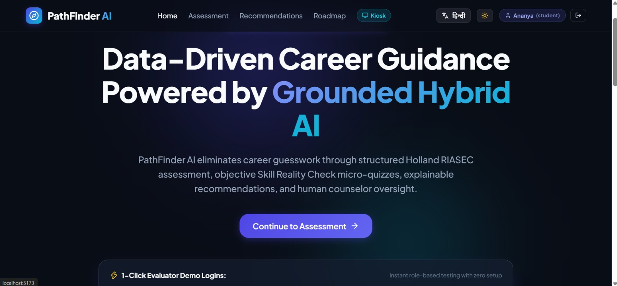



The Problem vs. The PathFinder Solution
01 · WHY PATHFINDER
The Problem
Hallucinations in AI advice
No skill testing of self-ratings
Not India-aware: ignores JEE, NEET
No oversight from humans
Our Solution
Deterministic psychometrics
Verified skill micro-quizzes
Landing page
English / Hindi toggle and 1-click evaluator demo logins.
Human-in-the-loop review
India-first pathways, bilingual

Slide 3



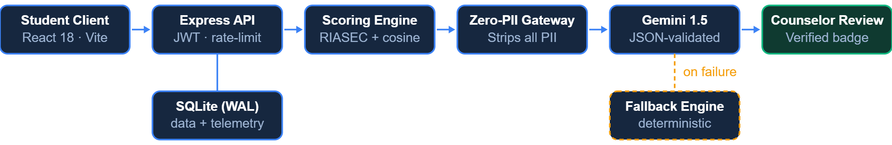
Grounded Hybrid AI Architecture
02 · ARCHITECTURE
01
02
03
04
Student Assessment
Deterministic Matching
LLM Enrichment
Human Oversight
Holland RIASEC + verified skill reality check
Cosine similarity across Math, Tech, Healthcare, Law and Finance datasets
Gemini 1.5 with zero-PII prompts, strict JSON validation and automatic fallback
Counselor review queue + official Counselor Verified badge
END-TO-END DATA FLOW

Slide 4
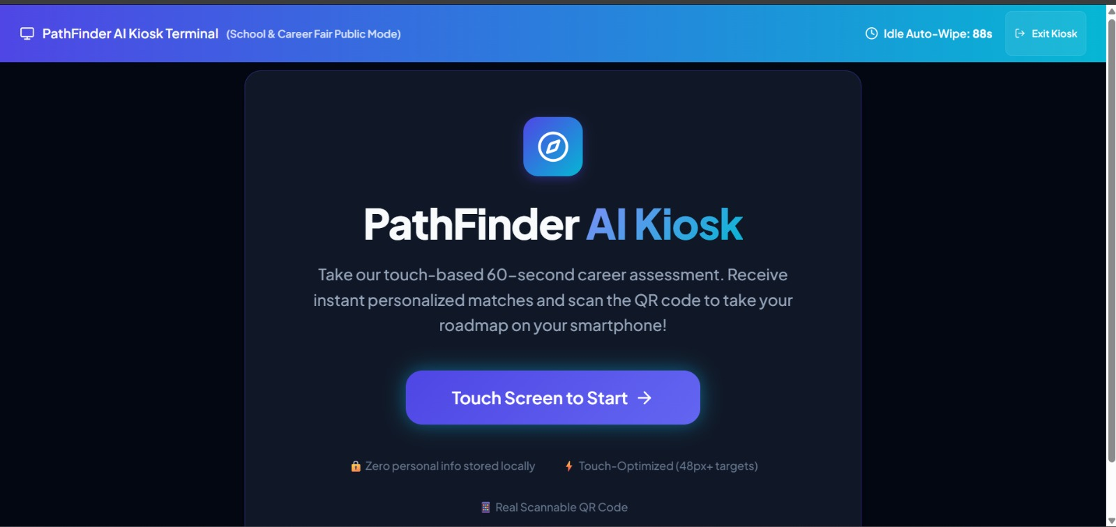




Key Differentiators & Unique Innovations
03 · INNOVATION
Skill Reality Check
India-Aware Ecosystem
3-question objective micro-quizzes validate self-rated skills (1–5) and flag inflation.
Class 10/12 streams, JEE / NEET / CUET / CAT / UPSC and NPTEL / SWAYAM courses.
Public Kiosk Mode
Privacy & Telemetry
Kiosk Terminal in action
48px+ touch targets, 90-second idle auto-reset and QR code mobile hand-off.
Zero PII sent to external APIs. Admin dashboard tracks model latency and token costs.
Touch-based 60-second assessment, an idle auto-wipe countdown and a QR code to continue on a phone.

Slide 5

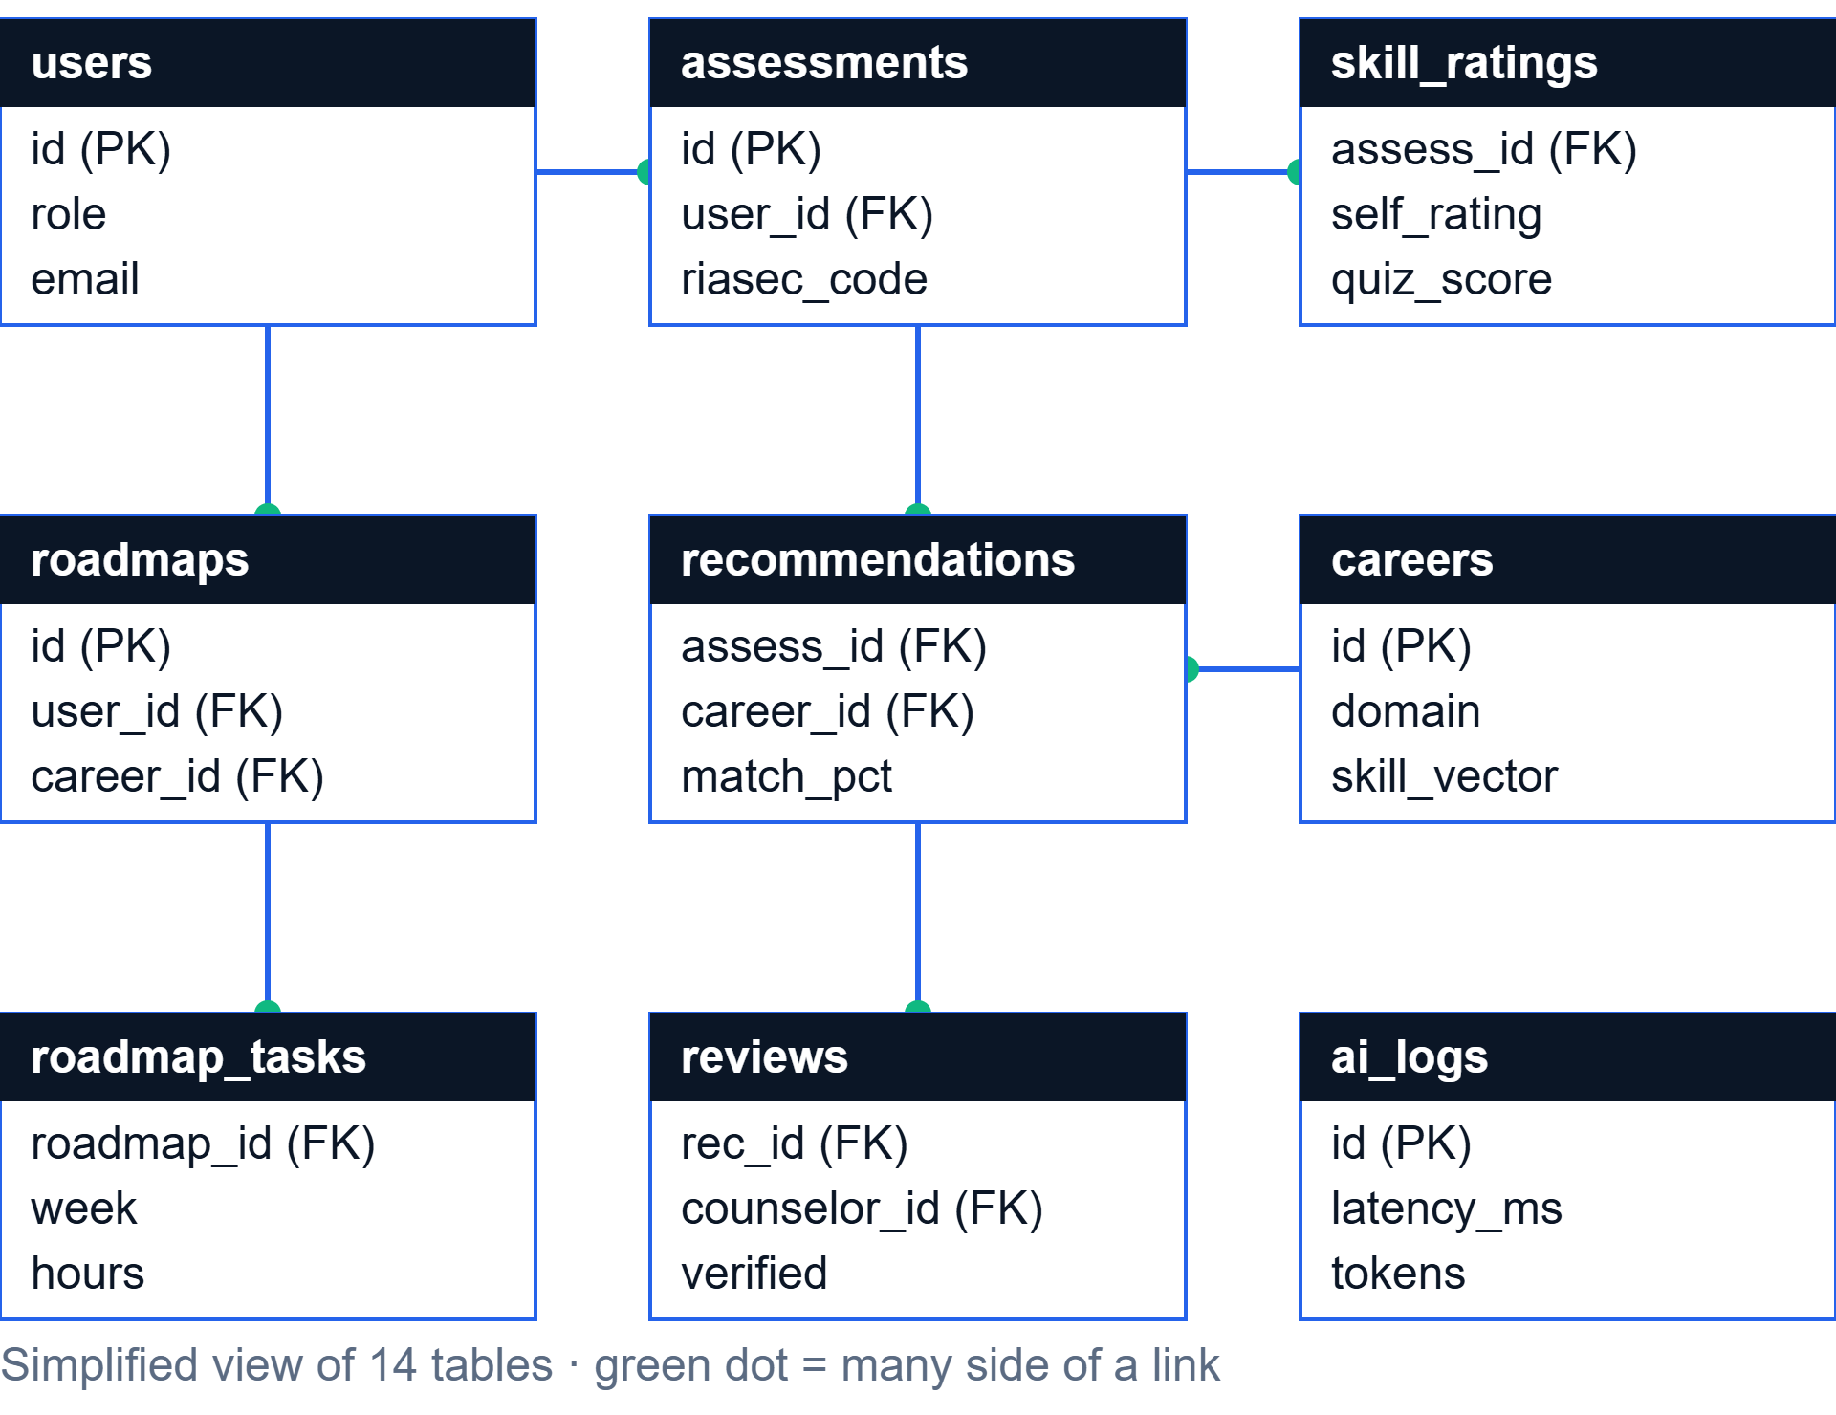


Technology Stack & Database Architecture
04 · TECHNOLOGY
FRONTEND
React 18 · Vite · Tailwind/CSS
BACKEND
Node.js · Express REST API
DATABASE
SQLite in WAL mode
SECURITY
JWT · bcrypt · rate-limiting
14
Relational tables
Users, assessments, career vectors, roadmaps, AI logs.

Slide 6
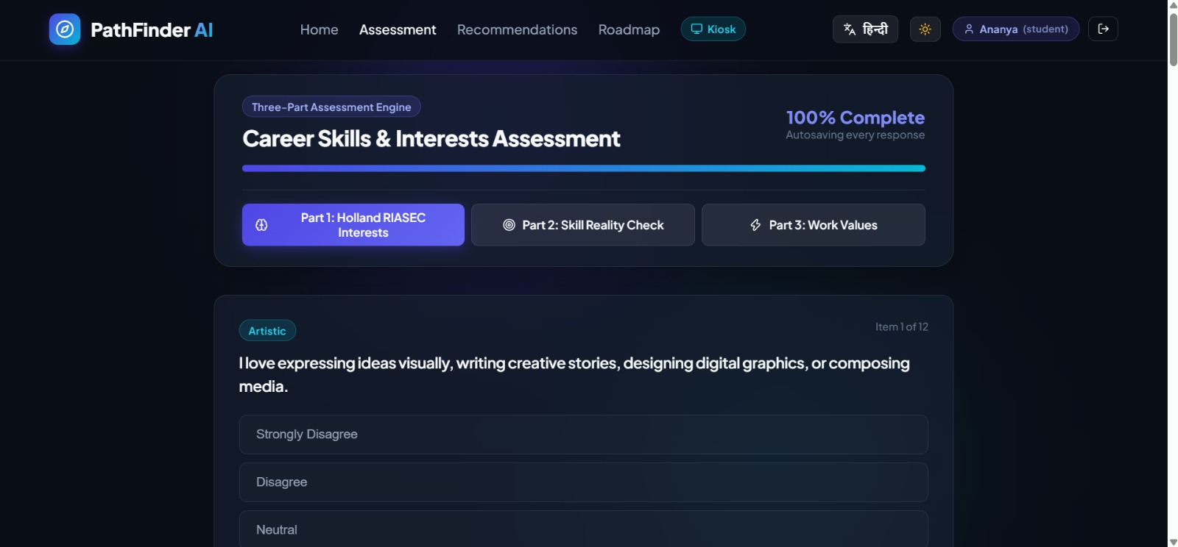



Student Portal & Recommendations
05 · STUDENT EXPERIENCE
Holland Code badge
Computed per student, e.g. CEI.
Match breakdown
Percentage score on every career card.
Exam pathways
PART 1
PART 2
PART 3
Expandable JEE, NEET and CUET routes.
Holland RIASEC
Skill Reality Check
Work Values

Slide 7




10-Week Actionable Roadmap & AI Career Coach
06 · GUIDANCE
10-Week Roadmap
Context-Aware AI Coach
Weekly milestones with hour estimates
Floating assistant on every page
Free resources: NPTEL / SWAYAM links
Grounded in the student’s own report
Live progress saved, with celebratory confetti
Guidance on syllabus, time and study plans
YOUR PATH, WEEK BY WEEK
1
2
3
4
5
6
7
8
9
10
WEEK
WEEK
WEEK
WEEK
WEEK
WEEK
WEEK
WEEK
WEEK
WEEK

Slide 8
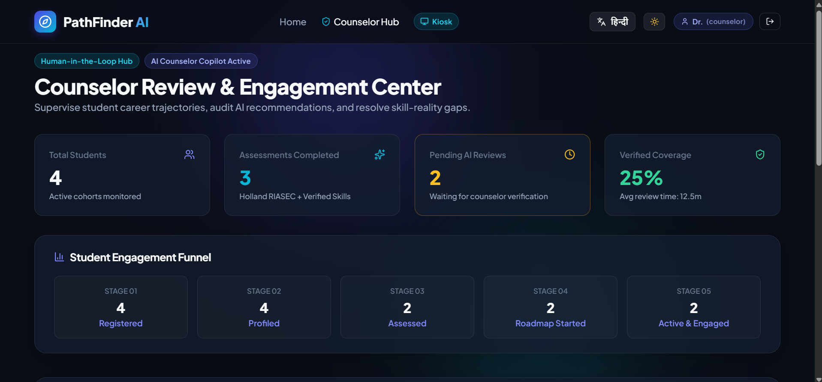


Counselor Advisory Cell & AI Copilot
07 · HUMAN-IN-THE-LOOP
1 Registered
2 Profiled
3 Assessed
4 Active
AI Counselor Copilot
Auto-generated student briefs
Discussion prompts ready for each session
Verification Flow
One-click approve and attach.
✓ Counselor Verified
Counselor dashboard — engagement funnel, pending AI reviews and verified coverage

Slide 9






Admin Telemetry & Evaluator Quick Access
08 · OPERATIONS
Admin Telemetry
1-Click Demo Accounts
Rahul Verma
Student
Ready to explore
AI model calls
Token costs
tracked live
per request
Dr. Vikram Seth
Counselor
Reviews and verifies AI reports
Average latency
Fallback rate
Admin
Admin
in ms
of the backup engine
Telemetry dashboard

Slide 10

09 · IMPACT
Conclusion & Impact
Production-grade
Privacy-compliant
Always on
Secure, fully responsive deployment.
1-click JSON export and GDPR “Right to be Forgotten” self-service deletion.
Hybrid fallback keeps 100% uptime during LLM outages.
PathFinder AI — Bridging the gap between student aspirations and verified career success.

