Slide 1
Player Statistics Visualization Using PCA and UMAP
Machine Learning Project
Problem definition, data understanding, preprocessing, EDA and feature engineering

Slide 2
1. Problem Definition
What we solve, why it matters, who benefits, and what we deliver

Slide 3
What problem are we solving?
The problem
Each player has 50+ correlated statistics (runs, strike rate, wickets, economy). In raw tables, similar players and hidden patterns are hard to spot.
Why it matters
Teams spend up to ₹17 crore on one player. Seeing who is truly similar, or an outlier, supports fairer comparison and smarter selection.
Who will use it
Analysts, coaches and team management for player profiling; fans and students for exploring performance data.
Expected output
2D PCA and UMAP maps that group players by style, flag outliers, and show which statistics drive the differences.

Slide 4
2. Dataset Collection
Source, structure, target and size of the data

Slide 5
Dataset overview
182
53
10
9
rows (players)
columns
teams
countries
Item | Detail
Source | IPL player statistics file: player_statistics.csv (career IPL and a second-format record per player)
Format | CSV, one row per player; downloaded and loaded with pandas
Target / output | No supervised target. Paying_Role (Batting, Bowling, All rounder) is used to colour and validate the maps; SOLD_PRICE is a secondary outcome
Shape check | 182 rows × 53 columns, no duplicate rows

Slide 6
Understanding the 53 columns
Profile (6)
Player, COUNTRY, TEAM, AGE, CAPTAINCY EXP, Paying_Role
IPL batting (16)
Mat, Inns, Runs, BF, HS, Avg, SR, NO, 4s, 6s, 0s, 50s, 100s
IPL bowling (10)
B_Inns, B_Balls, B_Runs, B_Maidens, B_Wkts, B_Avg, B_Econ, B_SR, B_4w, B_5w
Second-format batting and bowling (20)
TMat to T100s and B_TInns to B_T5w; prefix T marks the second record set
Price (1)
SOLD_PRICE, stored as text such as "6cr" or "50l"

Slide 7
3. Data Understanding
Records, types, missing values, duplicates, uniques and distributions

Slide 8
Basic structure and quality
Check | Result
Records | 182 players
Features | 53 columns
Data types | 47 numeric (3 int, 44 float), 6 text
Text that is really numeric | Avg and SOLD_PRICE
Duplicate rows | 0 (all 182 player names unique)
Unique values | Country 9, Team 10, Role 3, Age 22
Missing values | 25% (IPL cols), 53% (second-format)
Missing values are mostly structural: pure bowlers have no batting record and vice versa.

Slide 9
Statistical summary of key features
Feature | Count | Mean | Median | Std | Min | Max
AGE | 182 | 28.5 | 29 | 4.5 | 19 | 41
Matches (Mat) | 182 | 49.0 | 29 | 54.3 | 1 | 234
Runs | 125 | 1,058 | 318 | 1,467 | 2 | 6,624
Strike rate (SR) | 125 | 126.5 | 128.4 | 35.7 | 40 | 400
Wickets (B_Wkts) | 115 | 35.5 | 18 | 42.7 | 0 | 183
Price (₹ crore) | 182 | 4.47 | 2.7 | 4.40 | 0.2 | 17
Reading the table
Mean is far above median for Runs, Wickets and Price: a few stars pull the averages up (right-skewed).
Scales differ by orders of magnitude (runs in thousands, age in tens), so standardization is required before PCA.

Slide 10
Distribution of important features
Runs are heavily right-skewed (55 players under 250 runs); strike rate is roughly bell-shaped around 128.

Slide 11
4. Data Preprocessing
Missing values, duplicates, outliers, incorrect data and variable types

Slide 12
Issues found and how we fix them
Check | Finding | Action
Missing values | 57 players no batting, 67 no bowling; second-format columns 53% empty | Counts to 0; rates to role median; drop second-format columns
Duplicates | 0 duplicate rows | None needed
Outliers | Markande economy 805; Mankad SR 400 (4 runs); Tim David SR 210 (9 inns) | Set impossible values missing; require minimum innings
Incorrect data | Umesh Yadav not-outs 137.5; Avg and SOLD_PRICE stored as text | Fix or drop; convert to numbers (price to ₹ crore)
Categorical | COUNTRY, TEAM, Paying_Role | One-hot encode; keep Paying_Role for colouring
Numerical | 47 numeric columns on very different scales | StandardScaler before PCA and UMAP

Slide 13
5. Exploratory Data Analysis
Count plots, histograms, box plots, scatter plot and correlation heatmap

Slide 14
Count plots: roles and countries
Roles are balanced; 65% of players are Indian. Every team has 15 to 21 players.

Slide 15
Age and auction price
Most players are 23 to 34 (median 29). All-rounders command the highest prices.

Slide 16
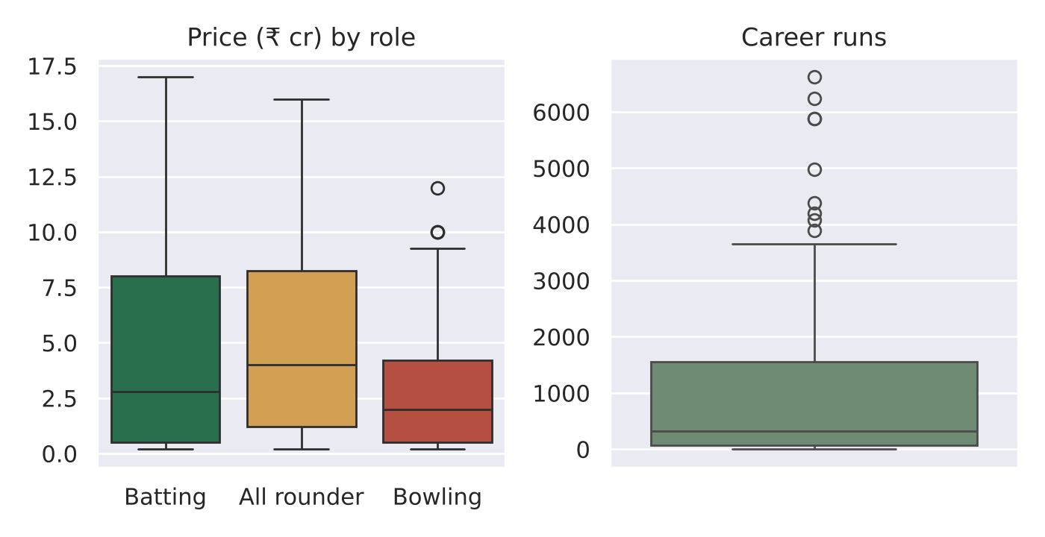
Box plots: outliers and spread
What we see
All-rounders have the highest median price.
9 players are run outliers (top scorers such as Kohli, 6,624 runs); they are real, so we keep them.

Slide 17
Scatter plot: runs vs auction price
Insight
Correlation r = 0.55: more runs generally means a higher price.
Wide scatter at every level shows price also reflects role, age and reputation, not runs alone.

Slide 18
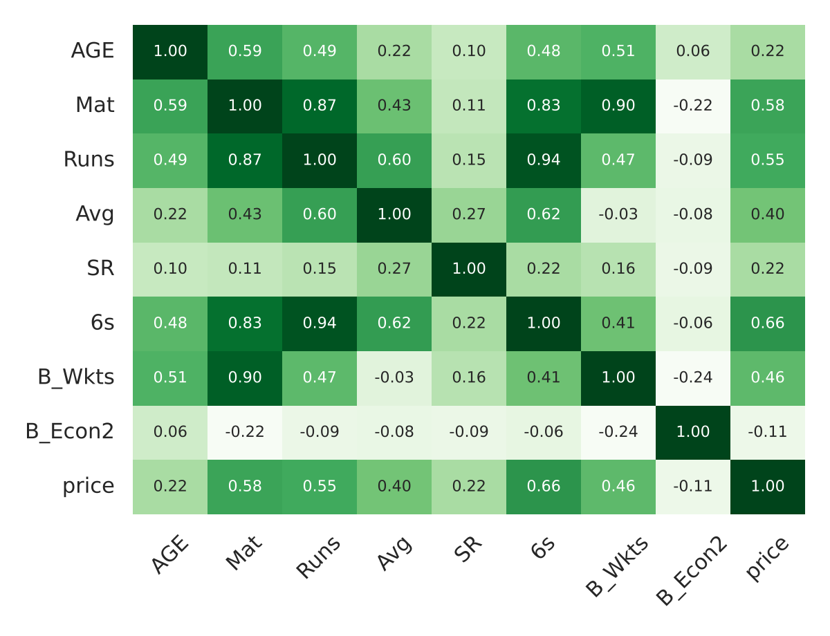
Correlation heatmap
Why PCA fits
Runs, 4s, balls faced and innings correlate at 0.95 to 1.00.
Matches, wickets and runs bowled also move together (0.98).
SR, average and economy are only weakly tied to volume, so they add independent signal.

Slide 19
6. Feature Selection and Engineering
Which features stay, which go, and which are created

Slide 20
Features used and removed
Used
Runs, Avg, SR, 6s, 50s, 100s, HS
B_Wkts, B_Avg, B_Econ, B_SR, B_4w, B_5w
Mat, AGE, CAPTAINCY EXP
Paying_Role (colour labels only)
Removed and why
Player: identifier, no signal
All second-format columns: over 50% missing
BF, Inns, 4s, B_Balls, B_Runs: correlation 0.95+ with kept features
TEAM, COUNTRY: not performance; kept only for tooltips

Slide 21
New features we create
New feature | Formula | Why
runs_per_match | Runs / Mat | Compares players with different career lengths
boundary_share | (4s×4 + 6s×6) / Runs | Separates power hitters from anchors
wkts_per_match | B_Wkts / Mat | Fair bowling impact across careers
is_captain | CAPTAINCY EXP > 0 | Simple leadership flag (19 players)
price_cr | Parse "6cr", "50l" | Numeric price in ₹ crore
role one-hot | Paying_Role | Numeric form of a categorical column

Slide 22
Summary and next steps
Understood 182 players, 53 columns, no duplicates, structural gaps
Next steps
Standardize features
Apply PCA, check explained variance
Apply UMAP and tune parameters
Interpret clusters and outliers
Cleaned Fixed text numbers, impossible values and missing data
Explored Skewed counts, role-price link, strong feature overlap
Engineered About 20 compact features, scaled for modelling

