Slide 1
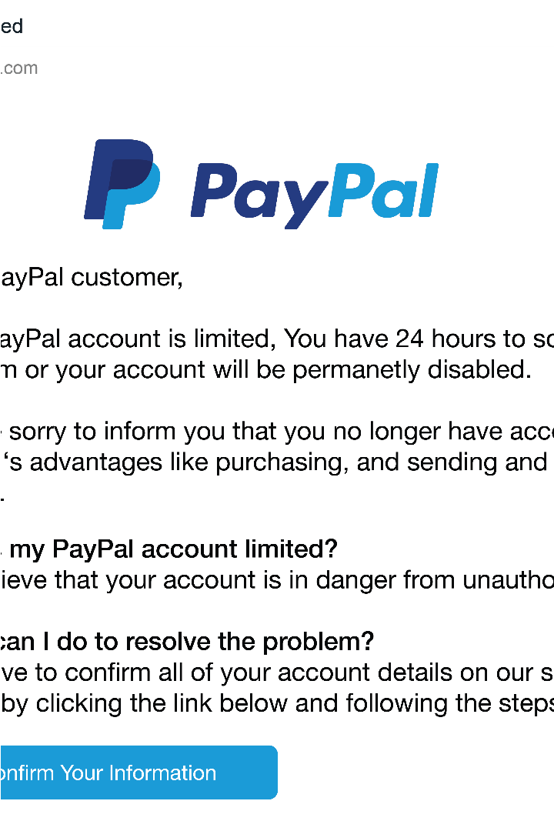
What is Phishing?
Phishing is a type of cybercrime where attackers attempt to trick individuals into revealing sensitive information, such as login credentials or financial data, through deceptive communication like emails, text messages, or fake websites.

Slide 2
Common Phishing Tactics
Fake Emails
Malicious Websites
Phishers send fraudulent emails that appear to be from legitimate organizations, tricking victims into sharing sensitive information or clicking on malicious links.
Phishers create fake websites that mimic real ones, luring victims to enter login credentials or other personal data.
Impersonation Scams
Urgent Warnings
Phishers may pretend to be a boss, coworker, or trusted authority figure to convince victims to wire money or share confidential information.
Phishers create a sense of urgency, such as a problem with an account, to pressure victims into acting quickly without verifying the request.

Slide 3
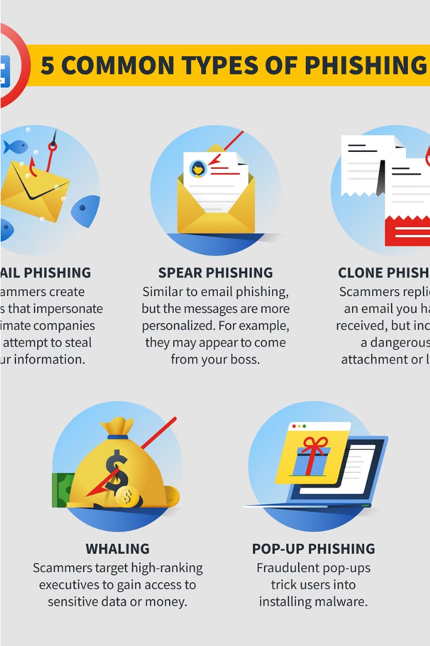
Identifying Phishing Emails
Phishing emails often have telltale signs that can help you spot them. Look for suspicious email addresses, generic greetings, urgent calls to action, and requests for sensitive information. Hover over links to check the true destination before clicking.
Be wary of emails that create a sense of fear or demand immediate action. Legitimate companies will not ask you to share passwords or financial details via email.

Slide 4
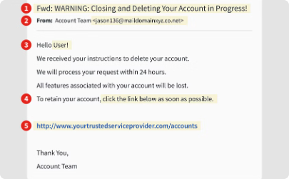
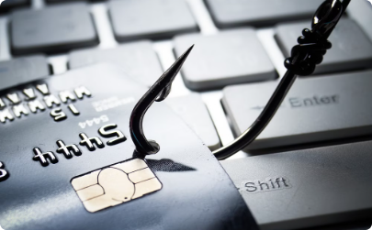
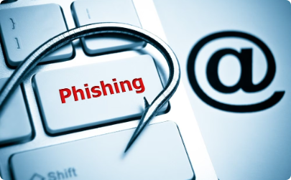
Phishing Scams Targeting Businesses
Credential Theft
Financial Fraud
Supply Chain Attacks
Phishers often try to steal employee login credentials to gain access to sensitive business data and systems, leading to data breaches and financial losses.
Phishing scams targeting businesses may involve fraudulent wire transfers, fake invoices, or other schemes to siphon funds from company accounts.
Phishers may impersonate vendors or partners to infiltrate a company's supply chain, compromising sensitive data and systems across the organization.

Slide 5
Protecting Yourself from Phishing Attacks
1
Be Skeptical
Approach all unsolicited emails, messages, or calls with caution. Verify the sender's identity before taking any action.
2
Check for Red Flags
Look for signs of phishing such as urgent deadlines, requests for sensitive information, or suspicious links and attachments.
3
Verify Legitimacy
When in doubt, contact the organization directly using a known, trusted method to confirm the request is legitimate.

Slide 6



Reporting Phishing Attempts
Forward Suspicious Emails
Call the Reported Source
Report to Authorities
If the email claims to be from a legitimate company, call them directly to verify the request.
File a report with the FTC, FBI, or other relevant authorities to help stop the spread of phishing scams.
Forward any suspicious emails to your IT or security team for investigation and analysis.

Slide 7
Phishing Prevention Best Practices
Email Verification
Cybersecurity Training
Always verify the sender's email address and domain before opening attachments or links. Hover over URLs to check the destination.
Regularly train employees to identify phishing attempts and report suspicious emails to the security team.
Multi-Factor Authentication
Security Software
Require multi-factor authentication on all accounts to add an extra layer of security against phishing attacks.
Ensure your organization has up-to-date anti-virus, anti-malware, and firewall software to detect and block phishing threats.

Slide 8

Educating Employees about Phishing
Educating employees about phishing is crucial to protect your organization from cyber threats. Provide regular training on identifying phishing emails, the latest scam tactics, and best practices for verifying the legitimacy of messages.
Empower employees to report suspicious activities and encourage a culture of security awareness. Ongoing education helps ensure your team remains vigilant against evolving phishing attempts.

Slide 9




Implementing Phishing Awareness Training
Assess Risks
1
Identify key vulnerabilities and high-risk users.
2
Develop Program
Create a comprehensive training curriculum.
3
Deliver Training
Engage employees through interactive sessions.
4
Test & Evaluate
Monitor progress and refine the program.
Implementing an effective phishing awareness training program is crucial for protecting your organization. Start by assessing your specific risks and vulnerabilities. Then, develop a tailored training curriculum that engages employees through realistic scenarios and interactive exercises. Regularly test and evaluate the program to ensure continuous improvement.

Slide 10
Staying Vigilant and Keeping Up with Phishing Trends
Ongoing Vigilance
Industry Awareness
Continuous Education
Adaptable Defense
Phishing tactics are constantly evolving, so staying vigilant and alert is crucial. Regularly review warning signs and update your knowledge to identify the latest phishing schemes.
Follow cybersecurity news and industry reports to stay informed about emerging phishing trends targeting your sector. This helps you anticipate and prepare for new types of attacks.
Provide regular phishing awareness training for employees to keep their skills sharp. Incorporate real-world examples and simulated attacks to test and strengthen their ability to spot phishing.
Regularly review and update your organization's phishing defense strategies. Implement new tools and techniques to keep pace with the ever-changing phishing landscape.

