Slide 1
3:07 a.m.
Rack 7. Thermal alarm.
A SCENARIO
Notes:
00:00–00:15 (15 s). “Maya’s phone lights up. Eleven days of training are on that machine.” Pause. This is a scenario, not a customer claim. Source: team launch-kit brief; LIFERAFT_MASTER_SPEC.md; INTEGRATION_CONTRACTS.md; docs/COCKPIT_PLAN.md. Maya is fictional; no customer relationship is claimed.

Slide 2
Stalled.
Lost.
Unclear.
Notes:
00:15–00:27 (12 s). “Stalled. Lost. Unclear. The handoff is a Slack thread and a prayer.” Source: team launch-kit brief; LIFERAFT_MASTER_SPEC.md; INTEGRATION_CONTRACTS.md; docs/COCKPIT_PLAN.md. Maya is fictional; no customer relationship is claimed.

Slide 3

LIFERAFT
Compute continuity for AI infrastructure.
▱
▱
PRIMARY
STANDBY
ONE CONTINUOUS JOB
Notes:
00:27–00:44 (17 s). “Meet LIFERAFT: compute continuity for AI infrastructure. A lifeboat for compute. It saves, hands off, and proves it.” We support checkpoint-aware training, not arbitrary running-process migration. Source: team launch-kit brief; LIFERAFT_MASTER_SPEC.md; INTEGRATION_CONTRACTS.md; docs/COCKPIT_PLAN.md. Maya is fictional; no customer relationship is claimed.

Slide 4
Four beats
01
02
03
04
Detect
Save
Hand off
Prove
→
→
→
INJECTED SIGNAL
VERIFIED CHECKPOINT
FENCED OWNERSHIP
MEASURED NEXT STEP
Notes:
00:44–01:02 (18 s). “Detect. Save. Hand off. Prove. A verified checkpoint, an ownership transfer with fencing, and a measured first step on the new machine.” The coordinator alone owns the transitions. The pull cord injects a drill; it does not cause real overheating. Source: team launch-kit brief; LIFERAFT_MASTER_SPEC.md; INTEGRATION_CONTRACTS.md; docs/COCKPIT_PLAN.md. Maya is fictional; no customer relationship is claimed.

Slide 5
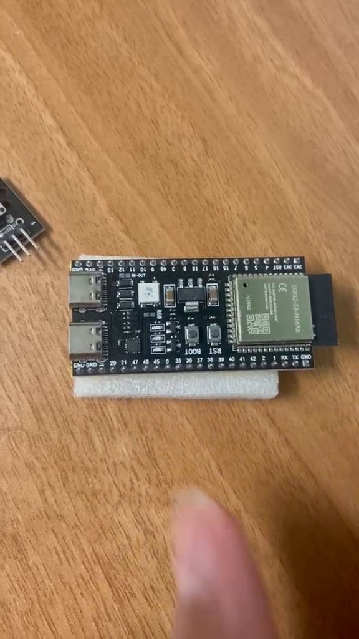
Live.
Notes:
01:02–01:10 (8 s), then pause the deck for the demo. “The button is the pull cord. You are the operator. This is mission control. Rather than tell you, let’s pull it.” Cut to the actual on-site demo. Only call it Live while running the actual drill. If using the saved recording, change Live to Recorded replay before presenting. No power interruption or overheating. Photo: team-owned frame .liferaft/video-review/video-2-49.png, ESP32 hardware. Source: team launch-kit brief; LIFERAFT_MASTER_SPEC.md; INTEGRATION_CONTRACTS.md; docs/COCKPIT_PLAN.md. Maya is fictional; no customer relationship is claimed.

Slide 6
Why operators trust it
⊣
≋
◇
Fenced ownership
Flight Recorder
Read-only Nemotron
One accepted owner per epoch.
Tamper-evident, hash-linked events.
Advisory tools. No recovery authority.
Notes:
01:10–01:28 after the demo (18 s). “Fenced ownership. A tamper-evident Flight Recorder. Read-only Nemotron. The AI explains. It never decides.” Hash linking detects edits; legacy exports without a trusted head remain unanchored. Do not call the recorder tamper-proof. Source: team launch-kit brief; LIFERAFT_MASTER_SPEC.md; INTEGRATION_CONTRACTS.md; docs/COCKPIT_PLAN.md. Maya is fictional; no customer relationship is claimed.

Slide 7
Who it’s for
NOC engineer
Is it handled?
ML engineer
Did the training state resume?
Fleet manager
Can I trust the record?
Notes:
01:28–01:42 (14 s). “For the NOC engineer: is it handled? For the ML engineer: did the same training state resume? For the fleet manager: can I trust the record?” Personas describe intended users, not existing customers. Source: team launch-kit brief; LIFERAFT_MASTER_SPEC.md; INTEGRATION_CONTRACTS.md; docs/COCKPIT_PLAN.md. Maya is fictional; no customer relationship is claimed.

Slide 8
NEXT
Roadmap
Fleet Lifeboat Score
Multi-rack standby pools
Edge nodes
On-call channels
Notes:
01:42–01:55 (13 s). “Next, not now. Fleet Lifeboat Score, multi-rack standby pools, edge nodes, and on-call channels.” These are roadmap intentions; do not represent them as currently shipped fleet capabilities. Source: team launch-kit brief; LIFERAFT_MASTER_SPEC.md; INTEGRATION_CONTRACTS.md; docs/COCKPIT_PLAN.md. Maya is fictional; no customer relationship is claimed.

Slide 9
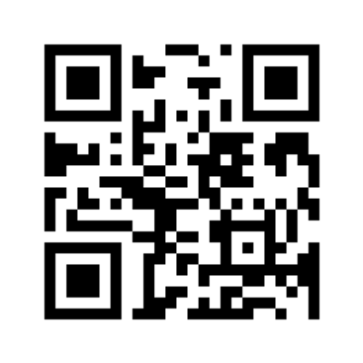
Training
survived.
LOCAL PREVIEW
127.0.0.1:4173
Notes:
01:55–02:00 (5 s). Say: “Training survived.” Then stop talking. The QR encodes http://127.0.0.1:4173 because the user requested local-only delivery. It opens only on the same computer, not a phone. Replace this QR with the verified public launch-page URL after publication is approved. Do not weaken the local cockpit Host restriction. Source: team launch-kit brief; LIFERAFT_MASTER_SPEC.md; INTEGRATION_CONTRACTS.md; docs/COCKPIT_PLAN.md. Maya is fictional; no customer relationship is claimed.

