Slide 1
Data structures and Algorithm
Queues
Dr. R.Preeth,

Slide 2
Queues
Queue is a container of objects
First-in first-out principle
Line of people waiting to reserve a ticket in railway reservation counter
Elements enter the queue at the rear and remover from the front

Slide 3
Queue Abstract Data type
Defines a container , where element access and deletion are restricted to the first element in the sequence
Deletion at the front of the queue and Insertion at rear of the queue
Enqueue(o): Insert objects o at the rear of the queue
Input : Object ; Output : None.

Slide 4
Queue Abstract Data type
Dequeue(): Remove and return from the queue the object at front
Input : None; Output : Object.
Size(): Return the number of objects in the queue
Input : None; Output : Integer.
Is Empty():Return a boolean value indicating if the queue is empty
Input : None; Output : boolean.

Slide 5
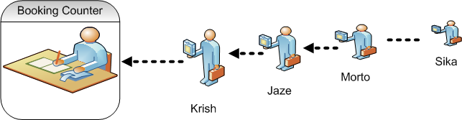
Graphical Representation of Queue

Slide 6
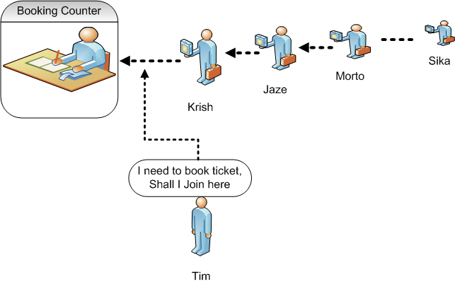
Graphical Representation of Queue

Slide 7
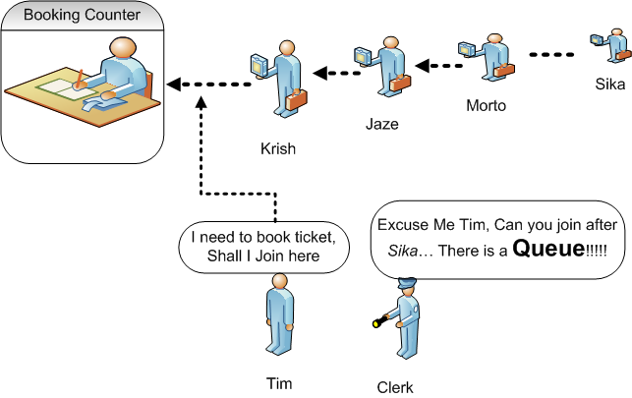
Graphical Representation of Queue

Slide 8
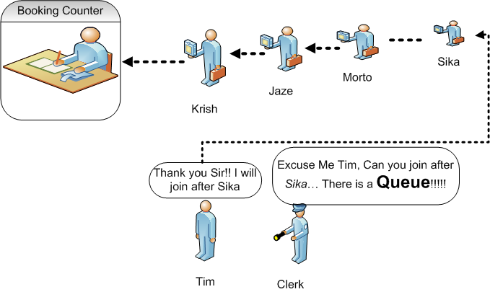
Graphical Representation of Queue

Slide 9
Array based implementation
Create an Array, Q, with capacity N for storing its elements, (N=1000)
Consider two variables front and rear, which will be initialized to zero. (i.e., queue is empty)
Q[0] be the front of the queue and the queue grow from there

Slide 10
Array based implementation
Enqueue(obj): If rear < N , it indicates that the array is not full then, increment rear by 1
and store the element at Q[rear]
Enqueue(obj): If rear == N, then the array is full and is said as queue overflow condition
Dequeue(): The element at Q[front] will be deleted, if rear > 0 (i.e., the queue should have atleast one element in it)

Slide 11
Array based implementation
Front(): Returns the reference to the front element in the queue( i.e., Q[front] if queue is not empty)
Time Complexity:
Enqueue(Insertion): O(1)
Dequeue(Deletion):O(1)
Dequeue(Deletion):O(n) { Array implementation of Queue in efficient manner}

Slide 12
Isempty()
# define Q[N]
int front = rear=-1;
Void Isempty ()
{
If(rear==-1 && front== -1)
{
return true
else
return false;
}

Slide 13
Enqueue(int x )
Void enqueue (int x)
{
If(rear==N-1)
printf(“Overflow”);
else if(front==-1&&rear==-1)
{
Front=rear=0;
Q[rear]=x;
}

Slide 14
Enqueue(int x)
else
{
rear++;
Q[rear]=x;
}
}

Slide 15
Dequeue()
void dequeue()
{
if(rear==-1 ||front>rear)
printf(“Underflow”)
else
{
element=Q[front];
printf(Element);
front++;
}

Slide 16
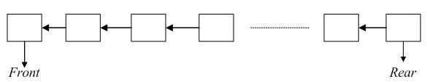
Queue: Example
Sample Illustration
The queue grows towards the right from the left
Two indices namely front and rear are used to traverse the elements.
Consider a example of queue with size N=5

Slide 17



Queue: Example
enqueue(5)
enqueue(3)
enqueue(10)

Slide 18


Queue: Example
Dequeue()
Output:5
enqueue(7)

Slide 19

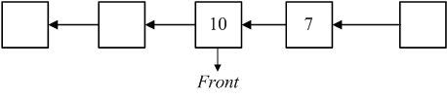
Queue: Example
Dequeue()
Output:3
After performing the dequeue operation

Slide 20


Queue: Example
Enqueue(2):
Now, rear == N-1, So the queue is full (i.e., Overflow)

Slide 21
Circular Queue
Linear data structure in which the operations are based on FIFO(First In-First Out)
It is also called as Ring buffer
Instead of ending the queue at the last position, it again starts from the first position after the last, hence making the queue behave like a circular data structure

Slide 22
Circular Queue
The circular queue was devised to limit the memory wastage of the linear queue
The new element is added at the very first position of the queue if the last is occupied and space is available.
The time complexity is O(1) for all the operations

Slide 23
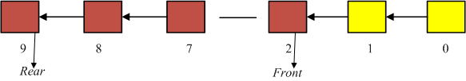
Operations: Circular Queue
when the rear end fills up and front part of the array has empty slots, new insertions should go into the front end
Consider the size N of queue Q as 10. The yellow coloured slots remain empty and brown coloured slots are having values in it.

Slide 24
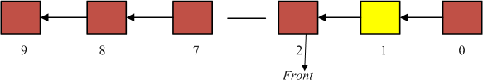
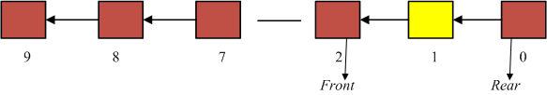
Operations: Circular Queue
The next insertion goes into slot 0, and rear tracks it.
After One Call to enqueue()

Slide 25
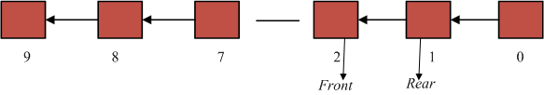
Operations: Circular Queue
After One Call to enqueue()
Now, the queue is full. So, memory wastage is avoided in circular queue, which leads to better performance.

Slide 26
Numeric for circular queue
front increases by (1 modulo size) after each dequeue( ):
front= (front+1)%size
rear increases by (1 modulo size) after each enqueue( ):
rear= (rear+1)%size

Slide 27
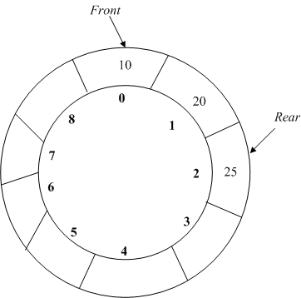
Illustration of Circular queue

Slide 28
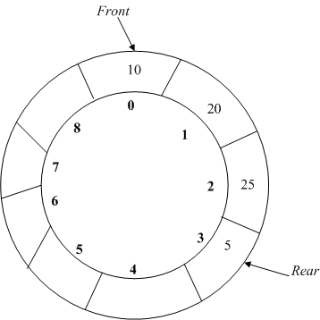
Enqueue(int x)
To add an element in circular queue, move rear clockwise
Then put it into Q[rear]

Slide 29
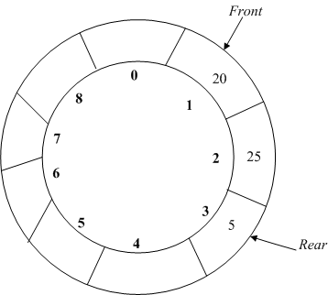
Dequeue()
To remove an element in circular queue, extract the data Q[front] and move front clockwise

Slide 30
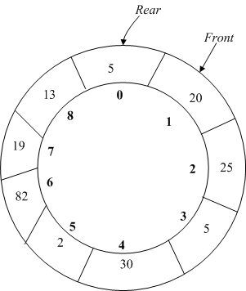
Isfull()

Slide 31
enqueue(int x)
void enQueue (int value)
{
if ((rear+1 mod size)==front)
{
printf("\nQueue is Full");
return;
}
else if (front == -1 and rear==-1) /* Insert First Element */
{ front = rear = 0;
arr[rear] = value;
}

Slide 32
enqueue(int x)
else {
rear= rear+1 mod size;
arr[rear] = value;
}
}

Slide 33
dequeue()
int deQueue()
{
if (front == -1 and rear==-1)
{
printf("\nQueue is Empty");
}
Else if(front == rear)
{
int data = Q[front];
front =rear= -1;
}

Slide 34
dequeue()
else
{
data= arr[front];
Front=Front+1 mod size;
}
}

Slide 35
Applications
CPU Scheduling is a process of determining which process will own CPU for execution while another process is on hold
First Come First Serve Scheduling
In this type of algorithm, the process which requests the CPU gets the CPU allocation first. This scheduling method can be managed with a FIFO queue.

