Slide 1
Singly Linked List
Operations
Dr. Preeth R
Assistant Professor
Department of Computer Sc. and Engg.

Slide 2
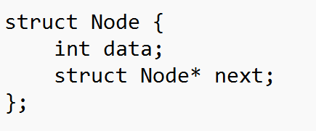
Linked List Node

Slide 3
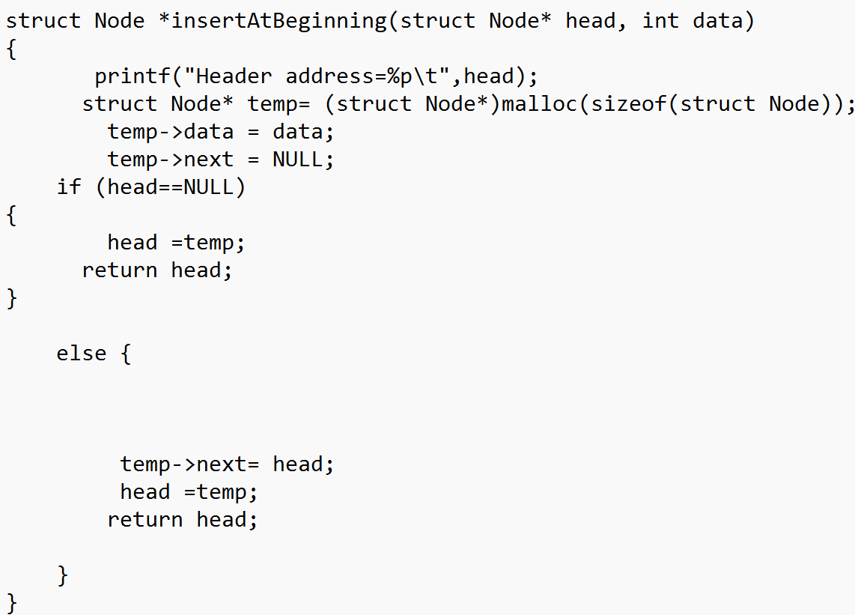
Insert at beginning

Slide 4
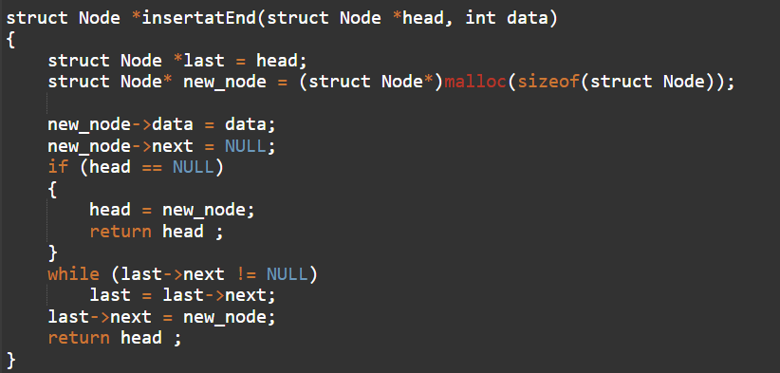
Insert at end

Slide 5
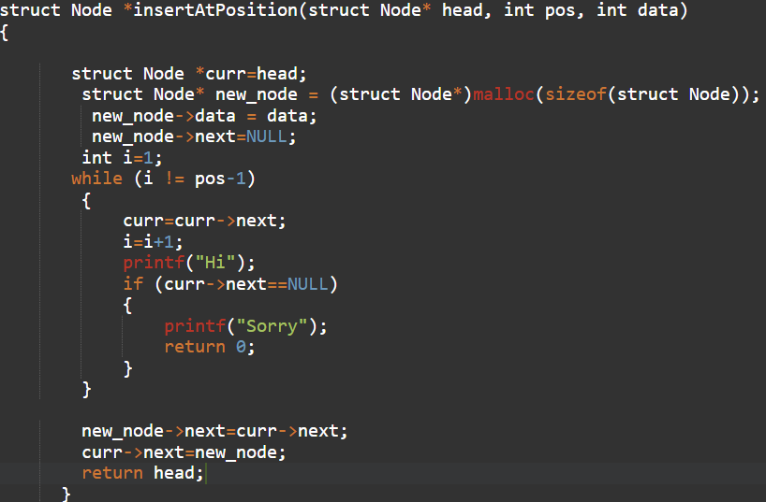
Insert at Position

Slide 6
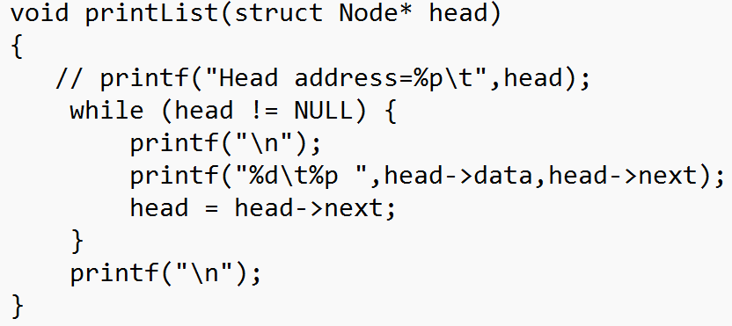
Print/Traverse

Slide 7
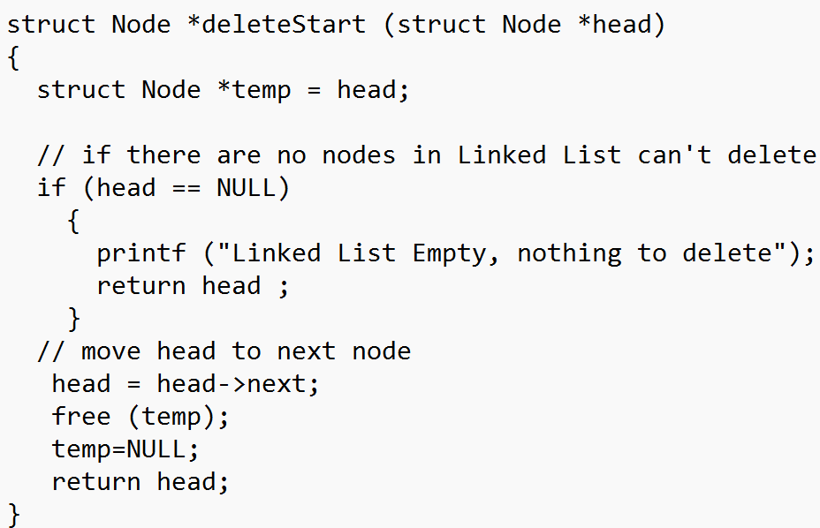
Delete at start

Slide 8
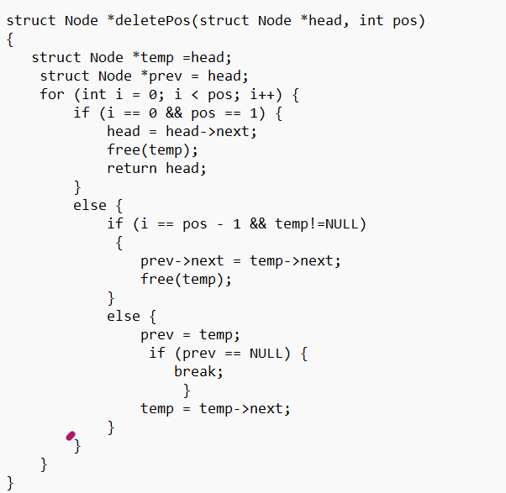
Delete at Position

Slide 9
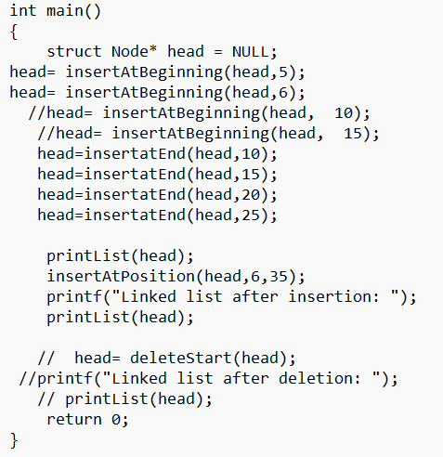
Main Function

Slide 10
Take Away Tasks
DeleteatEnd()
Deleteatposition()
Incorporation of identifying invalid position value in insertAtPosition().

