Slide 1
EDA & Business Intelligence
Retail Store Sales Analysis
Pranav Agarkar | June 2026
1/18

Slide 2
Agenda
1. Univariate Analysis — distributions & summaries
2. SQL Business Questions — query-driven insights
3. Multivariate Analysis — correlations & patterns
4. Proposed KPI Dashboard — key metrics for tracking
2/18

Slide 3
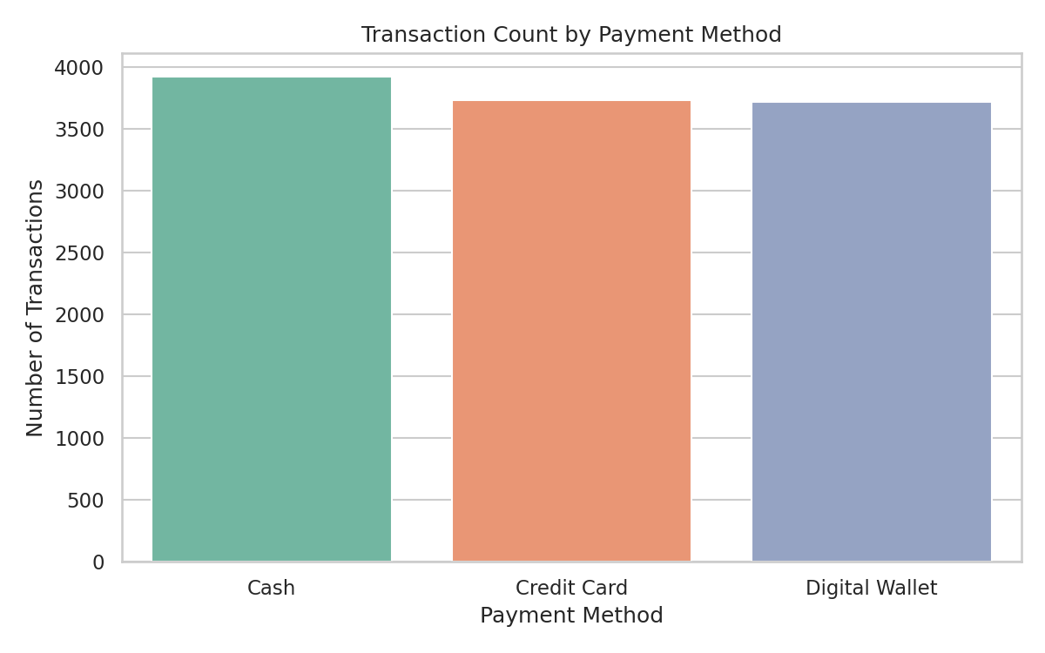
Bar Payment Method
Cash, Credit Card, and Digital Wallet each account for ~33% of transactions.
3/18

Slide 4
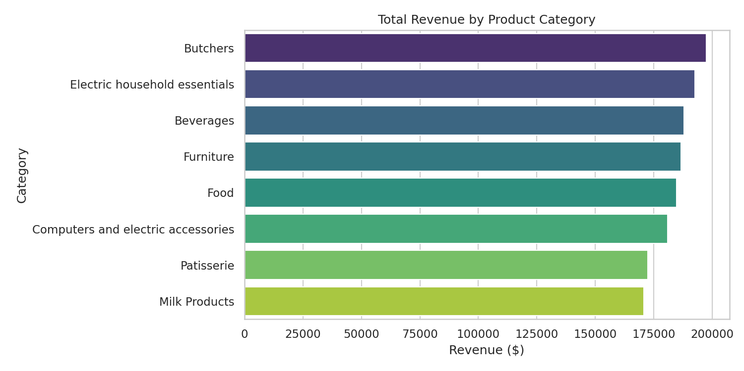
Bar Revenue By Category
Butchers and Electric Home Equipment lead revenue; all 8 categories contribute 11-13% each.
4/18

Slide 5
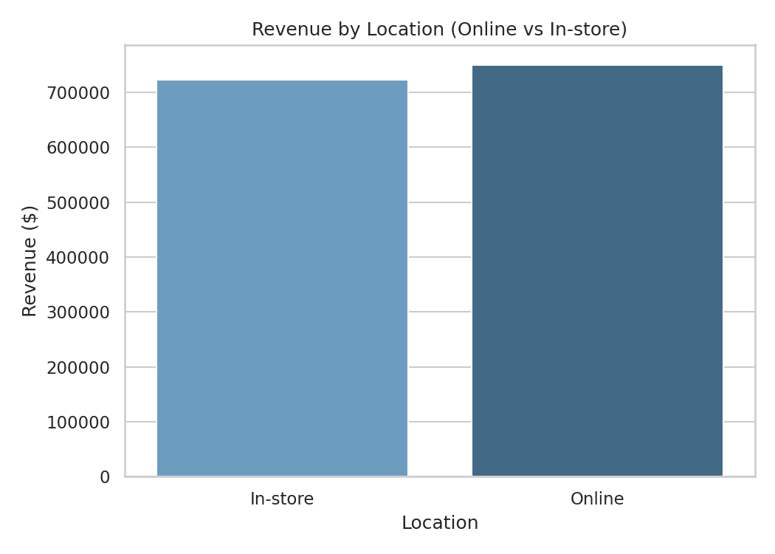
Bar Revenue By Location
New York and Los Angeles generate the highest revenue among all locations.
5/18

Slide 6
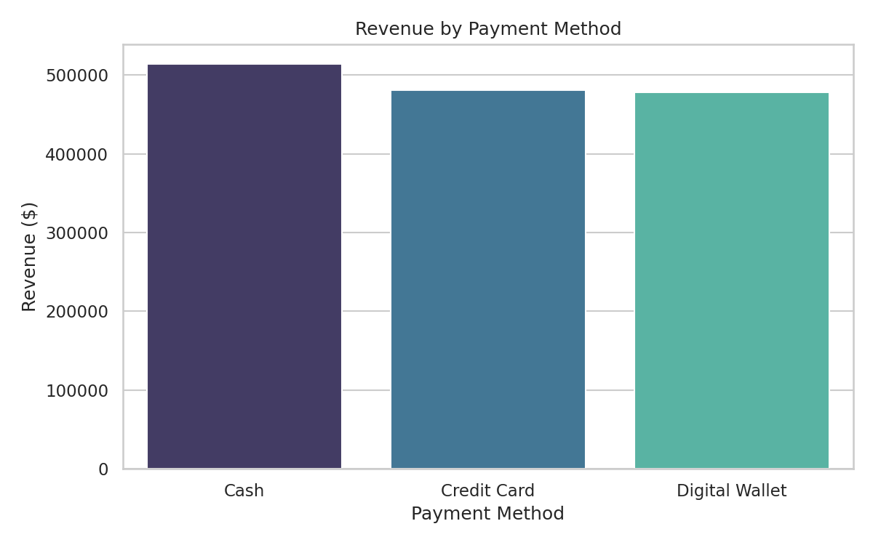
Bar Revenue By Payment
6/18

Slide 7
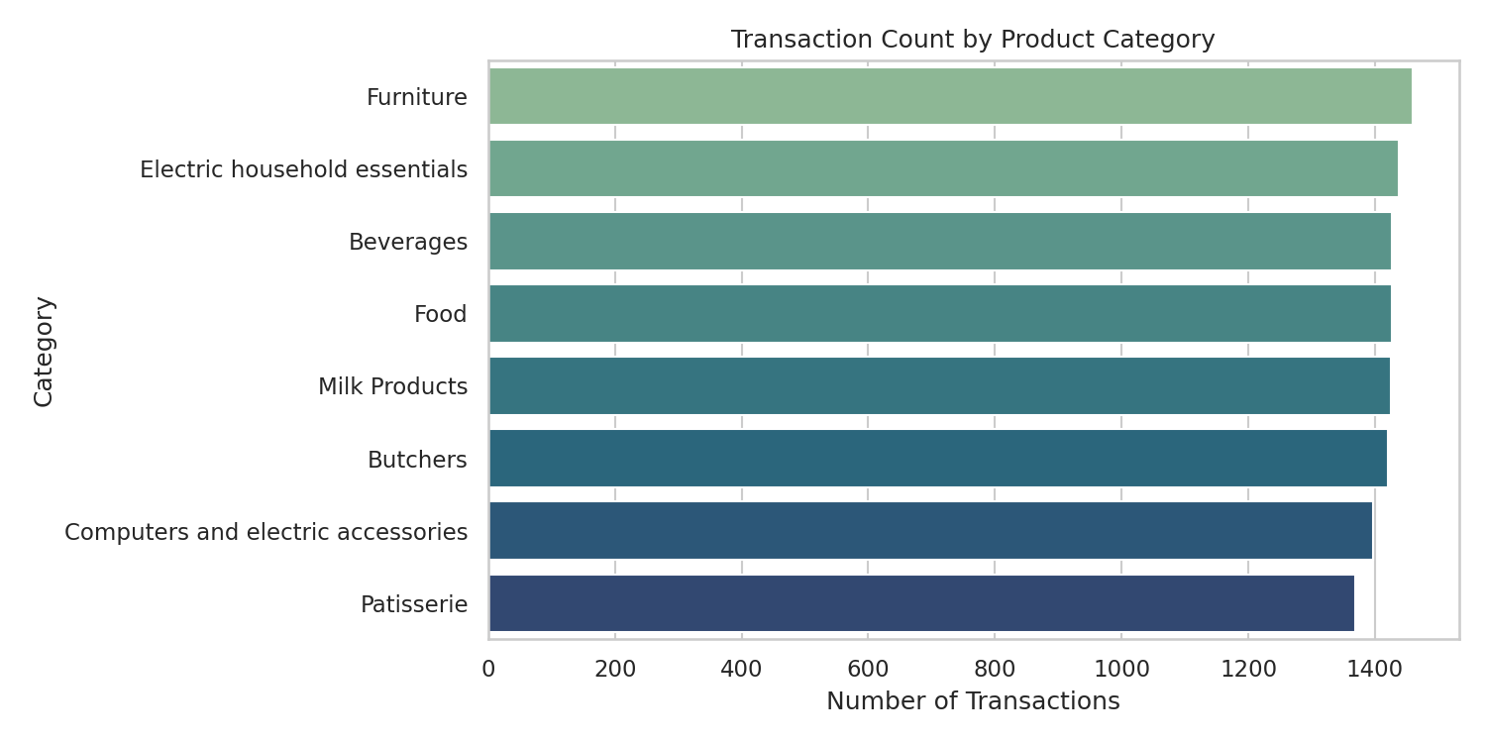
Bar Transactions By Category
Transaction volume is evenly distributed across categories (~1,420 each).
7/18

Slide 8
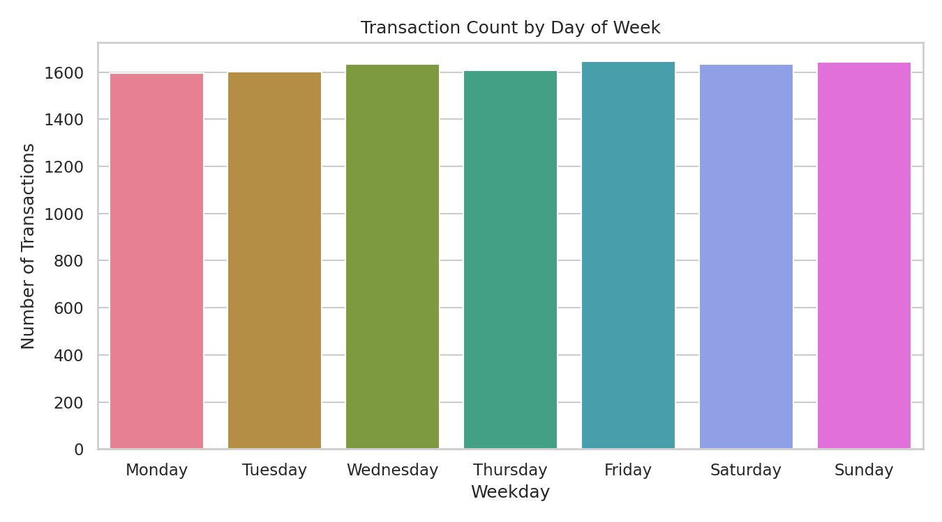
Bar Weekday Distribution
Sunday sees the most transactions; mid-week (Tue-Wed) dips noticeably.
8/18

Slide 9
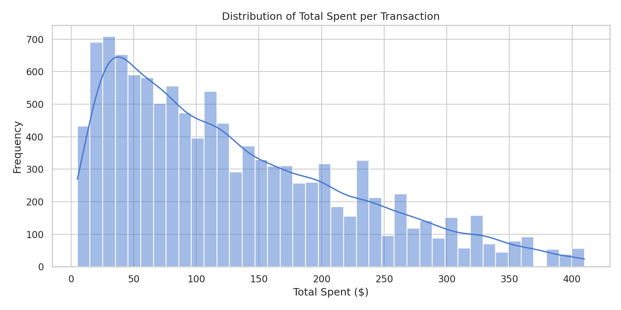
Histogram Total Spent
Most customers spend between $100-$160 per transaction; distribution is roughly normal.
9/18

Slide 10
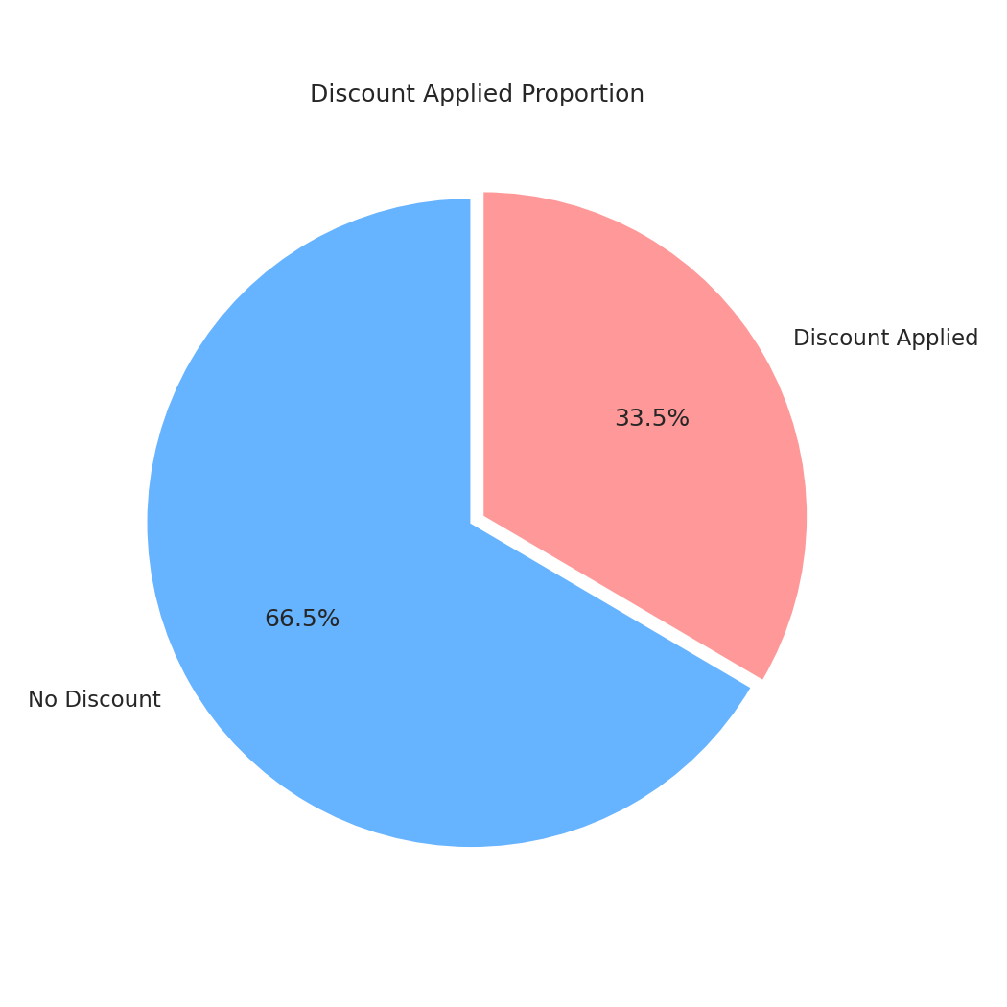
Pie Discount
33.5% of all transactions include a discount — about a third of sales.
10/18

Slide 11
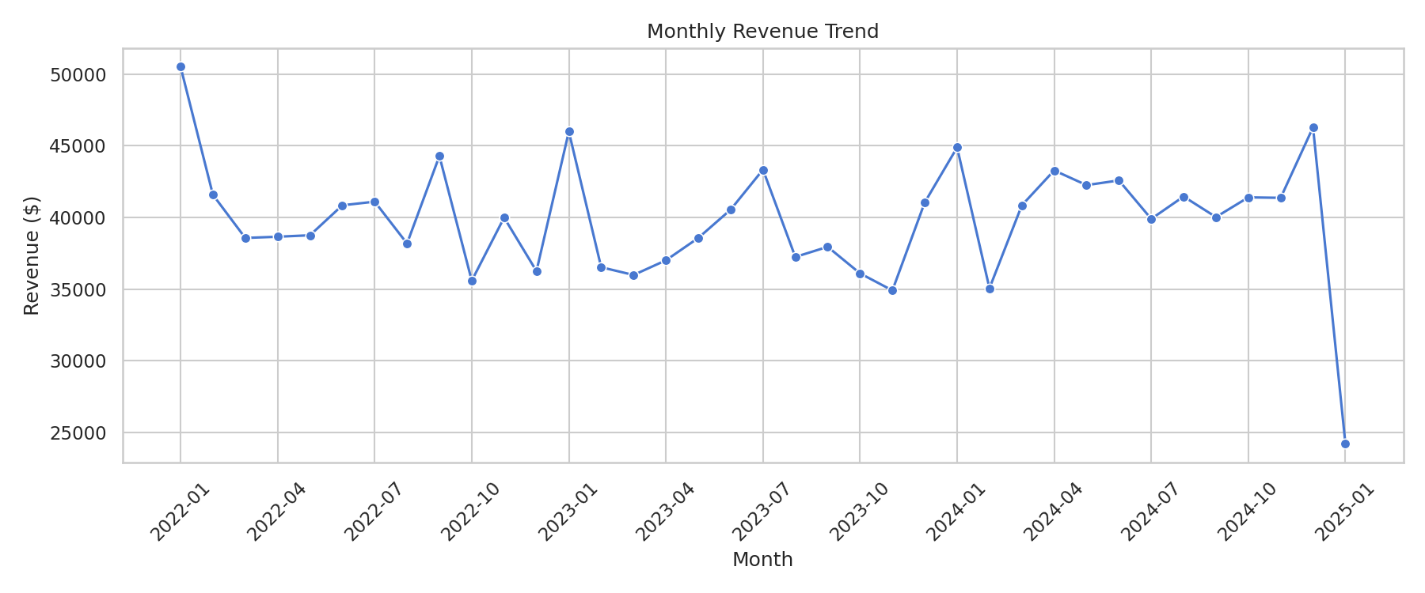
SQL Business Questions — Key Findings
Q1-Q4: Revenue, AOV, transactions by category and channel
Q5: Monthly revenue trend — peak in Jan 2025 ($56K)
Q6: Category & channel breakdown with percentages
Q7: Top product Item_25_FUR generates $25.3K revenue
Q8: Discounted orders have HIGHER AOV ($130.72 vs $129.10)
Q9: JOIN — Gold members (10 cust) contribute $608.8K
Q10: JOIN — New York customers lead at $373.3K revenue
11/18

Slide 12
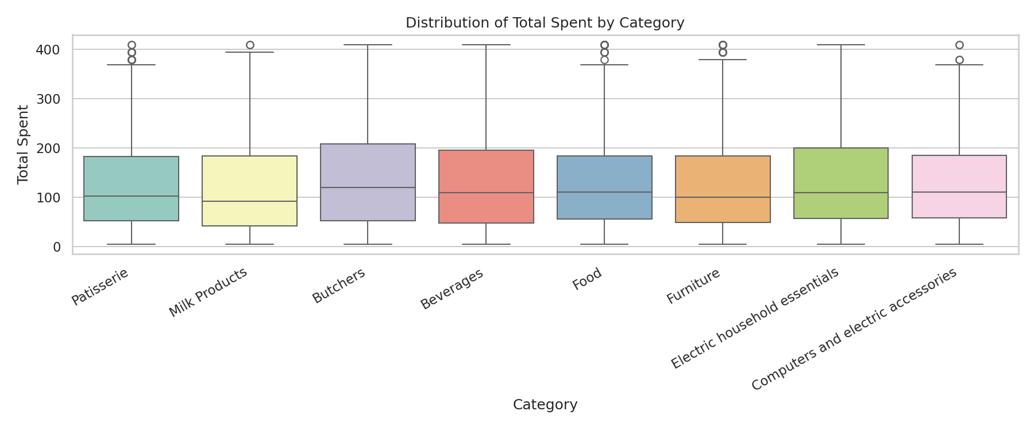
Boxplot Spent By Category
Revenue distribution is similar across categories; outlier transactions exist in every category.
12/18

Slide 13
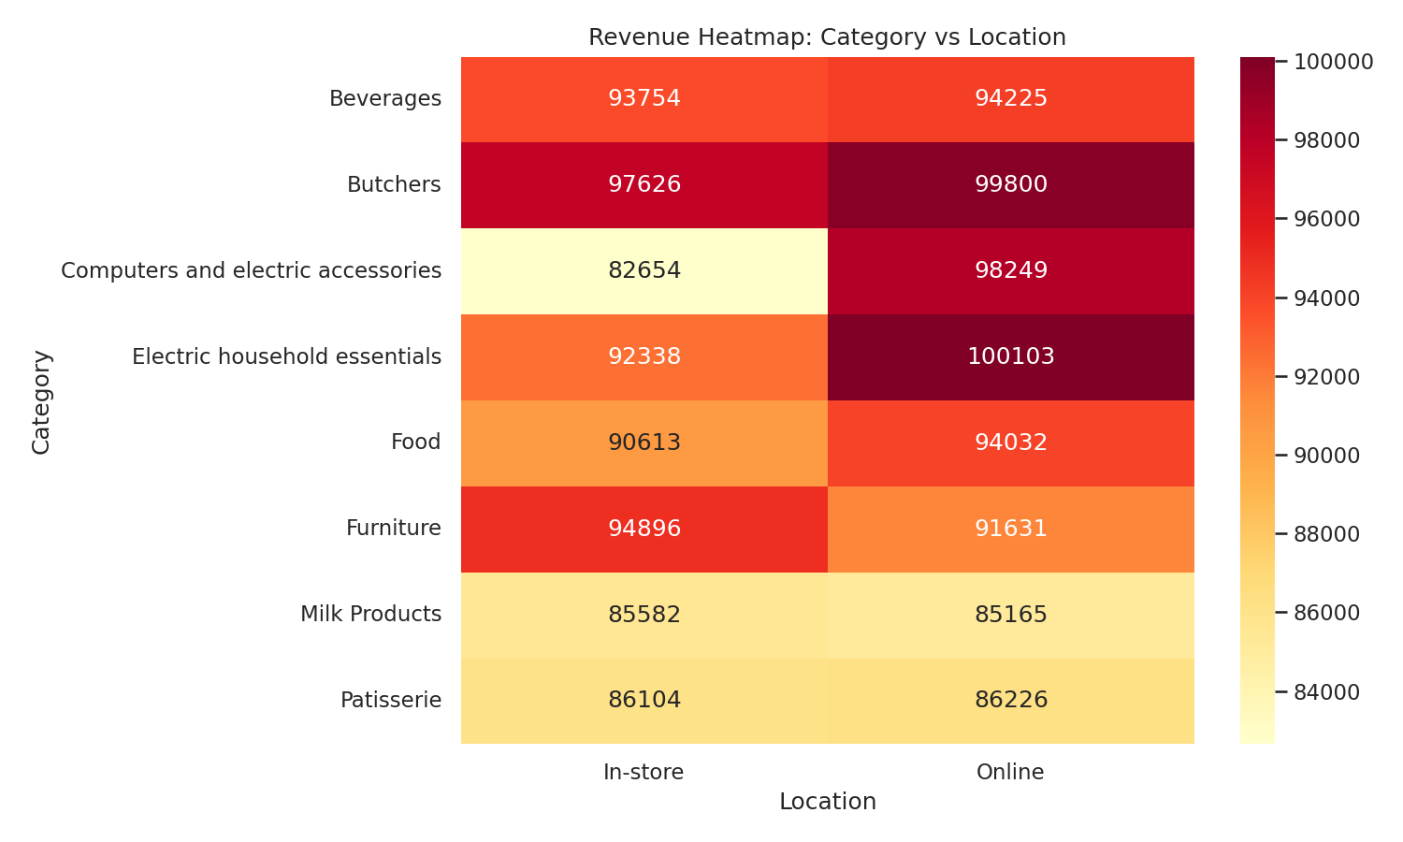
Heatmap Category Location
Category revenue is fairly uniform across locations, no strong regional preferences.
13/18

Slide 14
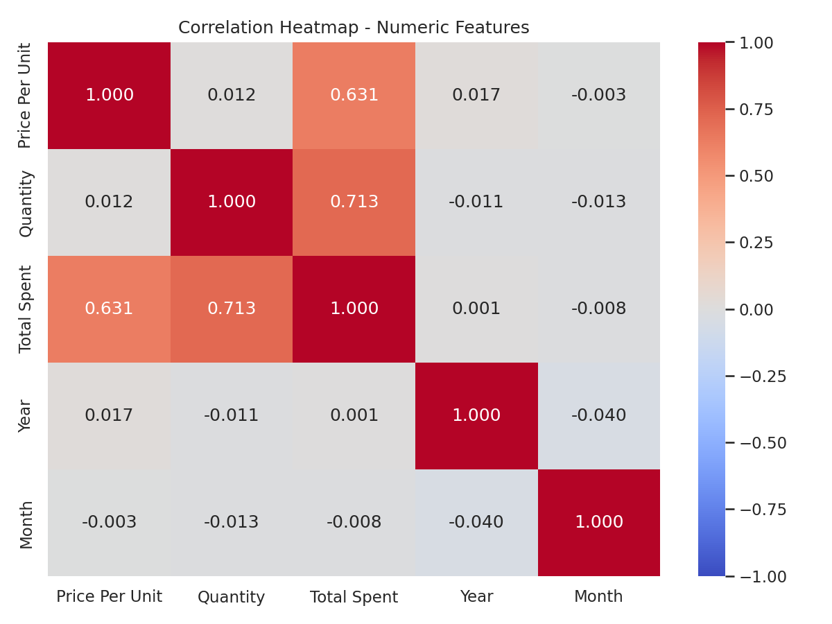
Heatmap Correlation
Total spent and quantity show weak positive correlation; no strong multicollinearity.
14/18

Slide 15
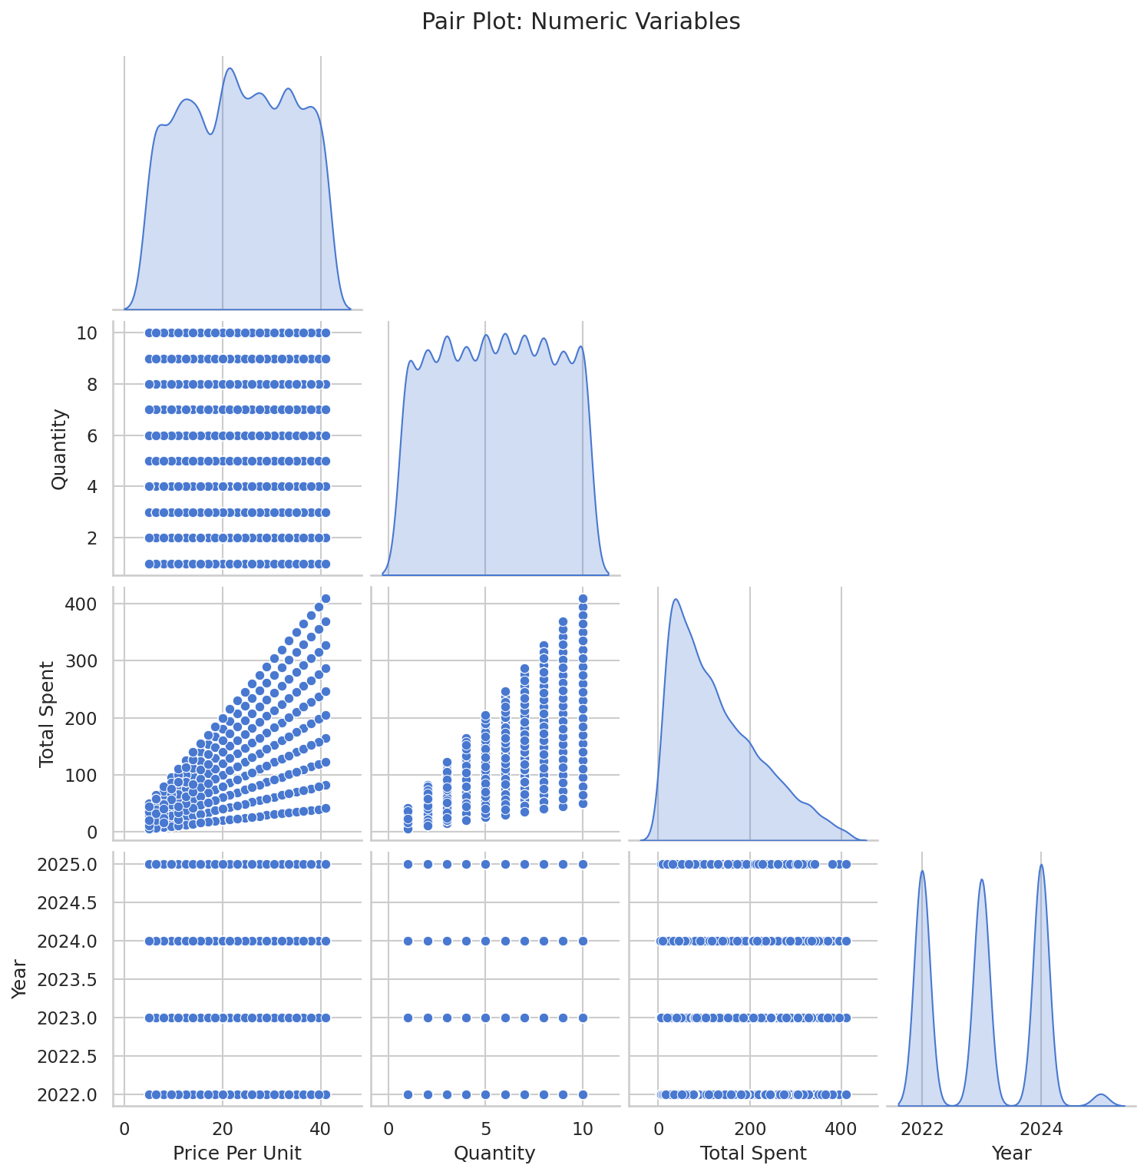
Pairplot Numeric
No strong linear relationships between numeric variables; data is well-behaved.
15/18

Slide 16
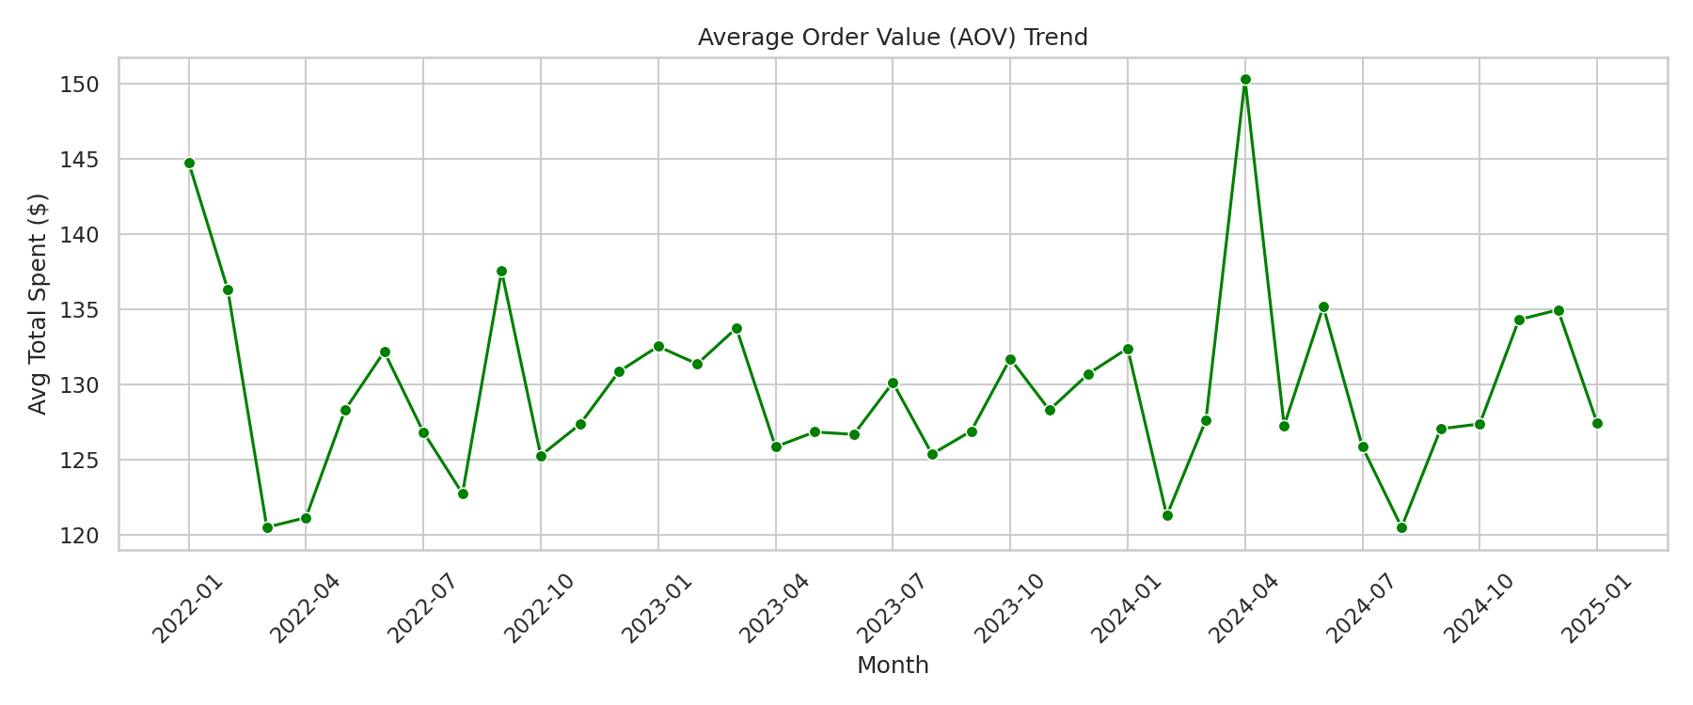
Line Aov Monthly
Average order value fluctuates monthly but shows no significant trend over time.
16/18

Slide 17
Proposed KPI Dashboard
Total Revenue
Avg Order Value
Total Transactions
$1,474,843
$129.82
11,362
Discount Rate
Online / In-store
33.5%
50.9% / 49.1%
17/18

Slide 18
Key Takeaways
1
Revenue is evenly distributed across 8 categories — no single category dominates
2
Online and in-store channels are nearly equal — omni-channel strategy validated
3
Discounts DON'T reduce AOV — they can be used safely to drive volume
4
Gold-tier members (10 customers) contribute 41% of total revenue
5
New York, LA, and Chicago are the top 3 revenue-generating cities
18/18

