Slide 1
UK Grants
360 Grant Nav Data

Slide 2
Information about all the grants from 1991-2022
632,657 Grants
Data about grant amount, date, funding and recipient organisation
Grant title and description
Number of Funding Organisations – 217
Number of Recipient Organisations – 281145

Slide 3
Location Division
Total 12 Regions
England is divided into 9 regions:
East of England
East Midlands
London
North East
North West
South East
South West
West Midlands
Yorkshire and the Humber
United Kingdom:
Scotland
Wales
Northern Ireland

Slide 4
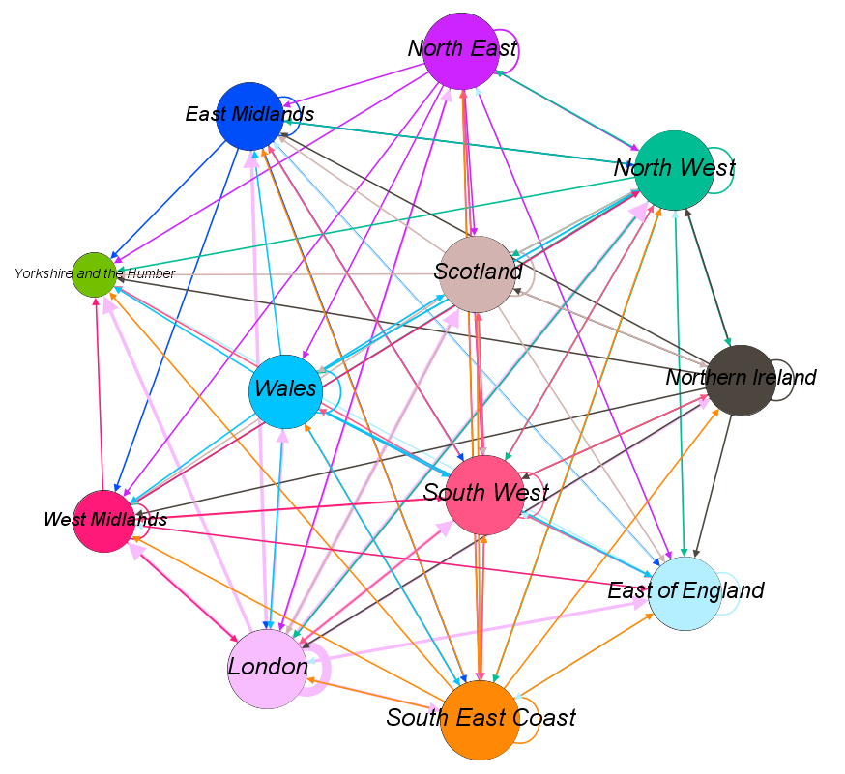
Flow of funds in UK
Nodes are sized by out degree
Edges are weighed by total amount
Edge color = source color

Slide 5
University Recipients
Total grants to universities = 12628
Number of university recipients across different regions:
London - 1578
North West - 1526
East of England - 1506
Scotland - 1474
West Midlands - 1394
South West - 1100
Yorkshire and the Humber - 904
North East - 893
East Midlands - 863
South East Coast - 681
Wales - 481
Northern Ireland - 228

Slide 6
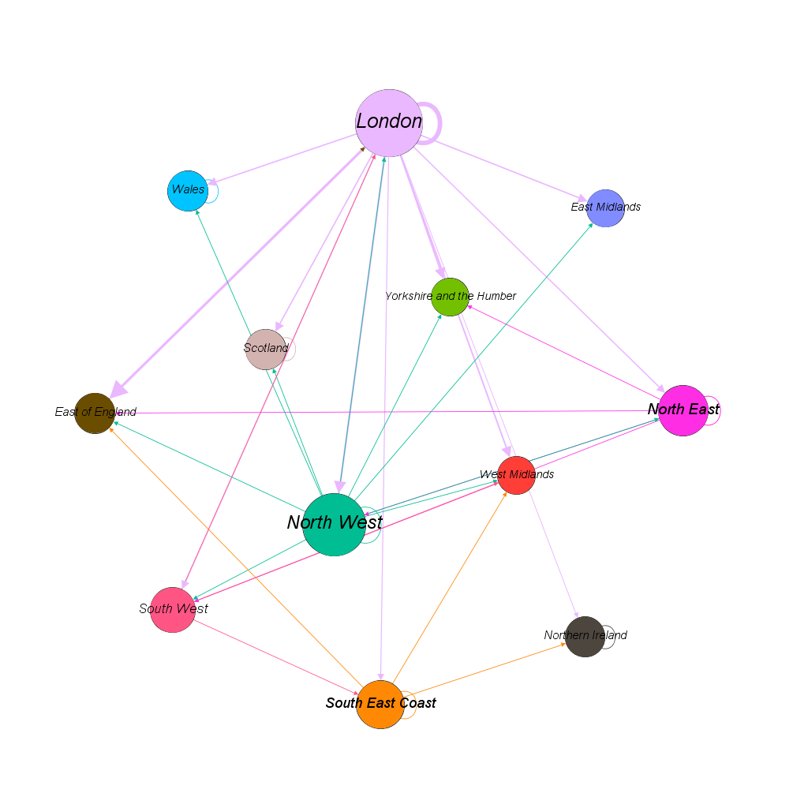
Flow of funds to University Recipients

Slide 7
In region and external Funding for University Recipients
Region | Internal | External
East Midlands | 0 | 0
East of England | 0 | 60000
London | 133872113 | 288822998
North East | 4000270 | 231619
North West | 31761 | 1447776
Northern Ireland | 3151 | 0
Scotland | 729974 | 0
South East Coast | 70000 | 95960
South West | 0 | 63606
Wales | 290916 | 0
West Midlands | 0 | 0
Yorkshire and the Humber | 0 | 0
Grant Sum in GBP

