Slide 1
UK Data

Slide 2
UK Charity Commission
170190 main organizations and 15165 linked charities
Includes information on revenue, expenses, trustees, mission
Note that the trustee information appears to already be disambiguated.

Slide 3
Trustee Network
170190 Organizations and 851555 Trustees
Note some oddities- e.g. Wellcome Trust officially only has the Wellcome Trust Limited as its trustee and none of the people affiliated are listed.
2 different organizations named Wiltshire Archaeological and Natural History Society with all the same trustees

Slide 4
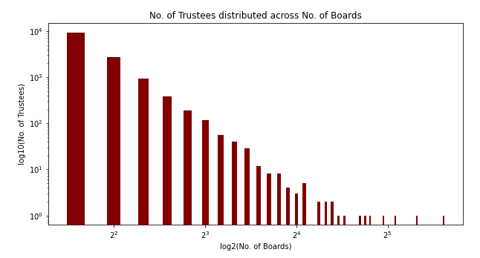

Slide 5
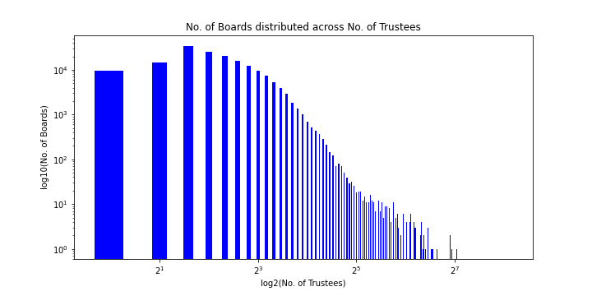

Slide 6
Top 10 Charities by Income
Charity name | Income
THE ARTS COUNCIL OF ENGLAND | £1,488,655,343
LLOYD'S REGISTER FOUNDATION | £1,290,104,000
THE BRITISH COUNCIL | £1,288,716,795
INTERNATIONAL FINANCE FACILITY FOR IMMUNISATION COMPANY | £1,059,428,626
THE CHARITIES AID FOUNDATION | £1,008,480,000
SAVE THE CHILDREN INTERNATIONAL | £876,468,492
NUFFIELD HEALTH | £779,900,000
CANCER RESEARCH UK | £656,107,415
CARDIFF UNIVERSITY | £568,812,000
UNITED CHURCH SCHOOLS FOUNDATION LTD | £553,383,000

Slide 7
Top 10 Charities by Expenditure Growth
Charity name | Expenditure growth
THE ARTS COUNCIL OF ENGLAND | £729,213,010
LLOYD'S REGISTER FOUNDATION | £431,973,000
HOSPICE UK | £257,114,000
THE CHARITIES AID FOUNDATION | £247,673,000
REUBEN FOUNDATION | £86,545,100
THE BRITISH COUNCIL | £76,161,044
UNITED CHURCH SCHOOLS FOUNDATION LTD | £67,496,000
UK COMMUNITY FOUNDATIONS | £66,494,000
INTERNATIONAL BIBLE STUDENTS ASSOCIATION | £61,330,906
HCT GROUP | £55,451,472

Slide 8
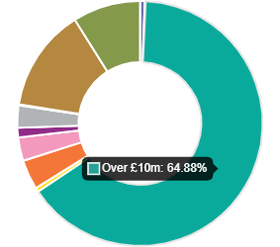

Charities by Income Band
Income Band | Charities | Total gross income | Total expenditure
£0 to £5k | 61,441 | £71,950,676 | £287,674,724
£5k to £10k | 16,606 | £122,049,475 | £161,476,453
£10k to £25k | 27,377 | £451,869,380 | £493,082,045
£25k to £50k | 15,373 | £552,007,943 | £559,818,890
£50k to £100k | 14,696 | £1,061,653,763 | £1,070,623,902
£100k to £250k | 15,532 | £2,466,745,118 | £2,419,517,839
£250k to £500k | 7,373 | £2,603,486,191 | £2,476,276,726
£500k to £1m | 4,632 | £3,301,646,675 | £3,150,640,263
£1m to £5m | 5,189 | £11,415,997,082 | £11,125,098,930
£5m to £10m | 1,056 | £7,491,871,748 | £7,259,116,912
Over £10m | 1,319 | £54,563,226,025 | £52,021,087,841

Slide 9
Charity Classification
Accommodation/housing: 1692,
Amateur Sport: 3178,
Animals: 1183,
Armed Forces/emergency Service Efficiency: 96,
Arts/culture/heritage/science: 3589,
Disability: 2616,
Economic/community Development/employment: 562,
Education/training: 21003,
Environment/conservation/heritage: 2376,
General Charitable Purposes: 12207,
Human Rights/religious Or Racial Harmony/equality Or Diversity: 198,
Other Charitable Purposes: 2284,
Overseas Aid/famine Relief: 88,
Recreation: 1088,
Religious Activities: 12871,
The Advancement Of Health Or Saving Of Lives: 3457,
The Prevention Or Relief Of Poverty: 3428
Multiple Categories : 98474

Slide 10
Royal Academy of Arts

Slide 11
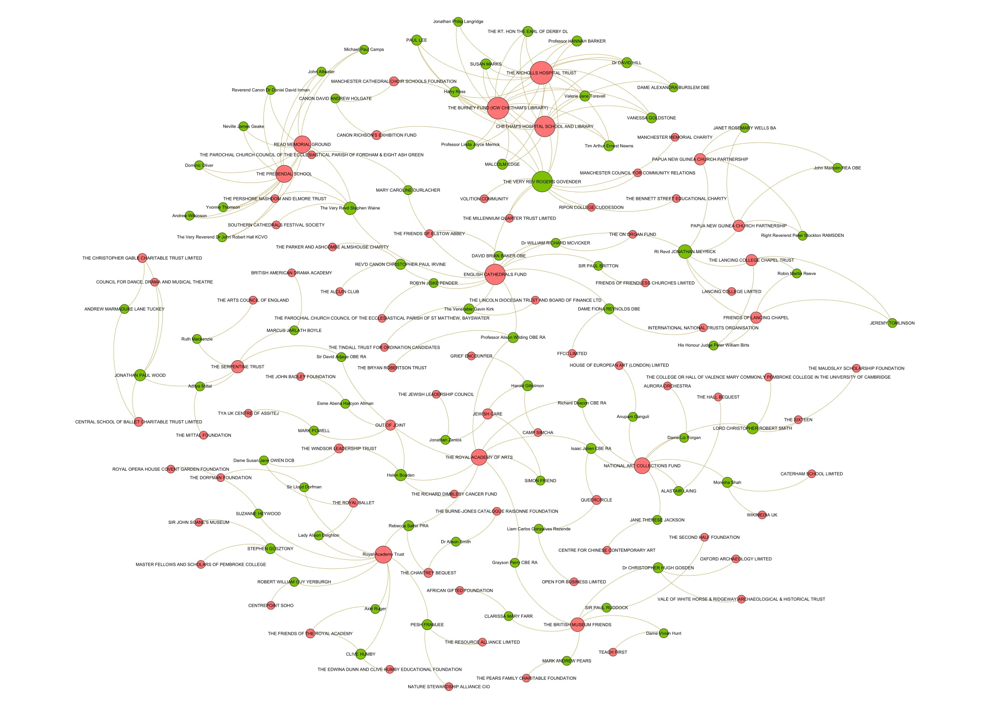

Slide 12
Royal Society for improving Natural Knowledge
Perhaps combine with dimensions.ai data to see what scholarly characteristics (field, citations, etc.) translate to these memberships?

Slide 13
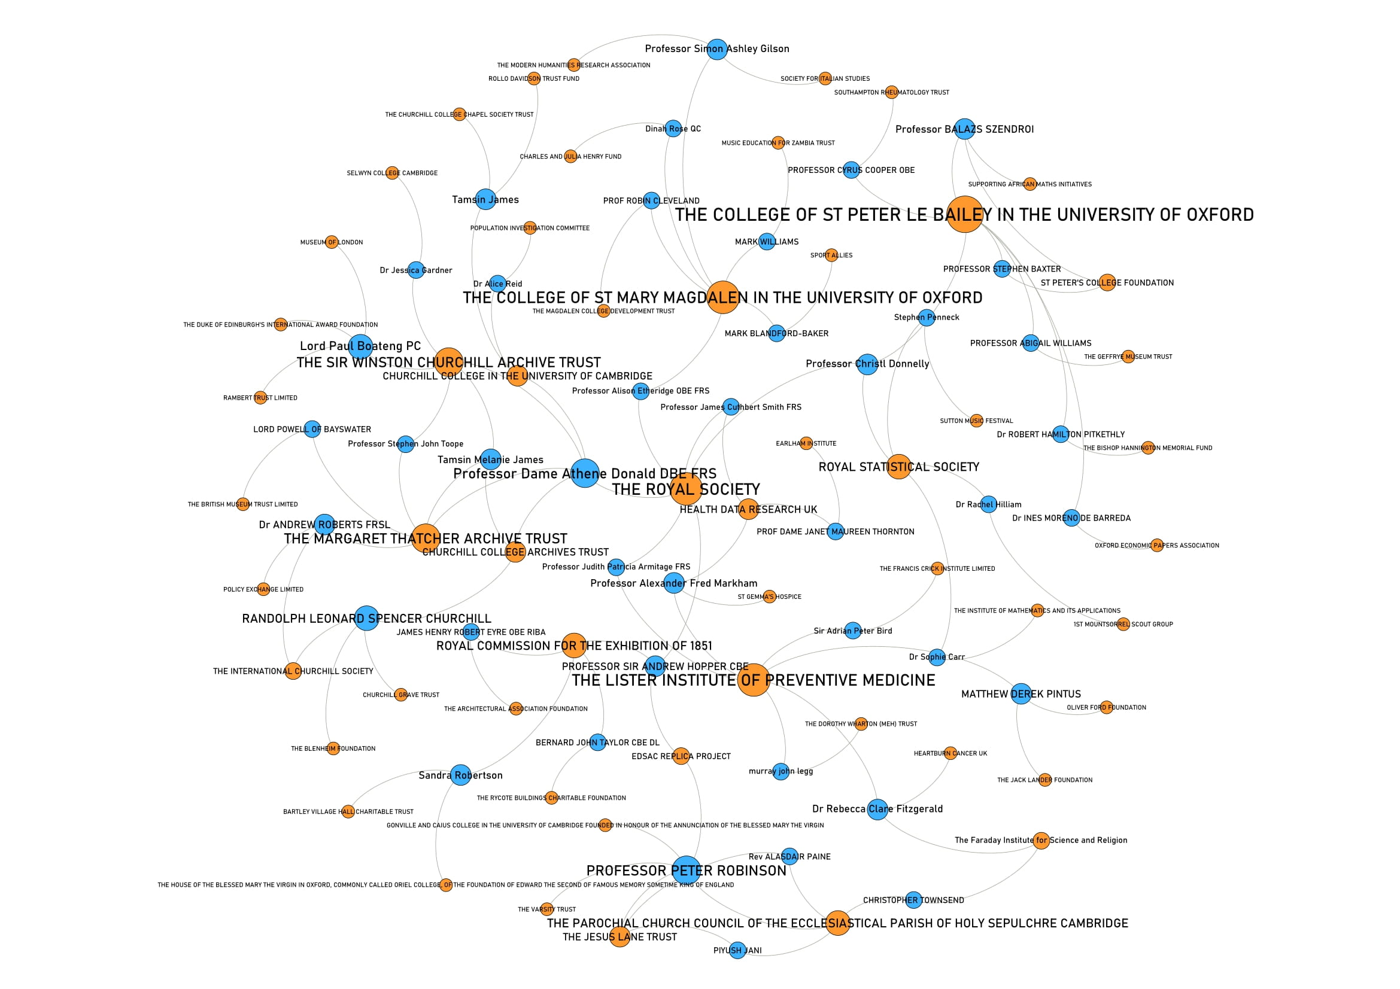

Slide 14
Rothschild Foundation

Slide 15
