Slide 1

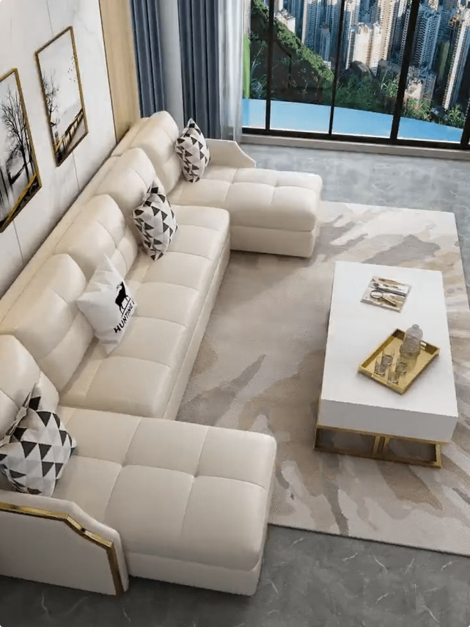
Sales Forecasting for a Furniture Store
Predicting future sales is crucial for furniture stores. Accurate forecasting can optimize inventory management, anticipate demand fluctuations, and inform marketing strategies.
PB
by Pranav Bejgam

Slide 2
Data Collection and Preprocessing
Historical Sales Data
External Factors
Data Cleaning
Gather historical sales data, including dates, products, quantities sold, and prices. Ensure data accuracy and completeness.
Consider external factors like economic indicators, seasonality, and competitor activity. Incorporate relevant data to enhance forecasting.
Clean and transform the data by addressing missing values, inconsistencies, and outliers to improve model performance.

Slide 3


Feature Engineering
1
Product Features
2
Customer Demographics
Extract features like product category, style, price, and material to understand product demand.
Analyze customer demographics, such as age, location, and income to identify purchasing patterns.
3
Time Series Features
4
Market Trends
Engineer time-based features like day of the week, month, and year to capture seasonal trends and cyclical patterns.
Consider macroeconomic factors like interest rates, inflation, and consumer confidence to predict future sales.

Slide 4

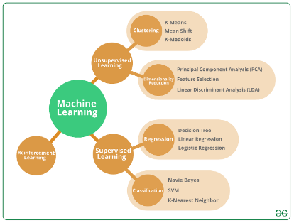
Model Selection and Training
Regression Models
Random Forest
Neural Networks
Linear regression, polynomial regression, and support vector regression can be used to predict continuous sales values.
An ensemble method that combines multiple decision trees to improve accuracy and reduce overfitting.
Recurrent neural networks (RNNs) and long short-term memory (LSTM) networks can learn complex patterns from time series data.

Slide 5

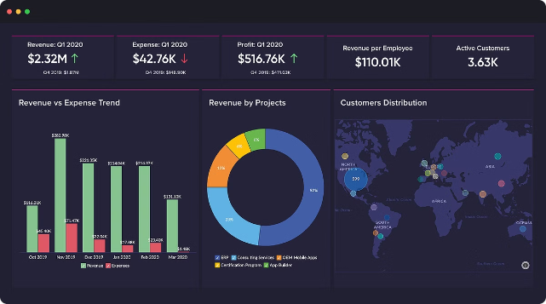
Evaluation Metrics
Metric
Description
Mean Absolute Error (MAE)
Average absolute difference between actual and predicted values.
Root Mean Squared Error (RMSE)
Square root of the average squared difference between actual and predicted values.
R-squared
Indicates the proportion of variance in the dependent variable explained by the independent variables.

Slide 6





Deployment and Integration
Model Deployment
Deploy the model using Streamlit for front-end and Flask for backend integration, enabling cloud or on-premises real-time predictions.
Integration with Systems
Integrate the model with POS or ERP systems using Flask for API requests and Streamlit for an interactive interface.
Monitoring and Maintenance
Implement monitoring, logging, and automated retraining to maintain model performance

Slide 7

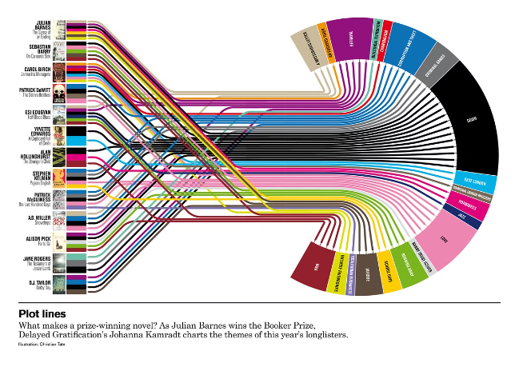
Monitoring and Continuous Improvement
1
Performance Monitoring
Continuously monitor the performance of the forecasting model and evaluate its accuracy over time.
2
Data Updates
Regularly update the model with new data to ensure it remains relevant and adapts to changing market conditions.
3
Model Retraining
Retrain the model periodically using new data to improve its performance and maintain accuracy.

Slide 8



Conclusion and Future Considerations
Future Enhancements
Explore advanced forecasting techniques, such as ensemble methods, deep learning, and reinforcement learning.
Business Value
Sales forecasting can provide valuable insights to optimize inventory management, improve customer service, and enhance marketing effectiveness.
Data-Driven Decisions
Leveraging data analytics and machine learning can enable furniture stores to make data-driven decisions for sustainable growth and success.

