Slide 1


Understanding Customer Purchase Behaviour
Customer purchase behaviour is a crucial aspect of business success. It involves understanding how customers make decisions, what factors influence their choices, and how to predict their future actions. By analysing customer behaviour, businesses can improve their marketing strategies, personalise customer experiences, and ultimately drive sales.
PB
by Pranav Bejgam

Slide 2


Importance of Predicting Customer Behaviour
Predicting customer behavior is essential for businesses to stay ahead of the competition. By anticipating customer needs and preferences, businesses can tailor their offerings and marketing efforts to maximize customer satisfaction and drive sales.
1
Targeted Marketing
2
Inventory Management
Businesses can use predictive models to target specific customer segments with personalized marketing campaigns.
By predicting demand, businesses can optimize inventory levels, reducing costs and preventing stockouts.
3
Pricing Optimization
4
Customer Retention
Predictive models can help businesses set dynamic pricing strategies to maximize revenue.
Identifying customers at risk of churn allows businesses to take proactive steps to retain them.

Slide 3
Data Sources for Modelling Customer Behaviour
Businesses collect a wealth of data about their customers, which can be used to model purchase behavior. This data can come from various sources, including transactional records, website interactions, social media activity, and customer surveys.
Transactional Data
Website Data
Social Media Data
Purchase history, order details, and payment information provide insights into customer preferences and spending patterns.
Website visits, page views, and search queries reveal user behavior and product interest.
Social media engagement, posts, and reviews offer valuable insights into customer sentiments and brand perceptions.

Slide 4

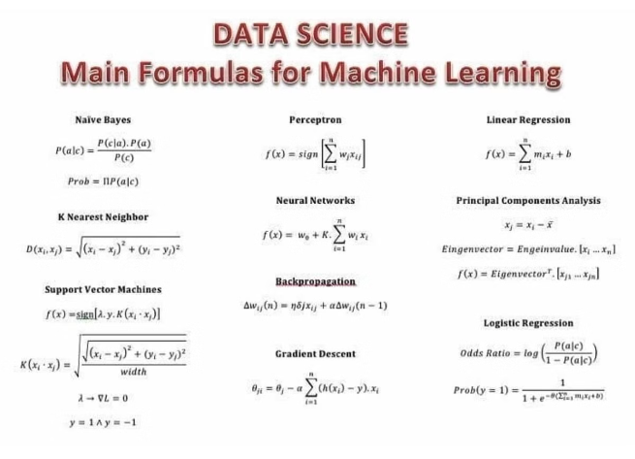
Machine Learning Techniques for Prediction
Machine learning algorithms are powerful tools for analyzing customer data and predicting their future behavior. These algorithms learn patterns from historical data and use them to make predictions about future events.
Random Forest Model
Classification Models
Predicts outcomes using multiple decision trees, enhancing accuracy and robustness by aggregating their results.
Predict categorical variables, such as whether a customer will make a purchase or not.
XGB Classifier
Leverage the power of the XGB Classifier model to predict customer behavior with high accuracy. This advanced algorithm can uncover subtle patterns in your data to forecast future actions.

Slide 5





Feature Engineering and Selection
Feature engineering involves transforming raw data into meaningful features that can be used by machine learning algorithms. Feature selection aims to identify the most relevant features for accurate prediction.
Data Cleaning
Removing inconsistencies and handling missing values.
Feature Creation
Deriving new features from existing data, such as customer lifetime value or recency.
Feature Selection
Choosing the most relevant features using techniques such as statistical analysis or feature importance scores.

Slide 6

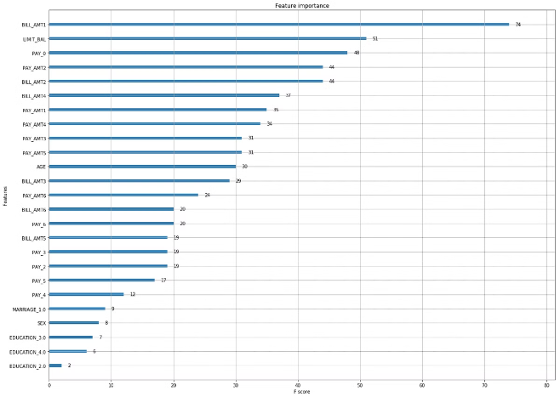
Model Training and Evaluation
Once features are engineered and selected, machine learning models are trained on historical data to learn patterns and relationships. After training, the models are evaluated to assess their performance and identify areas for improvement.
Accuracy
The percentage of correct predictions made by the model.
Precision
The proportion of positive predictions that are actually correct.
Recall
The proportion of actual positive cases that are correctly identified by the model.
F1-Score
A harmonic mean of precision and recall, providing a balanced measure of model performance.

Slide 7


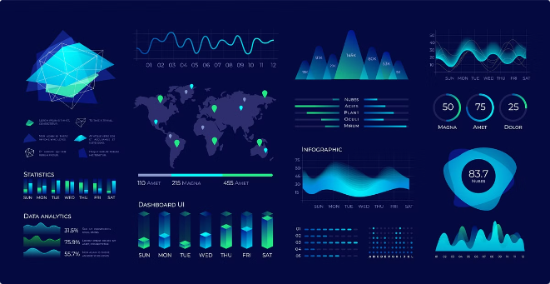


Interpreting Model Outputs
Once a model is trained and evaluated, it's important to interpret its outputs to gain insights into customer behavior and inform business decisions. This involves analyzing model predictions and understanding the factors that contribute to those predictions.
Feature Importance
Identifying the most influential features in driving predictions.
Model Diagnostics
Assessing model performance and identifying potential biases.
Time Series Analysis
Understanding how customer behavior evolves over time.

Slide 8
Practical Applications and Business Impact
Predicting customer purchase behavior has numerous practical applications across various industries, leading to significant business impact.
Personalized Recommendations
1
Providing customized product recommendations based on individual customer preferences.
2
Targeted Marketing Campaigns
Reaching out to specific customer segments with tailored messages.
Customer Segmentation
3
Grouping customers based on their behavior to develop targeted strategies.
4
Fraud Detection
Identifying fraudulent transactions by analyzing unusual purchase patterns.
Inventory Optimization
5
Predicting demand to optimize stock levels and reduce waste.
6
Pricing Strategies
Developing dynamic pricing models to maximize revenue.

