Slide 1
WHO
WHO Infodemic Monitor
AI-powered health misinformation detection for short-form video
TikTok
Reels
Shorts
UIUC • 2026

Slide 2
The Problem
3.96B
72%
Manual
social media users
exposed to health content
of health misinformation
spread via short-form video
review is slow, costly
and doesn't scale
WHO needs a scalable, evidence-grounded tool to detect health misinformation in real time.

Slide 3





Our Solution
A cloud-deployed multimodal analysis pipeline
Upload Video
Transcribe
LLM Classify
PubMed Ground
Verdict
TikTok · Reels · Shorts
faster-whisper / OpenAI
Anthropic Claude/ Open AI
Peer-reviewed evidence
Label + Explanation
Classification Labels:
MISINFO
NO_MISINFO
DEBUNKING
CANNOT_RECOGNIZE

Slide 4




Cloud Architecture
Vercel
Railway
Frontend
FastAPI + Celery
Next.js 14 · TypeScript · Tailwind CSS
Auth-protected · Global CDN
REST API · Job queue
Async task workers · Health checks
Supabase
Upstash
Database + Storage
Redis Broker
PostgreSQL · Video file storage
Supabase Auth · JWT sessions
Celery message queue
Serverless · TLS encrypted

Slide 5
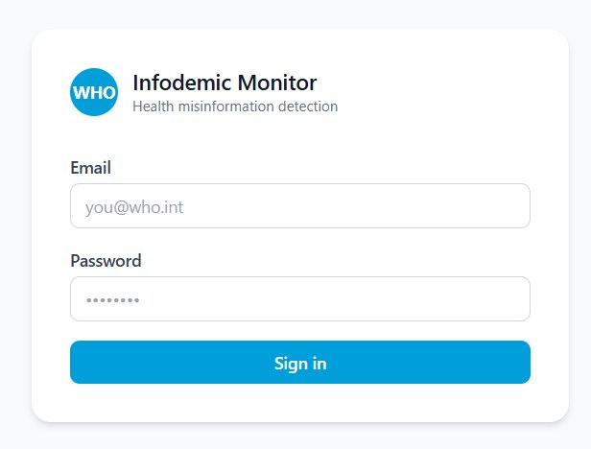
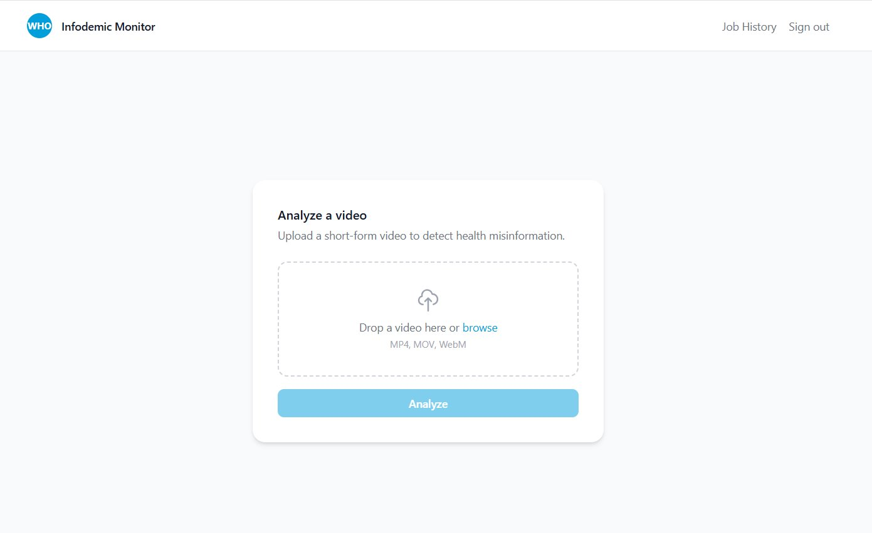
Application Screens
Authentication · Video Upload
🔐 Secure Login
📤 Video Upload

Slide 6
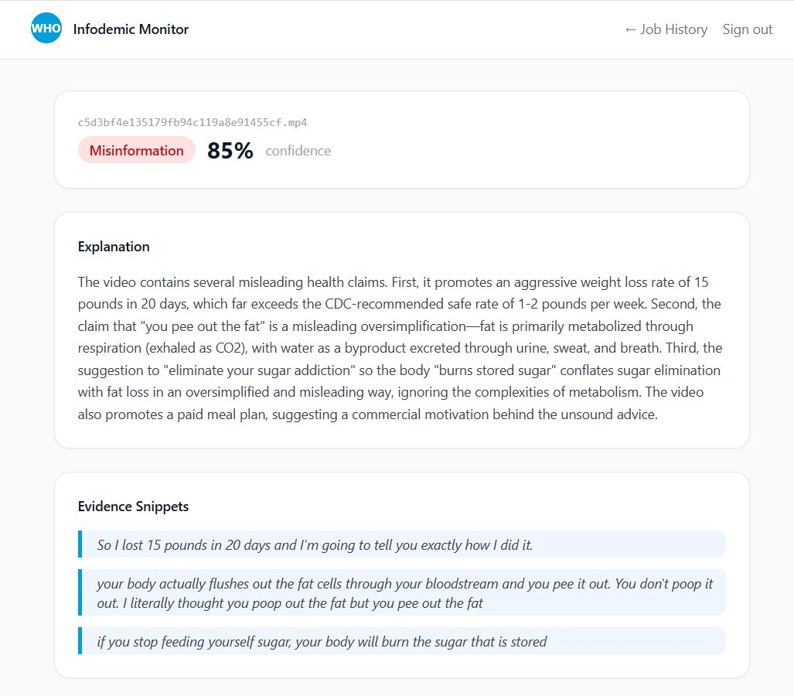
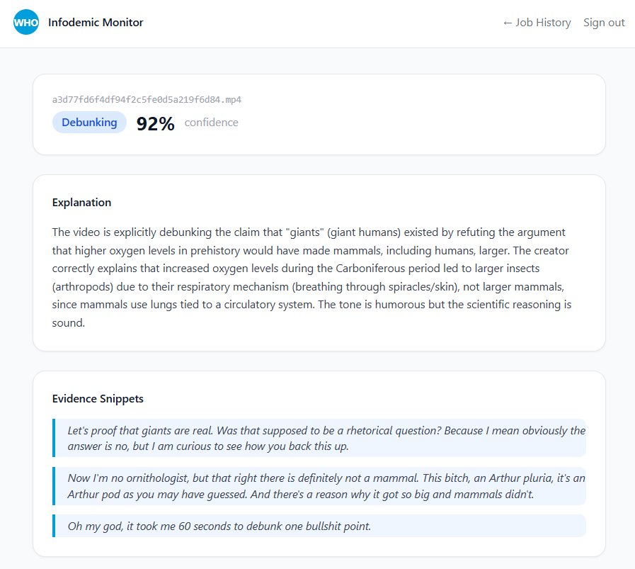
Analysis Results
Misinformation Detection · Debunking · PubMed Citations
🚨 MISINFO — 85% confidence
✅ DEBUNKING — 92% confidence

Slide 7
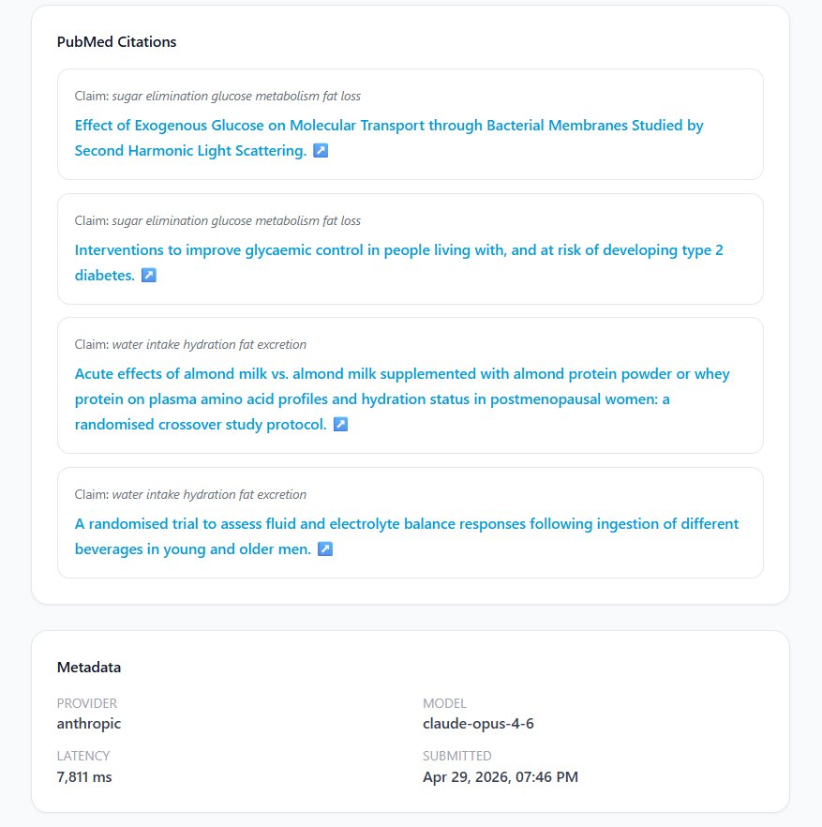
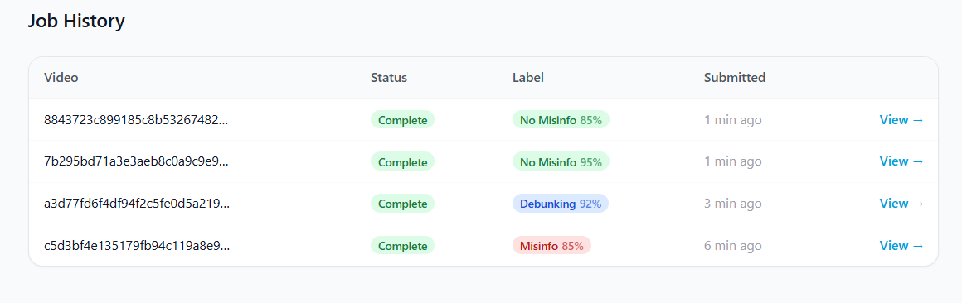
Evidence Grounding · Job History
PubMed citations for MISINFO/DEBUNKING · Full audit trail
📚 Linked peer-reviewed papers
📋 Job history dashboard

Slide 8
Live Test Results
4 videos tested across all classification categories
Weight loss claims (15 lbs / 20 days)
MISINFO
85%
"You pee out the fat" — metabolically misleading
Physics demonstration (ice melting)
NO MISINFO
85%
Correctly explains thermal conductivity — no health claims
Giants myth debunked
DEBUNKING
92%
Correctly refutes Carboniferous oxygen = human giants claim
Electrolytes hydration tip
NO MISINFO
95%
Broadly consistent with nutrition science
Avg. latency: ~6 seconds · Provider: Anthropic claude-opus-4-6

Slide 9
Status & Roadmap
Current Status
What's Next
✓
Frontend live on Vercel
Full Cloud Deployment
Railway Hobby + Supabase Pro for 24/7 availability
✓
API deployed on Railway
URL Ingestion
✓
Supabase DB + Storage connected
Paste a TikTok / Reels link directly — no download needed
✓
Upstash Redis broker configured
Stronger Evidence Search
MeSH terms + full-text retrieval via PubMed API
✓
End-to-end pipeline validated
Confidence Calibration
Celery worker — moving to full cloud
Ensemble scoring + eval harness for accuracy benchmarks
⚠

Slide 10
WHO
WHO Infodemic Monitor
Built for WHO representatives and public health researchers
infodemic-monitor.vercel.app
UIUC · 2026

