Slide 1

MAD_PWA PROJECTS
Title of the Project:
Flutter Project : Football Score
Pwa app: Football ecommerce
Name : Pranav Chidage
Class : D15B
Roll No. : 10
Lab Teacher :
Ravita Mishra

Slide 2
Content
Introduction
Problem Defination
Motivation
Literature Survey
Proposed System
Scope
Results and Analysis
Conclusion and Future Scope
References

Slide 3
Introduction to Flutter Project
Introducing the concept of a live football score app developed using the Flutter framework.
It highlights the increasing demand for real-time sports information in today's digital era, particularly among football enthusiasts worldwide.
The introduction discusses the limitations of existing solutions in providing timely and accurate football score updates and emphasizes the need for a more efficient and user-friendly alternative.
It outlines the objectives of the project, including the development of a user-friendly app that delivers live football scores and match details in real-time to cater to the needs of football fans.
r Rates

Slide 4
Problem Statement
There is very less app which give simple football live scores to the football viewers.
Limitations of existing solutions and the need for a more efficient and user-friendly alternative.
To address these issues through real-time score updates and user-friendly interface.
r Rates

Slide 5
Motivation
Catering to global football fans' need for instant score updates.
Meeting the rising demand for real-time sports information.
Enhancing user engagement through live score updates.
lem Statement
Problem Statement

Slide 6
Literature Survey
Live score of sports - Vilas Rathod, Shreyan Jain t
The idea of live scores is to provide real time information about sports results from various
disciplines. Live scores are usually free and are very popular among sports betting enthusiasts, as they allow viewing collected data on many sports events. In the past, live score services were only available on TV through teletext or on the radio. There are now many websites providing live scores. It is possible to follow live results of many events at the
same time.
where sports fans can gather and discuss the current event. Several sports organizations such Major league football
atem

Slide 7
Proposed System
Utilization of Flutter Framework: Leveraging the Flutter framework for cross-platform development to ensure compatibility across both Android and iOS devices, providing a seamless user experience for a wider audience.
Integration of Live Football Data API: Implementing an API for accessing live football scores, match details, and statistics in real-time, ensuring that users receive up-to-date and accurate information directly within the app interface.
User-Friendly Interface Design: Designing an intuitive and visually appealing user interface (UI) with features such as easy navigation, customizable notifications, and interactive match updates to enhance user engagement and satisfaction.

Slide 8
Scope
Initial Focus on Basic Features: The scope of the project initially entails implementing essential features such as live score updates, match schedules, and basic match statistics, ensuring a minimal viable product (MVP) is delivered within a reasonable timeframe.
Limited Platform Compatibility: Initially targeting deployment on a single platform (either Android or iOS) to streamline development efforts and ensure optimal performance and user experience on the chosen platform before expanding to other platforms.

Slide 9
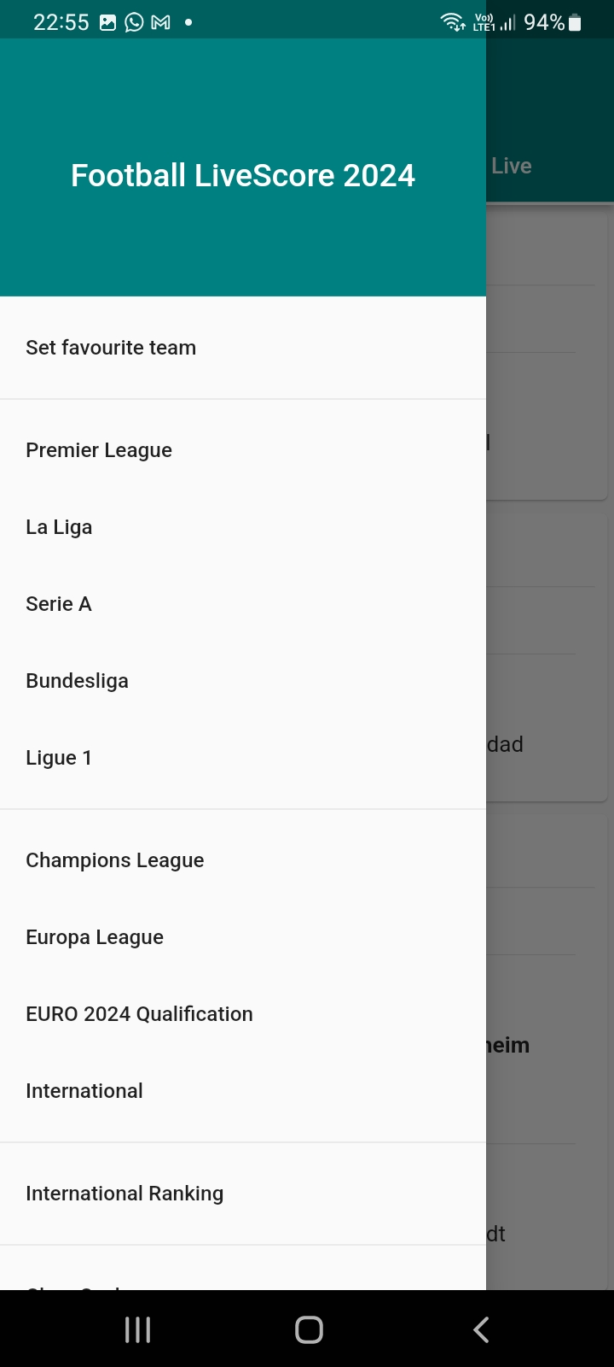
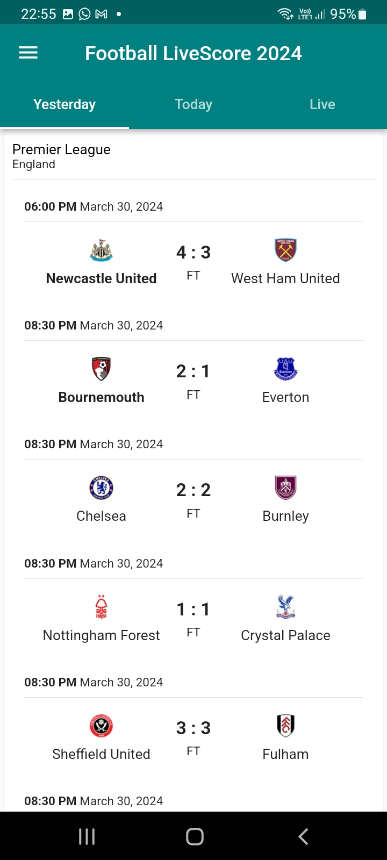
Result Analysis
Notes:
The max flow algorithm in the visualization is :-

Slide 10
Result Analysis
UI of app is responsive and work for any android as well as IOS devices.
API is working properly give a real time data .
Past 3 days matches is visible so has to give users a better knowledge of current football
matches.
The networking and loading activity is working properly, the transition of on page to next is smooth.

Slide 11
Conclusion
The live football score app developed with Flutter has effectively met the demand for real-time sports information. By integrating a live football data API and user-friendly features, the app offers a convenient platform for fans to stay updated. This project showcases the efficacy of modern cross-platform development tools in creating engaging mobile applications. Future prospects include expanding features and coverage to cater to evolving user needs.

Slide 12
References
Flutter Documentation: The official documentation provided by the Flutter team offers comprehensive guides, tutorials, and code samples to help developers understand and utilize the Flutter framework effectively for cross-platform app development.
Live Football Data API Documentation: References from the documentation of the chosen live football data API (e.g., RapidAPI, Sportradar) provide valuable insights into the available endpoints, request parameters, and response formats, aiding in the integration of real-time football data into the app.

Slide 13
Football Ecommerce App
This PWA (Progressive Web App) app's unique feature of being installable on users' devices, enhancing accessibility and user experience.
The app currently consists only of the front-end interface, designed to showcase the layout, design, and user interaction aspects.
Users can easily browse products, make purchases, and track orders directly from their web browsers, eliminating the need to download and install separate mobile applications.This biggest feature of pwa apps
This football ecommerce app showcase the pwa capabilties ,we can easily install the app and use it offline

Slide 14
Proposed System PWA
Front-End Technologies: Implementation of front-end technologies such as HTML, CSS, and JavaScript to create an engaging and user-friendly interface.
Installable Feature: Incorporation of PWA features to allow users to install the app on their devices, providing a native-like experience without the need for app store downloads.
Emphasis on Showcase: The proposed system focuses primarily on the front-end presentation and installation capability, with future potential for backend integration and expanded functionality.

Slide 15
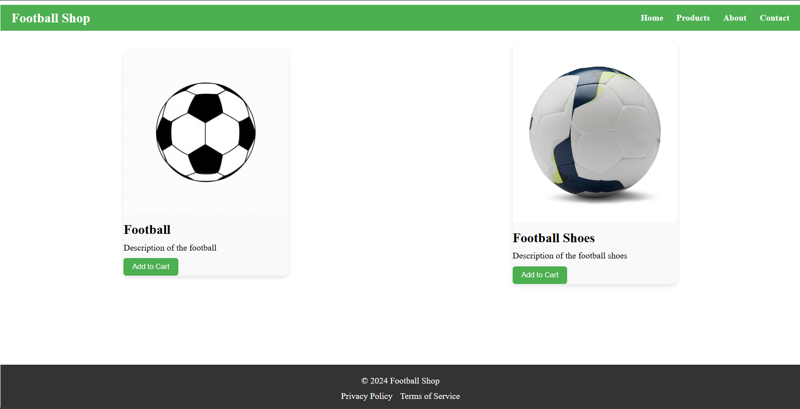
Result and Showcase

Slide 16
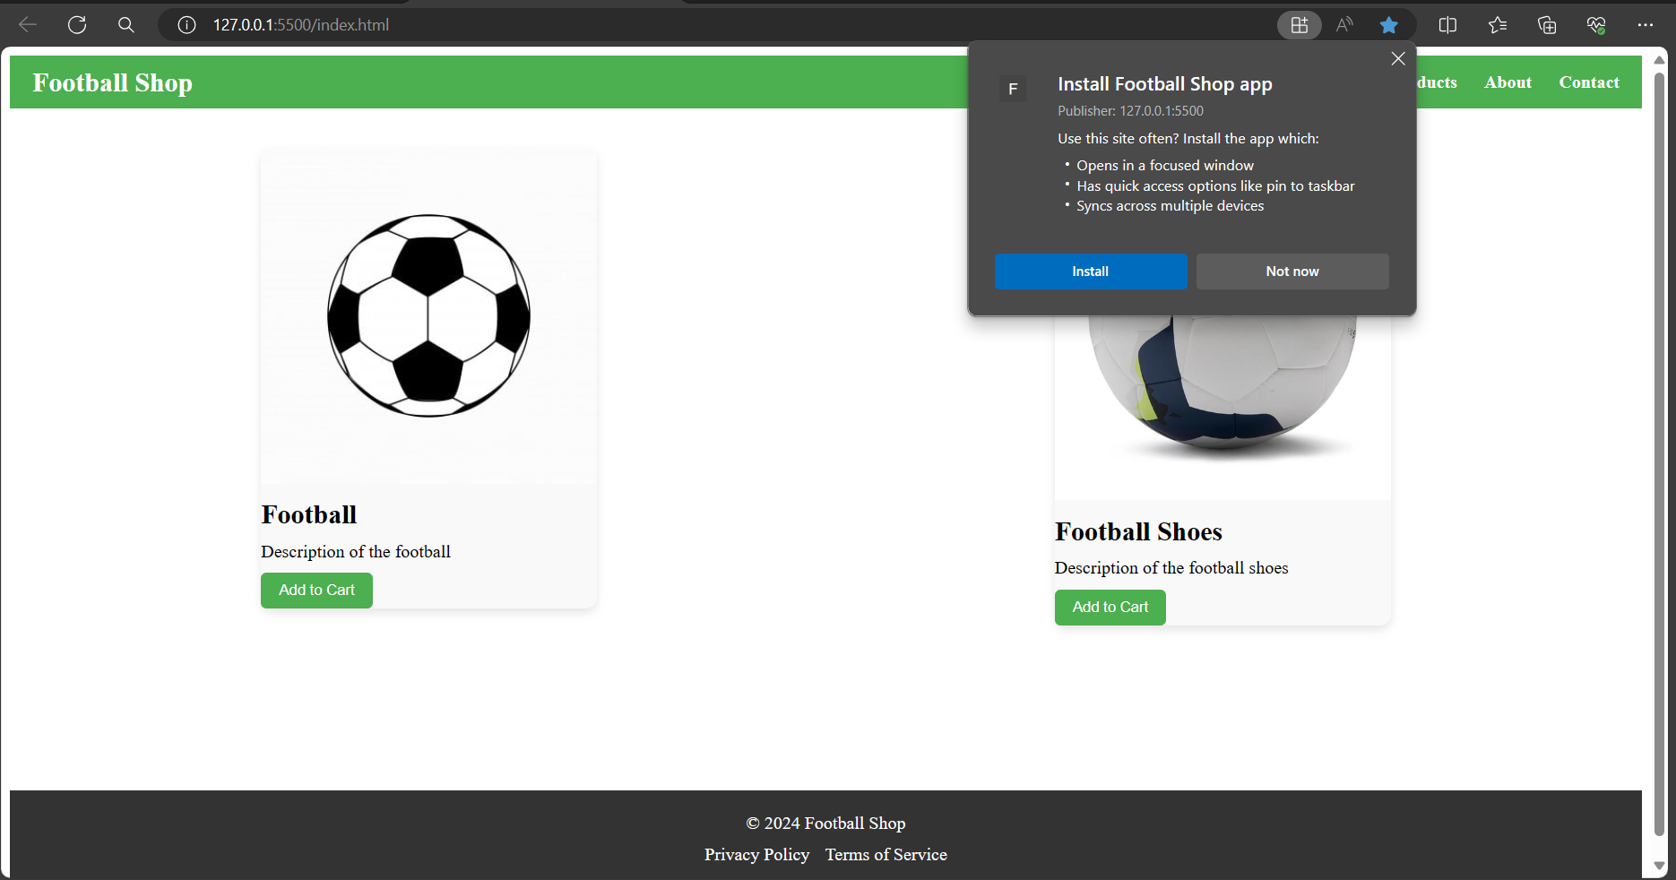
Result and Showcase

Slide 17
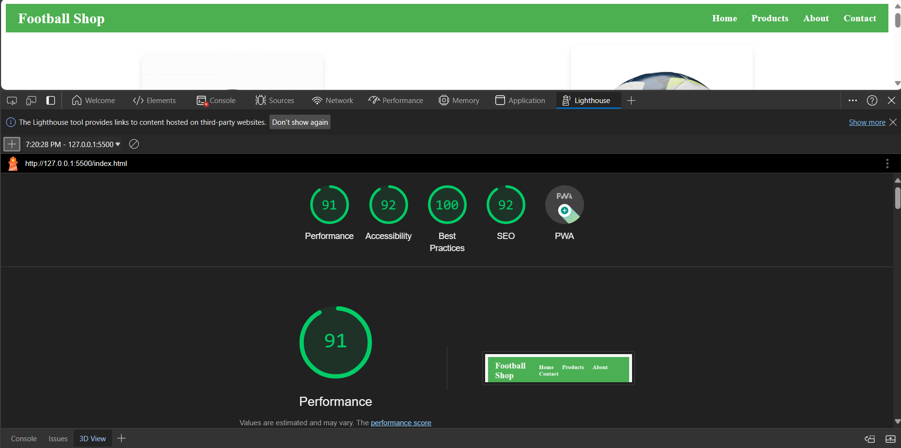
Result Analysis

Slide 18
Future Scope
Continuously improving the app's performance, accessibility, and functionality by leveraging new web technologies, optimizing codebase, and implementing progressive enhancement strategies to ensure compatibility with evolving browser standards and devices.
Expanding the PWA ecommerce app by integrating backend functionalities such as user authentication, product management, order processing, and payment gateways, enabling a complete end-to-end ecommerce solution.

Slide 19
Conclusion
The PWA ecommerce app showcases the potential of Progressive Web Apps in offering a convenient and accessible online shopping experience. With its user-friendly interface and installable feature, the app demonstrates the versatility of web technologies in delivering seamless ecommerce solutions.

