Slide 1
Image Stabiliser for
Color Blind Patients
Sai Pranav.C|Prof V.Naga lakshmi|Prof P.S.Avadhani

Slide 2
Outline
What is Color Vision Deficiency (CDV)?
How to Identify the type of CDV?
Analysis for Deuteranopia
Analysis for Anomalous Trichomacy
Results

Slide 3
Outline
What is Color Vision Deficiency (CDV)?
How to Identify the type of CDV?
Analysis for Deuteranopia
Analysis for Anomalous Trichomacy
Results

Slide 4
Color Vision Deficiency(CVD)
Color Vision:
It is the ability of the eye to discriminate between the different colors excited by light of different wavelengths.
The human eye contains two types of image receptors:
Rods: The rod receptors are sensitive to low light levels but do not differentiate colors.
Cones: These are only sensitive to brighter light levels but enable us to see different colors. Color perception is due to presence of three types of cones: long, medium and short wavelength cones.

Slide 5
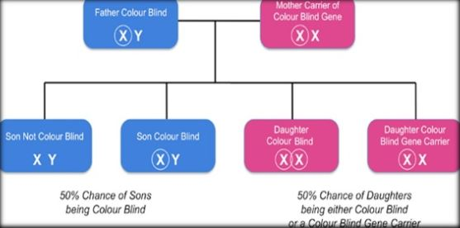
What is CVD and how is it caused?
Color Vision Deficiency (CVD) or simply Color blindness is a genetic disorder that occurs when one or more of the various types of cone cells is deficient or missing.
How can an individual be affected?

Slide 6
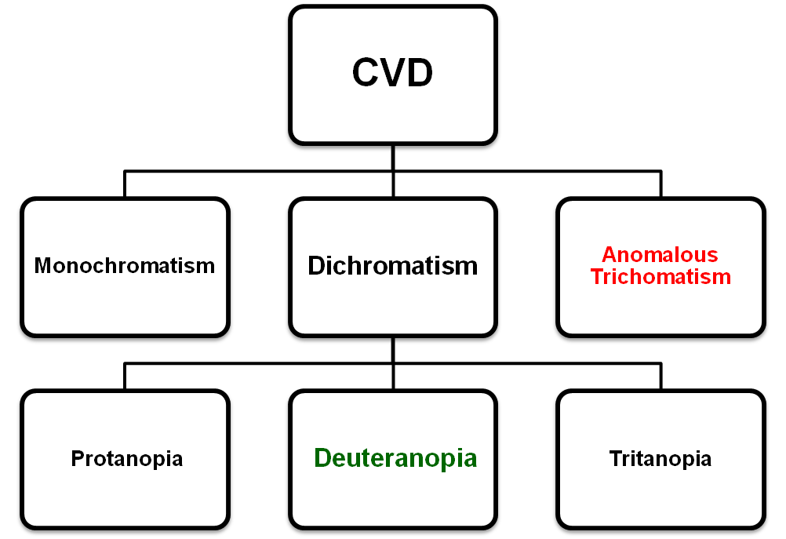
What are the types of CVD?

Slide 7
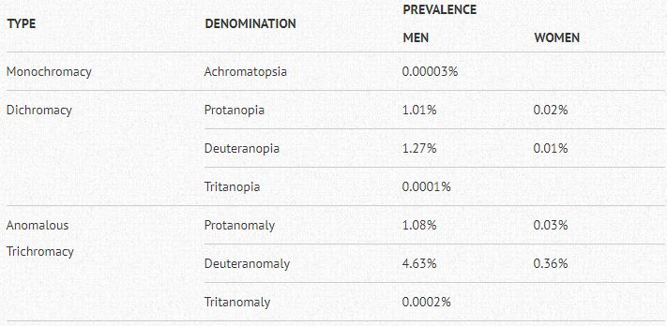
Prevalence Rate:
*According to www.colour-blndness.org

Slide 8
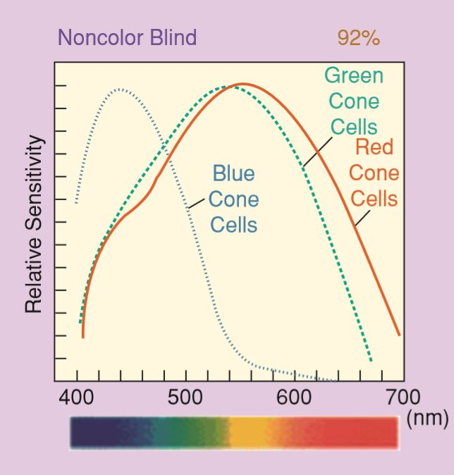
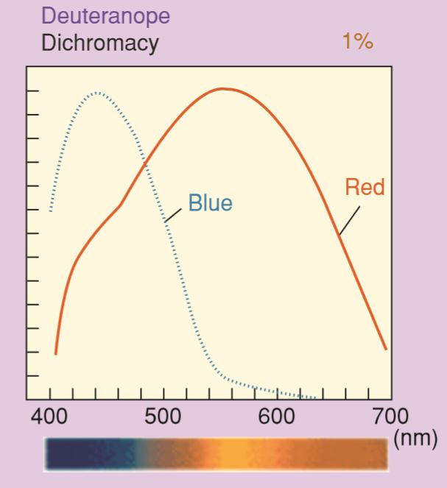
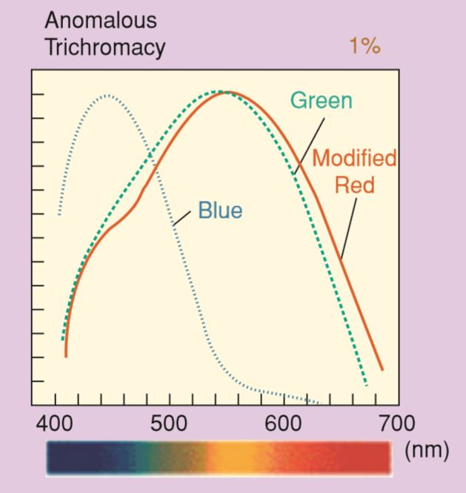

Slide 9
Outline:
What is Color Vision Deficiency (CVD)?
How to Identify the type of CVD?
Analysis for Deuteranopia
Analysis for Anomalous Trichomacy
Results

Slide 10
How to Identify the type of CVD?
Ishihara Test
Color Difference Vectors

Slide 11
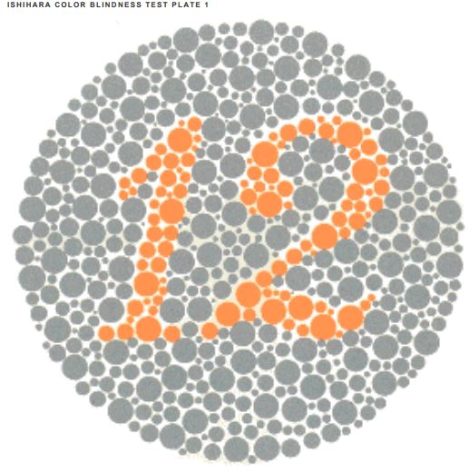
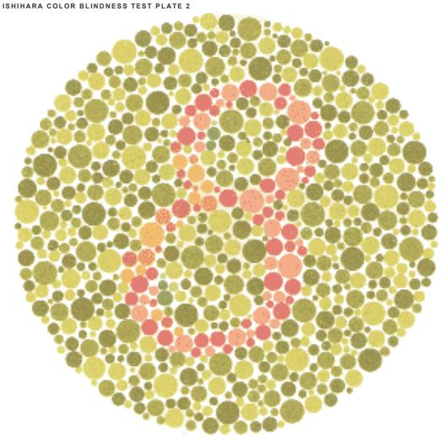
Ishihara Test

Slide 12


Ishihara Test
12
8

Slide 13
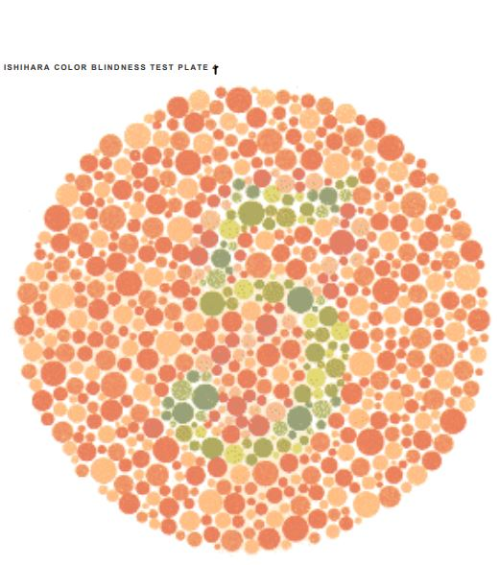
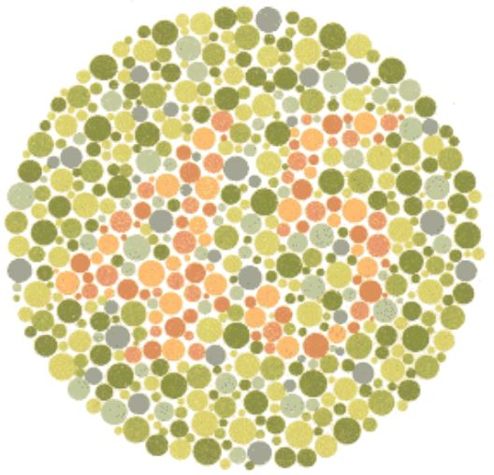



Slide 14
5
45

Slide 15

Color Difference Vectors:
Circle test for Color difference vectors
Non color blind result
Color blind result

Slide 16
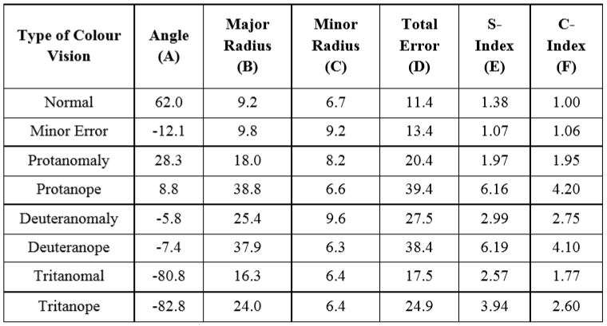
Calibration of Scoring results:
*From 53 normal and 66 color deficient subjects

Slide 17
Outline:
What is Color Vision Deficiency (CDV)?
How to Identify the type of CDV?
Analysis for Deuteranopia
Analysis for Anomalous Trichomacy
Results

Slide 18
Analysis for Deuteranopia :
Simulating Deuteranopia
Delta E
Compensation Algorithms

Slide 19


Simulating Deuteranopia :
In order assess the effectiveness of the algorithms in question, we have integrated a method of simulating an image through the eyes of a person suffering from deuteranopia.
The image is first converted into the LMS color space. Since Matlab’s imread function reads in images in the RGB color space, we must convert from RGB to LMS. Fortunately, this is a simple linear matrix multiplication operation.

Slide 20

Delta E:
Delta E is a popular metric for measuring color difference. We choose this metric in order to help determine the extent to which the algorithm in question changes the original image, i.e. negatively affecting the image as seen by viewers without color blindness.
This function takes in two images in order to evaluate the color difference between them. Both images are first converted from RGB to the LAB color space.
LAB pixel values hold lightness, L, and color coordinates A and B, based on a compressed version of the standard XYZ color coordinate space. The actual Delta E value for each pixel is calculated as follows

Slide 21

Compensation Algorithms
LMS Daltonization:
LMS daltonization uses the information lost in the deuteranopia simulation in order to improve the original image. The lost information from the original simulation is converted from the LMS color space to RGB and then mapped to wavelengths perceptible to the viewer, in this case long and short wavelengths, mostly red and blue.
The lost information, now as RGB pixels, is mapped using the following matrix multiplication.

Slide 22
RGB Color Contrasting and LAB Color Correction:
The RGB Color contrasting algorithm adjusts an image’s RGB values in order to enhance contrast between red and green and, in general, make green pixels appear to be bluer. The process begins by halving every pixel in the original image in order to provide room for pixel values to be increased.
The LAB color correction algorithm endeavors to modify reds and greens of an image to increase color contrast and clarity for a color blind individual. What sets this process apart from RGB Color Contrasting is that it is performed in the LAB color space.
LMS Daltonization affects the image only marginally for both viewers; the adjusted images require close inspection to notice differences. Finally, the color correction algorithm is even more benign, barely affecting the test image whatsoever.

Slide 23
Outline:
What is Color Vision Deficiency (CDV)?
How to Identify the type of CDV?
Analysis for Deuteranopia
Analysis for Anomalous Trichomacy
Results

Slide 24
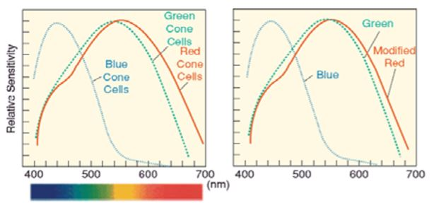
Analysis for Anomalous Trichomacy:
We focus on the red component itself is beneficial in color blind image processing, whereas overall image attributes like contrast and brightness do not play a large role in case of the anomalous trichomats. Figure illustrates the difference in sensitivity of the red cone receptor. The sensitivity of the red cone is clearly weakened. The sensitivity of the red cone is reduced for all brightness along the curve

Slide 25
Designing a Filter by Ishihara test:
As a simple approach, the images were processed to remove the green and blue components leaving only the red component. By filtering out these two color components only the “weak” red component remains. The final improvement on the filter was to negate the image while double the red component and removing the green and blue components.
The image filtered with the preliminarily designed filter adds far too much red to the detailed image.
The concentration of the amount of red had to be reduced. The red component added to the original image is weighted towards the darker red shades.
The values of all the red components were increased by 19.5%, (50 of 256 total levels).

Slide 26
Outline:
What is Color Vision Deficiency (CDV)?
How to Identify the type of CDV?
Analysis for Deuteranopia
Analysis for Anomalous Trichomacy
Results

Slide 27
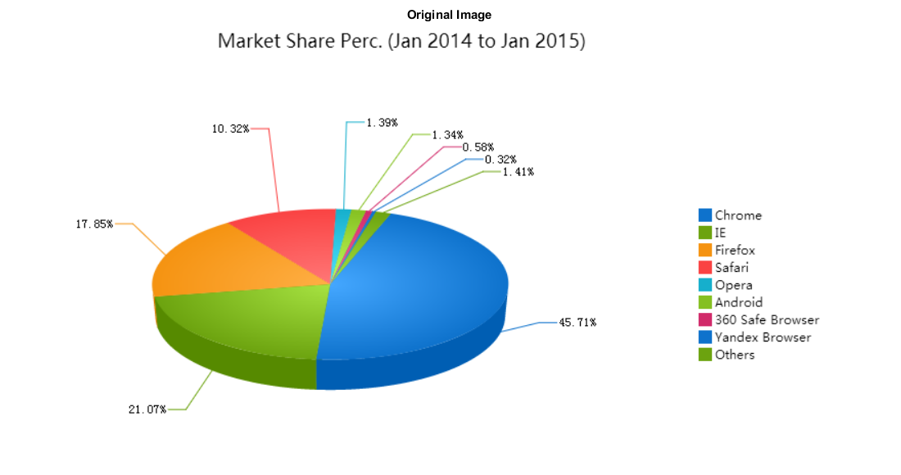
Results:
Deuteranopia Results:

Slide 28
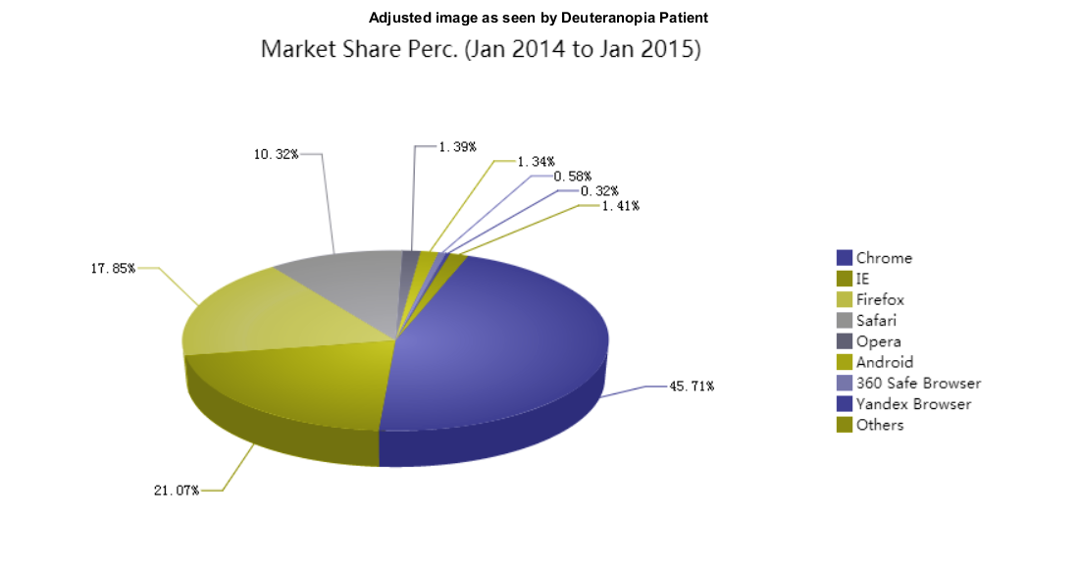

Slide 29
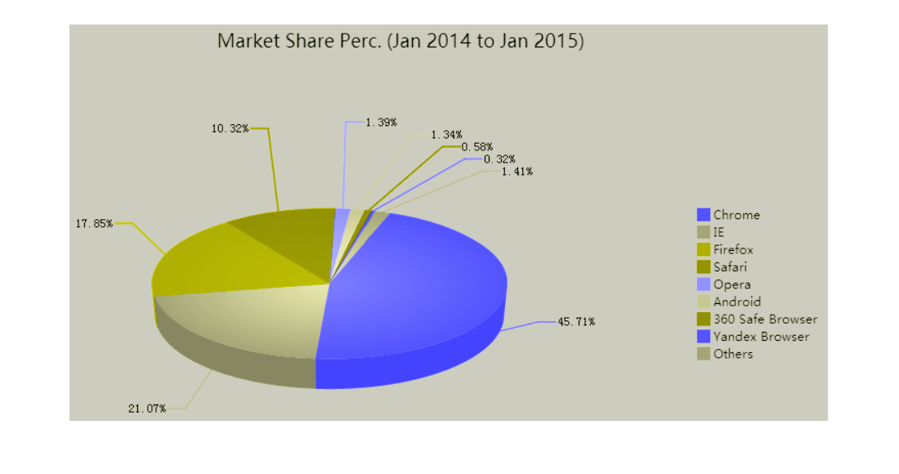
Final Result:

Slide 30
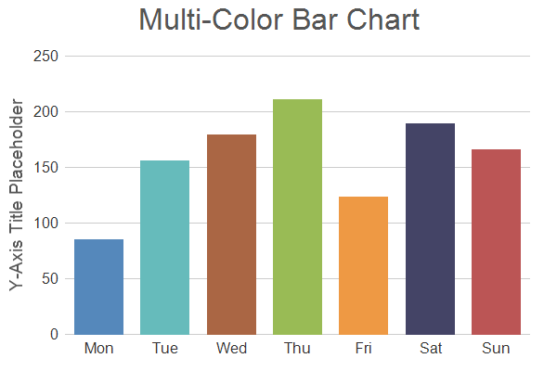
Anomalous trichomacy Results:
Original Image

Slide 31
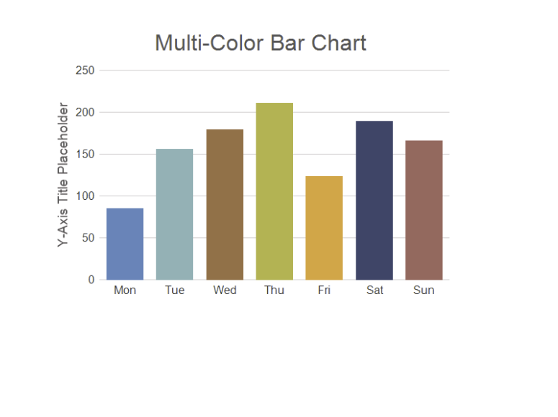
Anomalous Trichomat’s view

Slide 32
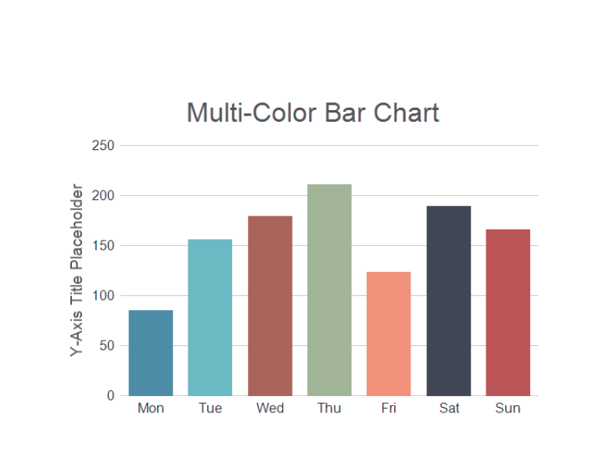
Filtered Image

Slide 33
Thank You!

