Slide 1

Intelligent Framework for Detecting Predatory Publishing Venues
CVR COLLEGE OF ENGINEERING (An UGC Autonomous Institute, Accredited by NAAC with ‘A’ Grade) Department of CSE B. Tech CSE-B III Year II Semester
Industrial Oriented Mini Project
SECTION COORDINATOR:​
Ms. S. Satya Sudha​
Assistant Professor
PROJECT SUPERVISOR:
Dr. S. Srinivasulu
Associate Professor
​
Presented By:-
1. AITHAGONI SPANDANA - 23B81A05B0
2. D. SRICHARANPRANAV - 23B81A05B3

Slide 2
Contents
Abstract
Introduction
Literature Survey
Existing System
Proposed System
Modules
Architectural Design
ER Diagrams
References
Future Courses and Actions

Slide 3
Abstract
Intelligent Framework for Detecting Predatory Publishing Venues is an AI-based system that helps to identify whether a journal or conference is predatory or genuine.
The system studies important details such as journal website content, indexing claims, peer review policies, publication time, fees and editorial board information. This data is stored and managed using a SQLite database. By using Machine Learning and Natural Language Processing (NLP), the system learns patterns from previous data to find suspicious publishing practices.
By using advanced models like BERT, the system predicts whether a publishing venue is safe or risky. This helps researchers avoid fake journals, choose the right platform for publishing, and maintain research quality and integrity.

Slide 4
Introduction
In today’s research environment, the number of predatory journals and conferences has increased a lot. Researchers often find it difficult to identify whether a publishing venue is genuine or fake. Checking journals manually is time-consuming, confusing and not always reliable.
The Intelligent Framework for Detecting Predatory Publishing Venues is an AI-based system that uses Machine Learning and Natural Language Processing (NLP) to analyze journal website content, indexing claims, peer review policies, publication fees and editorial details.
The system learns patterns from past data and automatically classifies a publishing venue as Predatory or Legitimate. It helps researchers make safe publishing decisions, protect their academic reputation and maintain research integrity.

Slide 5
Literature Survey
Author | Title of Paper | Methodology | Key Findings | Gaps in Literature
Beall J | Beall’s Criteria for Identifying Predatory Journals | Rule-based evaluation using predefined journal indicators. | Provides structured guidelines to detect suspicious journals. | Manual process; not automated or scalable.
Shamsheer L. et al | Potential Predatory and Legitimate Biomedical Journals | Comparative analysis of journal characteristics. | Identifies major differences in peer review and indexing claims. | No automated detection model implemented.
Dadkhah M. et al | Machine Learning for Predatory Journal Detection | Supervised machine learning using website text features. | Improves detection accuracy over manual methods. | Limited feature set; lacks advanced NLP models.

Slide 6
Literature Survey
Author | Title of Paper | Methodology | Key Findings | Gaps in Literature
Devlin J. et al | BERT: Pre-training of Deep Bidirectional Transformers for Language Understanding | Transformer-based deep learning model for contextual text classification. | Improves accuracy in text classification and contextual understanding tasks. | General NLP model; not specifically designed for predatory journal detection.

Slide 7
Objectives
Develop an intelligent system to detect predatory publishing venues.
Collect journal and conference website information automatically.
Analyze indexing claims, peer review policies, fees and editorial details.
Apply Machine Learning and NLP techniques for classification.
Predict whether a venue is Predatory or Legitimate.
Provide a simple and user-friendly interface for researchers.
Ensure the system is reliable and scalable.

Slide 8
Existing System
Currently: Journal authenticity is verified manually. Researchers depend on online searches and personal judgment. Indexing claims are checked individually. Editorial board details are verified manually. Process is time-consuming and confusing. High risk of misidentifying predatory venues.
Limitations: No automated detection system. No centralized verification platform. High manual effort required. Possibility of human error. Not scalable for large number of journals.

Slide 9
Proposed Modules
The system provides: Web-based platform for journal verification. Automatic extraction of journal and conference details. AI-based classification of publishing venues. Prediction of Predatory or Legitimate status. User-friendly interface for researchers.
Advantages: Faster journal verification process. Reduced manual effort. Improved detection accuracy. Supports safe publishing decisions. Scalable and reliable framework.

Slide 10
Functional Requirements
● User registration and login ● Journal or conference URL submission ● Automatic website data extraction ● Feature extraction from collected data ● Machine Learning-based classification ● Prediction of Predatory or Legitimate status ● Storage of user search history

Slide 11
Non-Functional Requirements
● Fast response time ● Secure user authentication ● High classification accuracy ● Easy and simple user interface ● Scalable system architecture ● Reliable database management

Slide 12
Software Requirements ● Scikit-learn ● BeautifulSoup ● TF-IDF ● BERT ● Flask ● SQLite
Hardware Requirements
● i5/i7 Processor ● Minimum 8GB RAM

Slide 13
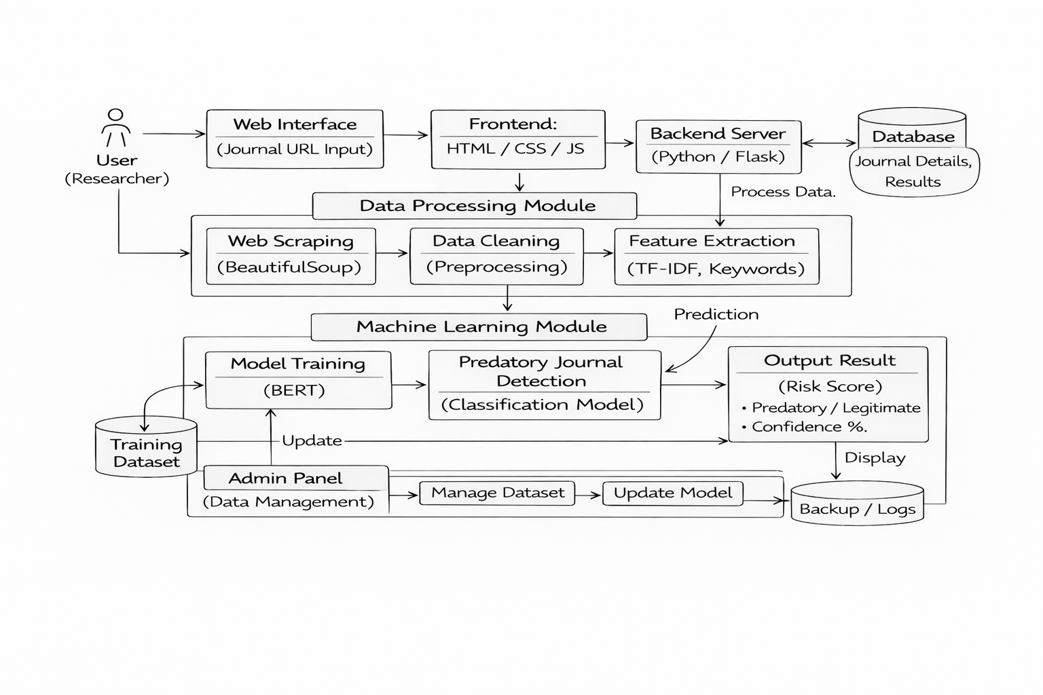

ARCHITECTURAL DESIGN

Slide 14
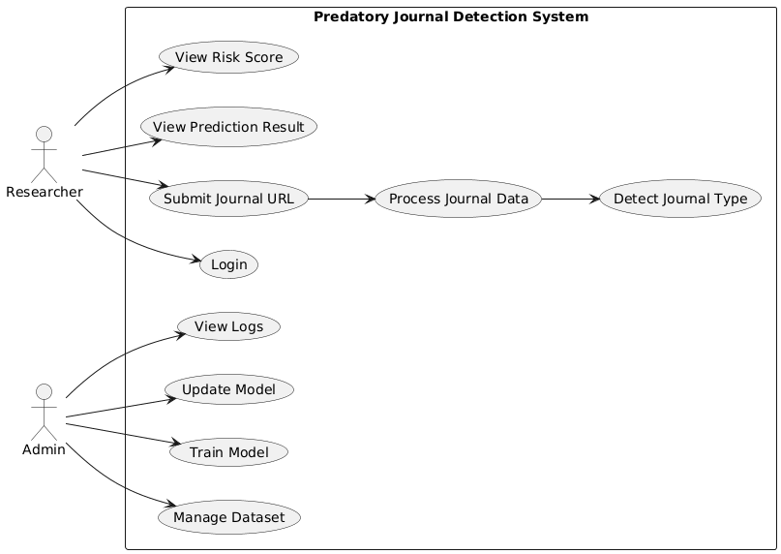
USE CASE DIAGRAM

Slide 15
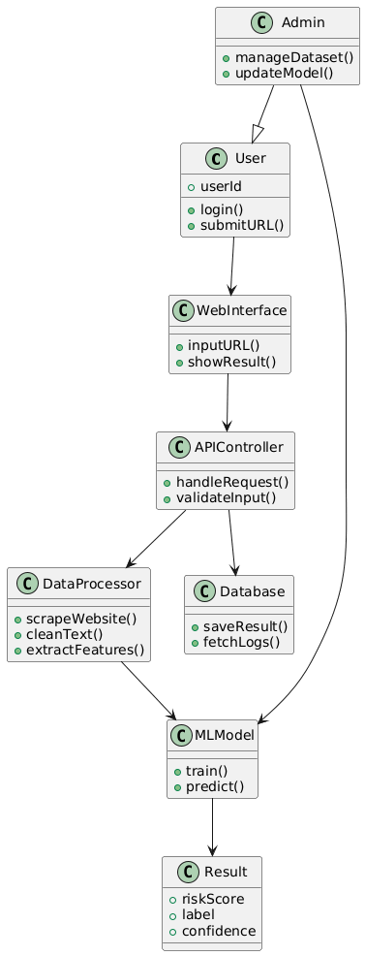
CLASS DIAGRAM

Slide 16
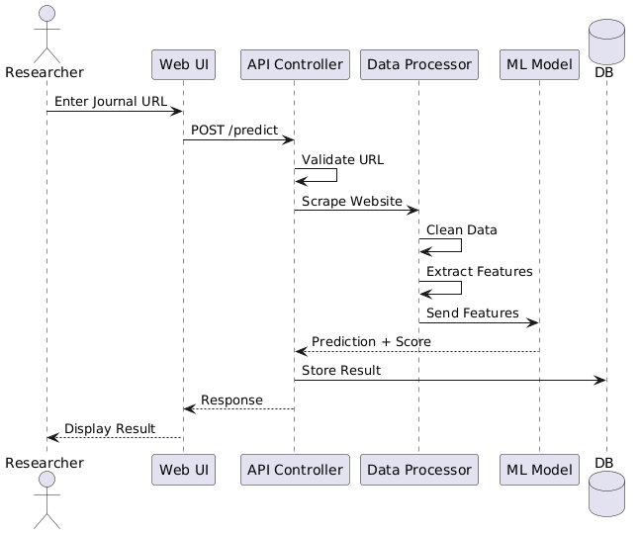
SEQUENCE DIAGRAM

Slide 17
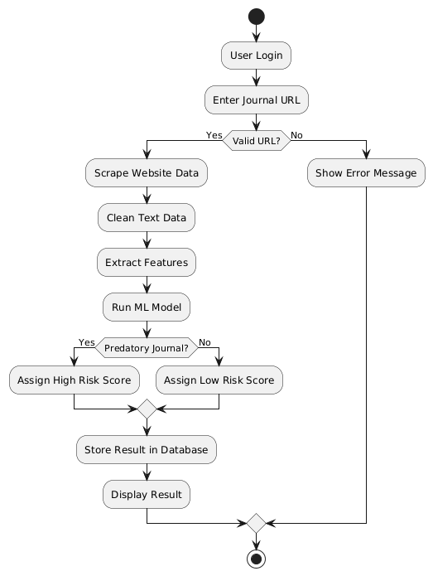
ACTIVITY DIAGRAM

Slide 18
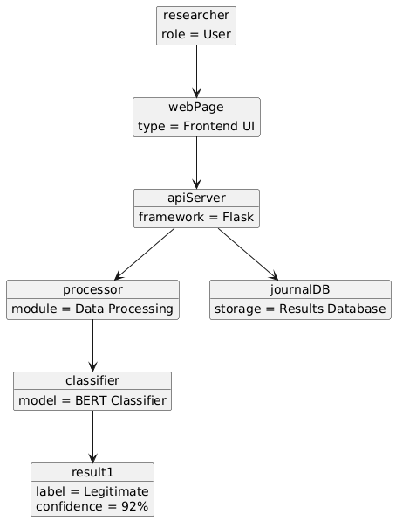
OBJECT DIAGRAM

Slide 19
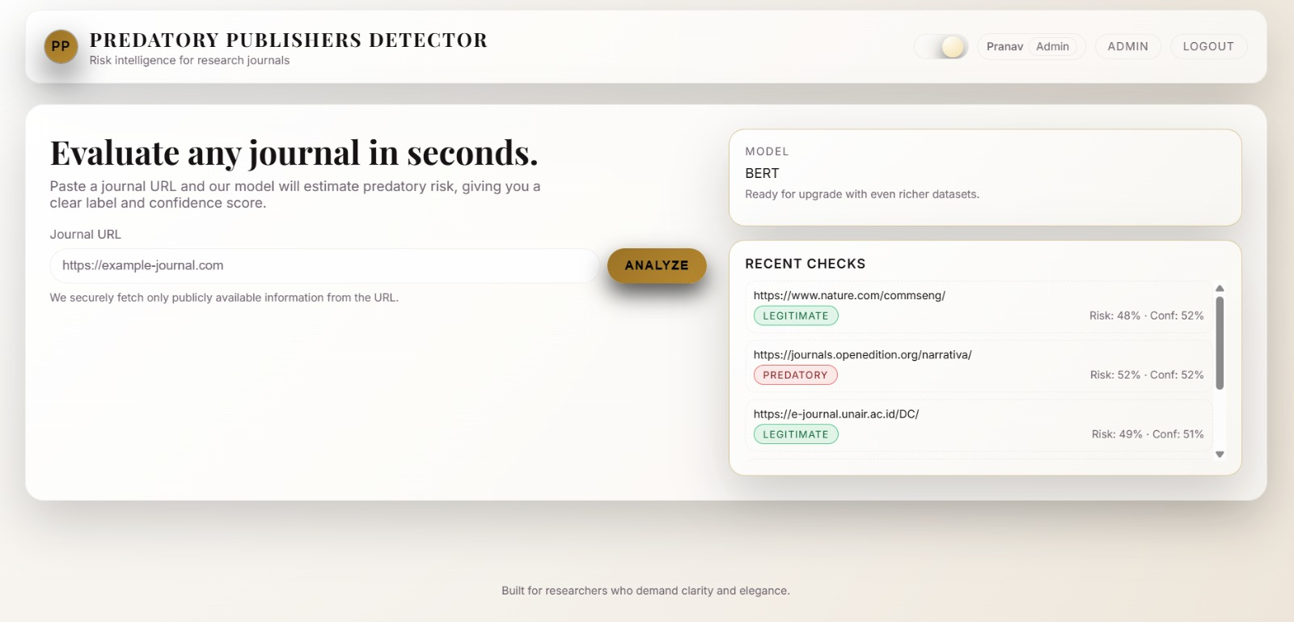
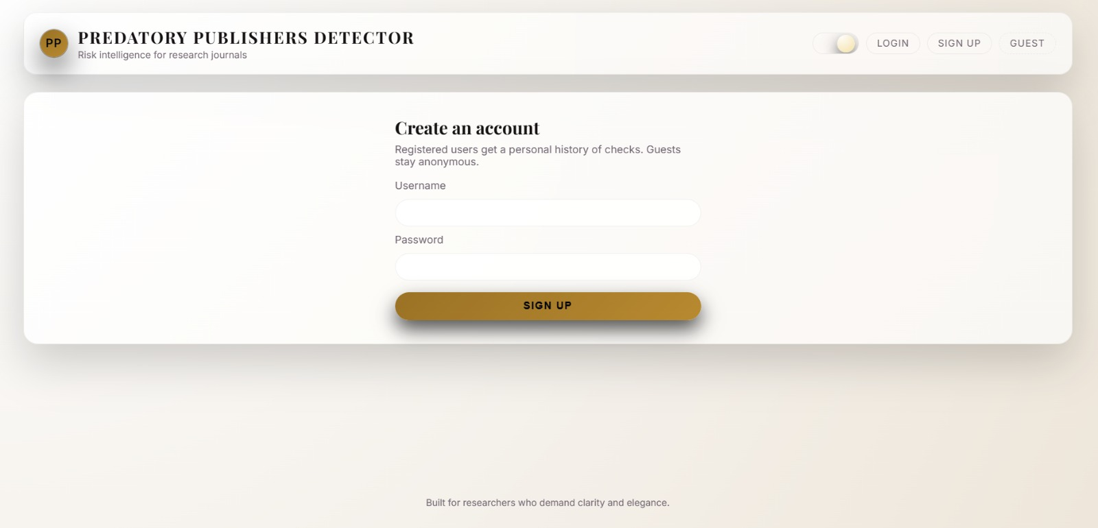
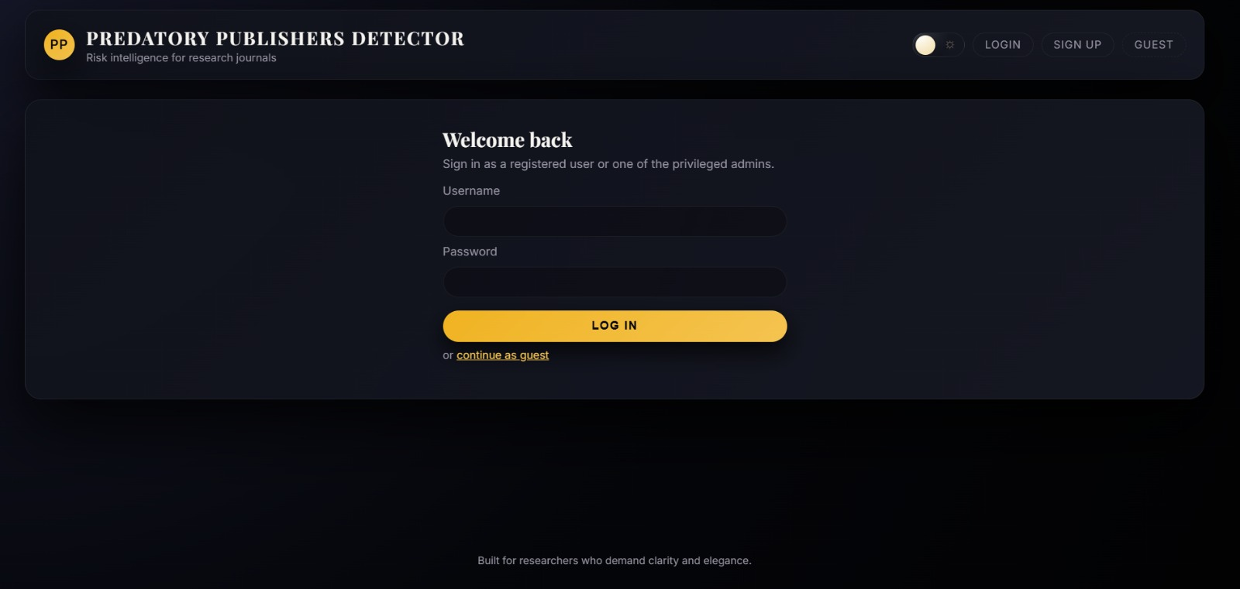
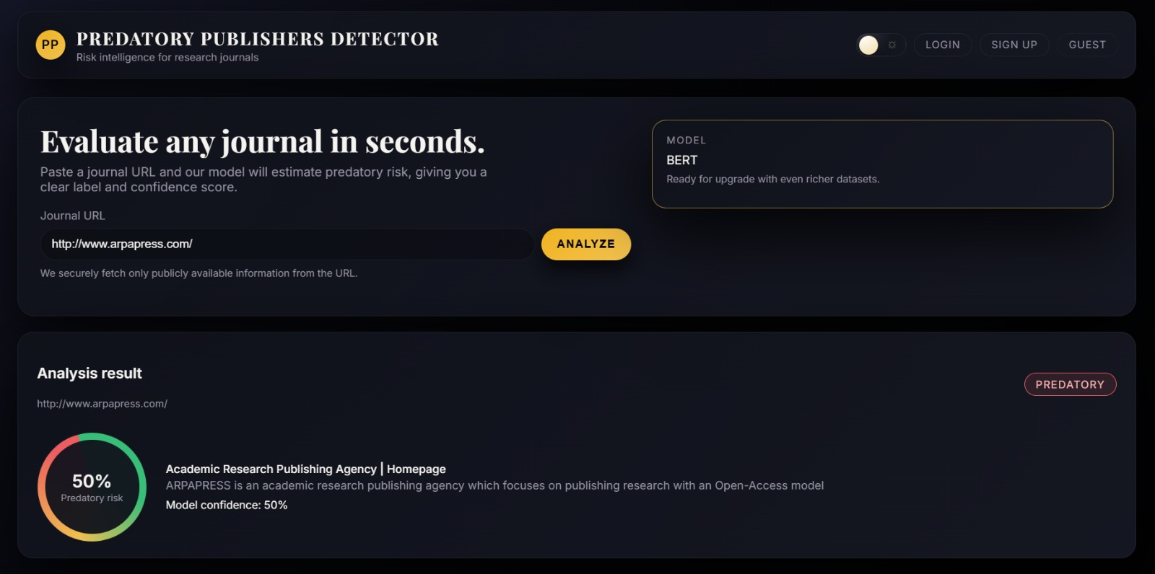
OUTPUT

Slide 20
References
Shamseer L. et al. “Potential Predatory and Legitimate Biomedical Journals: A Comparative Study” – https://bmcmedicine.biomedcentral.com/articles/10.1186/s12916-017-0785-9
Devlin, J. et al. “BERT: Pre-training of Deep Bidirectional Transformers for Language Understanding” – https://aclanthology.org/N19-1423/
Beall, J. (2012). Predatory publishers are corrupting open access. Nature.https://beallslist.net
Dadkhah, M. et al. Machine Learning methods for predatory journal detection https://ieeexplore.ieee.org/document/8269414

Slide 21
Future Course of Actions
● Include detection of fake conference invitations. ● Improve model accuracy using advanced deep learning techniques. ● Add browser extension for quick journal verification. ● Support multi-language website analysis. ● Develop a public API for institutional use. ● Deploy the system on cloud platform. ● Build a centralized global predatory journal database.

Slide 22
THANK YOU

