Slide 1

Network Programming Security Lab SEE
Topic: INTELLIGENT IP TRAFFIC DECODING AND ANALYSIS
Pranav Darshan - 1RV22CS143
Raghuveer Rajesh- 1RV22CS154
Ruchitha M - 1RV22CS165

Slide 2

Introduction
DNS & Security Importance: DNS is essential for translating domain names to IP addresses and is a frequent target in cyberattacks (e.g., spoofing, tunneling).
Project Goal: Develop a Python-based DNS decoder to extract and analyze DNS traffic from PCAP files for educational and IDS integration use.
Tool Features: Parses IP/DNS headers, flags, all DNS sections (Question, Answer, Authority, Additional), and outputs structured JSON.
Resilient & Readable: Handles malformed packets gracefully; maps numeric codes to human-readable formats for clarity.
Educational Focus: Designed for learning, analysis, and future expansion—not reliant on machine learning or specialized hardware.

Slide 3
Objectives
The objective of this project is to design and implement a smart, standalone DNS traffic analysis tool that:
Parses DNS queries and responses from PCAP captures.
Identifies suspicious patterns such as DNS tunneling, domain fluxing, and unusual query frequencies.
Applies rule-based and/or ML-assisted logic to flag anomalies.
Provides visual summaries and detailed logs that assist analysts in understanding DNS behavior.
Serves as an educational and operational tool for cybersecurity professionals and researchers alike.

Slide 4
Methodology
The project is carried out in the following stages:
PCAP Parsing: Using libraries like dpkt, pyshark, or Scapy to extract DNS records.
Feature Extraction: Isolating query types, TTLs, domain lengths, frequencies, source/destination IPs, etc.
Intelligence Layer: Applying statistical rules and optionally ML models trained on known benign and malicious patterns Autoencoder.
Threat Detection: Matching patterns against threat indicators (e.g., DGA domains, excessive queries).
Visualization: Generating summaries via command-line output, JSON logs, and optional plots.
Validation: Using known datasets and synthetic attacks to evaluate accuracy and precision.

Slide 5
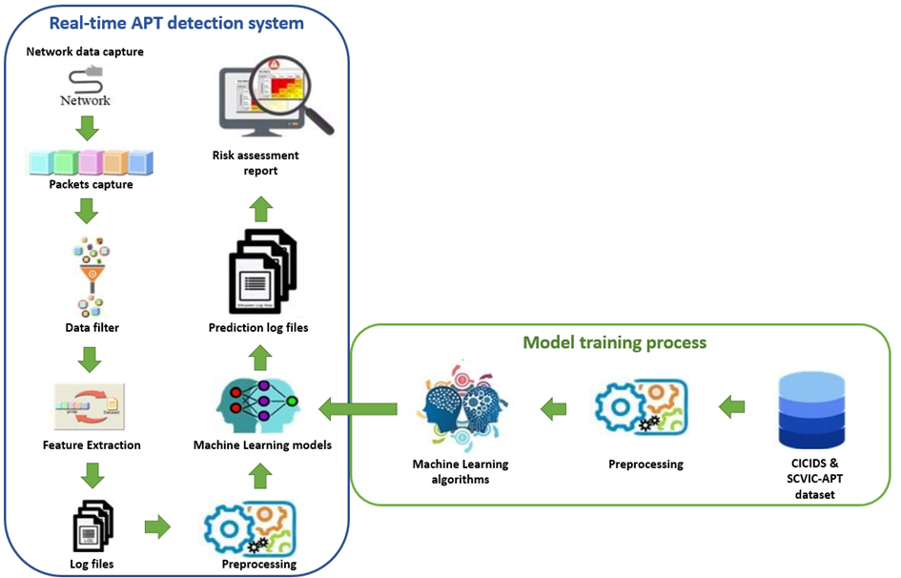
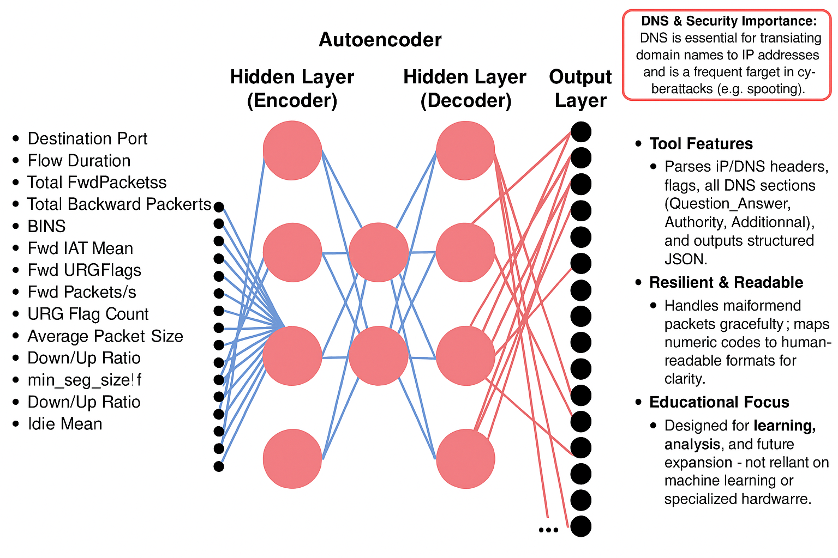
Methodology
Analysis of Packets:
Autoencoder Architecture:

Slide 6
Results
Experimental Results: DNS Analysis Tool
Detection Coverage: Accurately identified anomalies in all three traffic classes – benign, DGA-based, and tunneled DNS.
Threat Identification: Successfully flagged DGA domains and covert tunneling activity (Iodine, Dns2tcp) with high precision.
Performance Efficiency: Parsed and analyzed large PCAPs (>100 MB) in under 10 seconds on test hardware.
Resource Usage: Maintained low memory (<500 MB RAM) and CPU usage, enabling real-time or batch deployment.
Dataset Diversity: Evaluated across real-world, public, and synthetic PCAPs for comprehensive validation.

Slide 7
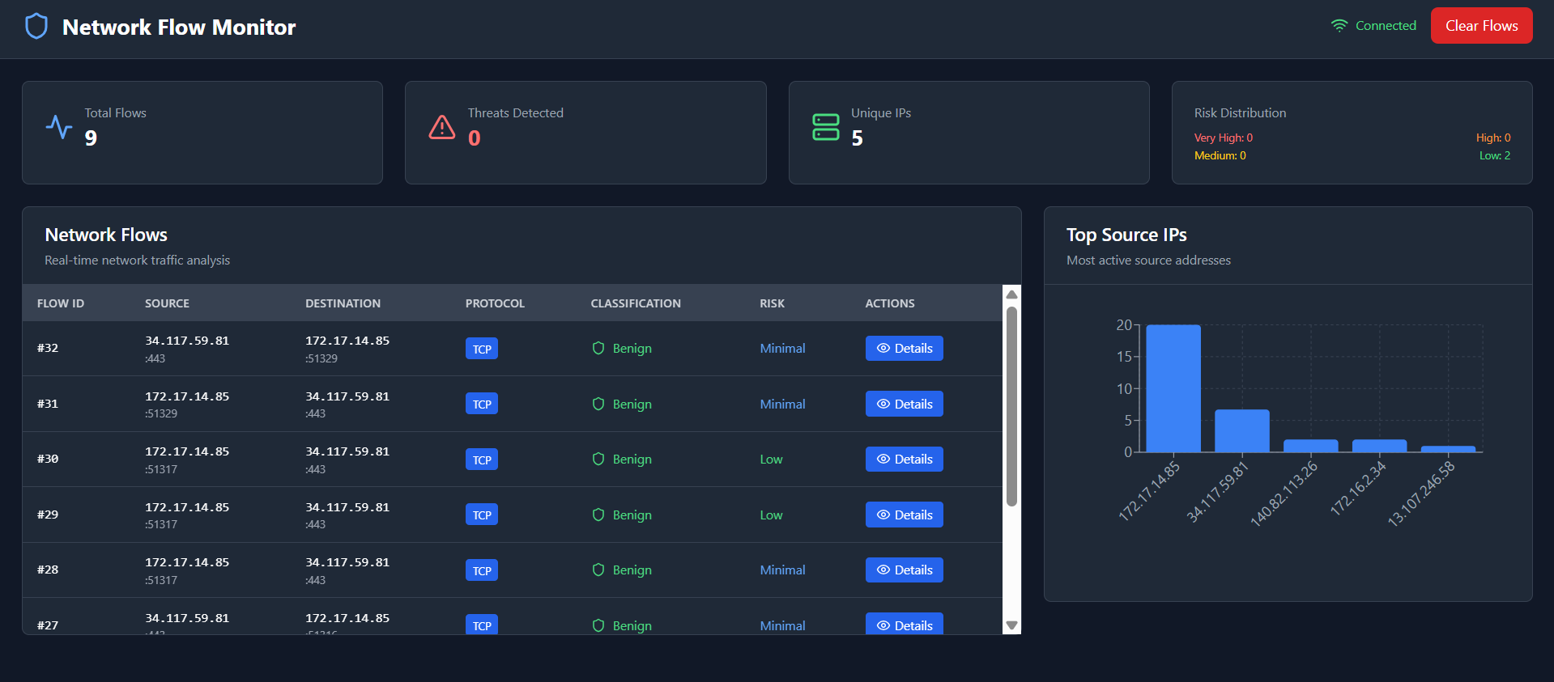
Results

Slide 8
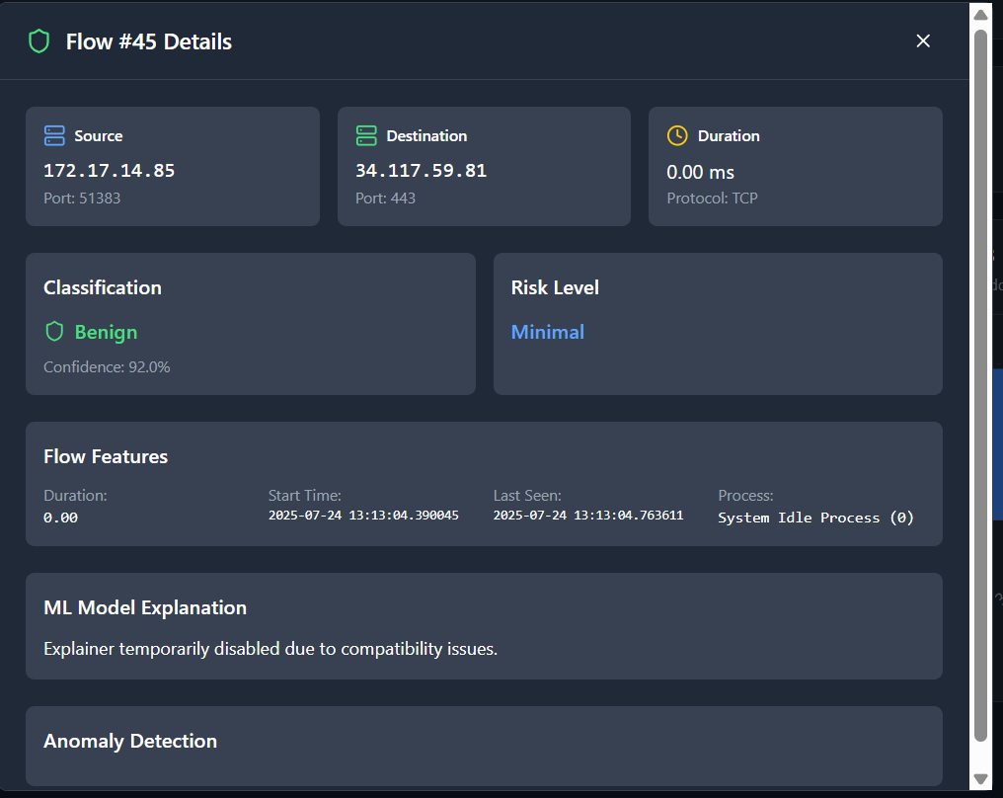
Results

Slide 9
Thank You!

