Slide 1

E-Banking Automation Using Selenium and Java
By-Pranav Duggal
Roll No-1702765
Section-CSE (Y2)

Slide 2
What is Selenium?
Selenium is one of the most widely used open-source Web UI (User Interface) automation testing suite. It was originally developed by Jason Huggins in 2004 as an internal tool at Thought Works. Selenium supports automation across different browsers, platforms and programming languages.
Selenium can be easily deployed on platforms such as Windows, Linux, Solaris and Macintosh. Moreover, it supports OS (Operating System) for mobile applications like iOS, windows mobile and android.
Selenium supports a variety of programming languages through the use of drivers specific to each language. Languages supported by Selenium include C#, Java, Perl, PHP, Python and Ruby. Currently, Selenium Web driver is most popular with Java and C#. Selenium test scripts can be coded in any of the supported programming languages and can be run directly in most modern web browsers. Browsers supported by Selenium include Internet Explorer, Mozilla Firefox, Google Chrome and Safari.

Slide 3
Applications and Uses of Selenium
Selenium WebDriver is used to automate web application testing to verify that it works as expected. It supports many browsers such as Firefox, Chrome, IE, and Safari. However, using the Selenium WebDriver, we can automate testing for web applications only.
Open Source and Portable – Selenium is an open source and portable Web testing Framework.
Combination of tool and DSL – Selenium is combination of tools and DSL (Domain Specific Language) in order to carry out various types of tests.
Easier to understand and implement – Selenium commands are categorized in terms of different classes which make it easier to understand and implement.
Less burden and stress for testers – As mentioned above, the amount of time required to do testing repeated test scenarios on each and every new build is reduced to zero, almost. Hence, the burden of tester gets reduced.
Cost reduction for the Business Clients – The Business needs to pay the testers their salary, which is saved using automation testing tool. The automation not only saves time but gets cost benefits too, to the business.
Increased test coverage – With the uses of Selenium, testing time gets reduced and hence the tester can do more testing on other test scenarios at the same time.
Reduce test execution time – Selenium supports parallel test execution that reduce the time taken in executing parallel tests.
Lesser resources required – Selenium requires lesser resources when compared to its competitors like UFT, RFT, etc.
Supports Multiple Programming Languages – C#, Java, Python, PHP, Ruby, Perl, and JavaScript
Supports Multiple Operating Systems – Android, iOS, Windows, Linux, Mac, Solaris.
Supports Multiple Browsers – Google Chrome, Mozilla Firefox, Internet Explorer, Edge, Opera, Safari, etc.
Parallel Test Execution – It also supports parallel test execution which reduces time and increases the efficiency of tests.
A flexible language – Once the test cases are prepared, they can be executed on any operating system like Linux, Macintosh, etc.
No installation Required – Selenium web driver does not require server installation, test scripts interact directly with the browser.

Slide 4
Tools Used In This Project
Eclipse IDE
Maven
Selenium
Java SE 1.8

Slide 5
Project Phases

Slide 6
Phase 1-Implementaition
Create Maven Project
Update pom.xml
Create Page Objects
Create Basic Test case
Add logs to test case
Read common values from properties file
Run test case on desired browser
Add extent report
Create Data Driven test case
Adding new test case

Slide 7
Phase-2: Execution
Running test cases with Maven pom.xml
Running test cases through Maven CLI(Command Line Interface)

Slide 8
Phase-3: Maintenance
Creating repository in GitHub.
Commit the project code in local repository
Push the project code to GitHub remote repository from local GIT repository.

Slide 9
Appendix

Slide 10
Automation Framework(Hybrid)
Page Objectives
Test Cases
LoginPage.java
AddCustomerPage.java
EditCustomerPage.java
Testng.xml
LoginTest.java
AddCustomerTest.java
EditCustomerTest.java
Base Class
Utilities
Pom.xml
ReadConfig.java
Reporting.java
XLUtils.java
Config Files
Pom.xml
Extent-config.xml
Log4j.properties
Config.properties
Report

Slide 11
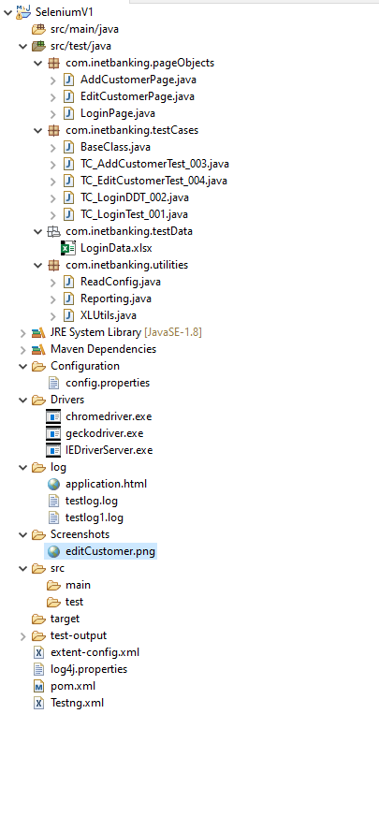
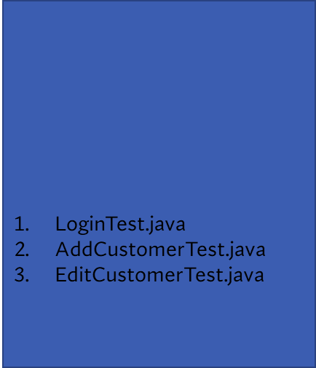
Framework Structure
Page Objectives
LoginPage.java
AddCustomerPage.java
EditCustomerPage.java
Page Object
Testng.xml
Test Cases
Test Cases
Test Data
Base Class
Utilities
ReaConfig.java
Reporting.java
XLUtils.java
Utilities
Pom.xml
Logs
Config Files
Pom.xml
Extent-config.xml
Log4j.properties
config.properties
Screenshots
Reports
Report
Config Files

