Slide 1


SMART INDIA HACKATHON 2025
TITLE PAGE
Problem Statement ID –SIH25031
Problem Statement Title- Crowd sourced Civic Issue Reporting and Resolution System
Theme-Clean & Green Technology
PS Category- Software
Team ID-
Team Name -

Slide 2
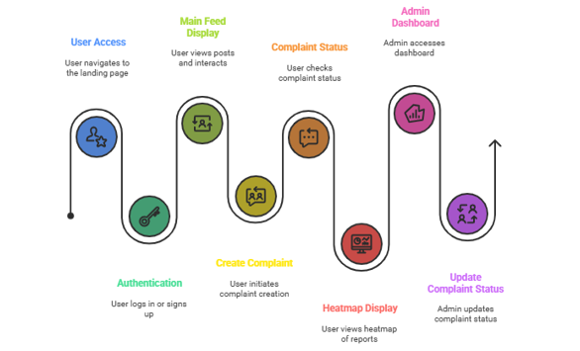
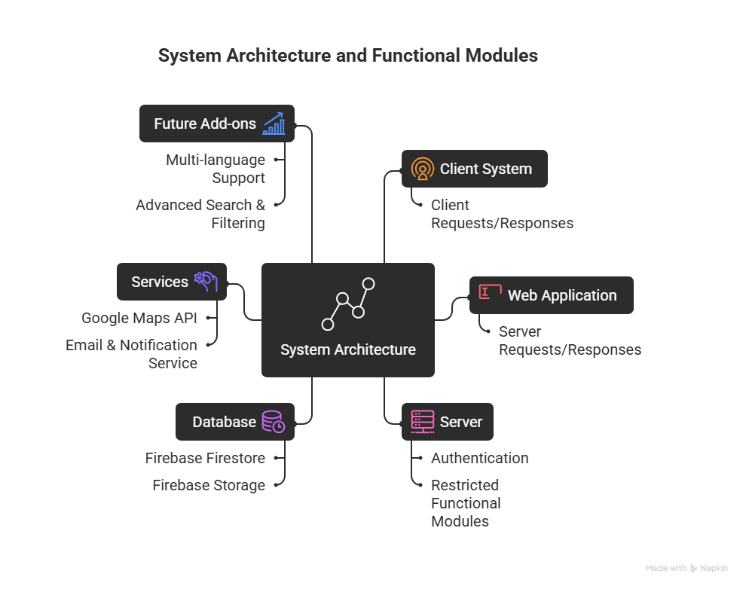
IDEA TITLE
Your Team Name
Proposed Solution
📱 Citizens report civic issues (potholes, garbage, broken lights, illegal parking, etc.) via photos, videos, or blogs.
🌍 Reports are geo-tagged and displayed on a heatmap for better visualization.
🗳 Upvote/Downvote mechanism to crowd-prioritize the most urgent issues.
🔔 Real-time notifications to users on complaint progress.
📊 Complaint tracking system with status updates: Unviewed → In Progress → Resolved.
🔐 Secure authentication via Gmail/Email (Firebase + Google Sign-in).
🖥 Admin dashboard for authorities to view, categorize, and update complaint status.
📸 Proof-based resolution – authorities upload photos/videos before closing an issue.
📈 Analytics and insights for authorities to track density, frequency, and response times.
🌐 Future scope – multilingual support, AI categorization, IoT integration with smart city infrastructure.
How it Addresses the Problem
Builds a Transparent communication bridge between citizens and authorities.
Provides visual data to help officials allocate resources.
Empowers citizens with visibility of progress, reducing frustration and distrust.
Encourages community participation and collective responsibility for civic issues.
Innovation and Uniqueness of the Solution
🚀 Social-media style engagement for civic problem-solving.
🙌 Crowdsourced validation (upvotes/downvotes) – ensures priority is given to genuine & widely impactful issues.
📷 Proof-backed resolution system → no complaint can be marked resolved without evidence.
🎯 Gamified transparency loop → motivates citizens to actively report and track issues.
🌍 Scalable for smart cities with future add-ons like AI issue detection, multilingual chatbot, and IoT-enabled monitoring.

Slide 3
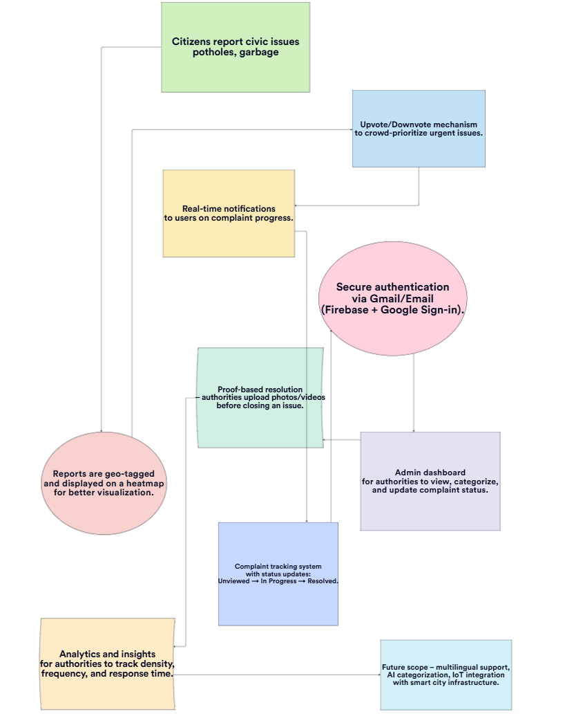







TECHNICAL APPROACH
Your Team Name
Technology Stack
Frontend: Flutter (cross-platform mobile & web support)
Backend: Firebase, Supabase
Database: PostgreSQL
Features:Heatmap for data visualization
Current status checking (real-time updates)
Deployment & Tools:Firebase Hosting / Supabase Edge Functions
GitHub, Docker (optional), GCP/AWS for scaling

Slide 4
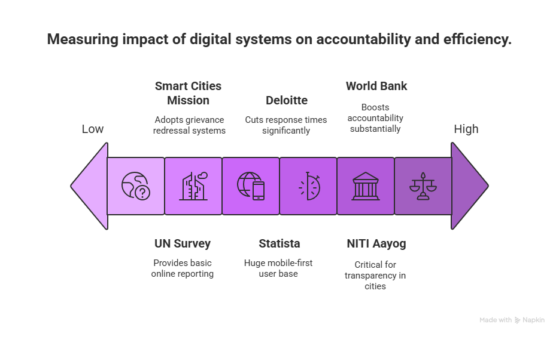
FEASIBILITY AND VIABILITY
Your Team Name
Strategies to Overcome Challenges
🔒 Privacy & Security: End-to-end encryption, compliance with data protection laws.
🎮 User Engagement: Gamification (points, badges), recognition for active contributors.
🤝 Authority Integration: API integration with municipal systems, training admin users.
🧹 Content Moderation: AI-based spam filters, Gmail/social logins for verification.
🔄 Scalability: Modular architecture, continuous updates via agile development.
Feasibility
🖥️ Technical: Uses Flutter, Firebase, Google Maps API, cloud infra for scalability.
🧩 Modularisation: Core features first (reporting, status tracking, admin dashboard), advanced features later (AI-based categorization, multilingual support).
📈 Market: Rising demand for civic engagement & accountability platforms; governments moving towards Smart City solutions.
💰 Economic: Low-cost cloud setup, scalable infra, potential NGO & CSR partnerships.
Viability
💵 Revenue/Support Models: Government tie-ups, CSR sponsorships, NGO collaborations, analytics tools for civic bodies.
👥 Large User Base: Citizens, students, residents, and activists across urban & semi-urban India.
🌍 Scalable: Start city-level, expand to multiple municipalities/states.
🔒 Long-Term Value: Builds transparency, encourages civic participation, strengthens citizen–authority trust.
Challenges
🔐 Data Privacy & Security: Handling sensitive citizen & location data safely.
🙋 User Adoption: Keeping users engaged after initial excitement.
🏛️ Authority Integration: Getting municipal bodies & police to actively respond.
🚫 Content Moderation: Avoiding spam, fake complaints, and misuse.
⚡ Tech Evolution: Keeping up with fast-changing APIs & cloud infra

Slide 5
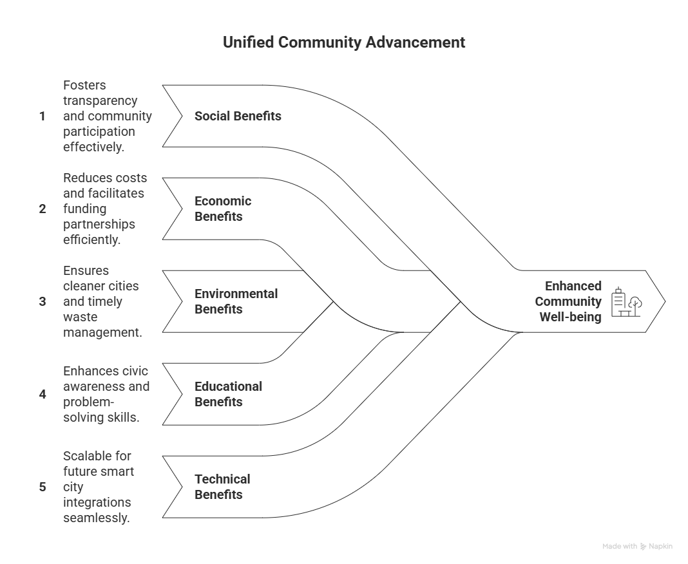
IMPACT AND BENEFITS
Your Team Name
Benefits of the Solution
Potential Impact on Target Audience
👥 Citizens: Easy platform to report civic issues → empowers ordinary people to take part in governance.
🏛️ Authorities: Streamlined grievance handling → faster redressal and better accountability.
🌍 Communities: Improved civic environment → cleaner, safer, more livable neighbourhoods.
📱 Youth & Students: Encourages digital participation in civic life.
🏘️ Social Benefits
Builds transparency and trust between citizens and authorities.
Strengthens community participation in governance and civic problem-solving.
Reduces frustration by offering a clear and accessible complaint system
💰Economic Benefits
Lowers administrative costs by digitizing complaint handling.
Saves citizens’ time and money (less need for in-person visits to municipal offices).
Potential for CSR & NGO partnerships to fund civic initiatives
🌱 Environmental Benefits
Faster reporting & resolution of issues like garbage dumping, sewage leaks, illegal constructions.
Promotes cleaner and greener urban spaces.
Reduces pollution & hazards through timely civic interventions.
🎓 Educational Benefits
Promotes civic awareness among youth.
Encourages responsible citizenship.
Builds problem-solving and accountability skills.
Inspires students to engage in digital civic participation.
🖥️ Technical Benefits
Scalable cloud infrastructure for growth.
Real-time complaint tracking with dashboards & heatmaps.
Secure authentication & data handling with Firebase

Slide 6
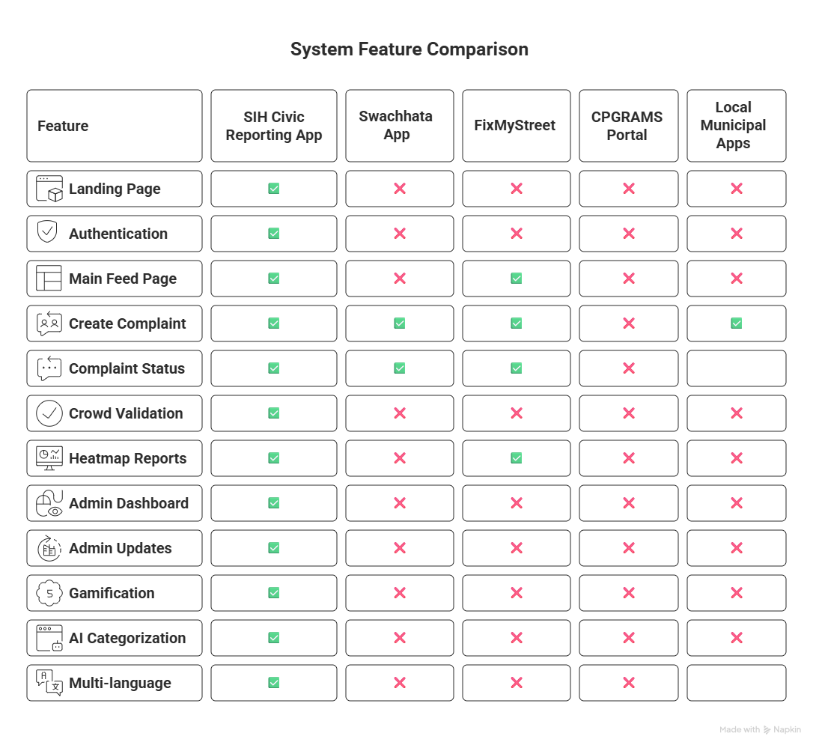
RESEARCH AND REFERENCES
Your Team Name
References
References

