Slide 1
Play Store Applications Performance Analysis
EXPLORATORY DATA ANALYSIS COURSE PROJECT
TEAM NO: 10
Guided by:
Dr. Karibasappa K G
Prof. Sunil V G

Slide 2
TEAM DETAILS
NAME | USN | Roll No.
Pranavi Kulkarni | 01FE20BCS118 | 253
Mayuri Kalmat | 01FE20BCS095 | 230
Parag Hegde | 01FE20BCS096 | 231
Pranav Jadhav | 01FE20BCS099 | 234

Slide 3

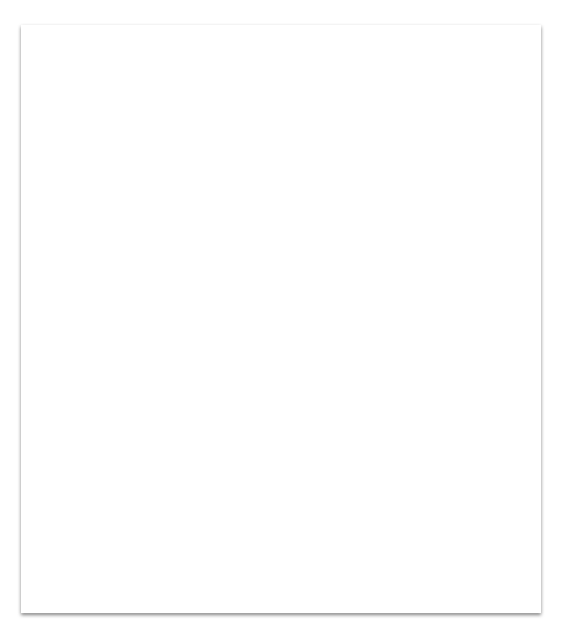
Problem Statement:
“Analyze the user interests and trends of Google Play Store applications”.

Slide 4
Domain Understanding
Google Play Store is home to millions of mobile applications used worldwide. Everyday, millions of users download various applications that belong to wide range of genres from Education to Finance, from beauty to communication, from shopping to sales. Every possible categories are covered by the apps.

Slide 5
Domain Understanding
As there are several applications hosted on the play store for a single genre, it becomes essential to figure out which application among all performs well. Based on the data available such as number of downloads, ratings, reviews and so on, we can analyze the users’ interests. This analysis helps the users to download the better applications and also the application developers to improvise and modify according to the user interests.

Slide 6
Data Set Description
Source: Google Play Store, kaggle.com
Type Of Attributes:
Total Number Of Attributes: 19
Number Of Records: 10841
Categorical | Category,Type, Genres, ContentRating | 4
Ordinal | Rating, LastUpdated, TimeStamp, date, month, year, CurrentVersion, AndroidVersion | 8
Numerical | NoOfReviews,Size,NoOfInstalls,Price, UpdateFrequency | 5
Binary | Advertisement, BetaVersion | 2

Slide 7
Data Set Description
Type Of Attribute: Categorical
Attributes | Description
Category | Denotes the category to which the app belongs.
Type | Denotes if the application is free to use or the paid one.
Genres | Denotes the genre to which the application belongs.
Content Rating | Denotes the group of users suitable to use the respective application.

Slide 8
Data Set Description
Type Of Attribute: Ordinal
Attributes | Description
Rating | Denotes the category to which the app belongs.
LastUpdated | Denotes the date on which the application was updated recently.
Timestamp | Denotes the time at which the data was recorded for analysis.
Date, Month, Year | The date on which the data was recorded for analysis.
CurrentVersion | Denotes the current version of application.
Android Version | Denotes the minimum version supported by the application.

Slide 9
Data Set Description
Type Of Attribute: Numerical
Attributes | Description
NoOfReviews | Denotes the count of reviews by the users to the application.
Size | Denotes the download size of the application.
NoOfInstalls | Denotes the number of downloads of the application throughout the globe.
UpdateFrequency | Denotes the average time gap between two successive updates to the application.

Slide 10
Data Set Description
Type Of Attribute: Binary
Attributes | Description
Advertisement | Denotes if the application contains advertisements.
Beta Version | Denotes if the beta version is available for the application.

Slide 11
Objectives:
Contents
1.Data Preprocessing
2.Exploratory Data Analysis
3.Predictions

Slide 12
Objectives Of Data Preprocessing :
I. Data Cleaning and conversion
Handling null values present in different columns. By dropping the entries, entering the mode value of the column.
To remove unwanted values like: ‘+’, ‘M’, ‘$’ from ‘Installs’, ‘Size’,’Pricecolumns respectively in order to carry out the numerical analysis.
Conversion of data in ‘Installs’ , ‘Size’, ‘Paid’ column to numeric, which they were not previously.
Further handle the null values in the converted column by entering the mean value into it
II. Data Integration and Data Reduction
Integration Of Data: We have manually integrated the data collected from Google Play Store and Kaggle.com
Elimination: Because we have two columns i.e Category and Genre which almost have the same content.So, we can consider eliminating Genre to reduce redundancy.
Dropping Of Columns: Through brief runthrough through the csv, we realised that no analysis can be made using the column Beta version, Current version, Last Updated,Android version columns. Hence we drop these columns.
III. Data transformation/ Making predictions
Here we are considering making predictions.

Slide 13
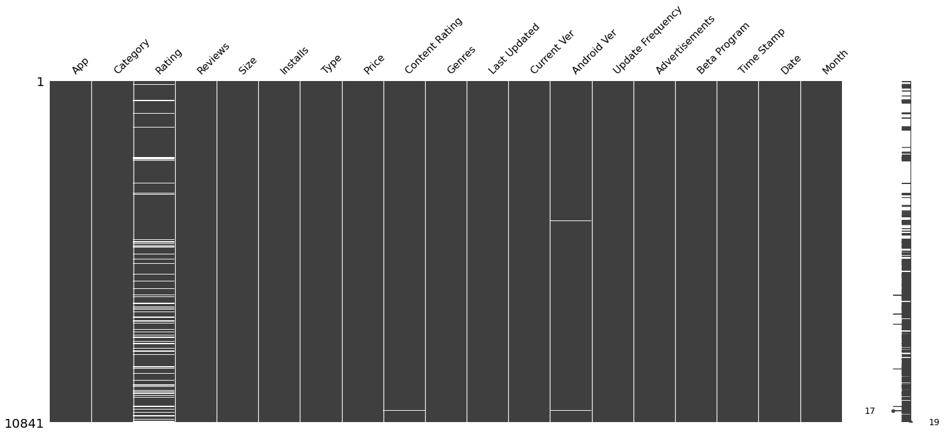
The Heat Map of Null Values

Slide 14
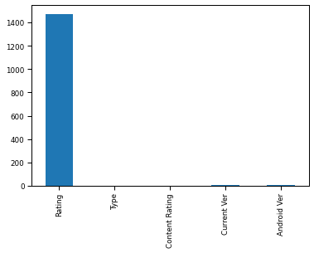
Null Values Count
From the bar graph of Null Values, it is evident that attribute 'rating' has the highest number of null values. This also indicates that users are less active in giving the ratings to the applications they use.

Slide 15
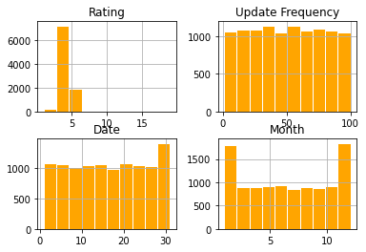
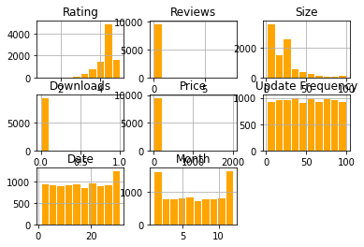
The Impact of Preprocessing
After the preprocessing, since the null values are removed, there is increase in the number of numeric attributes because of the conversion of datatype of the attributes.
Before After

Slide 16
Objectives Of Exploratory Data Analysis :
1.To know the count of applications as per their user type.
2.To know the Applications with highest earning
3.To know the Range in which most application Reviews lie in
4.To know the distribution Of paid and free applications in Play Store
5.To know number of applications that are free and paid in each category
6.To know which category has the highest number of downloads in Play Store
7.To know relation between Category, count of application and their highest rating

Slide 17
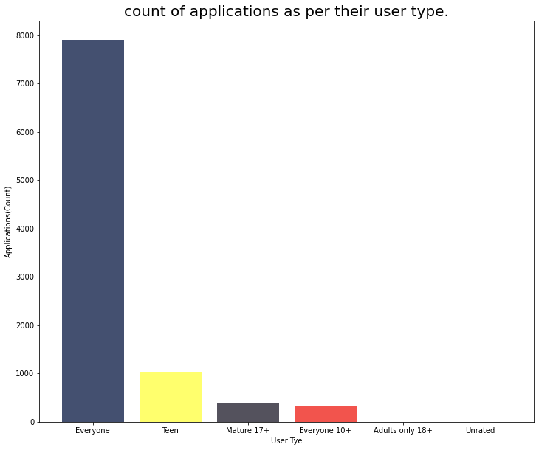
To know the count of applications as per their user type.
The applications that are under everyone’s use include music, social media, navigation etc. They are widely used by all and sundry everyday. Hence, there are more number of applications under the user type ‘everyone’.

Slide 18
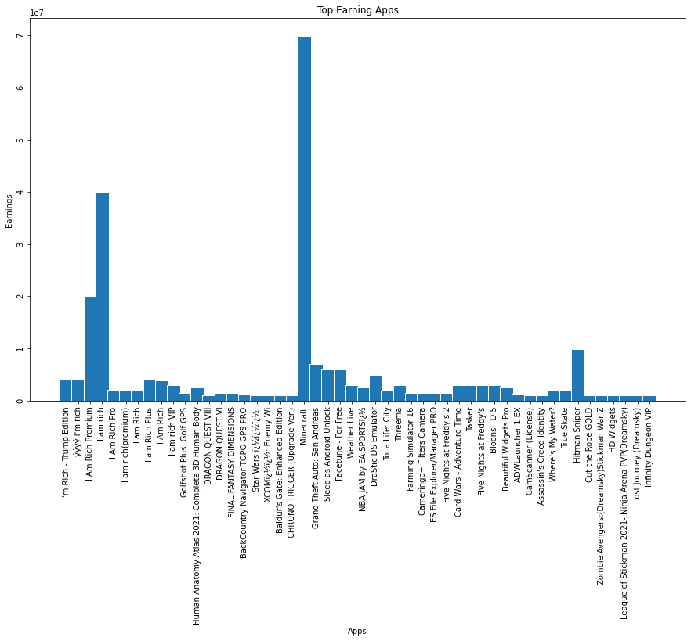
2. To know the Applications with highest earning
Of all the paid applications, Minecraft is the highest earning application because of its versatility, creativity and quirky graphics with which it attracts more users.

Slide 19
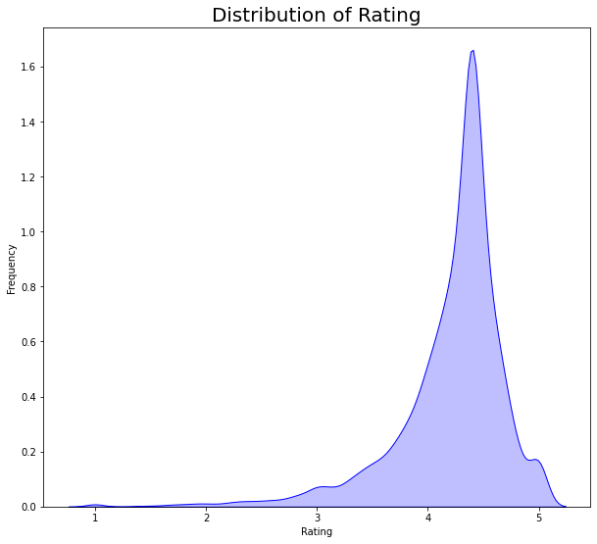
3. To know the Range in which most application Reviews lie.
From the graph, it is inferred that majority of the applications are rated between 4.0 and 4.5. This indicates that majority of applications are user satisfactory. The applications with ratings below 3.5 are not upto to the users expectations.

Slide 20
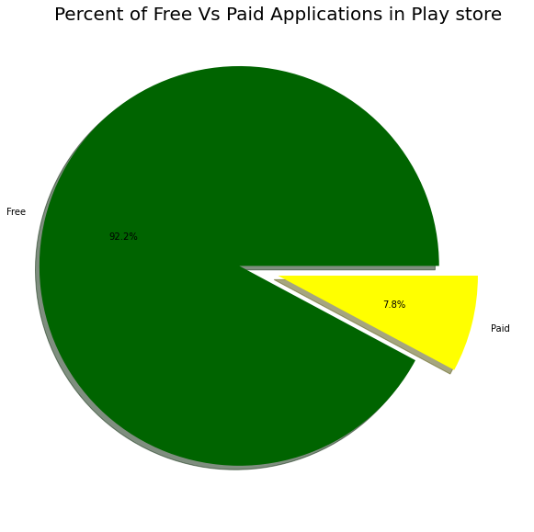
4. To know the distribution Of paid and free applications in Play Store
This chart tells us that majority of users prefer free applications over paid applications as they do not wish to spend money to access these applications.
Moreover, most of the paid applications are expensive due to which many of the users cannot afford them. Hence, they are lesser in count than that of free applications.

Slide 21
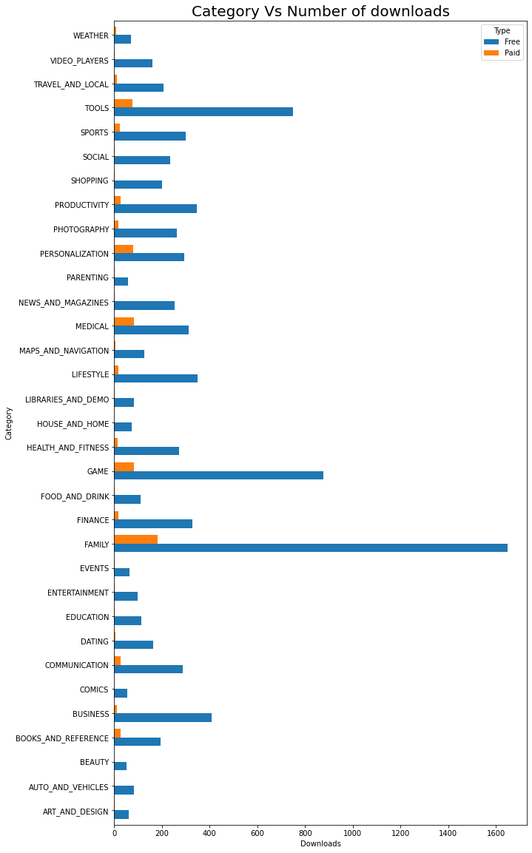
5. To know number of applications that are free and paid in each category
With 183 paid applications, Family is the category with the highest number of paid applications
With 1647 free applications It is also the category with the highest number of free applications
With 876 and 749 free applications respectively, the Game and Tools stand next to the Family with respect to number of free applications.

Slide 22
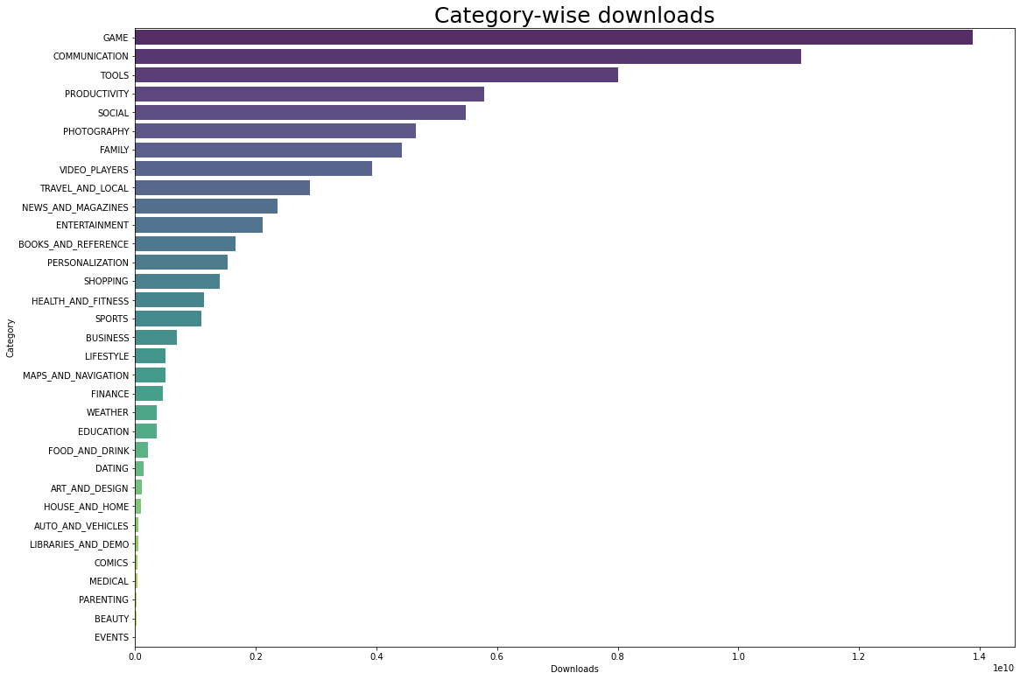
6. Analysis of the number of downloads
When it comes to the number of downloads, the category 'Game' acquires the first position and can be called as the highest downloaded category.
It is then followed by Communication, Tools, Productivity, and Social.
This shows that majority of users are interested in Gaming category.
It's more likely that users might range between teenagers to mid 20s.
Very minimum downloads has been observed from the category Events.

Slide 23
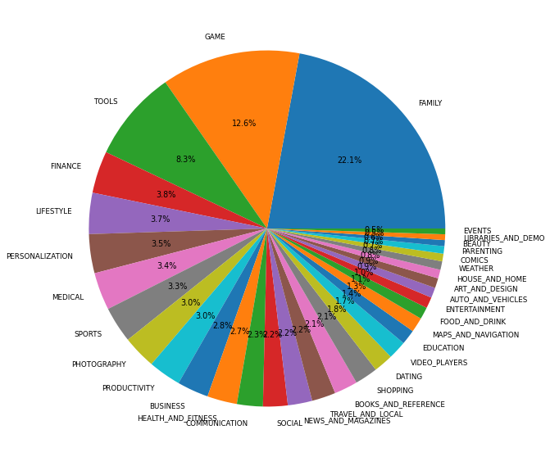
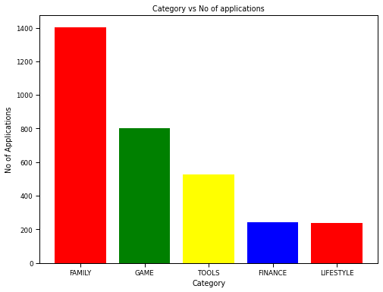
7. To know relation between Category and the count of application
The category ‘Family’ has the most number of applications as in majority of households, there will be at least one kid and many users use it. More active mobile users are the youngsters and they are interested in playing games, so it contains the second largest number of applications. Next are the categories of Tools, finance and lifestyle.

Slide 24
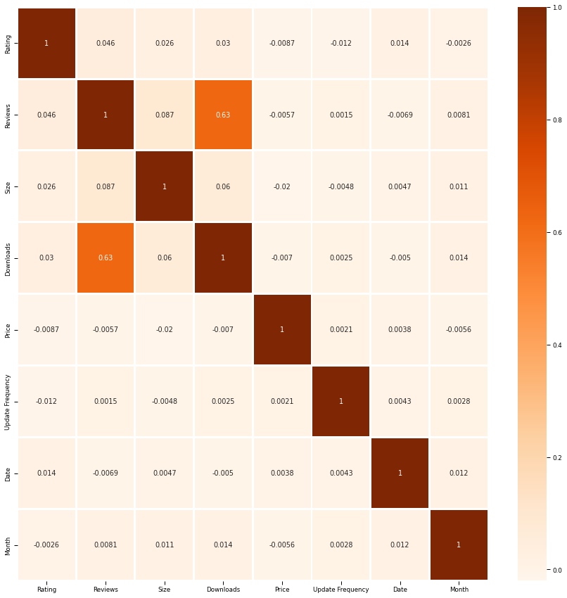
CORRELATION BETWEEN ALL THE NUMERIC ATTRIBUTES

Slide 25
Predictions
To predict the rating of the application, given the number of downloads, number of reviews and size of the application,
Number of downloads: 500000
Number of Reviews: 1000
SIze of the application: 20
Result:
Predicted Rating value: 4.2
Error= 26%

Slide 26
References
https://www.sportskeeda.com/esports/5-reasons-minecraft-best-selling-video-game-time
https://www.statista.com/statistics/279286/google-play-android-app-categories/
https://towardsdatascience.com/data-science-a-deep-analysis-on-google-play-store-apps-from-kaggle-8283bbc508b0

Slide 27
Thank-You

