Slide 1
CAPSTONE PROJECT
KEY LOGGER AND SECURITY
Presented By:
1. Pranav Jaysankar – College of Engineering, Guindy – Computer science and Engineering

Slide 2
OUTLINE
Problem Statement
Proposed System/Solution
System Development Approach
Algorithm & Deployment
Result
Conclusion
Future Scope
References

Slide 3
Problem Statement
In our modern digital landscape, characterized by looming cybersecurity threats, a notable concern revolves around the widespread occurrence of keyloggers. These stealthy software tools are specifically engineered to surreptitiously monitor and log keystrokes on a user's computer, all without their awareness. The presence of keyloggers represents a significant hazard to both individuals and organizations alike. By clandestinely capturing sensitive information such as passwords, credit card details, and other personal data, they precipitate grave consequences including identity theft, financial loss, and breaches of privacy.

Slide 4
Proposed Solution
Key Capture:
The program utilizes pynput to monitor keyboard events.
It records each keystroke in a list named keys_used.
It distinguishes between pressed, held, and released keys for potential analysis, although the current implementation doesn't utilize this distinction.
Data Storage:
Two output files are generated:
key_log.txt: It contains a straightforward text log detailing all pressed keys in sequential order.
key_log.json: This file stores a JSON-formatted list of keys, including additional information about their press/release states (e.g., if the key was held down).
Graphical User Interface (GUI):
The application utilizes the tkinter library to create a basic GUI featuring:
A label for displaying status messages.
"Start" and "Stop" buttons to initiate and halt the keylogging functionality.

Slide 5
System Approach
System Requirements
Functional Specifications:
1. Capture keystroke events, including presses and releases, utilizing a library such as pynput.
2. Save the captured keystrokes in a specified file format, either text or JSON.
3. Present a user interface (GUI) to manage the keylogging process effectively.
- The GUI should include options to:
- Initiate keylogging.
- Terminate keylogging.
Non-Functional Specifications:
1. Implement a user-friendly interface featuring intuitive labels and straightforward functionality.
2. Ensure reliable keystroke capture with minimal errors to maintain data accuracy and integrity.

Slide 6
Libraries and Tools Used:
Keystroke Capture:
The code utilizes the pynput library to monitor keyboard events.
Data Storage:
Currently, the code stores keystrokes in two files: key_log.txt (plain text) and key_log.json (JSON format). However, it lacks secure storage methods such as encryption, which could be essential for future enhancements.
User Interface:
The code employs the tkinter library to craft a basic GUI featuring "Start" and "Stop" buttons for managing keylogging operations.

Slide 7
Algorithm & Deployment
1. Library Import:
The code starts by importing the necessary library: pynput. This library provides functions to listen for keyboard events on the user's computer.
2. Keystroke Capture Function:
A function named on_press is defined. This function gets called whenever a key is pressed on the keyboard.
Inside the on_press function:
The pressed_key variable stores the information about the pressed key using key.char (for printable characters) or key.name (for non-printable keys like function keys).
The captured key information (potentially including press/release state) is appended to a list named keys_used.
3. Data Storage:
The code defines two functions for storing the captured keystrokes:
write_keys_to_file(keys_used):
This function takes the list of captured keys (keys_used) and writes them to a plain text file named key_log.txt. Each key is written on a separate line.

Slide 8
write_keys_to_json(keys_used):
This function also takes the keys_used list, but it converts it into JSON format and writes it to a file named key_log.json. This JSON file potentially allows for storing additional information about the keystrokes .
4. User Interface (GUI):
The code utilizes the tkinter library to create a simple graphical user interface (GUI).
The GUI consists of a label displaying a message ("Log Started" or "Log Stopped") and two buttons:
"Start": clicking this button starts the keylogging process by calling the on_press function whenever a key is pressed.
"Stop": Clicking this button stops the keylogging process by presumably preventing the on_press function from being called.
5. Main Execution:
The code includes a main function that creates the GUI window and starts the event loop, waiting for user interaction with the buttons.

Slide 9
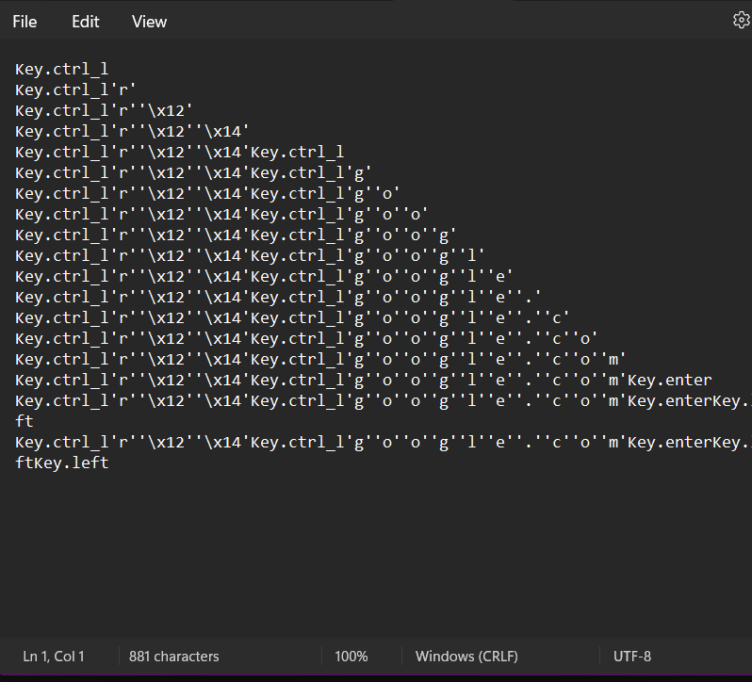
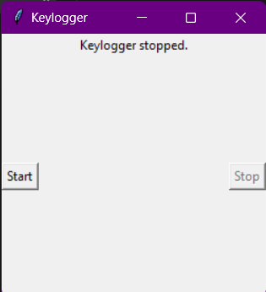
Result

Slide 10
Conclusion
Our project is centered around creating a basic keylogger using Python alongside the pynput library. This keylogger captures various keyboard events such as key presses, holds, and releases, and records them in both text and JSON formats. Additionally, we've developed a straightforward GUI using Tkinter, enabling users to initiate and halt the keylogging process with ease.
Key observations from our project encompass successful implementation of keylogging functionality, thoughtful design of a user-friendly interface, and adept handling of file operations for logging keystrokes. Along the way, we encountered challenges including potential detection by antivirus software and limitations in error handling.
To further enhance our keylogger, we aim to implement advanced logging features, bolster error handling mechanisms, and prioritize considerations for security and cross-platform compatibility.
In summary, our project serves to shed light on keylogging techniques, their practical applications, and the ethical considerations associated with their utilization.

Slide 11
Future scope
Ethical Enhancements Focus:
1. Emphasize obtaining user consent, ensuring transparency, and prioritizing data security through measures like encryption and access controls.
2. Enhance Core Functionality:
- Secure the storage of captured keystrokes to safeguard sensitive information.
- Introduce user management features and options for controlling logging activities, with ethical justifiability as a guiding principle.
3. Data Analysis Exploration:
- Delve into feature engineering and data preprocessing techniques while maintaining anonymity to achieve specific analysis objectives.
4. Exploration of Emerging Technologies:
- Investigate the potential of edge computing for conducting privacy-preserving analyses, where applicable.
- Approach the adoption of advanced machine learning methods cautiously, placing paramount importance on user consent and the implementation of privacy-preserving techniques.

Slide 12
References
Rai, S., Choubey, V., & Garg, P. (2022, July). A Systematic Review of Encryption and Keylogging for Computer System Security. In 2022 Fifth International Conference on Computational Intelligence and Communication Technologies (CCICT) (pp. 157-163). IEEE
Joy, J., Rajaram, V., Aditya, A. R., & Pandimurugan, V. (2023, December). Developing Advanced Software Keylogger using Python and Creating Awareness of their Functionalities. In 2023 2nd International Conference on Automation, Computing and Renewable Systems (ICACRS) (pp. 1551-1557). IEEE
Shirke, A., Pawar, R., Bivalkar, M., Waghela, H., & Shah, Z. (2023, December). Advance Keylogger–Capturing Keystrokes. In 2023 6th International Conference on Advances in Science and Technology (ICAST) (pp. 250-255). IEEE.
Bejo, S. P., Kumar, B., Banerjee, P., Jha, P., Singh, A. N., & Dehury, M. K. (2023, March). Design, Analysis and Implementation of an Advanced Keylogger to Defend Cyber Threats. In 2023 9th International Conference on Advanced Computing and Communication Systems (ICACCS) (Vol. 1, pp. 2269-2274). IEEE.
Ahmed, M. B., Shoikot, M., Hossain, J., & Rahman, A. (2019). Key logger detection using memory forensic and network monitoring. International Journal of Computer Applications, 975, 8887.
Parekh, D. H., Adhvaryu, N., & Dahiy, V. (2020). Keystroke Logging: Integrating Natural Language Processing Technique to Analyze Log Data. International Journal of Innovative Technology and Exploring Engineering (IJITEE), 9(3), 2028-2033.

Slide 13
THANK YOU

