Slide 1





ANONYMOUS MENTAL HEALTH SUPPORT
Idea Hackers

Slide 2


IDEA
WHAT WE PROPOSE:
WHAT MAKES OUR SOLUTION UNIQUE?
Anonymous Support Platform: A safe, stigma-free environment tailored to student mental health.
Integrated Features:
Chat: Interact with a mental health chatbot for immediate assistance.
Submit Form: Submit anonymous concerns directly to professional counselors.
Track Mood: Monitor daily emotions to identify patterns and trends.
Quiz: Self-assessment quizzes to help identify potential mental health concerns.
Resources: Access curated information on mental health issues and their management.
Complete Anonymity: No personal data required for accessing resources and features. All interactions are entirely confidential.
Tailored for Students: Specific focus on academic and social stressors common to student life.
Holistic Approach: Combines preventive measures (quizzes, resources) with responsive options (chat, counselor forms). This combination ensures a comprehensive mental health strategy.
Mood Tracking: Personalized insights over time with visual representation, enabling proactive mental health management.
User-Friendly Design: Simplified navigation for stress-free interaction.
WHY THIS APPROACH?
Confidential tools empower users to share their concerns openly and honestly.
Features like mood tracking and chatbots align with the specific needs of students, offering a relatable and supportive experience.
Regular mood tracking helps users recognize mental health trends and seek help before issues escalate.
Digital platforms can reach a large student population without geographical or logistical barriers.
Long-term engagement fosters self-awareness and mental health literacy.

Slide 3

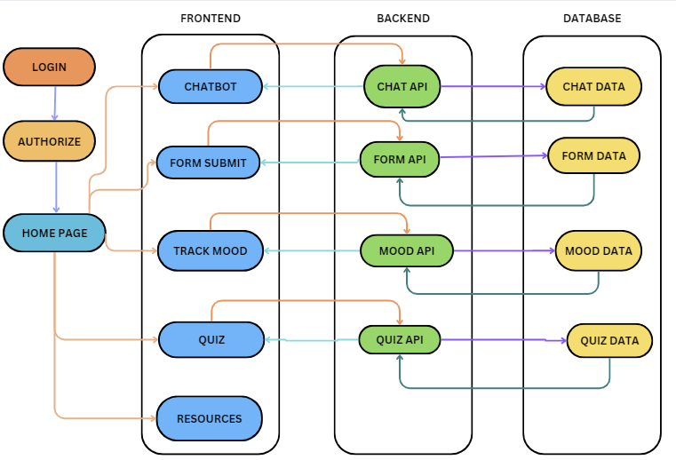




TECH
Authentication:
Json Web Token(JWT),
OAuth
Frontend:
HTML,
CSS,
JavaScript,
React JS
FLOWCHART
Deployment:
Vercel,
Docker
Backend:
Node JS,
Express JS,
REST API’s
TECH STACK
ChatBot AI
Model
Database:
MongoDB, MySQL

Slide 4
Student-Centric Design: The platform is tailored specifically for academic and social stressors faced by students, unlike generic mental health solutions.
FURTHER DESCRIPTION AND COMPETITOR ANALYSIS
Description
Competitor Analysis
The Anonymous Mental Health Support Platform stands out as an innovative, student-focused solution addressing the stigma and accessibility challenges in mental health support. By integrating tools like mood tracking, chatbots, and self-assessment quizzes, the platform provides students with actionable insights and direct access to professional guidance.
The use of advanced technologies, such as AI-powered chatbots and data visualization for mood tracking, ensures that the platform remains engaging, intuitive, and effective
While there are existing mental health apps in the market (e.g., BetterHelp, Talkspace, Wysa), our platform differentiates itself in key ways:
Student-Centric Design: The platform is tailored specifically for academic and social stressors faced by students, unlike generic mental health solutions.
Holistic Features: Competitors often focus on either therapy (e.g., Talkspace) or AI tools (e.g., Wysa), while our platform combines preventive measures (quizzes, resources) with responsive options (chat, counseling).
By addressing these gaps, the platform is uniquely positioned to become a go-to mental health resource in the academic community.

Slide 5
Our proposed Anonymous Mental Health Support Platform offers a comprehensive solution to address the mental health challenges faced by students. By combining proactive tools like mood tracking and quizzes with responsive features such as chatbots and counselor support, the platform ensures a holistic approach to mental well-being..
Leveraging advanced technologies, the platform bridges the gap between accessibility and effective mental health care, paving the way for improved awareness, prevention, and support in the student community
SUMMARY REPORT
With a focus on confidentiality, scalability, and user-friendly design, this initiative empowers students to take charge of their mental health in a stigma-free environment.
Leveraging modern technologies like Node.js, MongoDB, and AI chatbots, this initiative aligns with the unique challenges faced by students, bridging the gap between mental health support and accessibility.

Slide 6
THANK YOU

