Slide 1
Numerical integraton with python
Christopher Pham - EE SJSU

Slide 2
Goals
Use Python to solve numerical integration
Practical applications

Slide 3
References
https://docs.scipy.org/doc/scipy/reference/generated/scipy.integrate.odeint.html
Professor Morris Jones’ EE104 Lecture Notes

Slide 4
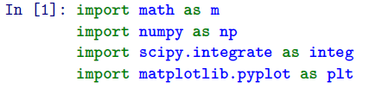


Import libraries

Slide 5
Some useful functions

Slide 6
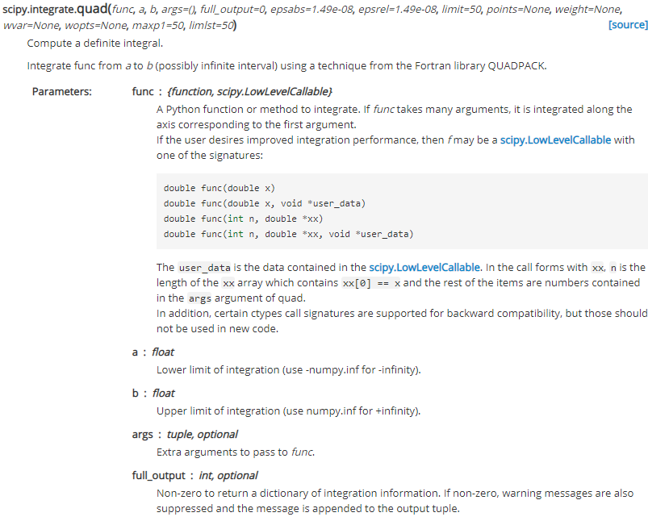
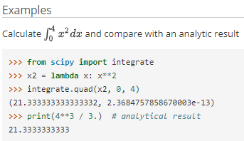
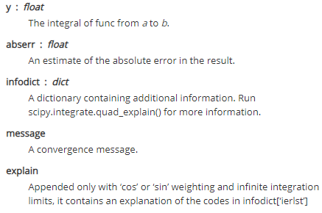
scipy.integrate.quad
https://docs.scipy.org/doc/scipy/reference/generated/scipy.integrate.quad.html

Slide 7
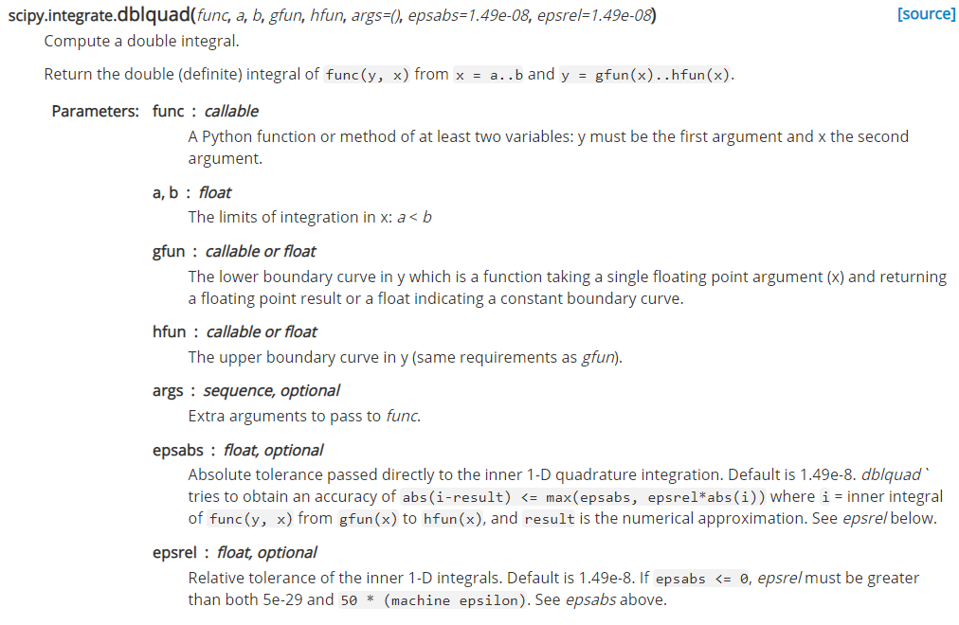
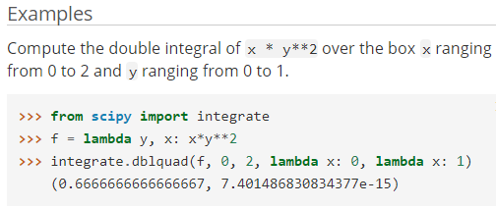

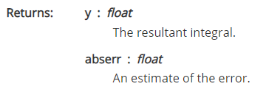
scipy.integrate.dblquad
https://docs.scipy.org/doc/scipy/reference/generated/scipy.integrate.dblquad.html

Slide 8
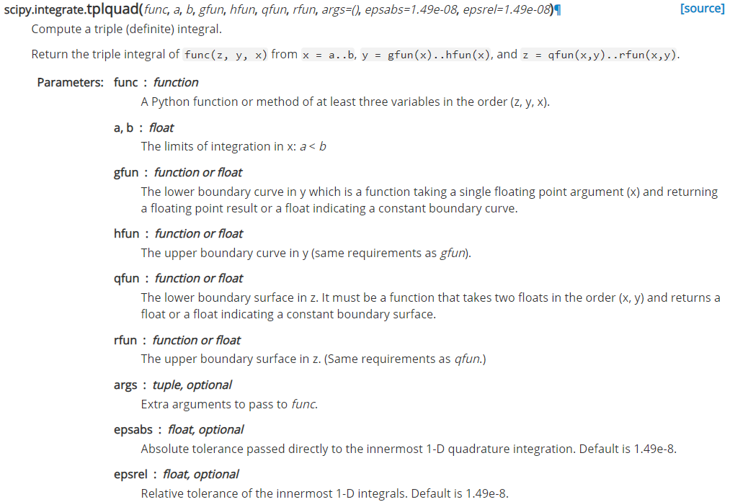
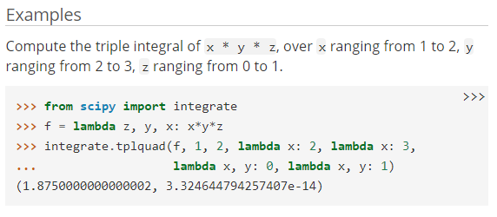

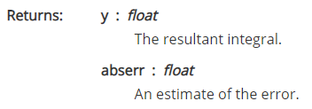
scipy.integrate.tplquad
https://docs.scipy.org/doc/scipy/reference/generated/scipy.integrate.tplquad.html

Slide 9
Solving single integral equations

Slide 10
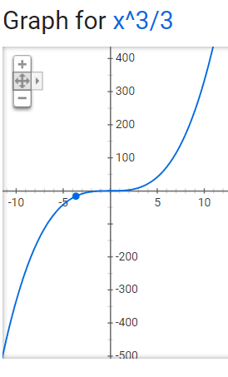
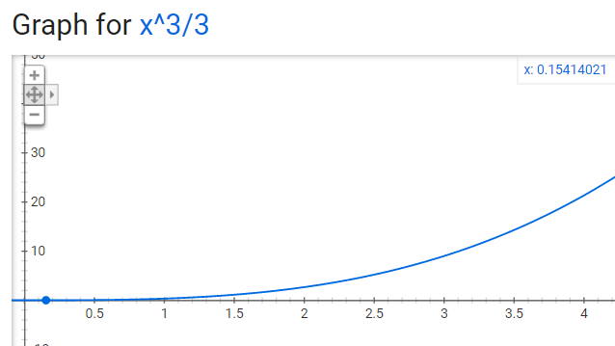
examples
Integral of X^2 dx is X^3/3
Quick check:
Triangle Area is about: (4-2)*22/2 = 2*11 = 22

Slide 11
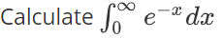
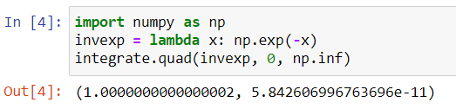
examples
Integral of e^(-x) is –e^(-x) + C

Slide 12
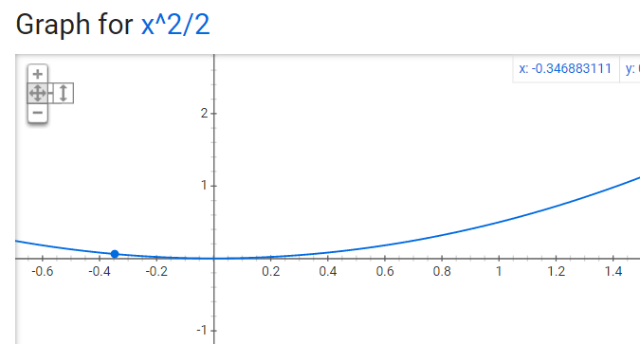

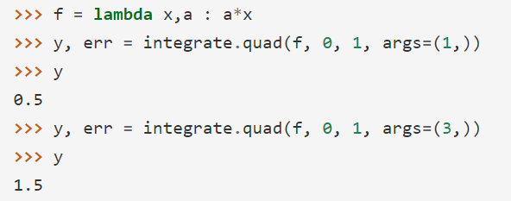
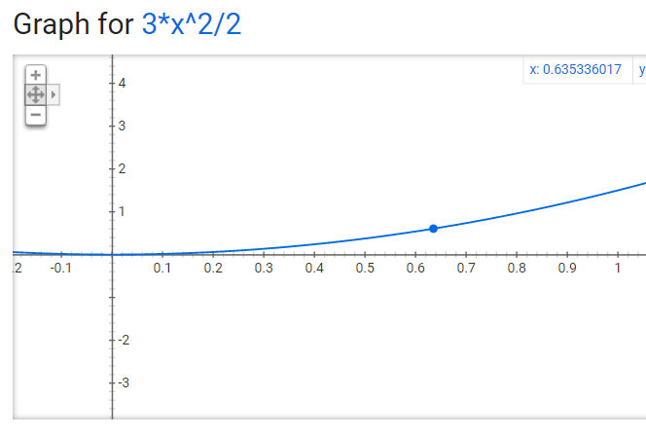
examples
Calculate Y, given X, using Integral of a*X
Y=0.5
X=1
Y=1.5
X=1

Slide 13

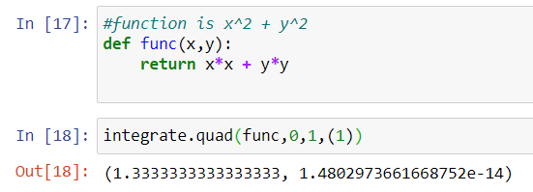
examples
, holding y = 1

Slide 14
Solving double integral equations

Slide 15
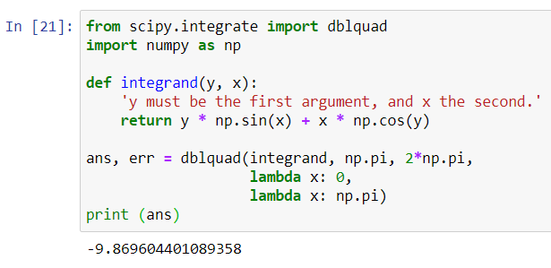

example
http://kitchingroup.cheme.cmu.edu/blog/2013/02/02/Integrating-functions-in-python/
#copy this code
from scipy.integrate import dblquad
import numpy as np
def integrand(y, x):
'y must be the first argument, and x the second.'
return y * np.sin(x) + x * np.cos(y)
ans, err = dblquad(integrand, np.pi, 2*np.pi,
lambda x: 0,
lambda x: np.pi)
print (ans)

Slide 16
Practical engineering applications with Numerical integration

Slide 17
resources
Applications of Integrations
https://www.intmath.com/applications-integration/applications-integrals-intro.php
This is an interesting one:
https://www.intmath.com/applications-integration/hic-head-injury-criterion.php
Good reviews about Numerical Integration and practical applications
https://www.academia.edu/31722261/Numerical_Methods_for_Engineers_7th_Edition_steven_chapra
Or http://www.civilittee-hu.com/uploads/1/numerical/book6th.pdf

Slide 18


