Slide 1
Bi-Directional DC-DC converter for EV Review - 3
By:
Pranav kulkarni
Abhinav Karmakar
Under the guidance of:
Dr. Prabhakar m

Slide 2
Aim
To simulate a bi-directional dc-dc converter with zero volt transition
( ZVT ) for electric vehicles ( EVs )

Slide 3
Objective
This project expects a bi-directional dc-dc convert with a zero volt transition ( ZVT ) which will be used for battery back-up systems in electric vehicles ( EVs ). This bi-directional converter should be able to transfer power from high-voltage to low-voltage and also vice-versa. By adding additional auxiliary cells to the already existing converters we shall achieve soft-switching of the MOSFETs used in order to reduce switching stress and also to realize better efficiency. By the end of this project we will present the converter circuit operation and also the simulation along with the results.

Slide 4
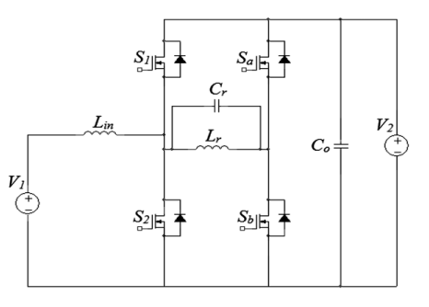
Circuit Diagram

Slide 5
Parameters
Parameter | Symbol | Value | Unit
Input voltage | V_{in} | 200 | V
Output voltage | V_{o} | 400 | V
Input inductor | L_{in} | 100 | μH
Resonant inductor | L_{r} | 2 | μH
Resonant capacitor | C_{r} | 10 | nF
Output capacitor | C_{o} | 470 | μF
Output resistor | R_{o} | 6.153 | ohm
Switching frequency | f_{sw} | 30 | kHz

Slide 6
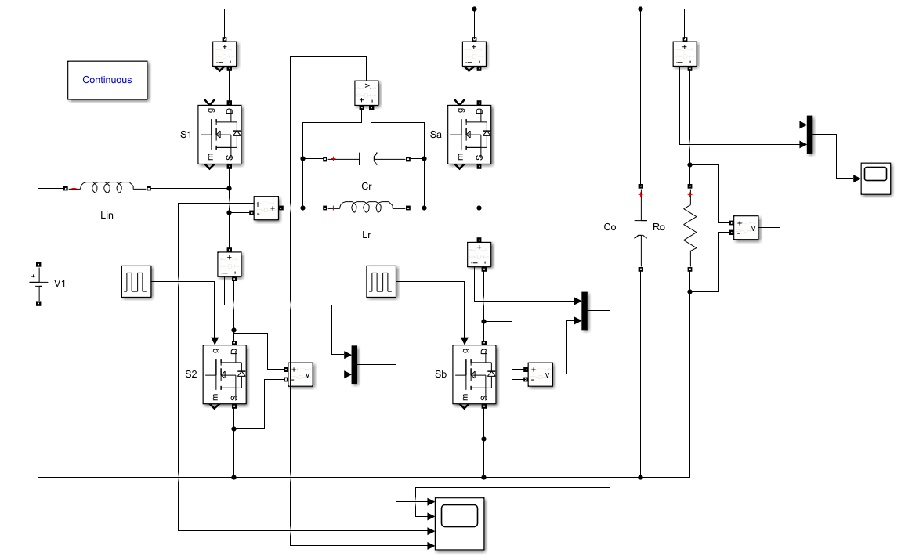
MATLAB Circuit
Boost mode

Slide 7
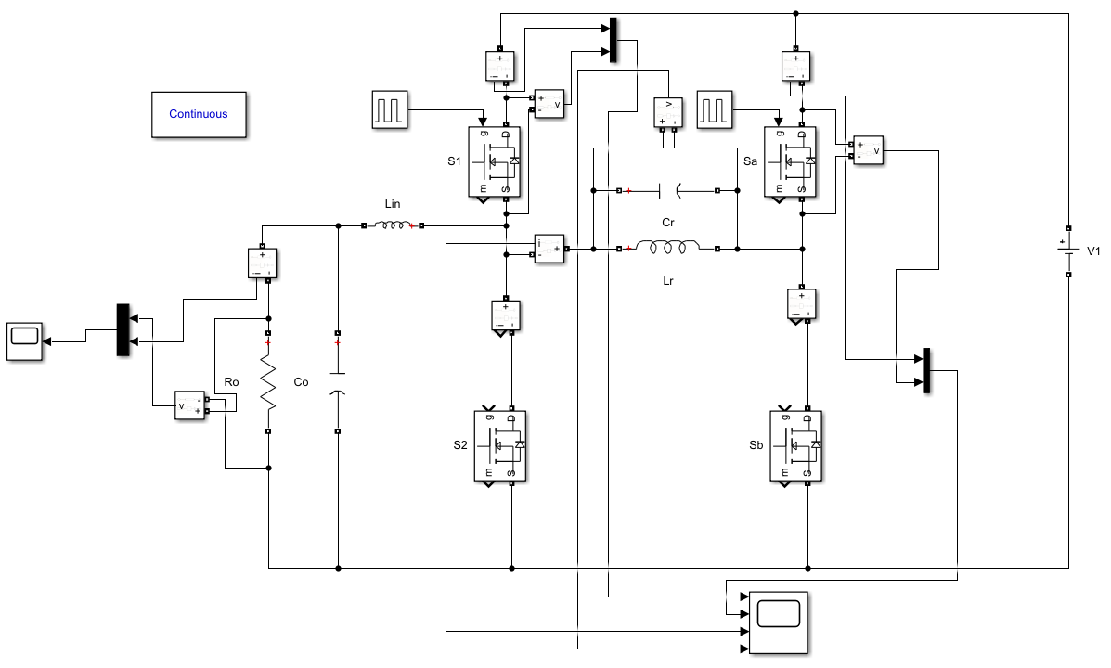
MATLAB Circuit
Buck mode

Slide 8
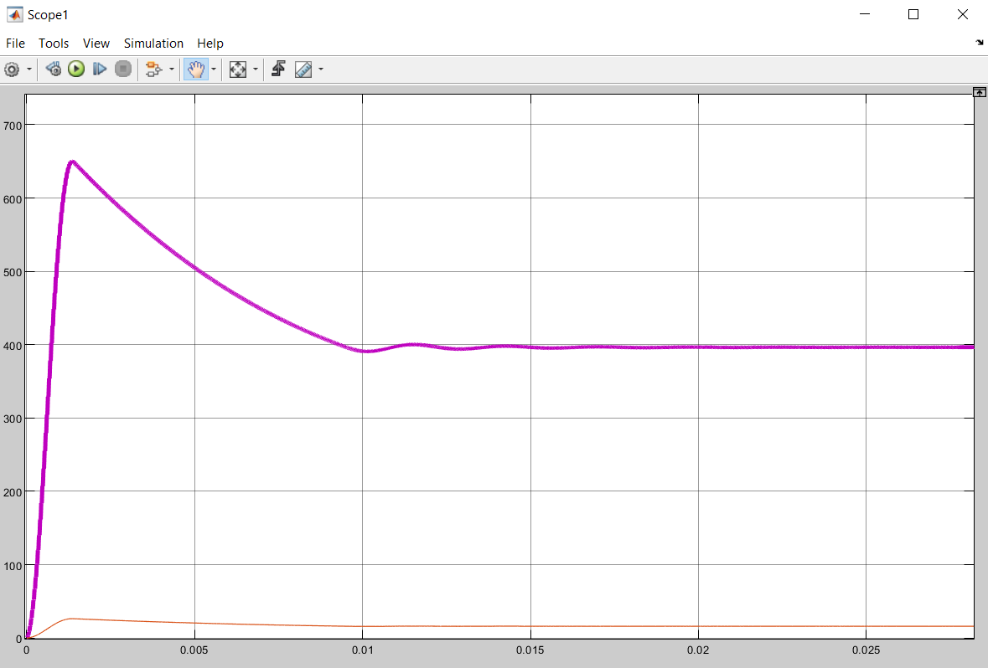
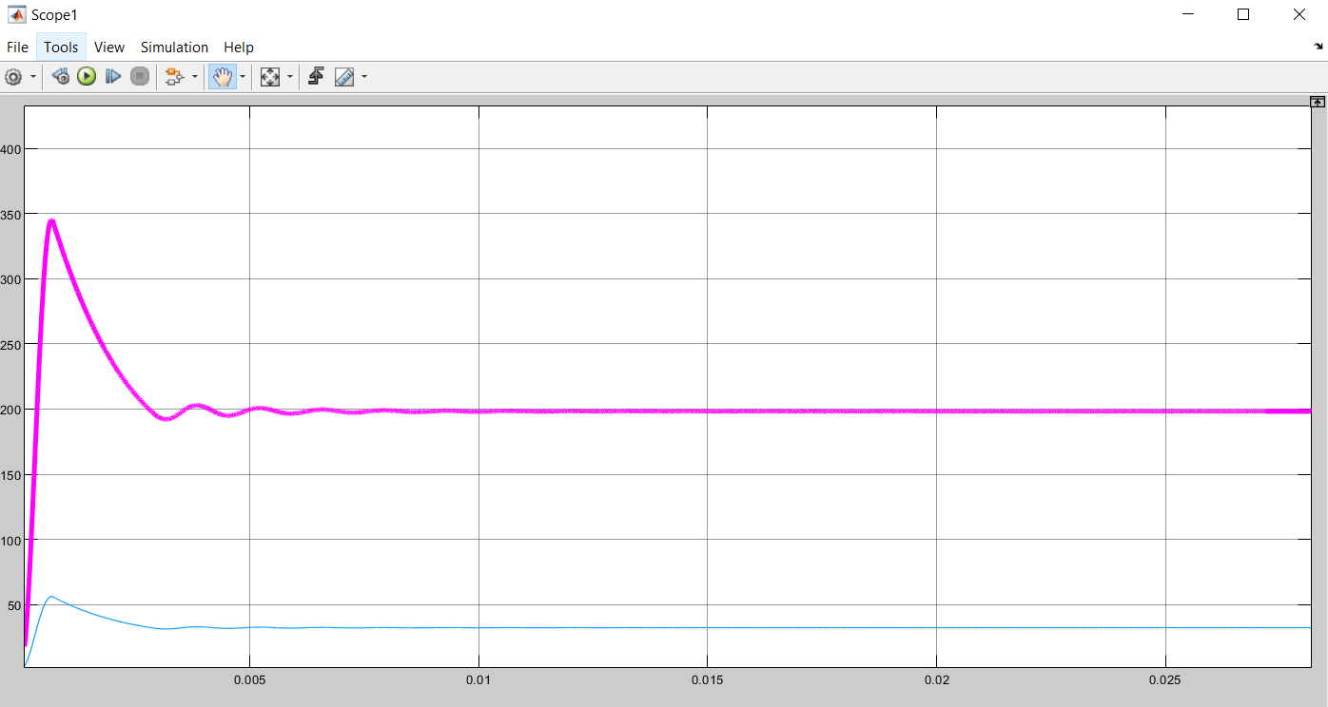
Output Waveforms
Boost Mode
Buck Mode

Slide 9
Boost Mode
Output Voltage | 386.6 V
Output Current | 62.83 A
Output Power | 6357.29 W
Efficiency | 97.5 %
Buck Mode
Output Voltage | 198.1 V
Output Current | 32.2 A
Output Power | 6378.8 W
Efficiency | 98.2 %

Slide 10
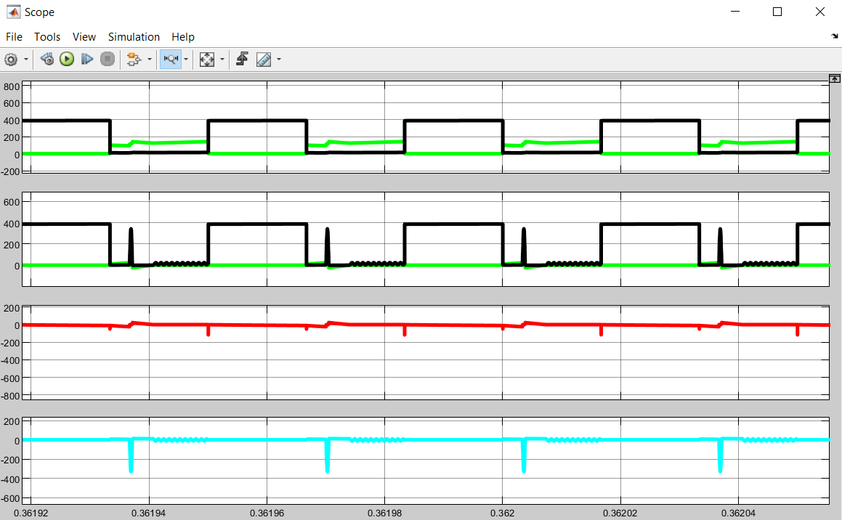
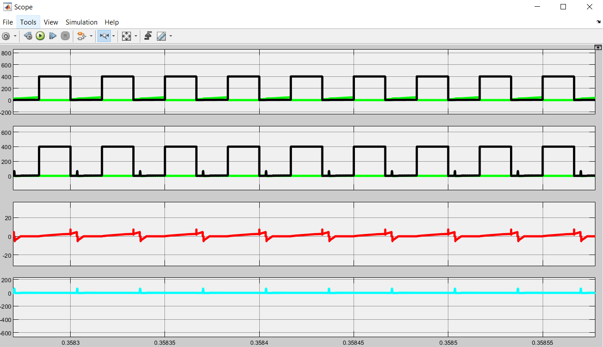
Waveforms
Boost Mode
Buck Mode

Slide 11
Conclusion
This project hence presented the design and simulation of a new ZVT bi-directional dc-dc converters for battery back-up systems in hybrid electric vehicles.
The design simulations performed for 200V/400V converter system under 6 kW output power. The simulated efficiencies obtained 97.5% for boost and 98.2% for buck modes, respectively.
It is hence observed and taken into account that the proposed converter has achieved reduced turn-on switching losses and improved efficiency.

Slide 12
References
https://www.researchgate.net/publication/319345462_Design_and_Simulation_of_a_New_ZVT_Bi-directional_DC-DC_Converter_for_Electric_Vehicles
https://ieeexplore.ieee.org/document/1703726
SJ Chiang, KT Chang, CY Yen. Residential photovoltaic energy storage system. IEEE Transactions on Industrial Electronics. 1998; 45(3): 385-394.
https://www.researchgate.net/publication/3731602_Small-signal_models_of_quasi-resonant_converters
https://digital-library.theiet.org/content/journals/10.1049/ip-b.1993.0002

Slide 13
Thank You

