Slide 1

Max – K Cut
- By Pranav Menon

Slide 2
Flow
Understanding the problem
Understanding two solutions – Approximation solutions
Comparing two methods
Introducing the K – state P – bit engine and the need for it
Algorithms and Functions involved.

Slide 3
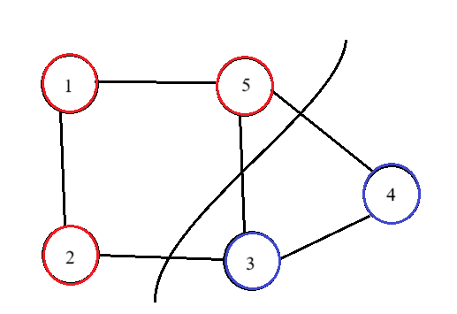
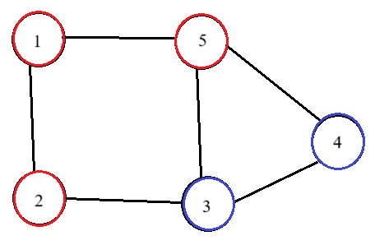
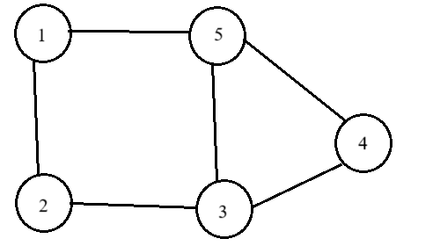


We first need to define what a cut is.
Cut
Max -
To cut the graph we need to colour the nodes with two colours – say red and blue.
Cut edges or broken edges are those edges who have their end points coloured with two different colors
These colors are like states.
$x_{i}=\left\{\begin{aligned}+1, if(i∈Red Partition) \\ −1, if (i∈Blue Partition)\end{aligned}\right.$
Hence a function to check if an edge has been cut or not can be given by:
$$\frac{1−x_{i}x_{j}}{2}$$
Because $x_{i}x_{j}=1$ if they are in same state, or else if they are present in different state (are cut), the value is 0.

Slide 4

Max - cut
The value of the cut would be:
$$\sum_{edges\left(i,j\right)}{\frac{1−x_{i}x_{j}}{2}}$$
Our Goal for the Max – Cut:
max
PROBLEM: This is an NP Hard problem.

Slide 5
Approximation Algorithms
$$Cut≥cMax_cut$$
Approximation Algorithms
𝐶𝑢𝑡≥𝑐𝑀𝑎𝑥_𝑐𝑢𝑡
Semi Definite programming
Random Assignment

Slide 6
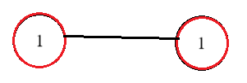

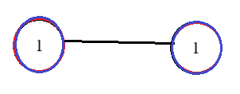
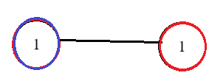


Random Algorithm
We assign the nodes, randomly with values $\left\{+1\right\}$ and $\left\{−1\right\}$.
$$x_{i}=\left\{\begin{aligned}+1, w.p. 50\% \\ −1, w.p. 50\%\end{aligned}\right.$$
Expected value if the edge will be a part of the cut:
$$P\left(e∈E is part of the cut\right)=\frac{1}{2}$$
So, if $m$ edges are supposed to be the part of the cut, on an average we would get $\frac{m}{2}$ edges as the cut for the graph.

Slide 7

Approximation ratio : $\frac{1}{2}$
Can we do any better??
Yes, we can convert it to a semi – definite program

Slide 8
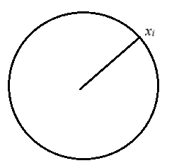


By using semi-definite programming, Goemans and Williamson were able to achieve Approximation ratio of 87%
Step – 1: Semi definite relaxation
Instead of the value of $x_{i}∈\left\{−1, +1\right\}$ we would relax and allow $x_{i}$ to be a vector such that $\left|\left|x_{i}\right|\right|=1$ and $x_{i}∈ℝ^{n}$
And instead of using, the function: $\max{\sum_{edges\left(i,j\right)}{\frac{1−x_{i}x_{j}}{2}}}$
We use the function:
$$\max{\sum_{edges\left(i,j\right)}{\frac{\left(1−x_{i}^{τ}x_{j}\right)}{2}}}$$
Notes:
Inner products -> +ve for same direction

Slide 9



Step – 2: Conversion to a semi definite program:
If we consider the matrix consisting of all the inner products also called the Gram matrix:
$$X_{ij}=\left\langle x_{i}, x_{j}\right\rangle$$
We can mathematically prove that the Gram Matrix is positive semi definite
$$X_{ij}≽0$$
Hence the problem can be reduced to the below Semi definite program:
$X_{ij}≽0$
$\max{\sum_{edges\left(i,j\right)}{\frac{\left(1−x_{i}^{τ}x_{j}\right)}{2}}}$
$X∈R^{n×n}$
$X_{ii}=1, i=1,2,3…, n$

Slide 10

Step – 3: Solving the semi – definite program:
There are efficient solvers for this problem and using them we can obtain the value of $X$.
Also since PSD can be broken down in the form:
$$X=\left[x_{1},x_{2},…, x_{n}\right]{\left[x_{1},x_{2},…, x_{n}\right]}^{τ}$$

Slide 11
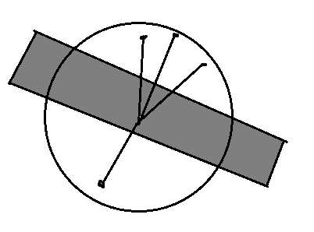
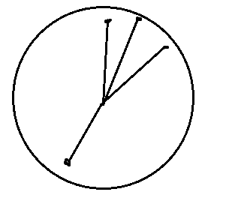


Step – 4: Rounding (Going from vectors to scalers)
Since the vectors have $\left|\left|x_{i}\right|\right|=1$, we can view them as points on a unit sphere.
Generate a random hyperplane and assign all the points on one side of the hyper plane as one state $\left\{+1\right\}, say$ and the other side will correspond to $\left\{−1\right\}$

Slide 12

Max – K Cut problem
The Max – K cut problem is the more generalized version of the Max cut problem.
Here we are supposed to divide the graph into $k$ partitions such that the sum of edges across all partitions is maximized.

Slide 13

Max – K Cut problem
A crucial component of the above solution was the states in which the hardware can be $\left\{+1, −1\right\}$. In the Max cut problem there were only 2 states hence we could manage in.
But when we generalize this to say K cut problem, the mapping is no longer simple since it requires more than one state in which it can be.
To achieve this we need to perform a pre processing step called as graph reduction. This step transforms the Max – K cut problem approximately into the Max Cut Problem.

Slide 14

Graph Reduction for Max 3 Cut:
To use the Max Cut algorithm to find 3 partitions we need to transform the graph $G→G^{′},$such that applying the above algorithms on $G^{′}$ would give us 3 partitions.
To use the Max Cut algorithm to find 3 partitions we need to transform the graph $G→G^{′},$such that applying the above algorithms on $G^{′}$ would give us 3 partitions.
To do this we have to make 3 copies of all the nodes for the states in which they are supposed to be. So if we are using a 2 state $p−bit$, for a $N$ node graph we would use $3N$ p – bits. This leads to increased computational resources.

Slide 15


A 3 – state p bit engine
Now to make computation easy, we develop a 3 state engine. Let a p – bit has three possible state $\hat{e_{1}},\hat{e_{2}}$ $\hat{e_{3}}$. The property of p bit:
Whenever a p bit tries to transition, it can switch to the other two states with equal probability.
Hence we can transform this into the energy minimization problem:
$$H=−\sum_{i<j}{J_{ij}\left(2\overline{σ_{i}}.\overline{σ_{j}}−1\right)}$$
[J] : Adjacency matrix for input graph i.e. it is
$J_{ij}=\left\{\begin{aligned}−1, edge is present between i and j \\ 0, edge is absentbetween i and j\end{aligned}\right.$
$\overline{σ_{i}}.\overline{σ_{j}}=1$, if nodes $i$ and $j$ are in same partition. {energy is increased}
$\overline{σ_{i}}.\overline{σ_{j}}=−1, if$nodes $i$ and $j$ are in different partition. {energy is decreased}

Slide 16


Formulae and Algorithm:
We define the weighted synaptic feedback $φ$ for the $α^{th}$ bit as:
$$φ_{α}=\sum_{j=1}^{N}{J_{αj}\left(2\overline{σ_{α}}\overline{σ_{j}}−1\right)}$$
The new state based on this feedback is:
$$σ_{α,3−state}^{+}=$$
$\left(\overline{σ_{α}}.\hat{e_{1}}\right)\left[\left[0.5\left(1+\operatorname{sgn}{(f(φ_{α})}\right)\right]\hat{e_{1}}+\left[0.5\left(1−\operatorname{sgn}{(f(φ_{α})}\right)\right]g\hat{e_{2}}+\left[0.5\left(1−\operatorname{sgn}{(f(φ_{α})}\right)\right](1−g)\hat{e_{3}}\right]$+
$$\left(\overline{σ_{α}}.\hat{e_{2}}\right)\left[\left[0.5\left(1+\operatorname{sgn}{(f(φ_{α})}\right)\right]\hat{e_{2}}+\left[0.5\left(1−\operatorname{sgn}{(f(φ_{α})}\right)\right]g\hat{e_{3}}+\left[0.5\left(1−\operatorname{sgn}{(f(φ_{α})}\right)\right](1−g\hat{e_{3}}\right]+$$
$$\left(\overline{σ_{α}}.\hat{e_{3}}\right)\left[\left[0.5\left(1+\operatorname{sgn}{(f(φ_{α})}\right)\right]\hat{e_{3}}+\left[0.5\left(1−\operatorname{sgn}{(f(φ_{α})}\right)\right]g\hat{e_{2}}+\left[0.5\left(1−\operatorname{sgn}{(f(φ_{α})}\right)\right](1−g\hat{e_{1}}\right]$$

Slide 17

$$f\left(φ_{α}\right)=\tanh\left(βφ_{α}\right)−θ_{\left[−1,1\right]}$$
This is the non-linear transformation on the synaptic input $φ_{α}$ along with a stochastic input $θ_{\left[−1, 1\right]}$. The various components of the equation are:
$β:$Controls the steepness of the non – linear transformation
$θ_{\left[−1, 1\right]}$ : is a random number between $−1$ and $1$ chosen uniformly at random.
$g$: is a chosen randomly between 0 and 1. to signify that the state change can occur into the other state with equal probability.
$f\left(.\right)$ is designed in such a fashion that when present state is favoured, the Probability of it remaining in that state tends to $1$, other wise the probability of switch is split equally between the other two states.

Slide 18


