Slide 1

B. Tech Major Project Evaluation-2, VII Sem
EventSync: Sharda Event Scheduler & Coordination Planner
Presented by :
Mohit Saraswat (2021001021)
Pranav Mishra (2021381168)
Nishant Kumar (2021459955)
Under the Supervision of:-
Prof.(Dr.) Mandeep Kaur, Professor, Department of Computer Science & Engineering
DEPARTMENT OF COMPUTER SCIENCE & ENGINEERING
SHARDA SCHOOL OF ENGINEERING AND TECHNOLOGY
September, 2024

Slide 2
AGENDA
Introduction
Relevance
Problem Statement
Team Details
Literature Table
Objectives
Methodology
Project Planning
Use of Latest Design Tools
Computing Framework
SDLC Model Description
Functional Specification
Schema Design – Phase 1
Development – Phase 1
Conclusion
References

Slide 3
INTRODUCTION TO EVENTSYNC
EventSync is an innovative solution designed to revolutionize event management at Sharda University.
It serves as an end-to-end Event Management System, offering a comprehensive platform to streamline event planning, coordination, budget management, approval processes, and post-event reporting.
By addressing the current inefficiencies in event management, EventSync aims to enhance efficiency, transparency, and overall event experience within the college community.

Slide 4
IMPORTANCE OR RELEVANCE OF THE PROJECT
EventSync holds significant importance for Sharda University due to the challenges it addresses in event management.
Current practices involving manual effort, lack of synchronization, and communication issues often lead to confusion, delays, and suboptimal event outcomes.
EventSync offers a solution to these challenges by providing a centralized platform that streamlines processes and enhances coordination.
By improving efficiency and transparency in event management, EventSync contributes to the overall success and reputation of Sharda University’s events, fostering student engagement and community involvement.

Slide 5
PROBLEM STATEMENT
Sharda University currently faces challenges such as manual effort, lack of synchronization, and communication issues in event management. These inefficiencies lead to confusion, delays, and suboptimal event outcomes.
Effective event management is crucial for the success of college activities, student engagement, and community involvement. Addressing the identified challenges will lead to improved efficiency, transparency, and overall event experience.
Implementing EventSync offers a solution to the identified challenges, streamlining event planning, coordination, and execution. This will result in enhanced efficiency, reduced workload, and improved event outcomes for Sharda University.
.

Slide 6
TEAM DETAILS
NAME | SYSTEM ID | TASK ASSIGNED
Pranav Mishra | 2021381168 | Frontend, Research Paper
Nishant Kumar | 2021459955 | UI/UX Design, Research Paper
Mohit Saraswat | 2021001021 | Backend, Research Paper

Slide 7
LITERATURE TABLE
Year of Publication | Title | Technology Used | Results/Conclusions
2021 | Method and system for internet-based event management at universities (Case study: Van Lang University). | Internet-based methods and systems. | The research focuses on managing and planning events based on the Internet for students. It addresses the needs of event management at universities in the context of the smartly connected society of Industry 4.0.
2018 | Event Management System for Higher Education Institutions: A Case Study. | Web-based system. | The proposed system streamlines event planning, registration, and communication. It enhances collaboration among stakeholders and improves overall efficiency in managing educational events.
2019 | Design and Implementation of an Event Management System for Universities | Web-based Platform. | The system facilitates event creation, participant registration, and communication. It aims to enhance event organization and coordination within universities.

Slide 8
2020 | Smart Event Management System for Educational Institutions | IoT-based system. | The research explores an IoT-enabled event management system that integrates smart devices for efficient event planning, monitoring, and feedback collection.
2017 | An Integrated Event Management System for Universities | Web-based solution | The proposed system simplifies event organization, participant registration, and resource allocation
2016 | Event Management System for Educational Institutions: A Comparative Study. | Comparative analysis of existing systems. | The study evaluates different event management systems used in educational institutions. It provides insights into their features, usability, and effectiveness.

Slide 9
EVENTSYNC OBJECTIVES ARE CRAFTED ON THE BASIS OF SURVEY CONDUCTED
OBJECTIVES
Streamline Event Planning
Enhance Coordination
Optimize Budget Management
Streamline Approval Processes
Generate Comprehensive Reports
Promote Efficiency and Transparency
Simplify event planning processes by centralizing scheduling, task coordination, and communication.
Facilitate seamless collaboration among organizers, stakeholders, and team members.
Track expenses and ensure events stay within budgetary constraints.
Automate workflows to expedite event proposal approval by stakeholders.
Capture attendance data, feedback, and financial summaries for post-event analysis.
Improve event execution, communication, and accountability within the college community.

Slide 10
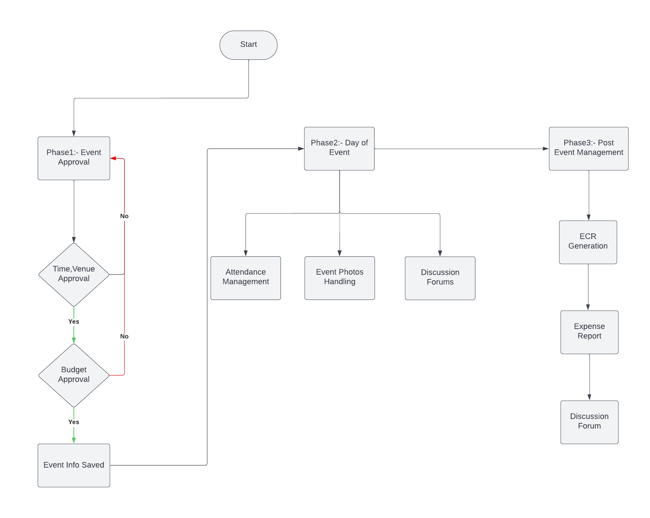
METHODOLOGY

Slide 11
PROJECT PLANNING
PHASE | DESCRIPTION | DURATION
Phase 1:- Planning and Requirements Gathering | Defining Scope of Project Stakeholders Interviews | 2-3 Weeks
Phase 2:- Design and Prototyping | Creating wireframes and design mockups , Develop prototype for initial testing | 4-6 Weeks
Phase 3:- Development | Implement Core features and functionalities , conduct iterative development | 10-14 Weeks
Phase 4:- Testing and Quality Assurance | Perform Thorough testing, identify and fix bugs | 4-6 Weeks
Phase 5:- Deployment and Launch | Prepare for deployment to production environment Train users and administrators | 2-3 Weeks

Slide 12
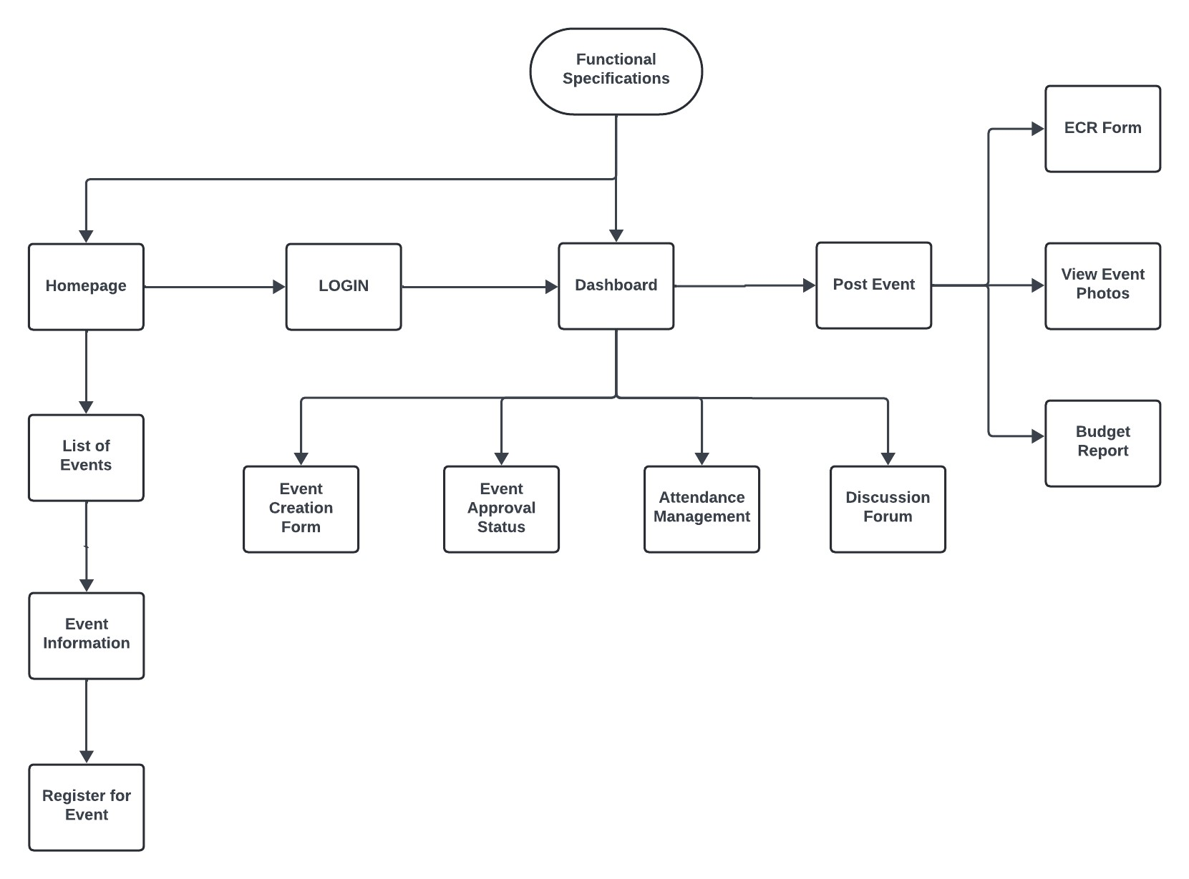
FUNCTIONAL SPECIFICATIONS
SOFTWARE COMPONENTS:-
These Design Specification would be used to develop the application.
Flowchart Describes the Component Mapping in the Application

Slide 13




USE OF LATEST DESIGN TOOLS
FIGMA
LUCIDCHARTS
BOOTSTRAP
ANGULAR MATERIAL
Angular Material: A UI component library for Angular that follows Google's Material Design guidelines.
Bootstrap: A popular CSS framework for responsive, mobile-first web development.
Lucidcharts: A web-based diagramming tool for creating flowcharts, mind maps, and wireframes.
Figma: A collaborative design tool used for creating UI/UX prototypes and wireframes.

Slide 14


COMPUTING FRAMEWORKS
Angular is a front-end framework for building dynamic single-page applications (SPAs).
It offers two-way data binding, modular components, and dependency injection for efficient development.
Built-in tools like routing, form handling, and HTTP services streamline app development.
Spring Boot simplifies back-end development, focusing on RESTful APIs and microservices.
Embedded servers like Tomcat enable quick deployment without extensive setup.
Seamlessly integrates with databases, security protocols, and other enterprise systems.

Slide 15
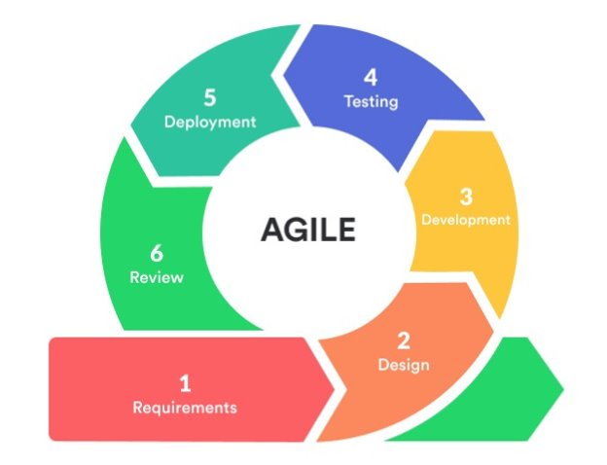
SOFTWARE DEVELOPMENT LIFECYCLE MODEL
Phase 1 Development Cycle
Requirements Gathering – Event approval process, User roles,
Design – Schemas, Data relations, etc.
Development – Use of Angular and Spring Boot, with MySQL database.
Testing – Phase 1 Manual Testing comprised of unit and integration testing.

Slide 16
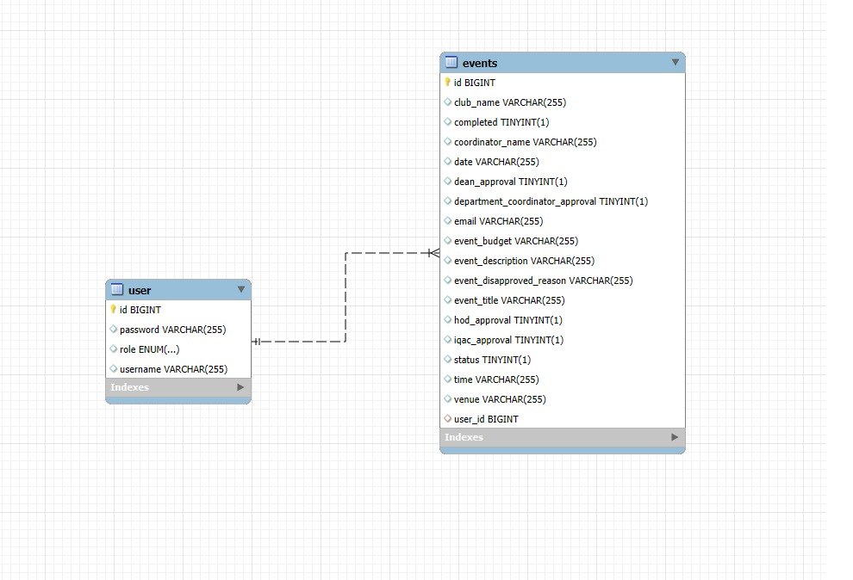
PHASE 1 - SCHEMA DESIGN
Event Entity Attributes: Includes id, eventTitle, coordinatorName, clubName, email, date, time, venue, eventBudget, eventDescription, and various approval statuses.
User Entity Attributes: Comprises id, username, password, and role.
Relationship: A many-to-one relationship exists between Event and User, where each event is coordinated by a single user, but a user can coordinate multiple events.
Foreign Key: The user_id foreign key in the events table references the id in the user table.
Cascade Operations: Ensures that updates or deletions to a user propagate to their associated events, maintaining consistency across related data.

Slide 17
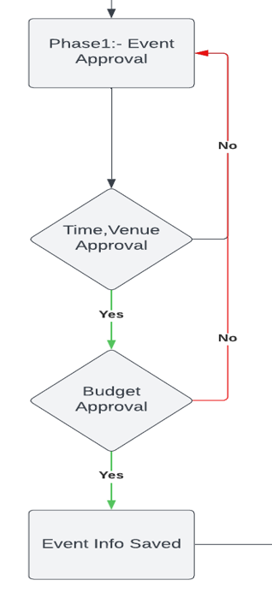
PHASE 1 - DEVELOPMENT
Registration and Login Page: New users can register and log in to access the website.
Event Coordinator Capabilities: Coordinators can create event requests, track approval status, and manage their own and others' events.
Authority Roles and Actions: Authorities (Department Coordinators, HODs, Deans, IQAC team) can log in, view event details, and approve or deny requests.
Automated Notifications: Automated emails notify authorities of event status changes, including approval, disapproval, or new requests.
Coordinator Dashboard: Provides Event Coordinators with a view to manage and track their event requests.
Authority Dashboard: Allows authorities to efficiently review and manage event approvals or rejections.

Slide 18
CONCLUSION & PROJECT IMPACT
EventSync offers a comprehensive solution to streamline event management at Sharda University.
By centralizing event planning, coordination, budget management, and post-event reporting, EventSync enhances efficiency and transparency.
The project addresses current challenges such as manual effort, lack of synchronization, and communication issues.
EventSync's objectives include streamlining processes, enhancing collaboration, optimizing budget management, and generating comprehensive reports.
With a multidisciplinary team and a structured project timeline, EventSync is poised to deliver tangible benefits to Sharda University.
The project's importance lies in its potential to improve event outcomes, foster student engagement, and enhance the college's reputation.
EventSync's impact extends beyond operational efficiency, promoting a culture of innovation and excellence within the college community.

Slide 19
REFERENCES
Ananya U, Shetty Kavya Umesh, Shraddha Harish Mendon, Priya Poojary, Dr. Joseph Michael Jerard V. 2022. Event Management System for Educational Institutions. International Journal of Creative Research Thoughts (IJCRT), Volume 10, Issue 6, June 2022, ISSN: 2320-2882.
Assist. Prof. Khalil Pinjari, and Khan Nur, "Smart Event Management System," International Journal of Computer Science Trends and Technology (IJCST), vol. 4, no. 2, pp. 161-164, Mar-Apr 2016.
Nguyen, T. T., & Nguyen, T. H. (2021). Method and system for internet-based event management at universities (Case study: Van Lang University). Journal of Computer Science and Cybernetics, 37(1), 1-14.
Maria Rona L. Perez, Ace C. Lagman, and Rossana T. Adao. 2017. Event Management Solution Using Web Application Platform. In Proceedings of the 2017 International Conference on Information Technology (ICIT '17). Association for Computing Machinery, New York, NY, USA, 206–211.
R. Wadagave, S. Karoshi, P. Ravan, R. Santikar and R. Deshmukh, "Web Application based Event Organisation Portal using MEAN Stack," 2022 International Conference on Sustainable Computing and Data Communication Systems (ICSCDS).
Al-Maolegi, M. A., & Al-Maolegi, S. A. (2020). Smart Event Management System for Educational Institutions. International Journal of Computer Applications, 182(25), 1-5.
Robinson, Richard & Barron, Paul & David, Solnet. (2008). Innovative Approaches to Event Management Education in Career Development: A Study of Student Experiences. Journal of Hospitality, Leisure, Sports and Tourism Education..
P. S. Hada, Yogesh, Bhupen and Prince, "AI based Event Management Web Application," 2022 International Conference on Machine Learning, Big Data, Cloud and Parallel Computing (COM-IT-CON)
Akansha Pansare, Athang Patil, Nikita Patil, Yatin Patil, Mrs. Aparna Bhonde. 2023. Smart College Event Management System Using MERN Stack. International Journal for Research in Applied Science & Engineering Technology (IJRASET), Volume 11, Issue III, March 2023, ISSN: 2321-9653. https://doi.org/10.22214/ijraset.2023.49875.
B. Patil, S. Rawool, A. Sagar, and S. Yerme, "Web-Based College Event Management Platform," International Research Journal of Engineering and Technology (IRJET), vol. 11, no. 06, pp. 21-26, June 2024.

