Slide 1
Antenna Simulation : Cross-Yagi Antenna
- Pranav Munukutla

Slide 2
Problem Statement and its relevance
The aim of the project was to learn antenna simulation and antenna theory.
Importance of Antennas
Importance of Simulations
Learning antenna parameters
Designing and simulating Cross Yagi Antenna

Slide 3
Week 1 Milestones:
To learn about various parameters related to antennas.
To install HFSS.
Design a simple dipole antenna and find its plots of S11 vs impedance, radiation patterns to get a hang of Ansys HFSS software.

Slide 4
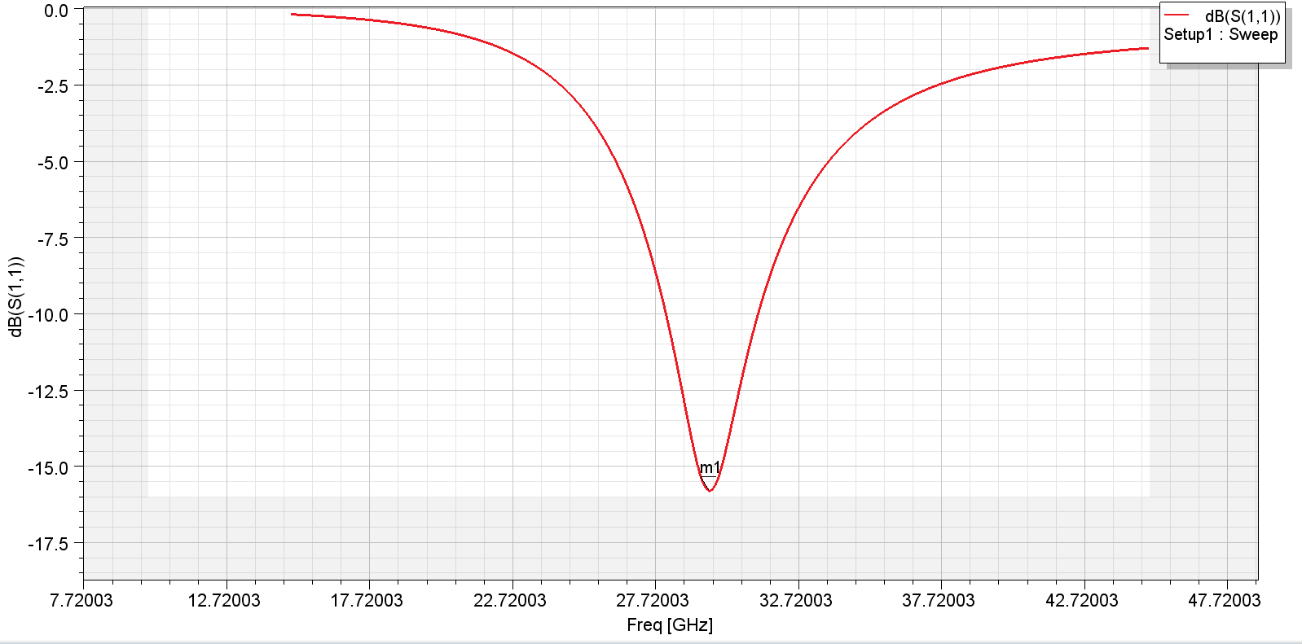
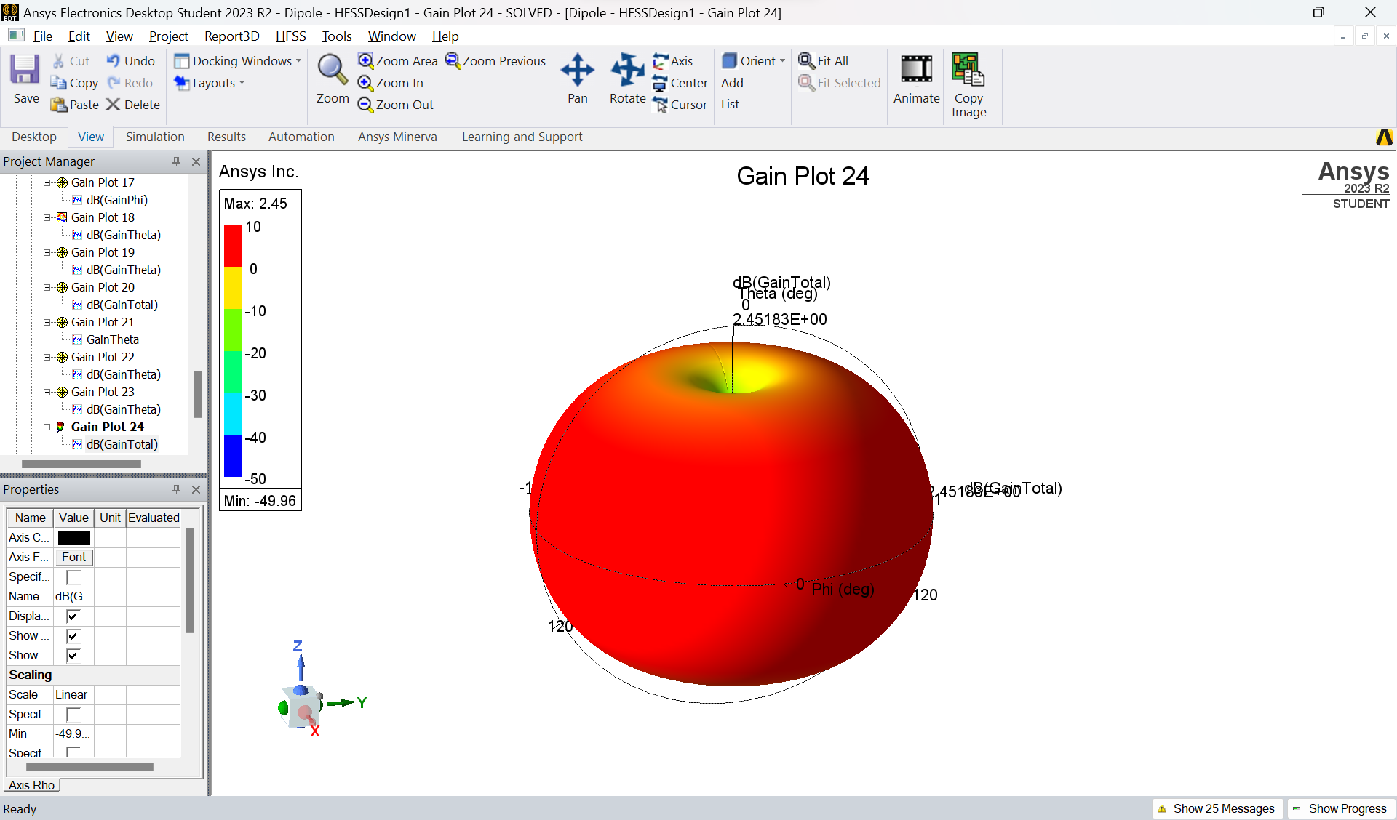
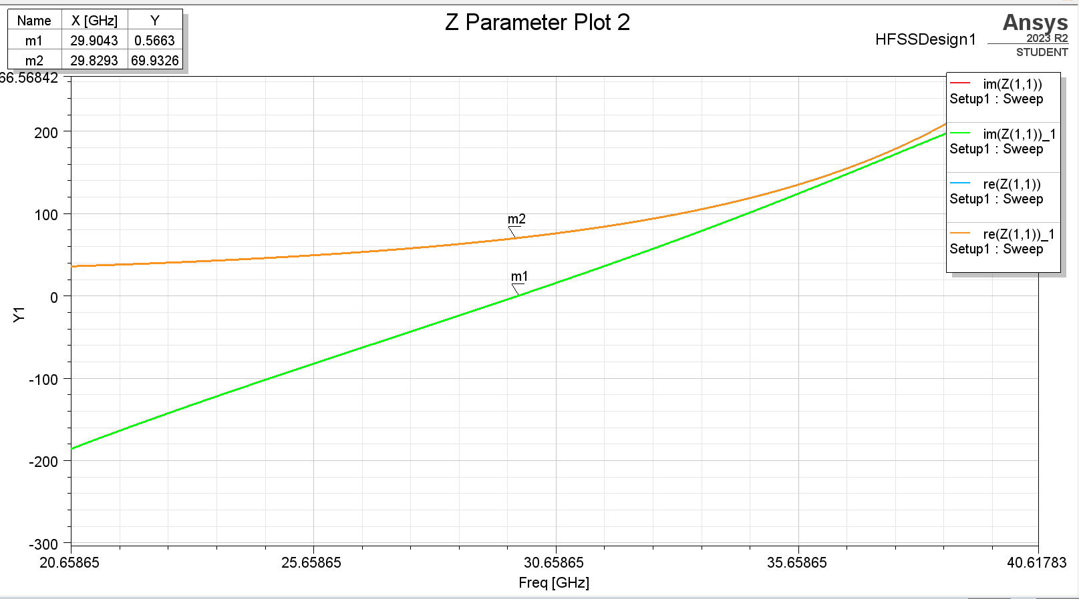
Week 1: Achieved
Basics of an antenna.
Installing HFSS.
Simulated dipole antenna successfully.

Slide 5
Week 2:Milestones
To simulate a coaxial cable on HFSS
Read about cross-yagi antenna.
Start designing the antenna in HFSS.

Slide 6
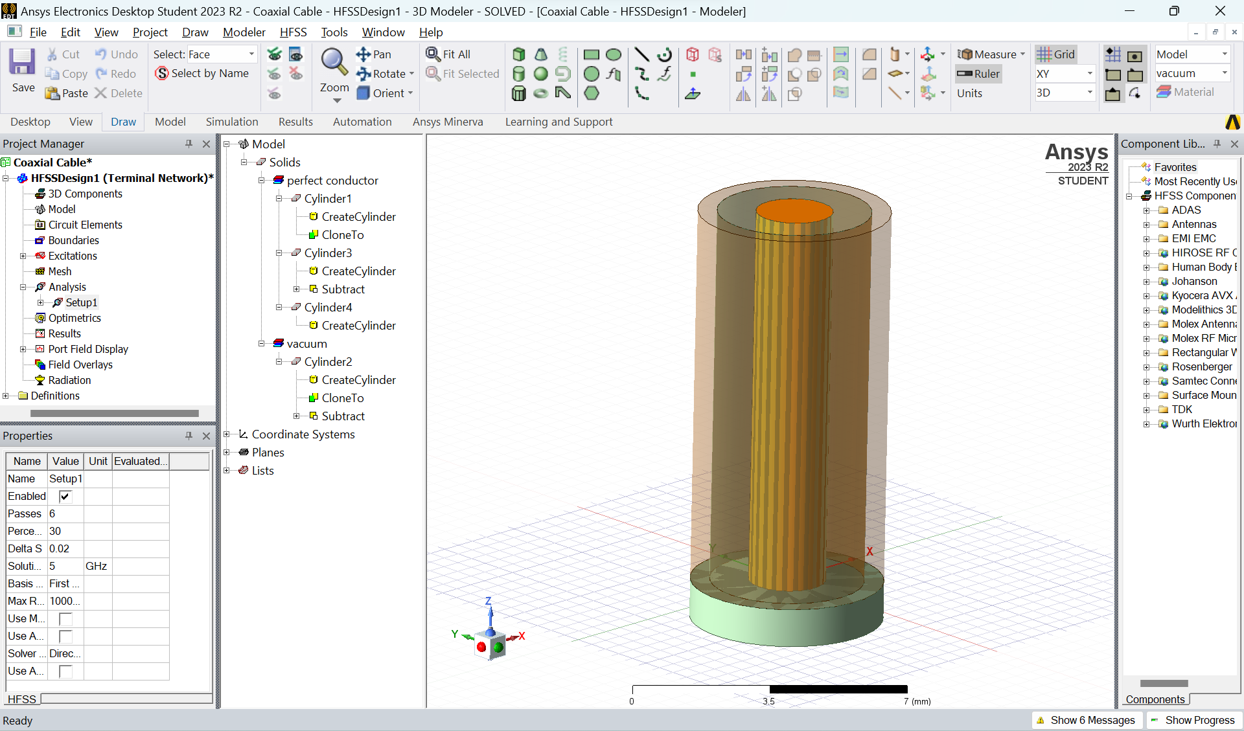
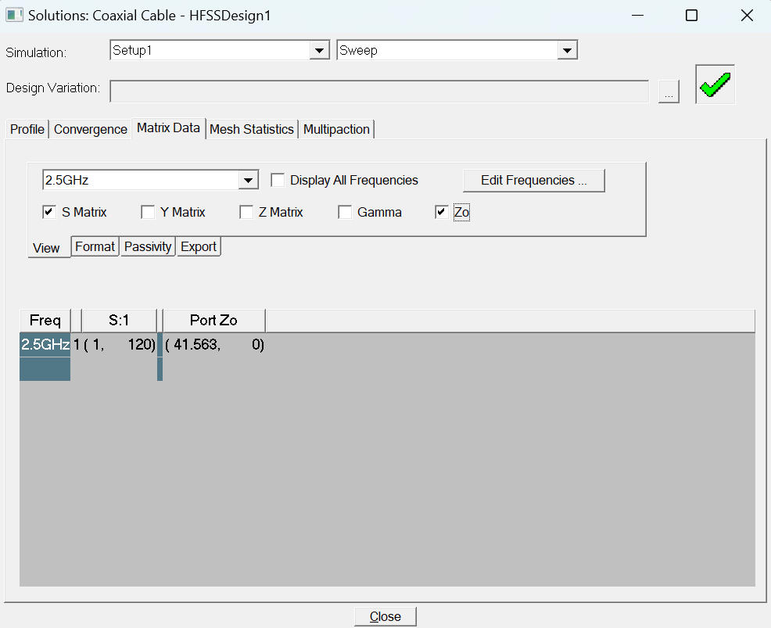
Week 2: Achieved
Successfully simulated the coaxial cable on Ansys HFSS.
Studied further into theory related to antenna
Dove deeper into different types of antenna and specifically the cross-yagi antenna.
Started designing the final antenna in Ansys.

Slide 7
Week 3:Milestones
Finishing the antenna design in Ansys HFSS.
Obtaining values regarding different parameters of the antenna designed.
Documenting the learnings.

Slide 8
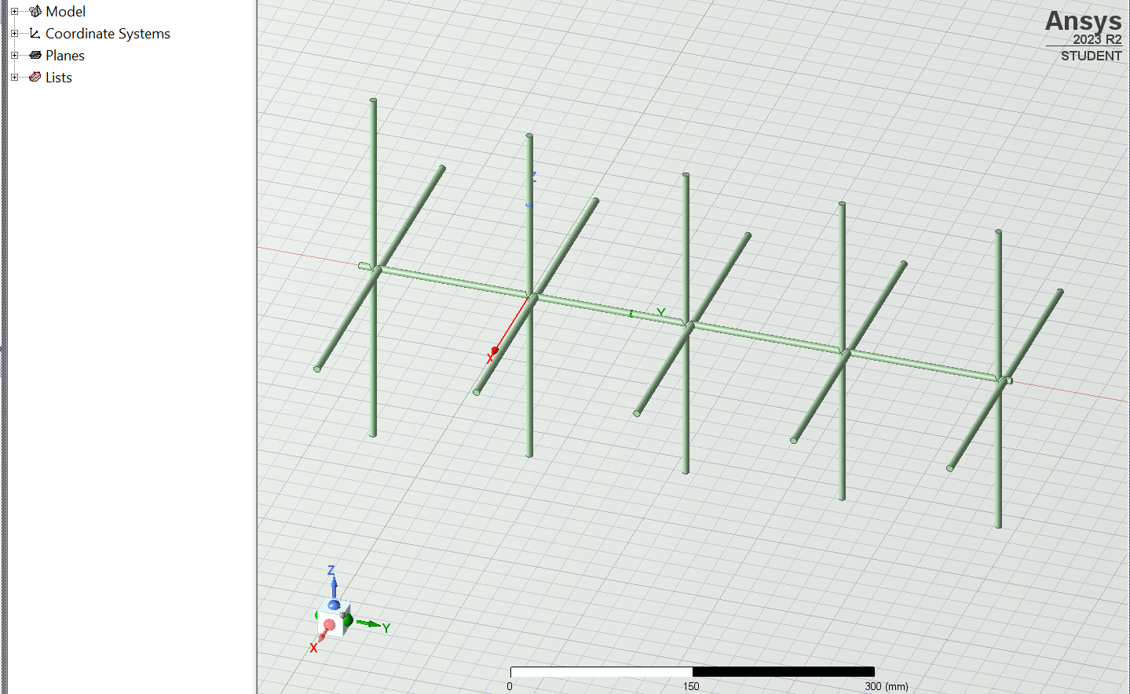
Week 3: Achieved
Successfully designed the cross-yagi
antenna on Ansys-HFSS.

Slide 9
My learnings from this project
Antenna and related concepts.
Ansys HFSS
Searching for information
Judging how much information is enough.

Slide 10
Thank You!!!

