Slide 1
COURSEWORK PROJECT · IMAGE PROCESSING
Smart Shadow Detection
& Removal in Outdoor Images
Using Color Space Analysis and Image Inpainting
Pranav
B.Tech, Artificial Intelligence & Data Science
Vishwakarma Institute of Technology, Pune

Slide 2
PROBLEM STATEMENT
Shadows quietly break computer vision pipelines
1
Object Detection & Tracking
2
Autonomous Navigation
Shadows are misread as extra objects or merge with real ones, hurting bounding-box accuracy.
Self-driving and robotics systems can mistake a hard shadow edge for an obstacle or lane boundary.
3
Surveillance & ANPR Systems
4
Image Segmentation
Harsh outdoor shadows reduce contrast on license plates, faces, and text regions, cutting recognition accuracy.
Shadow boundaries are frequently misclassified as object boundaries, corrupting segmentation masks.
Goal: detect and remove shadows automatically — without deep learning, without a GPU — using only classical color-space analysis.
02

Slide 3
OBJECTIVES
What this project set out to do
01
Detect shadow regions in a single outdoor RGB image using LAB & YCbCr color space analysis — no training data required.
02
Remove detected shadows via illumination correction (relighting) that preserves underlying surface texture.
03
Blend the recovered region seamlessly using boundary-aware image inpainting.
04
Evaluate detection (IoU, F1) and removal (RMSE, SSIM) quality against the ISTD benchmark dataset.
03

Slide 4
WHY THIS APPROACH
Classical color-space analysis vs. deep learning
Deep Learning (CNN / GAN)
Color Space Analysis (this project)
Data
requirement
Thousands of paired shadow/shadow-free images
None — works on a single image
Compute
GPU strongly recommended for training
Pure CPU, runs in milliseconds
Interpretability
Black-box decisions, hard to debug
Every threshold is a readable, tunable formula
Setup time
Model design + training pipeline
OpenCV + a few color-space formulas
Best for
Large-scale production accuracy
A CP-scale project with a tight timeline
04

Slide 5
SYSTEM DESIGN
End-to-end pipeline
Input Image
LAB / YCbCr
Conversion
Adaptive
Threshold
Mask Cleanup
Relighting
Boundary
Inpainting
→
→
→
→
→
Outdoor RGB photo
Color space transform
L, A, B statistics
Morphology + largest-
component filtering
LAB channel-wise
rescaling
Telea inpainting
on seam
Detection Stage
Removal Stage
Output: shadow-free image, saved alongside the mask and overlay for inspection.
05

Slide 6
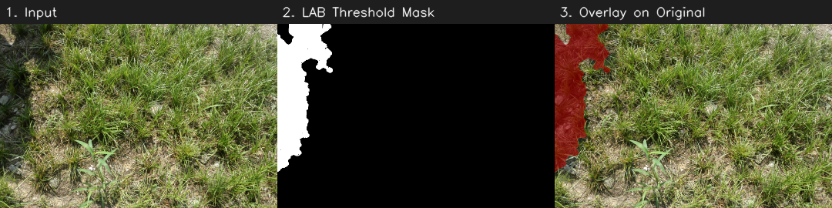
METHOD · DETECTION
Shadow detection via LAB color space
Based on Murali & Govindan's LAB-space method: shadows lower Lightness (L) while keeping chromaticity (a, b) roughly stable — unlike dark objects, which affect all channels.
If colorfulness ≤ 15: threshold on L alone → else: threshold on combined (L + A + B)
threshold = mean − (std / 3) + connected-component filtering to drop texture noise (grass, gravel, concrete grain)
06

Slide 7
METHOD · REMOVAL
Removal via relighting + boundary inpainting
1
2
3
Reference Ring
Channel-wise Relighting
Boundary Inpainting
Sample a ring of lit pixels just outside the shadow boundary as the relighting target.
For each LAB channel, rescale shadow pixels: (value − mean_shadow) × (std_lit / std_shadow) + mean_lit.
Apply Telea inpainting on a thin band around the shadow edge (cv2.inpaint) to blend the seam.
Why relighting before inpainting? Blind inpainting invents texture and loses realism; relighting keeps the original surface detail and only corrects illumination.
07

Slide 8
IMPLEMENTATION
Tools, libraries & dataset
Python 3
OpenCV
NumPy / SciPy
Core implementation language
Color space conversion, morphology, inpainting
Array operations & statistics
scikit-image
ISTD Dataset
CLI Design
SSIM metric for evaluation
1,330 train / 540 test shadow, mask, shadow-free triplets
main.py (pipeline) + evaluate.py (benchmarking)
08

Slide 9
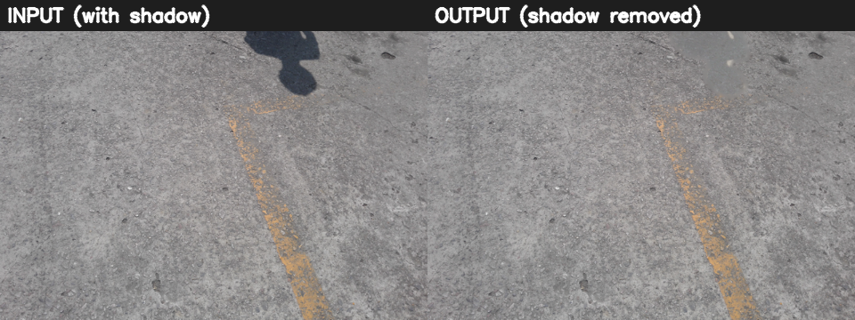
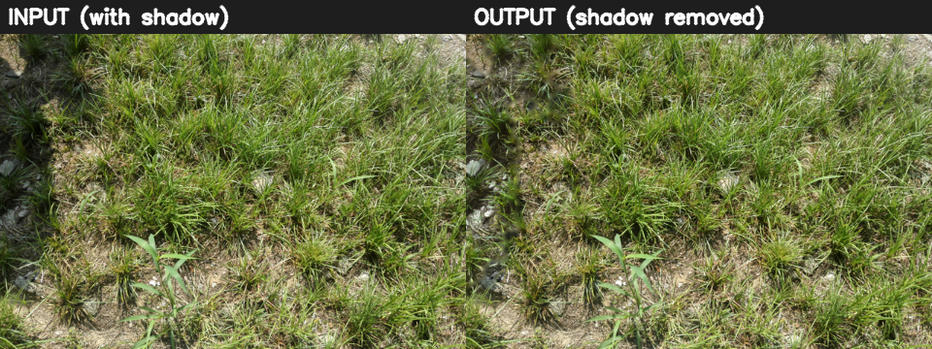
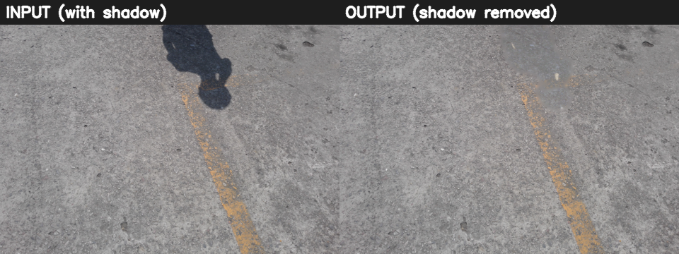
RESULTS
Real outdoor test images — before & after
Detection + relighting removes
the hard shadow edge and restores
surface tone, while keeping the
original texture (grain, blades,
cracks) intact.
Person + road · Grass patch · Person + road (2)
09

Slide 10
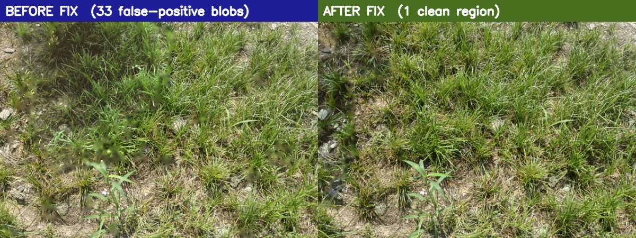
ENGINEERING CHALLENGE
Debugging a false-positive speckle bug
Problem: textured surfaces (grass blades, concrete grain) triggered dozens of tiny false-positive "shadow" blobs, each individually relit and inpainted → visible speckling across the whole image.
Fix: a real shadow is almost always one dominant region. Added a relative-size filter — keep a component only if it's ≥15% the size of the largest detected blob — dropping scattered texture noise.
Result: 33 scattered components → 1 clean region on the test image.
10

Slide 11
EVALUATION
Benchmarking against ISTD
evaluate.py runs the full pipeline over the ISTD test split and scores it against ground-truth masks and shadow-free images.
IoU
F1 Score
RMSE (LAB)
SSIM
DETECTION
DETECTION
REMOVAL
REMOVAL
Overlap between predicted and ground-truth shadow mask
Precision/recall balance of shadow-pixel classification
Pixel-level error vs. ground-truth shadow-free image
Structural similarity of the recovered region
Status: full ISTD test-set evaluation (540 images) in progress on local machine after the detection fix.
Numbers to insert here once evaluate.py finishes: IoU = ___, F1 = ___, RMSE = ___, SSIM = ___
11

Slide 12
CONCLUSION
Summary & future scope
What we built
Future scope
A dependency-free, training-free shadow detector using LAB/YCbCr color statistics
A two-stage removal pipeline: channel-wise relighting + boundary inpainting
A robustness fix for textured outdoor surfaces (grass, concrete)
A CLI pipeline + evaluation script benchmarked on the ISTD dataset
Hybrid model: classical detection + lightweight CNN refinement for hard/soft shadow edges
Extend to shadow removal in video (temporal consistency across frames)
Package as a mobile/web app for on-device photo correction
Benchmark against SRD dataset for broader generalization
12

Slide 13
Thank You
Questions & discussion welcome
References
Murali, S., Govindan, V.K. — "Shadow Detection and Removal from a Single Image Using LAB Color Space," Cybernetics and Information Technologies, 2013.
Wang, J., Li, X., Yang, J. — "Stacked Conditional GAN for Shadow Detection and Removal" (ISTD dataset), CVPR 2018.
Telea, A. — "An Image Inpainting Technique Based on the Fast Marching Method," 2004.
OpenCV Documentation — cv2.inpaint, color space conversions.
Pranav · AI & Data Science · Vishwakarma Institute of Technology, Pune

