Slide 1
MODULE-3
Identity and Access Management

Slide 2
THIS CHAPTER PRESENTS THE CURRENT STATE OF THE PRACTICE OF
IDENTITY AND ACCESS management (IAM) and support for IAM features that aid in Authentication, Authorization, and Auditing (AAA) of users accessing cloud services.

Slide 3
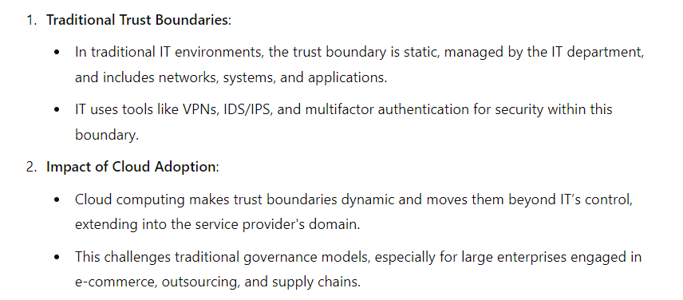
Trust Boundaries and IAM

Slide 4
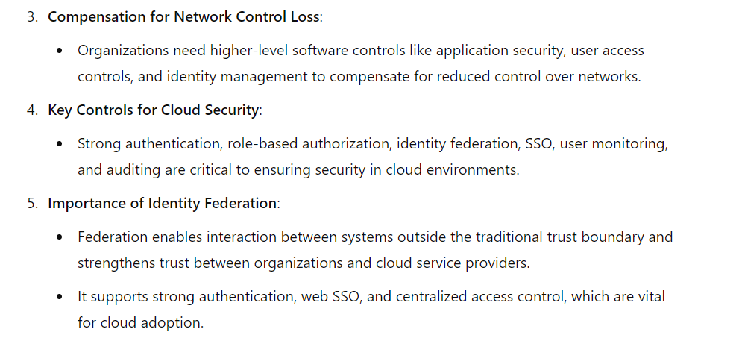

Slide 5
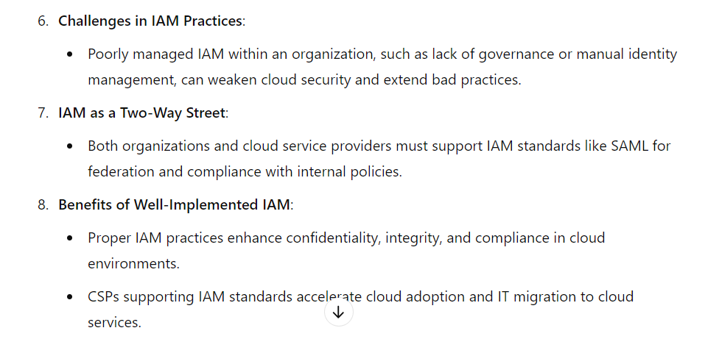

Slide 6
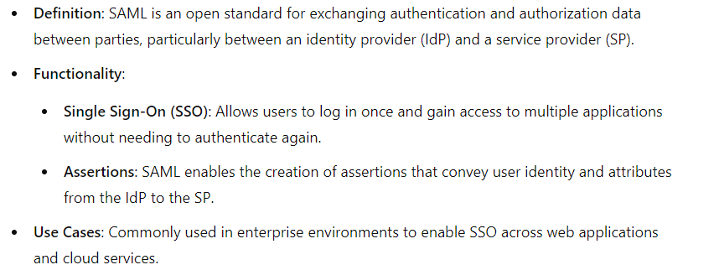
SAML (Security Assertion Markup Language)

Slide 7
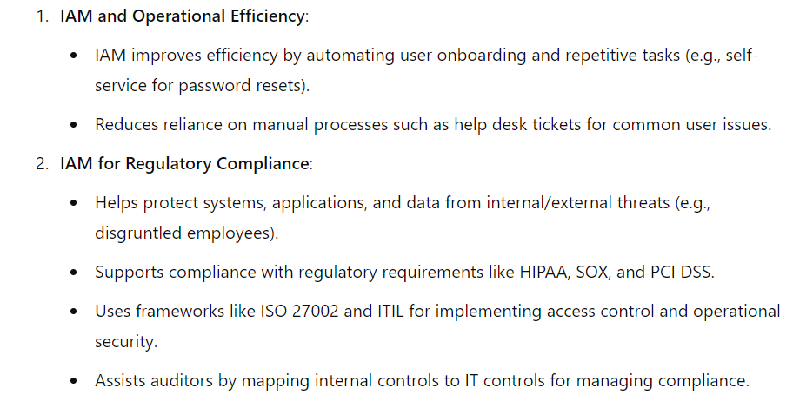
Why IAM?

Slide 8
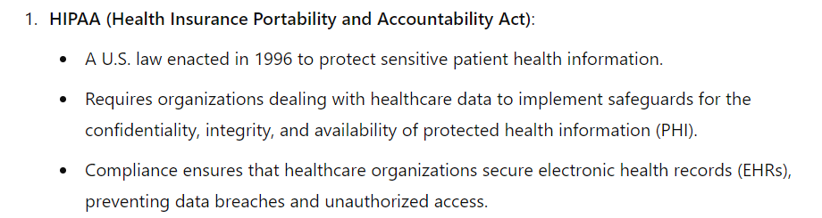

Slide 9
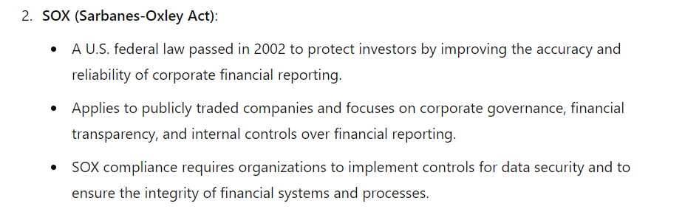

Slide 10
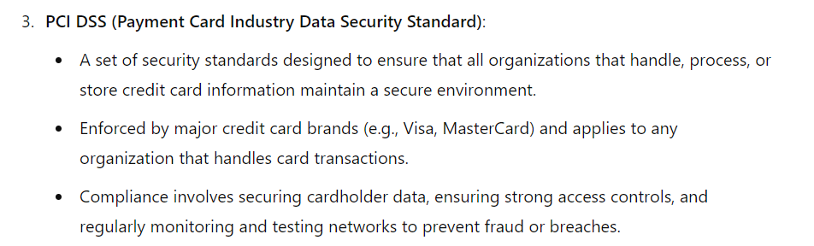

Slide 11
Web Single Sign-On (Web SSO) is a user authentication process that allows users to log in once and gain access to multiple related applications or services without needing to re-enter credentials for each one.

Slide 12
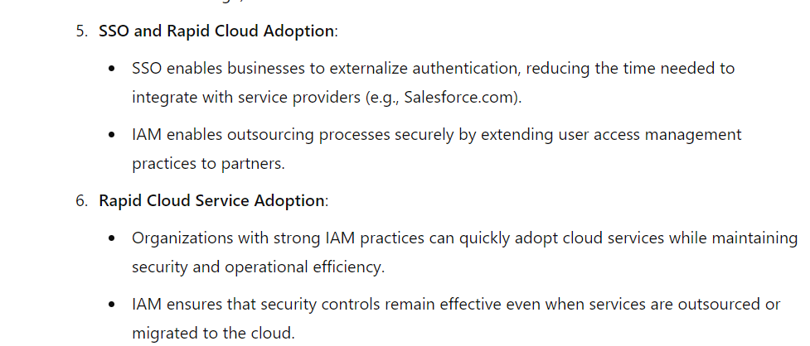

Slide 13
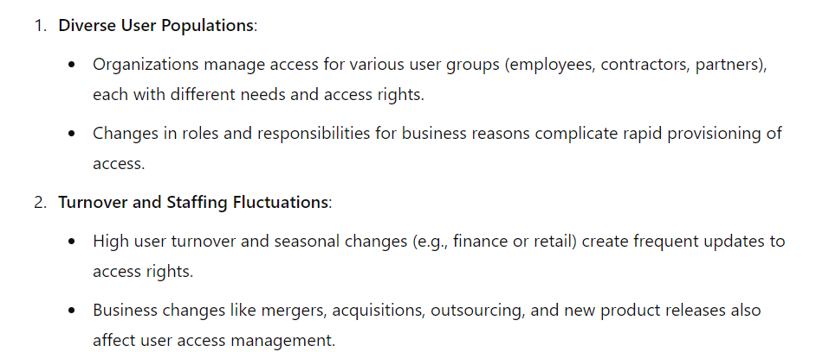
IAM Challenges

Slide 14
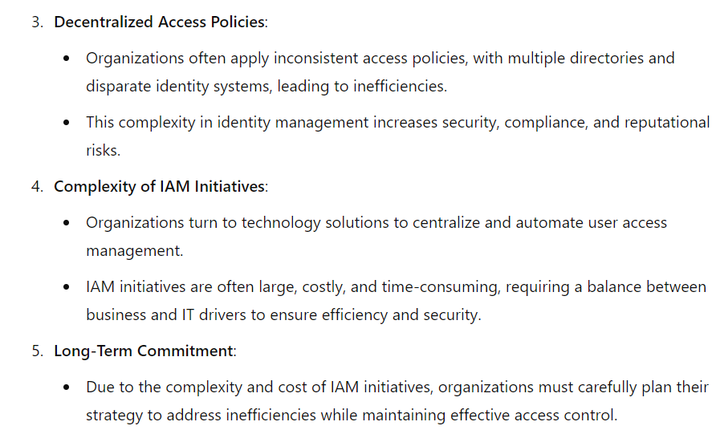

Slide 15
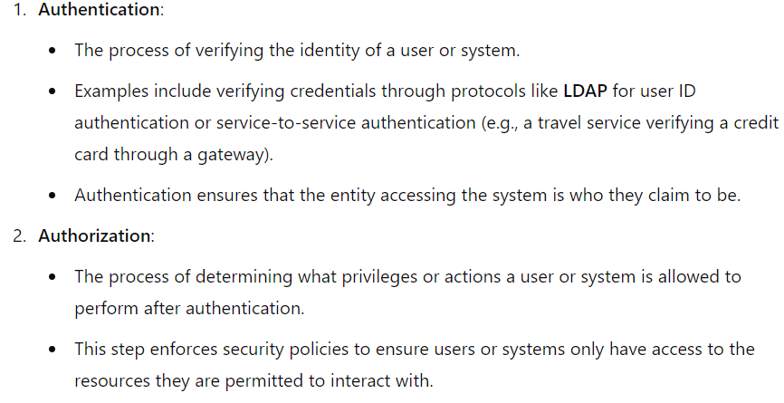
IAM (Identity and Access Management) definitions for key functions:

Slide 16
LDAP (Lightweight Directory Access Protocol) is an open, vendor-neutral protocol used for accessing and maintaining distributed directory information services over an IP network.
Directory services provide a centralized way to store information about users, systems, networks, and applications in an organized, hierarchical manner.
LDAP is widely used for authentication and authorization, particularly in corporate environments.

Slide 17
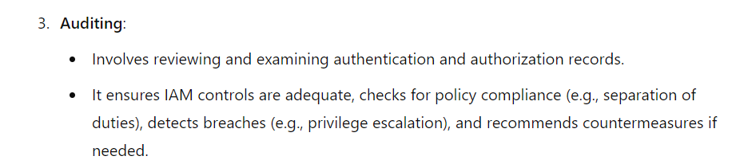

Slide 18
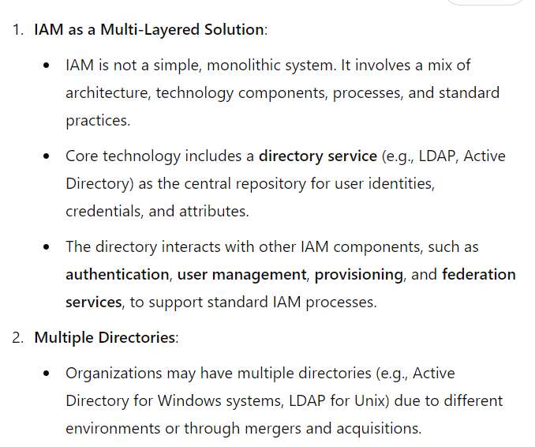
IAM Architecture and Practice

Slide 19
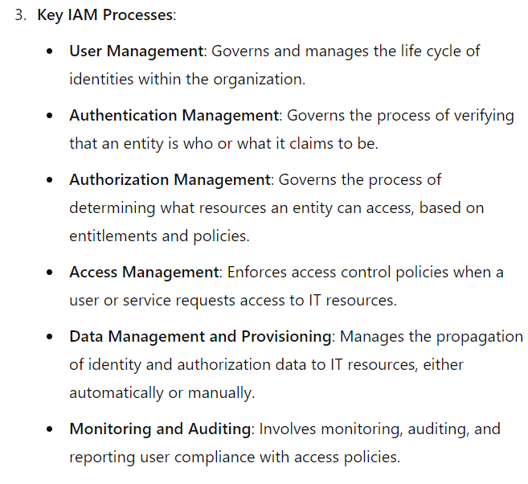

Slide 21
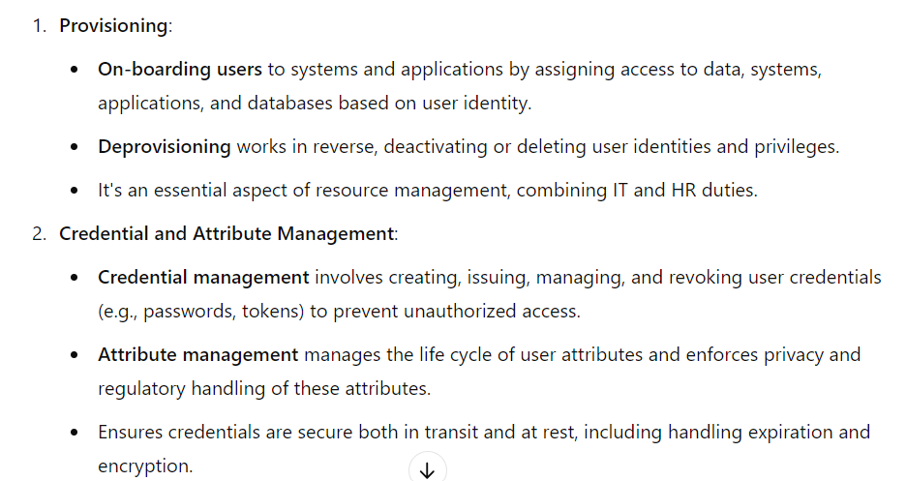
IAM processes support the following operational activities:

Slide 22
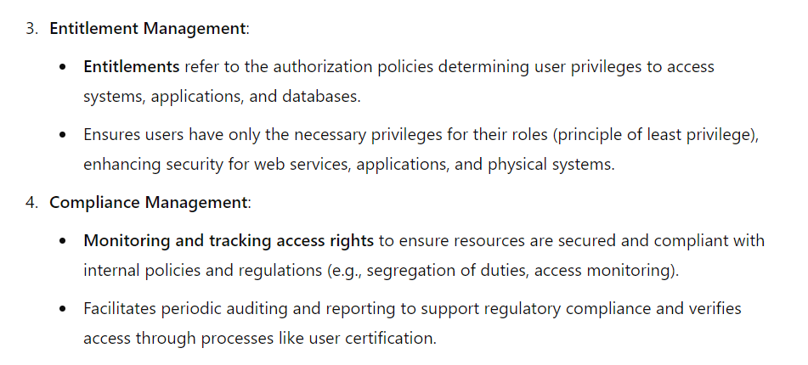

Slide 23
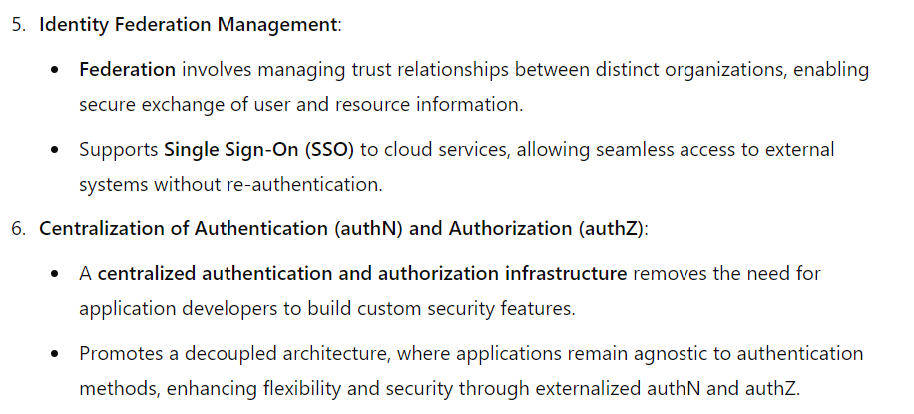

Slide 24
Identity life cycle

Slide 25
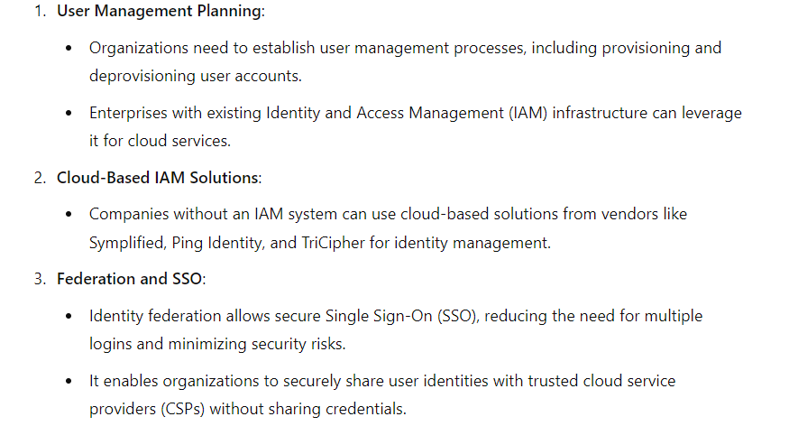
Getting Ready for the Cloud

Slide 26
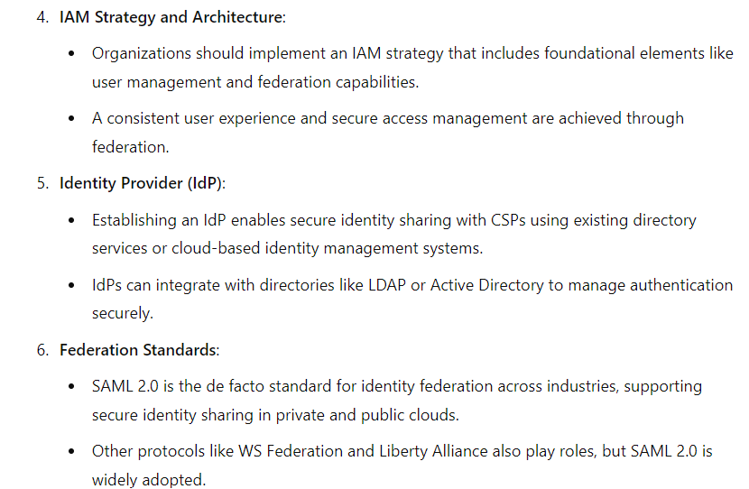

Slide 27
Relevant IAM Standards and Protocols for Cloud Services
IAM Standards and Specifications for Organizations
  Security Assertion Markup Language (SAML)
  Service Provisioning Markup Language (SPML)
  eXensible Access Control Markup Language (XACML)
  Open Authentication (OAuth)

Slide 28
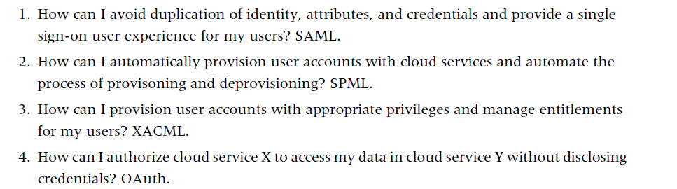
Four major challenges in user and access management faced by cloud users:

Slide 29
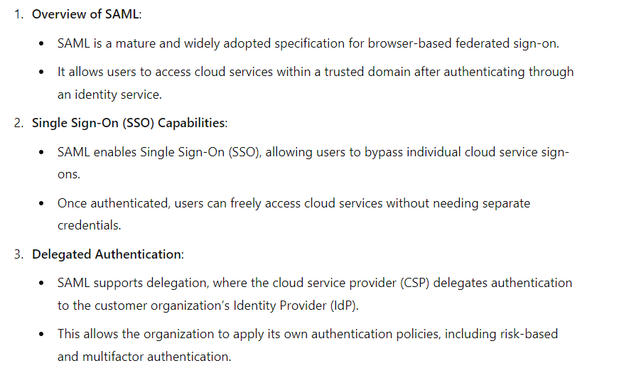
Security Assertion Markup Language (SAML)

Slide 30
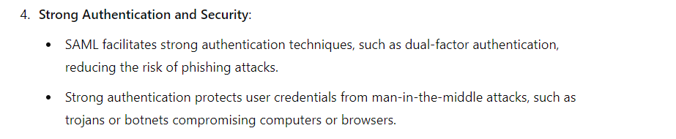

Slide 31
SSO transaction steps using SAML

Slide 32
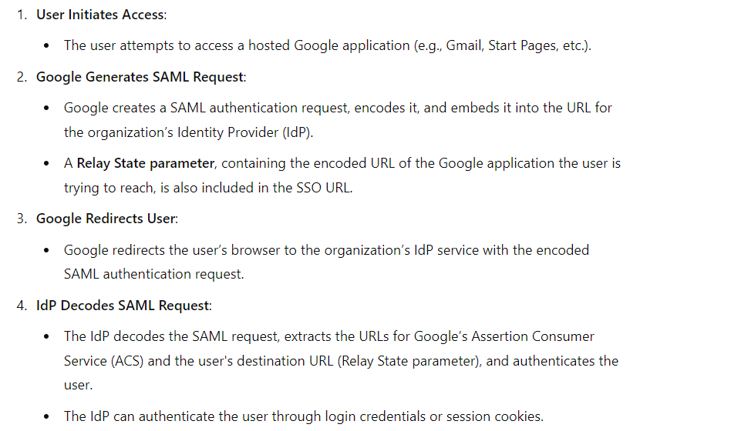

Slide 33
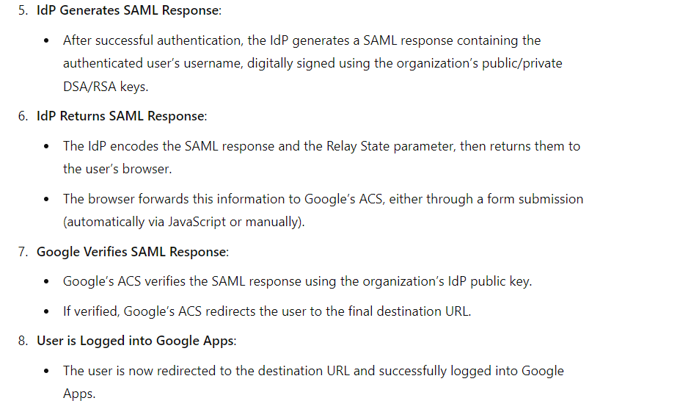

Slide 34
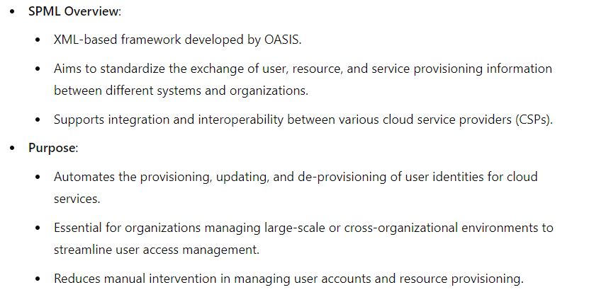
SPML Service Provisioning Markup Language

Slide 35
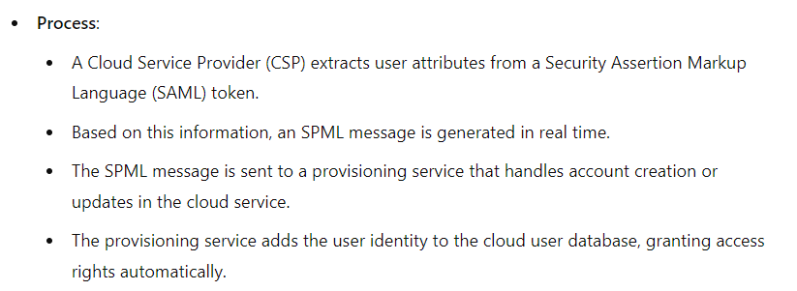

Slide 36
SPML USE CASE

Slide 37
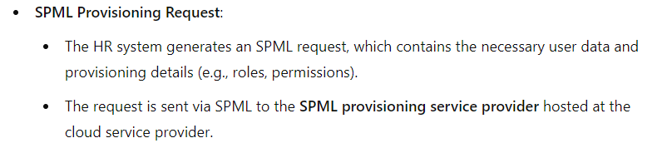
HR System of Record:
  Acts as the requesting authority.
  It is an SPML web services client that initiates the provisioning request for a user account (e.g., a new employee or an update to an existing user’s account).

Slide 38
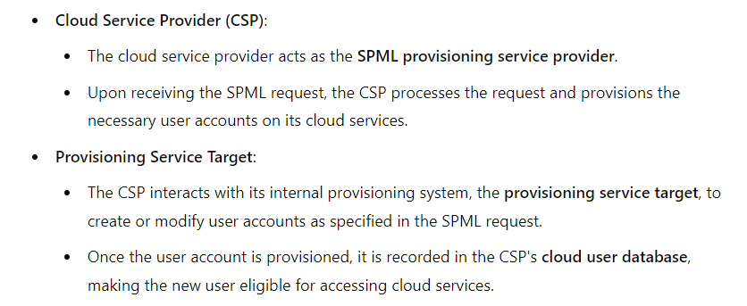

Slide 39
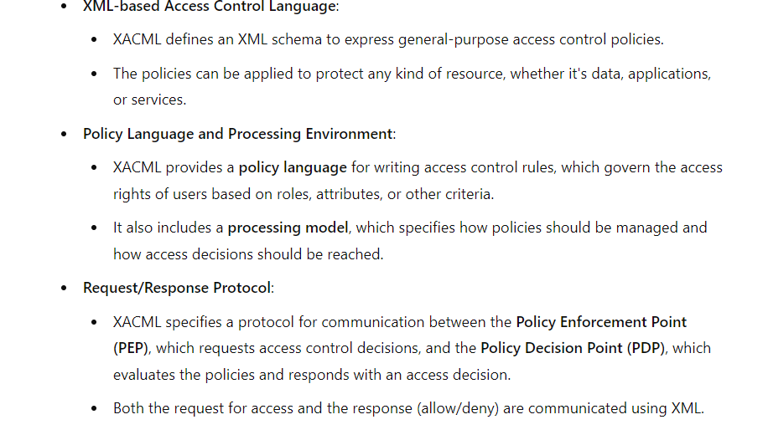
XAML-eXtensible Access Control Markup Language

Slide 40
eXensible Access Control Markup Language (XACML)
XACML is an OASIS-ratified, general-purpose, XML-based access control language for policy management and access decisions.
It provides an XML schema for a general policy language which is used to protect any kind of resource and make access decisions over these resources.
The XACML standard not only gives the model of the policy language, but also proposes a processing environment model to manage the policies and to conclude the access decisions.

Slide 41
XACML
XACML-eXtensible Access Control Markup Language
The XACML context also specifies the request/response protocol that the application environment can use to communicate with the decision point.
The response to an access request is also specified using XML.
In a centrally managed IAM architecture, application-specific authorization models (silos) make it difficult to state the access rights of individual users across all applications.
Hence,the goal of XACML is to provide a standardized language, a method of access control, and policy enforcement across all applications that implement a common authorization standard.
These authorization decisions are based on various authorization policies and rules centered on the user role and job function. In short, XACML allows for unified authorization policies.

Slide 42
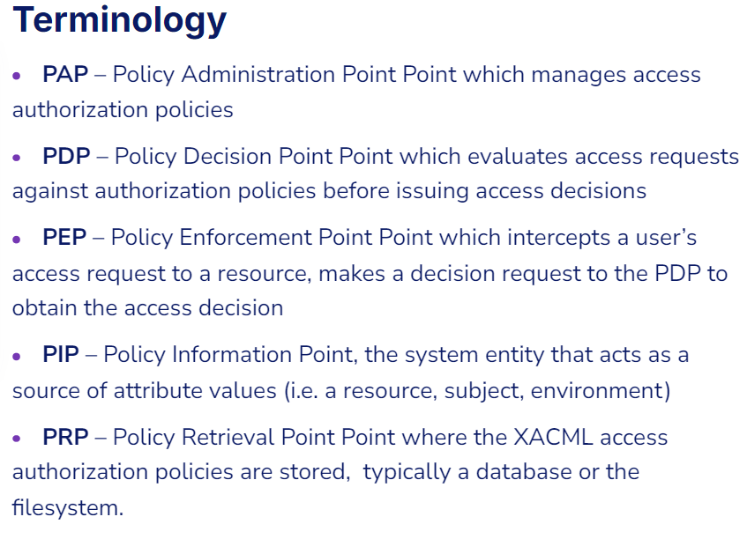

Slide 43
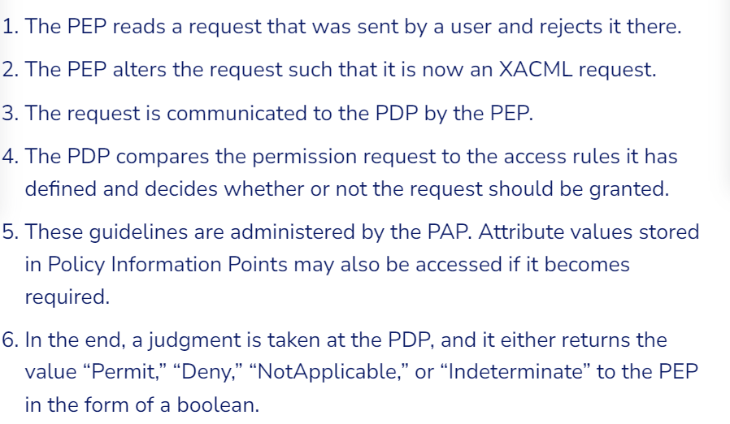
STEPS-

Slide 44
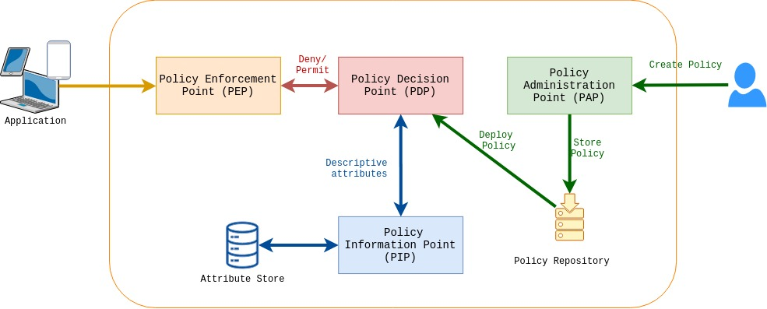
XACML Architecture Diagram

Slide 45
Illustrates the interaction among various health care participants with unique roles
(authorization privileges) accessing sensitive patient records stored in a health care application

Slide 46
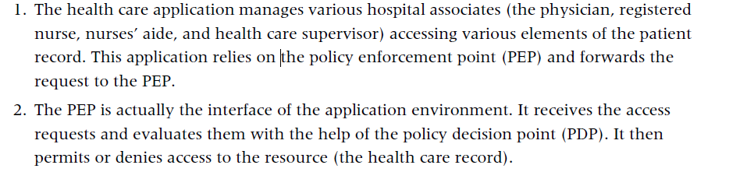
The figure illustrates the following steps involved in the XACML process:

Slide 47
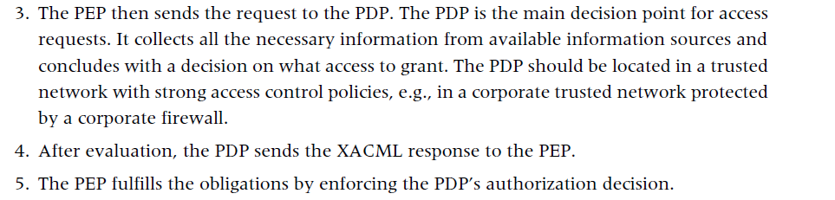

Slide 48
Open Authentication (OAuth)
OAuth is an emerging authentication standard that allows consumers to share their private resources (e.g., photos, videos, contact lists, bank accounts) stored on one CSP with another CSP without having to disclose the authentication information (e.g., username and password).
OAuth is an open protocol and it was created with the goal of enabling authorization via a secure application programming interface (API)—a simple and standard method for desktop, mobile, and web applications.

Slide 49
OAuth is a technological standard that allows you to authorize one app or service to sign in to another without divulging private information, such as passwords.
If you’ve ever received a message such as, “Sign in with Facebook?” or “Allow this application to access your account?” you’ve seen OAuth in action.
OAuth stands for Open Authorization—not authentication, as it’s sometimes assumed to be.
Authentication is a process that verifies your identity. OAuth does involve your identity, but its purpose is to grant permission to seamlessly connect to you with different apps and services without requiring you to create a new account.
OAuth provides that simplicity of experience by giving you the option to authorize two apps to share some of your data without revealing your credentials. It strikes a balance between convenience and security.

Slide 50
For application developers, OAuth is a method for publishing and interacting with protected data.
For CSPs, OAuth provides a way for users to access their data hosted by another provider while protecting their account credentials.
Google released a hybrid version of an OpenID and OAuth protocol that combines the authorization and authentication flow in fewer steps to enhance usability.
Google’s GData API recently announced support for OAuth.

Slide 51
Illustrates the sequence of interactions between customer or partner web application, Google services, and end user:

Slide 52
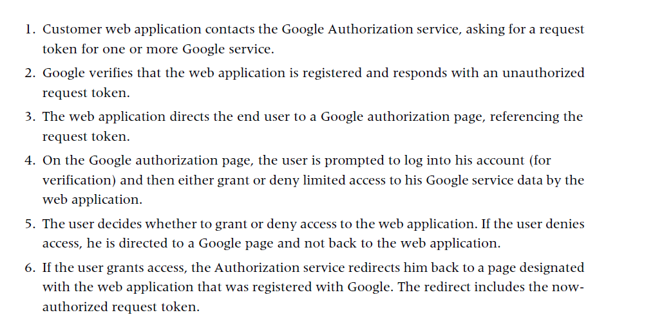

Slide 53
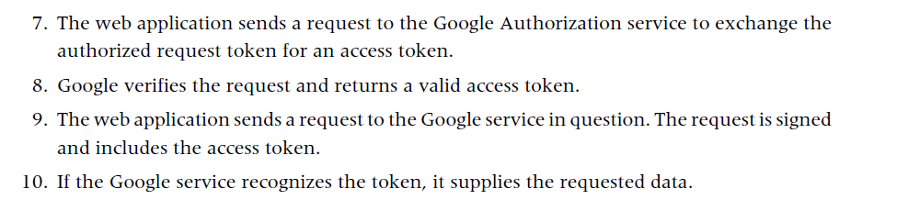

Slide 54
IAM Standards, Protocols, and Specifications for Consumers
OpenID
Information cards
Open Authentication (OATH)
Open Authentication API (OpenAuth)

Slide 55
OpenID
OpenID is an open, decentralized standard for user authentication and access control, allowing users to log on to many services with the same digital identity—i.e., a single sign-on user experience with services supporting OpenID.
As such, it replaces the common logon process that uses a logon username and password, by allowing a user to log on once and gain access to the resources of multiple software systems

Slide 56
OpenID is primarily targeted for consumer services offered by Internet companies including Google, eBay, Yahoo!, Microsoft, AOL, BBC, PayPal, and so on.
OpenID adoption for enterprise use (e.g., non-consumer use) is almost nonexistent due to trust issues; some researchers have revealed that OpenID could accelerate phishing attacks that can result in compromising user credentials.

Slide 57
Information cards
What is an Information Card?
An Information Card (InfoCard) is a digital identity representation that works like an electronic “ID card” stored on your computer or device.
It was introduced by Microsoft’s Identity Metasystem (CardSpace) around 2005–2011.
Instead of typing usernames and passwords, users select an InfoCard to authenticate to a service.

Slide 58
How It Works
User selects an InfoCard (like choosing a credit card from a wallet).
The InfoCard contains claims (pieces of identity information such as name, email, role).
These claims are issued by an Identity Provider (IdP) in a digitally signed token (e.g., SAML).
The InfoCard is presented to the Relying Party (RP) (the website or service).
The RP verifies the token and grants access.

Slide 59
Types of Information Cards
Self-issued Cards
  Created and managed by the user.
  Typically hold personal info (name, email).
Managed Cards
  Issued by an organization or IdP.
  Carry stronger security guarantees and trusted attributes.

Slide 60
Benefits
User-friendly → Selecting a card is easier than remembering multiple passwords.
Stronger Security → Reduces password reuse and phishing.
Claims-based Identity → Only necessary identity info is shared (privacy-friendly).
Limitations
Required Microsoft CardSpace or compatible software.
Never became widely adopted → replaced by modern standards like OpenID Connect (OIDC) and OAuth2.

Slide 61
IdP (Identity Provider)Definition
An Identity Provider (IdP) is a trusted system that creates, stores, and manages digital identities and provides authentication services to other applications or service providers.
Think of it as the “login authority” that vouches for your identity.
What IdP Does
Authentication – Verifies who you are (via username/password, MFA, biometrics, etc.).
Attribute/Claim Sharing – Passes user info (name, email, roles, group membership) to apps.
Federation – Allows single sign-on (SSO) across multiple apps and cloud services using standards like SAML, OAuth2, OpenID Connect.

Slide 62
Examples of IdPs
Enterprise IdPs: Microsoft Active Directory Federation Services (ADFS), OpenLDAP, Ping Identity, Okta.
Consumer IdPs: Google, Facebook, Apple ID, LinkedIn.
Cloud-native IdPs: AWS IAM, Azure AD (now Entra ID), Google Cloud IAM.

Slide 63
IAM Practices in the Cloud
Dynamic nature of IAM users, systems, and applications in the cloud and addresses the four key components of the IAM automation process:
• User Management, New Users
• User Management, User Modifications
• Authentication Management
• Authorization Management

Slide 64
User management functions in the cloud can be categorized as follows:
• Cloud identity administration
• Federation or SSO
• Authorization management
• Compliance management

Slide 65
Cloud Identity Administration
1. Focus on Lifecycle Management
  Provisioning and deprovisioning of user identities.
  Identity federation and Single Sign-On (SSO).
  Password/credential management and profile management.
  Administrative management of user accounts.
2. Federation and Identity Management Services
  Organizations unable to support federation internally should explore cloud-based identity management services.
  These services typically synchronize internal directories with a multitenant directory and act as a proxy Identity Provider (IdP).

Slide 66
Federated Identity (SSO)
Organizations planning to implement identity federation that enables SSO for users can take one of the following two paths (architectures):
• Implement an enterprise IdP within an organization perimeter.
• Integrate with a trusted cloud-based identity management service provider.
Both architectures have pros and cons.

Slide 67
Enterprise Identity Provider (IdP) Deployment Architecture
Cloud services delegate authentication to the organization’s Identity Provider (IdP).
The organization federates identities within a trusted circle of CSP (Cloud Service Provider) domains.
A circle of trust is established: only authorized CSP domains can delegate authentication to the IdP.
This approach gives the organization greater control over:
  User identities,
  Attributes,
  Credentials,
  Policies for authentication and authorization

Slide 68
Federated Identity
Definition
A federated identity is a way of linking a person’s digital identity across multiple systems, organizations, or domains so they can use one set of credentials to access many services.
It’s the foundation of Single Sign-On (SSO) across different platforms.
How It Works
Instead of each application having its own username/password for the user, a trusted Identity Provider (IdP) authenticates the user.
The IdP then shares a security token (via SAML, OAuth2, or OpenID Connect) with the other application (the Service Provider / Relying Party).
The user gains access without logging in again

Slide 69
Example (Everyday Use Case)
You log in to a university portal with your campus credentials.
Using the same login, you can access:
  Online library (external provider)
  Email (Google Workspace / Microsoft 365)
  Research databases (Springer, IEEE, etc.)
You don’t create separate accounts for each service -----that’s federated identity in action.

Slide 70
Pros
Leverage Existing IAM Investments
  Extend current IAM infrastructure (e.g., Active Directory, OpenSSO) to the cloud.
Consistent User Experience
  Enables Single Sign-On (SSO) across on-premises and cloud services.
Centralized Policy Control
  Organization retains full control of authentication rules, credentials, and attributes.
Stronger Security Posture
  Authentication does not rely solely on CSP; the IdP enforces the enterprise’s security policies.
Reduced Identity Duplication
  Avoids storing multiple sets of user credentials with different CSPs.

Slide 71
Cons
Operational Complexity
  The organization must maintain and secure the IdP infrastructure (servers, load balancers, replication).
High Availability Requirements
  IdP becomes a single point of failure; must ensure redundancy and disaster recovery.
Integration Challenges
  Different CSPs may have inconsistent support for federation standards (e.g., SAML, OIDC).
Cost Overhead
  Additional infrastructure, licensing, and maintenance increase costs.
Scalability Concerns
  Supporting multiple CSPs and large-scale user bases requires advanced capacity planning.

Slide 72
Identity provider deployment architecture

Slide 73
Note
Provides federated authentication-----one identity, multiple cloud services.
Ensures high availability using load balancers and replication.
Enterprise maintains full control over identities, policies, and credentials.

Slide 74
1. Identity Provider (IdP) and Cloud Service Provider (CSP)
The IdP application (on the left) is the enterprise-controlled identity system (e.g., OpenSSO, Active Directory Federation Services).
The CSP (on the right) is the cloud service (e.g., Salesforce, AWS, Office 365).
Authentication requests from the CSP are delegated to the IdP.
2. Secure Attribute Exchange & Federation (SAMLv2)
The IdP and CSP communicate using federation protocols like SAMLv2.
User attributes (identity info, permissions, roles) are securely exchanged.
This enables Single Sign-On (SSO) for users.

Slide 75
3. Load Balancer 2
Between the Internet and the IdP servers, a load balancer ensures high availability and distributes authentication requests.
If one server fails, requests are automatically routed to another.
4. OpenSSO Enterprise Servers
Two OpenSSO enterprise servers handle authentication and authorization.
They replicate configuration data between them for consistency (so policies, rules, and settings are always synchronized).

Slide 76
How it Works – Flow
A user tries to access a CSP service.
The CSP redirects the request to the IdP using SAMLv2.
The IdP authenticates the user using its directory servers.
If successful, the IdP sends a token/assertion back to the CSP.
The CSP grants access to the cloud service — without needing a separate CSP password.

Slide 77
5. Load Balancer 1
A second load balancer manages traffic to the backend directory servers (user databases).
Ensures requests are distributed evenly and avoids bottlenecks.
6. Directory Servers
The Directory Servers (1 & 2) store user data (credentials, attributes, roles, policies).
They perform multimaster replication, meaning updates in one directory automatically replicate to the other.
This ensures data redundancy and real-time synchronization.

Slide 78
Identity Management as a Service (IDaaS) Architecture
Cloud services can delegate authentication to a cloud-based IdP (IDaaS provider).
Organizations outsource identity management (federation, lifecycle, user processes) to third-party providers like Ping Identity, Myonelogin, Symplified.
This creates a SaaS model for identity management.

Slide 79
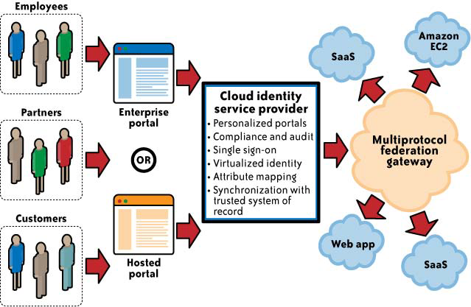
Cloud Identity Service Provider (IDaaS) with Multiprotocol Federation Gateway model.

Slide 80
1. Users
Employees, Partners, Customers need access to cloud services.
They log in through:
  Enterprise portal (for internal users like employees/partners), OR
  Hosted portal (for external users like customers).
2. Cloud Identity Service Provider (IDaaS)
This is the third-party identity management service (e.g., Ping Identity, Okta, Symplified).
It provides:
Personalized portals – Tailored login experiences for different user groups.
Compliance & audit – Logging and reporting for regulatory needs.
Single Sign-On (SSO) – One login works for multiple apps.
Virtualized identity – Centralized digital identity in the cloud.
Attribute mapping – Mapping user info (roles, department, etc.) to apps.
Synchronization – Keeps cloud identity store in sync with enterprise’s directory.

Slide 81
3. Multiprotocol Federation Gateway
Many cloud providers (CSPs) use different federation standards (e.g., SAML 1.1, SAML 2.0, OAuth2, OpenID Connect).
The gateway acts as a translator so organizations don’t need to reconfigure IAM for each provider.
It standardizes identity exchange across multiple CSPs.
4. Cloud Services
Once authentication is done, users can access:
  SaaS apps (e.g., Salesforce, Google Workspace, Office 365)
  Web apps
  Infrastructure services (e.g., Amazon EC2)

Slide 82
How it Works (Flow)
User (employee, partner, or customer) logs into the enterprise or hosted portal.
Authentication request goes to the Cloud Identity Service Provider (IDaaS).
The IDaaS authenticates the user (using synced corporate directory + policies).
The request passes through the Multiprotocol Federation Gateway, which translates federation standards if needed.
User gains seamless SSO access to cloud apps (SaaS, web apps, IaaS).

Slide 83
Cloud Authorization Management[3]
1. Enterprise Needs for Authorization
  Medium and large organizations usually require fine-grained authorization features to align with their internal security policies.
  This involves assigning privileges (also called entitlements) to users depending on their job roles or responsibilities.
  A common method is Role-Based Access Control (RBAC), where access rights are tied to organizational roles (e.g., HR staff, finance officers, IT administrators).

Slide 84
2. Current Limitations in Cloud Services
Many cloud service providers (CSPs) still offer only basic authorization features, often too coarse-grained for enterprise needs.
In practice, most CSPs support only two main roles:
  Administrator – can manage user accounts, set limited access policies, and control basic system configurations.
  End User – has access only to the services they use, with no administrative capabilities.

Slide 85
3. Typical Administrative Privileges
Administrators usually have the ability to:
  Provision and deprovision identities (create or remove user accounts).
  Manage basic user profiles (e.g., attributes like name, email, department).
  Configure basic policies, such as password strength rules or trusted network restrictions.
4. XACML (eXtensible Access Control Markup Language)
XACML is an industry standard for expressing fine-grained access control policies (who can access what, under which conditions).
It enables policy-driven authorization and supports complex organizational requirements.
However, as of now, most cloud providers do not support XACML for user authorization, leaving enterprises with limited policy enforcement options.

Slide 86
IAM Support for Compliance Management[5]
1. IAM’s Role in Compliance
Identity and Access Management (IAM) isn’t just about controlling access—it is also a compliance enabler.
Many compliance frameworks (like GDPR, HIPAA, SOX, ISO 27001) require strong access controls and auditability.
A well-implemented IAM system helps ensure that the right people have the right access at the right time—and that this can be proven during an audit.

Slide 87
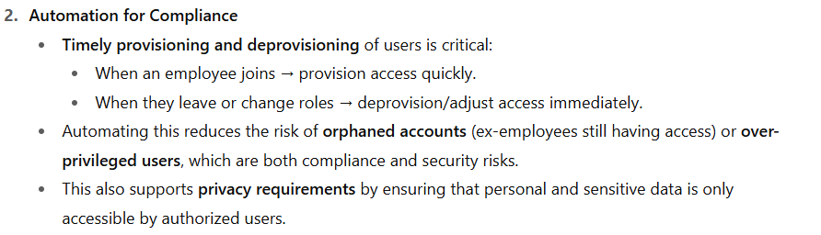

Slide 88
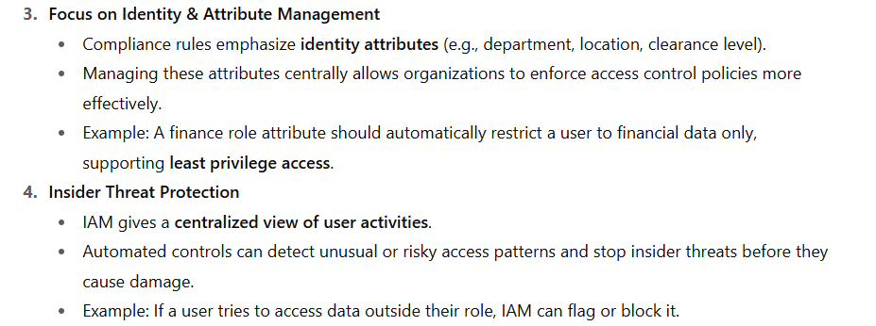

Slide 89
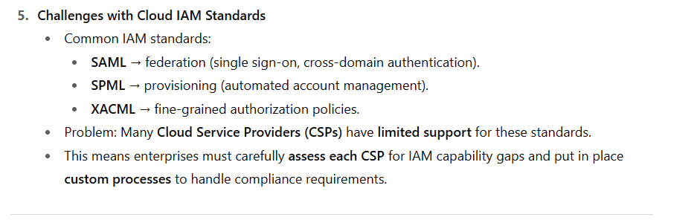

Slide 90
Cloud Service Provider IAM Practices
1. IAM as a Design Requirement for CSPs
CSPs (SaaS, PaaS, IaaS) should embed IAM features into the service design from the start.
Goal: Allow customers to manage user authentication and authorization through federation and user management standards.
Early IAM integration helps both:
  Customers – easier adoption (single sign-on, account provisioning).
  CSPs – smoother billing, accounting, and resource usage tracking.
If IAM is added later → costly retrofits.
Best practice: Externalize authentication from applications (e.g., use federation standards instead of custom login modules).

Slide 91
IAM Requirements in the Cloud[4]
1. Provisioning
  Users (including admins) must have cloud accounts provisioned automatically.
  Service-to-service integration (e.g., private cloud ↔ public cloud) must also support provisioning.
2. Single Sign-On (SSO)
  Should be based on federation standards (e.g., SAML, OpenID Connect).
  Enables seamless user experience across multiple apps/clouds.

Slide 92
3. Compliance & Access Control
  IAM must support regulatory compliance (SOX, PCI, HIPAA).
  RBAC (Role-Based Access Control) → grants minimum required privileges (least privilege model).
  Claims-based authentication → only entitlements (not full user identity) are passed.
    Example: Instead of sending “Alice Smith, HR Manager,” the system sends “Role: HR, Permission: View Payroll.”
    This supports privacy and fine-grained authorization.
4. User Activity Monitoring & Auditing
  Logging, monitoring, and reporting of user activity are mandatory.
  Helps meet internal security policies and external regulatory requirements.
  Example: Audit trails for HIPAA or PCI compliance.

Slide 93
SaaS Identity and Access Management (IAM) Responsibilities
[1] Key Security Concerns in SaaS
Security Management ----A top concern for IT and business leaders when adopting SaaS.
Operational Security vs. Access Control---While most SaaS vendors ensure operational security, organizations must address access control to align with internal policies and compliance.
Shadow IT Risk---Business units may bypass IT and directly purchase SaaS, causing loss of visibility and control.
Access Management Requirement----IT must ensure right users → right access → right time.

Slide 94
[2] IAM Challenges for Organizations
Provisioning & Life Cycle Extension
  Can the organization extend its existing IAM practices to SaaS services?
SaaS Provider IAM Capabilities
  Does the SaaS provider support automated provisioning and life cycle management, or is a custom solution needed?

Slide 95
Customer Responsibilities in SaaS IAM
User Provisioning
  Methods vary by provider (manual uploads, bulk spreadsheets, XML, just-in-time provisioning via SPML).
Profile Management
  Creation of roles (e.g., user, manager) to manage entitlements. Often basic and less flexible.
Evaluating IAM Features
  Check for support of SSO and federation (SAML 1.1 vs. 2.0).
  Example: Salesforce supports SAML 1.1, Google Apps supports SAML 2.0.
Investigation & Monitoring
  Logs and audit trails may be internal to the provider.
  Customers must negotiate log access for compliance (e.g., PCI DSS requires forensic investigation support).

Slide 96
Compliance Management
  Customers are responsible for ensuring compliance with SOX, GLBA, HIPAA, PCI DSS.
  Assess SaaS provider’s access control, logging, auditing capabilities.
SOX (Sarbanes–Oxley Act)= Financial reporting accuracy and integrity.
GLBA (Gramm–Leach–Bliley Act)= Protecting consumers’ financial information.
HIPAA (Health Insurance Portability and Accountability Act)
PCI DSS (Payment Card Industry Data Security Standard)

Slide 97
CSP Responsibilities in IAM (SaaS Context)
1. Authentication Services
If federated authentication is not supported, CSPs authenticate users directly.
Typically done via web forms over HTTPS with a user ID + password.
CSPs may enhance security by:
  Pre-registering trusted IP addresses/ranges (home, office, etc.).
  Blocking access from suspicious/untrusted networks.
  Preventing credential theft from keyloggers or compromised devices.
Key responsibility: Maintain a highly available authentication service, since it is the entry point for SaaS usage.

Slide 98
2. Account Management Policies
CSPs must define and communicate policies such as:
  Account lockout rules (e.g., after multiple failed login attempts).
  Account provisioning methods (manual, automated, delegated).
  Privileged account management roles and restrictions.
Ensures customers understand how accounts are created, suspended, or terminated.

Slide 99
3. Federation Support
CSPs should support identity federation to enable Single Sign-On (SSO).
Must clearly publish:
  Federation standards supported (e.g., SAML 1.1, SAML 2.0).
  Implementation examples for customer integration.
  Technical details for APIs (REST, SOAP) used in federation.
Enables enterprises to integrate SaaS authentication with corporate IAM systems.

Slide 100
PaaS IAM (Identity and Access Management)
Key Considerations for Organizations
Extending enterprise IAM practices to PaaS providers is more limited than in SaaS.
PaaS typically offers fewer standardized IAM options, requiring adaptation to provider-specific methods.

Slide 101
IaaS IAM (Identity and Access Management)
IaaS = Compute & Storage as a Service (e.g., AWS EC2).
Providers do not have visibility into the applications hosted on their infrastructure.
IAM support is basic and infrastructure-focused, not application-level.
Access typically via SSH (for admins) and API keys/certificates (for customers).

Slide 102
IaaS IAM Responsibilities & Challenges
1. User Provisioning
Provisioning developers/administrators on dynamic IaaS systems.
Large-scale workloads → provisioning must be automated at image creation.
Best practice: integrate with corporate directories (LDAP/Active Directory).
Challenge: cloud virtual networks and security policies may block directory-based authentication.
2. Privileged User Management
Admins often use SSH private keys.
Keys must be secured, rotated, and revoked when admins leave.
Risk: lost or compromised keys → full system access.

