Slide 1
15-440 Distributed Systems
Byzantine Fault Tolerance

Slide 2
Fault Tolerance
Terminology & Background
Byzantine Fault Tolerance (Lamport)
Async. BFT (Liskov)

Slide 3
Fault Tolerance
Being fault tolerant is strongly related to what are called dependable systems. Dependability implies the following:
  Availability: probability the system operates correctly at any given moment
  Reliability: ability to run correctly for a long interval of time
  Safety: failure to operate correctly does not lead to catastrophic failures
  Maintainability: ability to “easily” repair a failed system

Slide 4
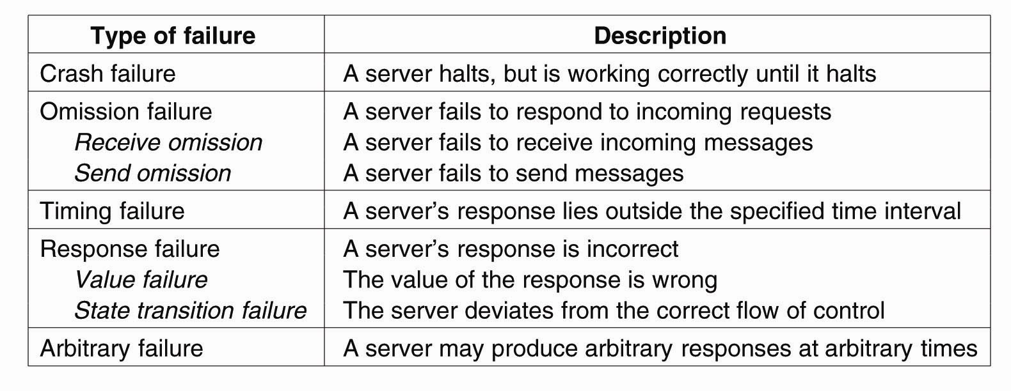
Failure Models
A system is said to fail if it cannot meet its promises. An error on the part of a system’s state may lead to a failure. The cause of an error is called a fault.

Slide 5
Process Resilience
Reaching agreement:
  computation results
  Electing a leader
  synchronization
  committing to a transaction
  …
How much replication is necessary?
  A system is k fault tolerant if it can survive faults in k components and still meet its specifications.

Slide 6
Agreement in Faulty Systems
Many things can go wrong…
Communication
  Message transmission can be unreliable
  Time taken to deliver a message is unbounded
  Adversary can intercept messages
Processes
  Can fail or team up to produce wrong results
Agreement very hard, sometime impossible, to achieve!

Slide 7
Fault Tolerance
Terminology & Background
Byzantine Fault Tolerance (Lamport)
Async. BFT (Liskov)

Slide 8
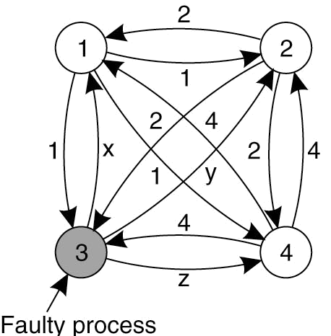
Agreement in Faulty Systems - 5
System of N processes, where each process i will provide a value v_{i} to each other. Some number of these processes may be incorrect (or malicious)
Goal: Each process learn the true values sent by each of the correct processes
The Byzantine agreement problem for three nonfaulty and one faulty process.

Slide 9
Byzantine General’s Problem
The Problem: “Several divisions of the Byzantine army are camped outside an enemy city, each division commanded by its own general. After observing the enemy, they must decide upon a common plan of action. Some of the generals may be traitors, trying to prevent the loyal generals from reaching agreement.”
Goal:
  All loyal generals decide upon the same plan of action.
  A small number of traitors cannot cause the loyal generals to adopt a bad plan.
The paper considers a slightly different version from the standpoint of one general (i.e. process) and multiple lieutenants.
Goal:
  All loyal lieutenants obey the same order.
  If the commanding general is loyal, the every loyal lieutenant obeys the order he sends.
Lamport, Shostak, Pease. The Byzantine General’s Problem. ACM TOPLAS, 4,3, July 1982, 382-401.

Slide 10
What we’ve learnt so far: tolerate fail-stop failures
Traditional RSM tolerates benign failures
  Node crashes
  Network partitions
A RSM w/ 2f+1 replicas can tolerate f simultaneous crashes

Slide 11
Why doesn’t traditional RSM work with Byzantine nodes?
Cannot rely on the primary to assign seqno
  Malicious primary can assign the same seqno to different requests!
Cannot use Paxos for view change
  Paxos uses a majority accept-quorum to tolerate f benign faults out of 2f+1 nodes
  Does the intersection of two quorums always contain one honest node?
  Bad node tells different things to different quorums!
    E.g. tell N1 accept=val1 and tell N2 accept=val2

Slide 12

Paxos under Byzantine faults
Prepare vid=1, myn=N0:1
OK val=null
N2
N0
N1
nh=N0:1
Prepare vid=1, myn=N0:1
OK val=null
nh=N0:1

Slide 13
Paxos under Byzantine faults
accept vid=1, myn=N0:1, val=xyz
OK
N2
N0
X
N1
N0 decides on
Vid1=xyz
nh=N0:1
nh=N0:1

Slide 14
Paxos under Byzantine faults
prepare vid=1, myn=N1:1, val=abc
OK val=null
N2
X
N0
N1
N0 decides on
Vid1=xyz
nh=N0:1
nh=N0:1

Slide 15
Paxos under Byzantine faults
accept vid=1, myn=N1:1, val=abc
OK
N2
X
N0
N1
N0 decides on
Vid1=xyz
nh=N0:1
nh=N1:1
Agreement conflict!
N1 decides on
Vid1=abc

Slide 16

BFT requires a 2f+1 quorum out of 3f+1 nodes
1. State:
…
2. State:
…
3. State:
…
4. State:
…
A
A
A
Servers
X
write A
write A
write A
write A
Clients
For liveness, the quorum size must be at most N - f

Slide 17
BFT Quorums
1. State:
…
2. State:
…
3. State:
…
4. State:
…
A
A
B
B
B
Servers
X
write B
write B
write B
write B
Clients
For correctness, any two quorums must intersect at least
one honest node: (N-f) + (N-f) - N >= f+1 N >= 3f+1

Slide 18
Impossibility Results
General 1
General 1
attack
attack
attack
retreat
General 2
General 3
General 2
General 3
retreat
retreat
No solution for three processes can handle a single traitor.
In a system with m faulty processes agreement can be achieved only if there are 2m+1 (more than 2/3) functioning correctly.
Lamport, Shostak, Pease. The Byzantine General’s Problem. ACM TOPLAS, 4,3, July 1982, 382-401.
Notes:
The resilience of BFT is optimal: at least 3 f + 1 replicas are necessary to provide the safety and liveness properties under our assumptions when up to f replicas are faulty. To understand the bound on the number of faulty replicas, consider a replicated service that implements a mutable variable with read and write operations. To provide liveness, the service may have to return a reply before the request is received by more than n− f replicas, since f replicas might be faulty and not responding. Therefore, the service may reply to a write request after the new value is written only to a set W with n − f replicas. If later a client issues a read request, it may receive a reply based on the state of a set R with n− f replicas. R and W may have only n−2 f replicas in common. Additionally, it is possible that the f replicas that did not respond are not faulty and, therefore, f of those that responded might be faulty. As a result, the intersection between R and W may contain only n − 3 f nonfaulty replicas. It is impossible to ensure that the read returns the correct value unless R and
W have at least one nonfaulty replica in common; therefore n > 3 f .

Slide 19
Agreement in Faulty Systems
Possible characteristics of the underlying system:
Synchronous versus asynchronous systems.
  A system is synchronized if the process operation in lock-step mode. Otherwise, it is asynchronous.
Communication delay is bounded or not.
Message delivery is ordered or not.
Message transmission is done through unicasting or multicasting.

Slide 20
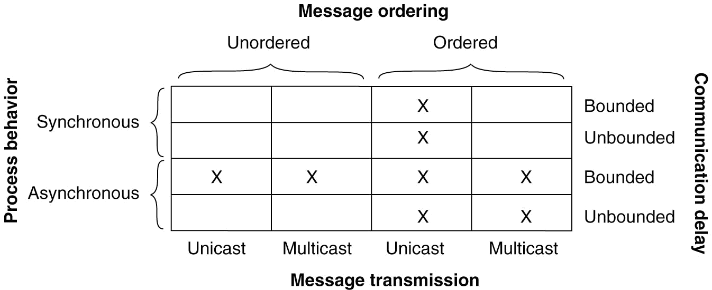
Agreement in Faulty Systems
Circumstances under which distributed agreement can be reached. Note that most distributed systems assume that
  processes behave asynchronously
  messages are unicast
  communication delays are unbounded (see red blocks)

Slide 21
Synchronous, Byzantine world
Synchronous
Asynchronous
Fail-stop
Byzantine

Slide 22
Agreement in Faulty Systems - 4
Byzantine Agreement [Lamport, Shostak, Pease, 1982]
Assumptions:
  Every message that is sent is delivered correctly
  The receiver knows who sent the message
  Message delivery time is bounded

Slide 23
Byzantine Agreement Algorithm
(oral messages) - 1
Phase 1: Each process sends its value to the other processes. Correct processes send the same (correct) value to all. Faulty processes may send different values to each if desired (or no message).
Assumptions: 1) Every message that is sent is delivered correctly; 2) The receiver of a message knows who sent it; 3) The absence of a message can be detected.
Lamport, Shostak, Pease. The Byzantine General’s Problem. ACM TOPLAS, 4,3, July 1982, 382-401.

Slide 24
Byzantine General Problem
Example - 1
Phase 1: Generals announce their troop strengths to each other
1
P1
P2
1
1
P3
P4

Slide 25
Byzantine General Problem
Example - 2
Phase 1: Generals announce their troop strengths to each other
2
P1
P2
2
2
P3
P4

Slide 26
Byzantine General Problem
Example - 3
Phase 1: Generals announce their troop strengths to each other
P1
P2
4
4
4
P3
P4

Slide 27
Byzantine Agreement Algorithm (oral messages) - 2
Phase 2: Each process uses the messages to create a vector of responses – must be a default value for missing messages.
Assumptions: 1) Every message that is sent is delivered correctly; 2) The receiver of a message knows who sent it; 3) The absence of a message can be detected.
Lamport, Shostak, Pease. The Byzantine General’s Problem. ACM TOPLAS, 4,3, July 1982, 382-401.

Slide 28
Byzantine General Problem
Example - 4
Phase 2: Each general construct a vector with all troops
P1 | P2 | P3 | P4
1 | 2 | y | 4
P1 | P2 | P3 | P4
1 | 2 | x | 4
P1
P2
x
y
z
P1 | P2 | P3 | P4
1 | 2 | z | 4
P3
P4

Slide 29
Byzantine Agreement Algorithm (oral messages) - 3
Phase 3: Each process sends its vector to all other processes.
Phase 4: Each process the information received from every other process to do its computation.
Assumptions: 1) Every message that is sent is delivered correctly; 2) The receiver of a message knows who sent it; 3) The absence of a message can be detected.
Lamport, Shostak, Pease. The Byzantine General’s Problem. ACM TOPLAS, 4,3, July 1982, 382-401.

Slide 30
Byzantine General Problem
Example - 5
Phase 3,4: Generals send their vectors to each other and compute majority voting
P1 | P2 | P3 | P4
1 | 2 | x | 4
e | f | g | h
1 | 2 | z | 4
P1 | P2 | P3 | P4
1 | 2 | y | 4
a | b | c | d
1 | 2 | z | 4
P1
P2
P1
P2
P3
P3
P4
P4
(a, b, c, d)
(1, 2, ?, 4)
(1, 2, ?, 4)
(e, f, g, h)
P1 | P2 | P3 | P4
1 | 2 | x | 4
1 | 2 | y | 4
h | i | j | k
(h, i, j, k)
P3
P4
P1
P2
P3
(1, 2, ?, 4)

Slide 31
Byzantine Agreement Algorithm (signed messages)
Adds the additional assumptions:
  A loyal general’s signature cannot be forged and any alteration of the contents of the signed message can be detected.
  Anyone can verify the authenticity of a general’s signature.
Algorithm SM(m):
The general signs and sends his value to every lieutenant.
For each i:
  If lieutenant i receives a message of the form v:0 from the commander and he has not received any order, then he lets Vi equal {v} and he sends v:0:i to every other lieutenant.
  If lieutenant i receives a message of the form v:0:j1:…:jk and v is not in the set Vi then he adds v to Vi and if k < m, he sends the message v:0:j1:…:jk:i to every other lieutenant other than j1,…,jk
  For each i: When lieutenant i will receive no more messages, he obeys the order in choice(Vi).
Algorithm SM(m) solves the Byzantine General’s problem if there are at most m traitors.
Lamport, Shostak, Pease. The Byzantine General’s Problem. ACM TOPLAS, 4,3, July 1982, 382-401.

Slide 32
Signed messages
General
General
attack:0
attack:0
attack:0
retreat:0
???
retreat:0:2
Lieutenant 1
Lieutenant 2
Lieutenant 1
Lieutenant 2
attack:0:1
attack:0:1
SM(1) with one traitor
Lamport, Shostak, Pease. The Byzantine General’s Problem. ACM TOPLAS, 4,3, July 1982, 382-401.

Slide 33
Fault Tolerance
Terminology & Background
Byzantine Fault Tolerance (Lamport)
Async. BFT (Liskov)

Slide 34
Practical Byzantine Fault Tolerance:Asynchronous, Byzantine
Synchronous
Asynchronous
Fail-stop
Byzantine

Slide 35
Practical Byzantine Fault Tolerance
Why async BFT? BFT:
  Malicious attacks, software errors
  Need N-version programming?
  Faulty client can write garbage data, but can’t make system inconsistent (violate operational semantics)
Why async?
  Faulty network can violate timing assumptions
  But can also prevent liveness

Slide 36
Agreement in Faulty Systems - 4
Byzantine Agreement [Lamport, Shostak, Pease, 1982]
Assumptions:
  Every message that is sent is delivered correctly
  The receiver knows who sent the message
  Message delivery time is bounded
Notes:
Table is from http://csis.pace.edu/~marchese/CS865/Papers/Turek-ManyFacesOfConsensus.pdf
In the system Fischer, Lynch, and Paterson studied, messages were unordered, communication was unbounded, and processors were asyn- chronous.

Slide 37
Distributed systems
FLP impossibility: Async consensus may not terminate
  Sketch of proof: System starts in “bivalent” state (may decide 0 or 1). At some point, the system is one message away from deciding on 0 or 1. If that message is delayed, another message may move the system away from deciding.
  Holds even when servers can only crash (not Byzantine)!
  Hence, protocol cannot always be live (but there exist randomized BFT variants that are probably live)
[See Fischer, M. J., Lynch, N. A., and Paterson, M. S. 1985. Impossibility of distributed consensus with one faulty process. J. ACM 32, 2 (Apr. 1985), 374-382.]
In the system Fischer, Lynch, and Paterson studied, messages were unordered, communication was unbounded, and processors were asynchronous.

Slide 38
PBFT ideas
PBFT, “Practical Byzantine Fault Tolerance”, M. Castro and B. Liskov, SOSP 1999
Replicate service across many nodes
  Assumption: only a small fraction of nodes are Byzantine
  Rely on a super-majority of votes to decide on correct computation.
  Makes some weak synchrony (message delay) assumptions to ensure liveness
    Would violate FLP impossibility otherwise
PBFT property: tolerates <=f failures using a RSM with 3f+1 replicas

Slide 39
PBFT main ideas
Static configuration (same 3f+1 nodes)
To deal with malicious primary
  Use a 3-phase protocol to agree on sequence number
To deal with loss of agreement
  Use a bigger quorum (2f+1 out of 3f+1 nodes)
Need to authenticate communications

Slide 40
PBFT Strategy
Primary runs the protocol in the normal case
Replicas watch the primary and do a view change if it fails

Slide 41
Replica state
A replica id i (between 0 and N-1)
  Replica 0, replica 1, …
A view number v#, initially 0
Primary is the replica with id
  i = v# mod N
A log of <op, seq#, status> entries
  Status = pre-prepared or prepared or committed

Slide 42
Normal Case
Client sends request to primary
  or to all

Slide 43
Normal Case
Primary sends pre-prepare message to all
Pre-prepare contains <v#,seq#,op>
  Records operation in log as pre-prepared
  Keep in mind that primary might be malicious
    Send different seq# for the same op to different replicas
    Use a duplicate seq# for op

Slide 44
Normal Case
Replicas check the pre-prepare and if it is ok:
  Record operation in log as pre-prepared
  Send prepare messages to all
  Prepare contains <i,v#,seq#,op>
All to all communication

Slide 45
Normal Case:
Replicas wait for 2f+1 matching prepares
  Record operation in log as prepared
  Send commit message to all
  Commit contains <i,v#,seq#,op>
What does this stage achieve:
  All honest nodes that are prepared prepare the same value
  At least f+1 honest nodes have sent prepare/pre-prepare

Slide 46
Normal Case:
Replicas wait for 2f+1 matching commits
  Ensures that at least f+1 trustworthy nodes have committed
Record operation in log as committed
  Execute the operation
  Send result to the client

Slide 47
Normal Case
Client waits for f+1 matching replies
  Ensures at least one node has committed and executed

Slide 48
PBFT
Request
Pre-Prepare
Prepare
Commit
Reply
Client
Primary
Replica 2
Replica 3
Replica 4

Slide 49
View Change
Replicas watch the primary
Request a view change
Commit point: when 2f+1 replicas have prepared

Slide 50
View Change
Replicas watch the primary
Request a view change
  send a do-viewchange request to all
  new primary requires 2f+1 requests to accept new role
  sends new-view with proof that it got the

Slide 51
Additional Issues
State transfer
Checkpoints (garbage collection of the log)
Selection of the primary
Timing of view changes

Slide 52
Possible improvements
Lower latency for writes (4 messages)
  Replicas respond at prepare
  Client waits for 2f+1 matching responses
Fast reads (one round trip)
  Client sends to all; they respond immediately
  Client waits for 2f+1 matching responses

Slide 53
Practical limitations of BFTs
Expensive
Protection is achieved only when <= f nodes fail
Does not prevent many types of attacks:
  Turn a machine into a botnet node
  Steal SSNs from servers

