Slide 1
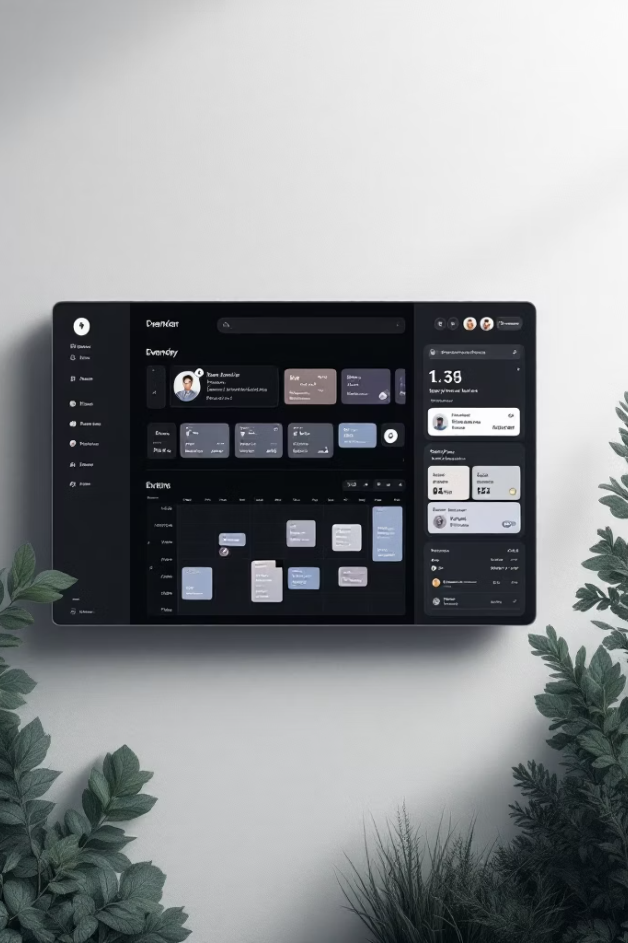
Event Management & Booking Platform
Microservices-Based Architecture
Team: Pranav Ozarde (322046)
Sarthak Kad (322021)
Shivraj Phatangare (322020)
Abhishek Gaikwad (322025)

Slide 2
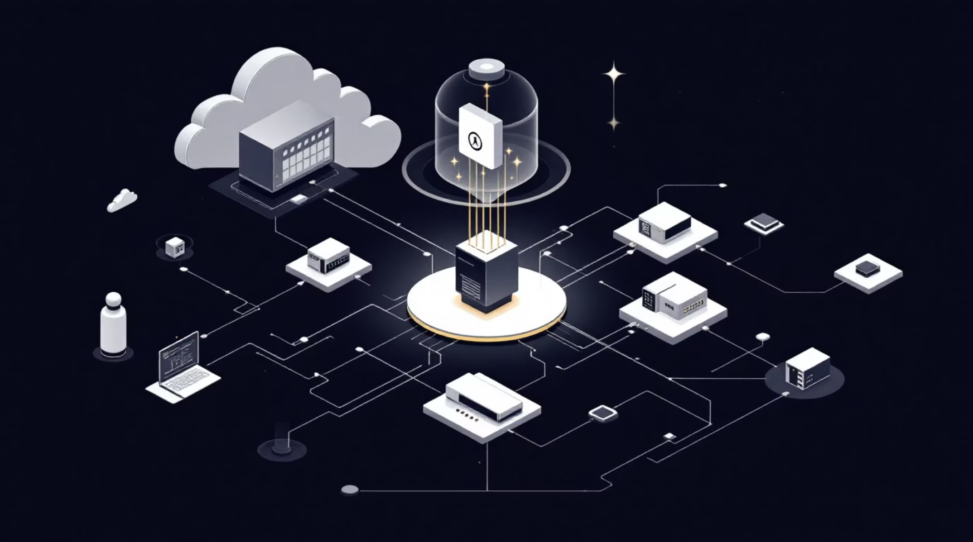
Introduction
Full-Stack Microservices System
A scalable platform managing users, events, and bookings through modular service architecture.
Built with Next.js frontend and Flask backend
Focus on scalability and clean separation of concerns
RESTful API communication between services
Stateless service design for horizontal scaling

Slide 3




Project Objectives
Reduce Manual Management
Scalable Architecture
Eliminate paper-based event and booking tracking through digital automation
Build infrastructure that scales horizontally with growing user demand
Enhanced UX
Demonstrate Microservices
Provide intuitive interface for seamless event discovery and booking
Showcase modular, independently deployable service architecture

Slide 4








Technology Stack
Frontend Stack
Backend Stack
Next.js
Python Flask
React framework with server-side rendering
Microservices framework for backend
React
RESTful APIs
Component-based UI architecture
HTTP-based service communication
TypeScript
Axios
Static typing for code quality
HTTP client for API requests
Tailwind CSS
In-Memory Storage
Utility-first styling approach
Prototype data persistence layer

Slide 5





Workflow Process
User Interaction
User performs action on dashboard or booking interface
Frontend Processing
Next.js frontend validates input and determines required API calls
API Requests
Axios sends HTTP requests to appropriate microservice endpoints
Service Processing
Flask services handle business logic and data operations
Response Handling
Data returned and UI state updated with fresh information

Slide 6
Core Features
Dashboard Analytics
Event Management
Booking Management
Real-time metrics display with recent bookings overview and system statistics
Full CRUD operations for creating, reading, updating, and deleting events with details
Create, modify, and cancel bookings with automatic availability checking
User Management
Local Caching
User profile management and role-based access control implementation
Client-side data persistence using localStorage for improved performance

Slide 7
System Architecture
User Service
Handles /api/users and user-related requests.
Next.js Frontend
Orchestrates API calls to backend Flask services.
Event Service
Handles /api/events and event data flows.
Booking Service
Handles /api/bookings and booking transactions.

Slide 8
Microservices Developed
1. User Service
Responsible for managing user data.
Features:
Fetch all users
Fetch user by ID
Runs on:
Port 5000
Example API:
GET /users GET /users/{id}
2. Events Service
Responsible for managing Events data.
Features:
Fetch Events list
Fetch Event by ID
Runs on:
Port 5001
Example API:
GET /Event GET /Events/{id}
3. Booking Service
Responsible for creating and managing Bookings.
Features:
Create Booking and fetch Booking history
Communicate with User and Event services
Runs on:
Port 5002
Example API:
POST /bookings GET /bookings

Slide 9
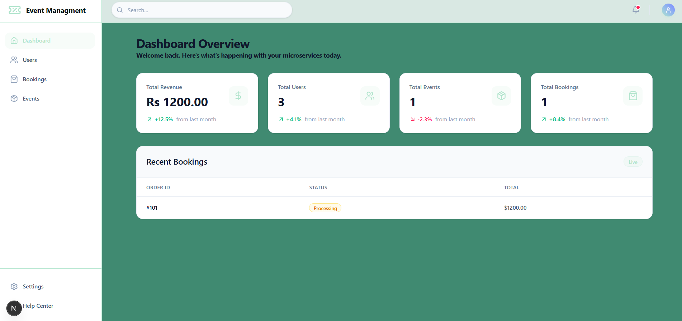
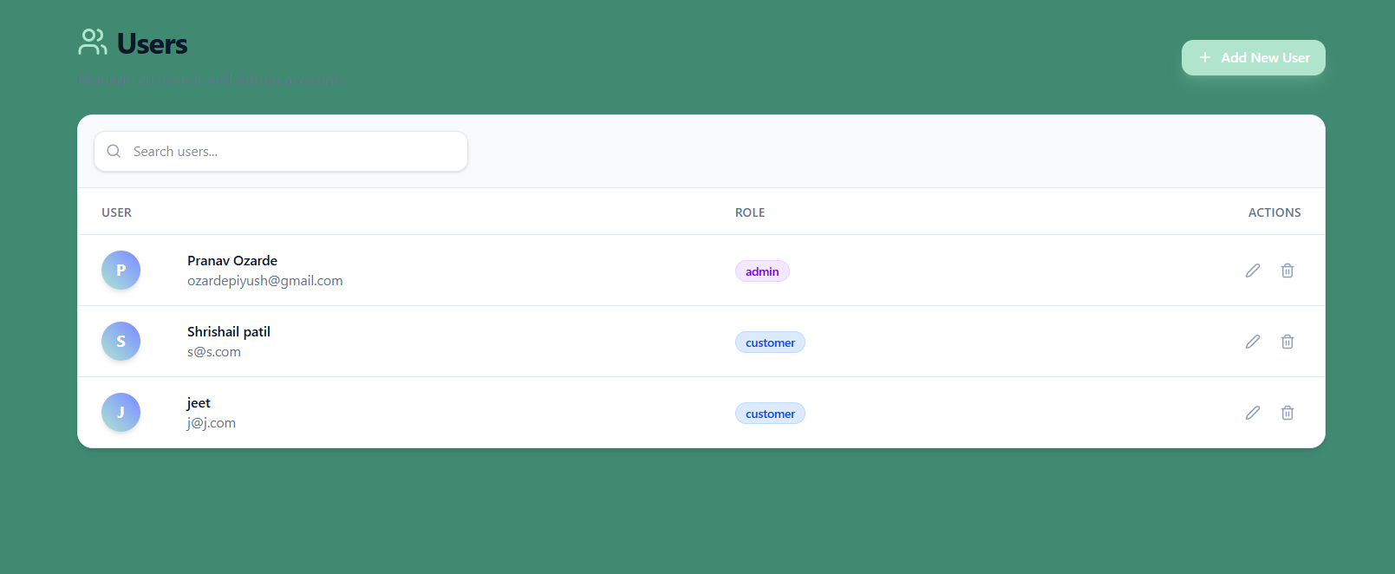
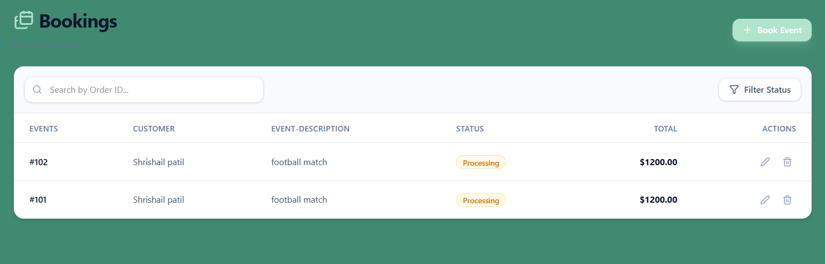
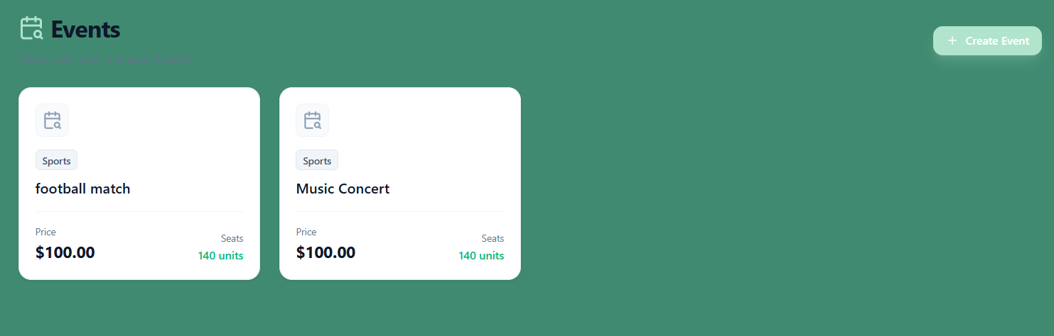
Output / Screenshots
Dashboard
Real-time data updates with live metrics
Recent bookings overview
System statistics and analytics
Events Page
Event listing with details
Create/edit event functionality
Event filtering and search
Booking Page
Booking form interface
Availability checking
Booking confirmation display
Working CRUD operations across all services
Seamless microservices integration
Real-time synchronization between frontend and backend

Slide 10

Deployment (AWS EC2)
Deployment Workflow
Instance Configuration
01
02
Our microservices platform is deployed on a lightweight t3.micro instance running Ubuntu OS, balancing cost-efficiency with necessary computing power for prototyping.
Launch EC2 Instance
Configure Security Groups
Provision an AWS EC2 instance with the specified operating system and instance type.
Establish inbound rules to allow traffic on SSH (port 22) and all designated service ports.
Service Port Allocation
03
04
Each component of the system is exposed on a distinct port, facilitating clear separation and routing within the EC2 environment:
Upload Project
Install Dependencies
Transfer the entire codebase, including frontend and backend repositories, to the instance.
Execute scripts to install required Python libraries and Node.js packages for all services.
User Service: 5000
Booking Service: 5001
Event Service: 5002
Frontend (Next.js): 3000
05
06
Run Services
Enable Public Access
Initiate each Flask microservice and the Next.js frontend, typically using process managers for stability.
Verify that the application is accessible publicly via the EC2 instance's assigned IP address or DNS.

Slide 11

Conclusion & Future Scope
Key Achievements
Future Enhancements
Successfully implemented microservices-based system with clear service boundaries
Integrate PostgreSQL/NoSQL database
Implement JWT-based authentication
Deploy on cloud infrastructure
Add comprehensive error handling
Implement service discovery
Containerize with Docker and Kubernetes
Demonstrated scalability through modular, independently deployable services
Created responsive frontend with intuitive user experience

