Slide 1
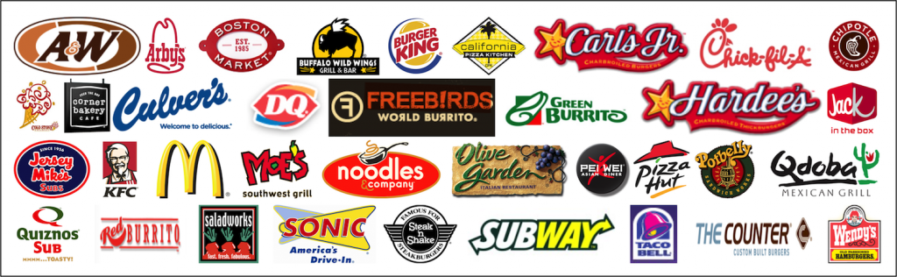
Fast Food Restaurants Across United States of America
-ProjectPranav

Slide 2
PROJECTP OBJECTIVE
To analyse the spread of various Fast Food restaurants across the United States.
Scope of the ProjectP:
The market survey has done in fast food restaurants : this project is useful for the better understanding of fast food restaurants spread across the states and cities of United states. The project encompasses the various restaurants located across the US. There is also overview of states and cities that has the most and least restaurants . The project work involves in identifying the top restaurants across it top states and cities leading the business across the country.

Slide 3
DATA DESCRIPTION
PRANAV
The dataset holds the information about Fast Food restaurants in United states across its province & city . Various variables present in the dataset includes data of city,province,name,latitude & longitute,websites, keys. It comprises of 10000 observations of 10 columns.
Address - Detail address of various restaurant branches on city level.
city - City names under each province.
country - United States[Constant].
keys - It holds the unique key for each restaurants.
Latitude - Angular distance of a place North or South where the restaurant is located.
Longitude - Angular distance of a place East or West where the restaurant is located.
name - Name of the Restaurants.
postal Code - zip code of the place where restaurants are located .
province - Holds the State code.
websites - Website links of the restaurants.
Only websites column has 465 null values.
Also name column had messy data.(Restaurants names)

Slide 4
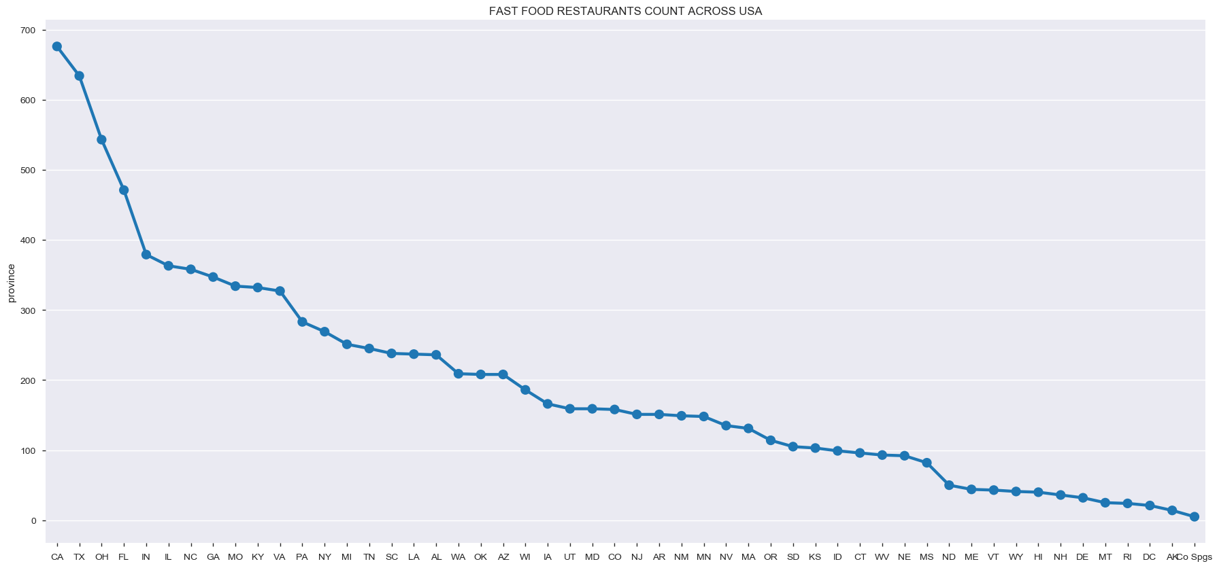
SPREAD OF FAST FOOD RESTAURANTS OF USA
The above graph would give rough idea on spread of restaurants across the country.

Slide 5
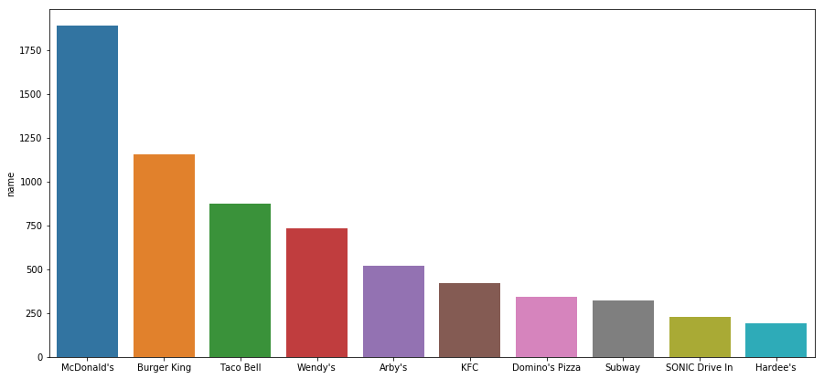
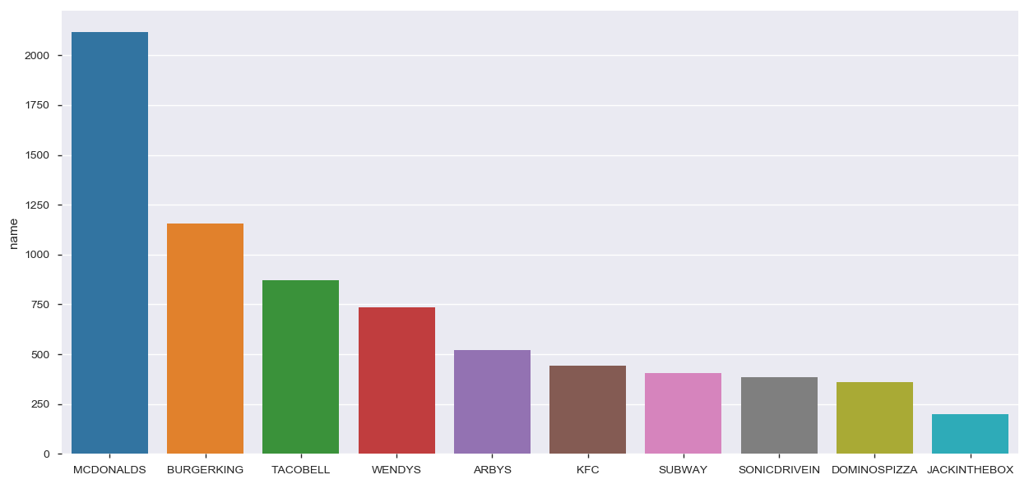
CLEANING MESSY DATA IN COLUMN NAME
BEFORE
AFTER
TOP 10 RESTAURANTS

Slide 6
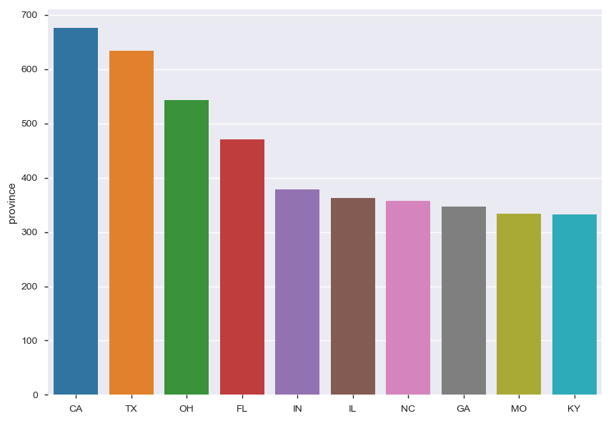
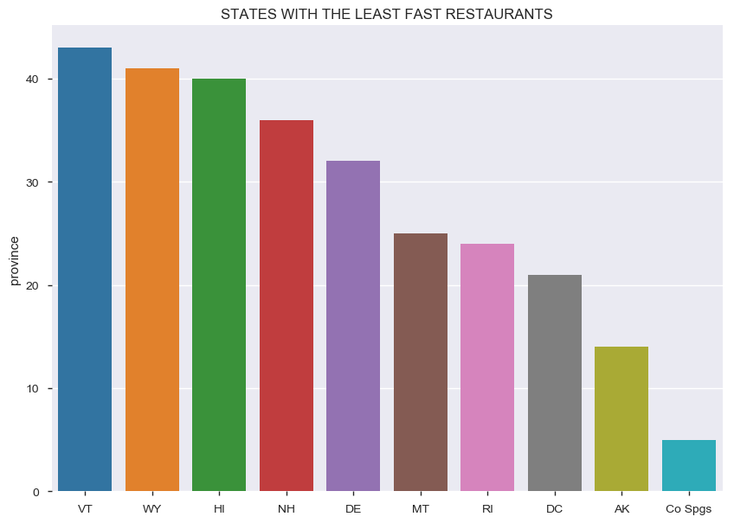
TOP & LEAST STATES
TOP
LEAST
The above graphs gives the idea on top and least business states for fast food Restaurants.

Slide 7
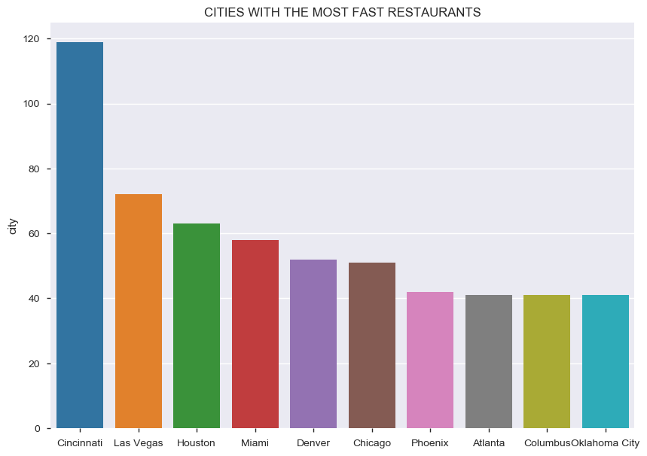
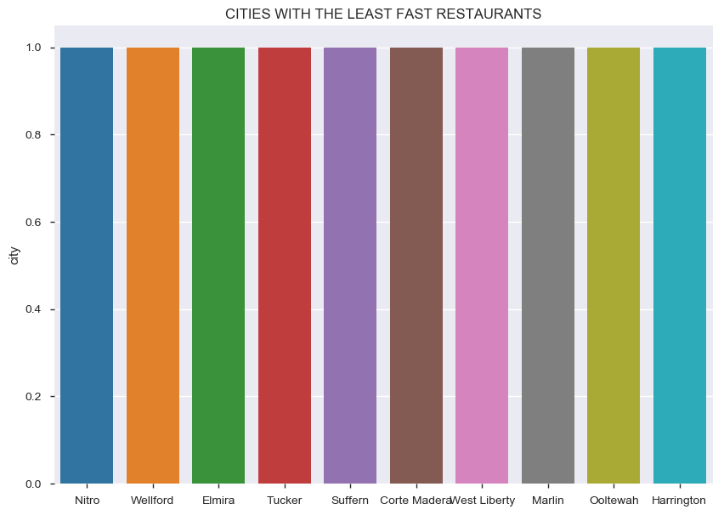
TOP & LEAST CITIES
The above graphs gives the idea on top and least business cities for fast food
Restaurants.

Slide 8
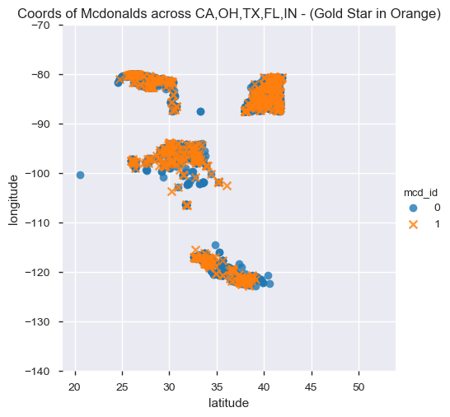
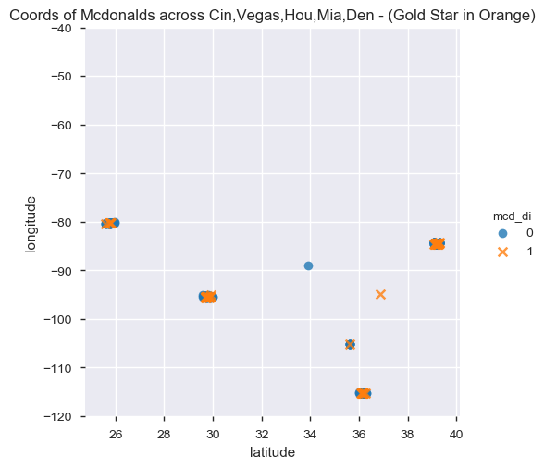
SPREAD OF MCDONALDS
Orange x markers are the spread of McDonald's across the top states & cities.
From the above plot we can conclude that McDonalds holds the 1st position across all the top business states and cities with most branches.

Slide 9


