Slide 1
English Activity
Ganga

Slide 2
Totapuri Mango
The 'Totapuri' mango, or Ginimoothi, is a cultivar that is widely grown in south India and is partially cultivated in Sri Lanka. It also goes by the names Bangalore, Collector, Kallamai, Kili Mooku, Gilli, Mukku, and Sandersha. In Bengaluru it is referred to as Ginimoothi Maavina Kayi, while most of the rest of India calls it Totapuri or Bangalora. It literally translates to parrot face (gini = parrot, muthi = beak).

Slide 3
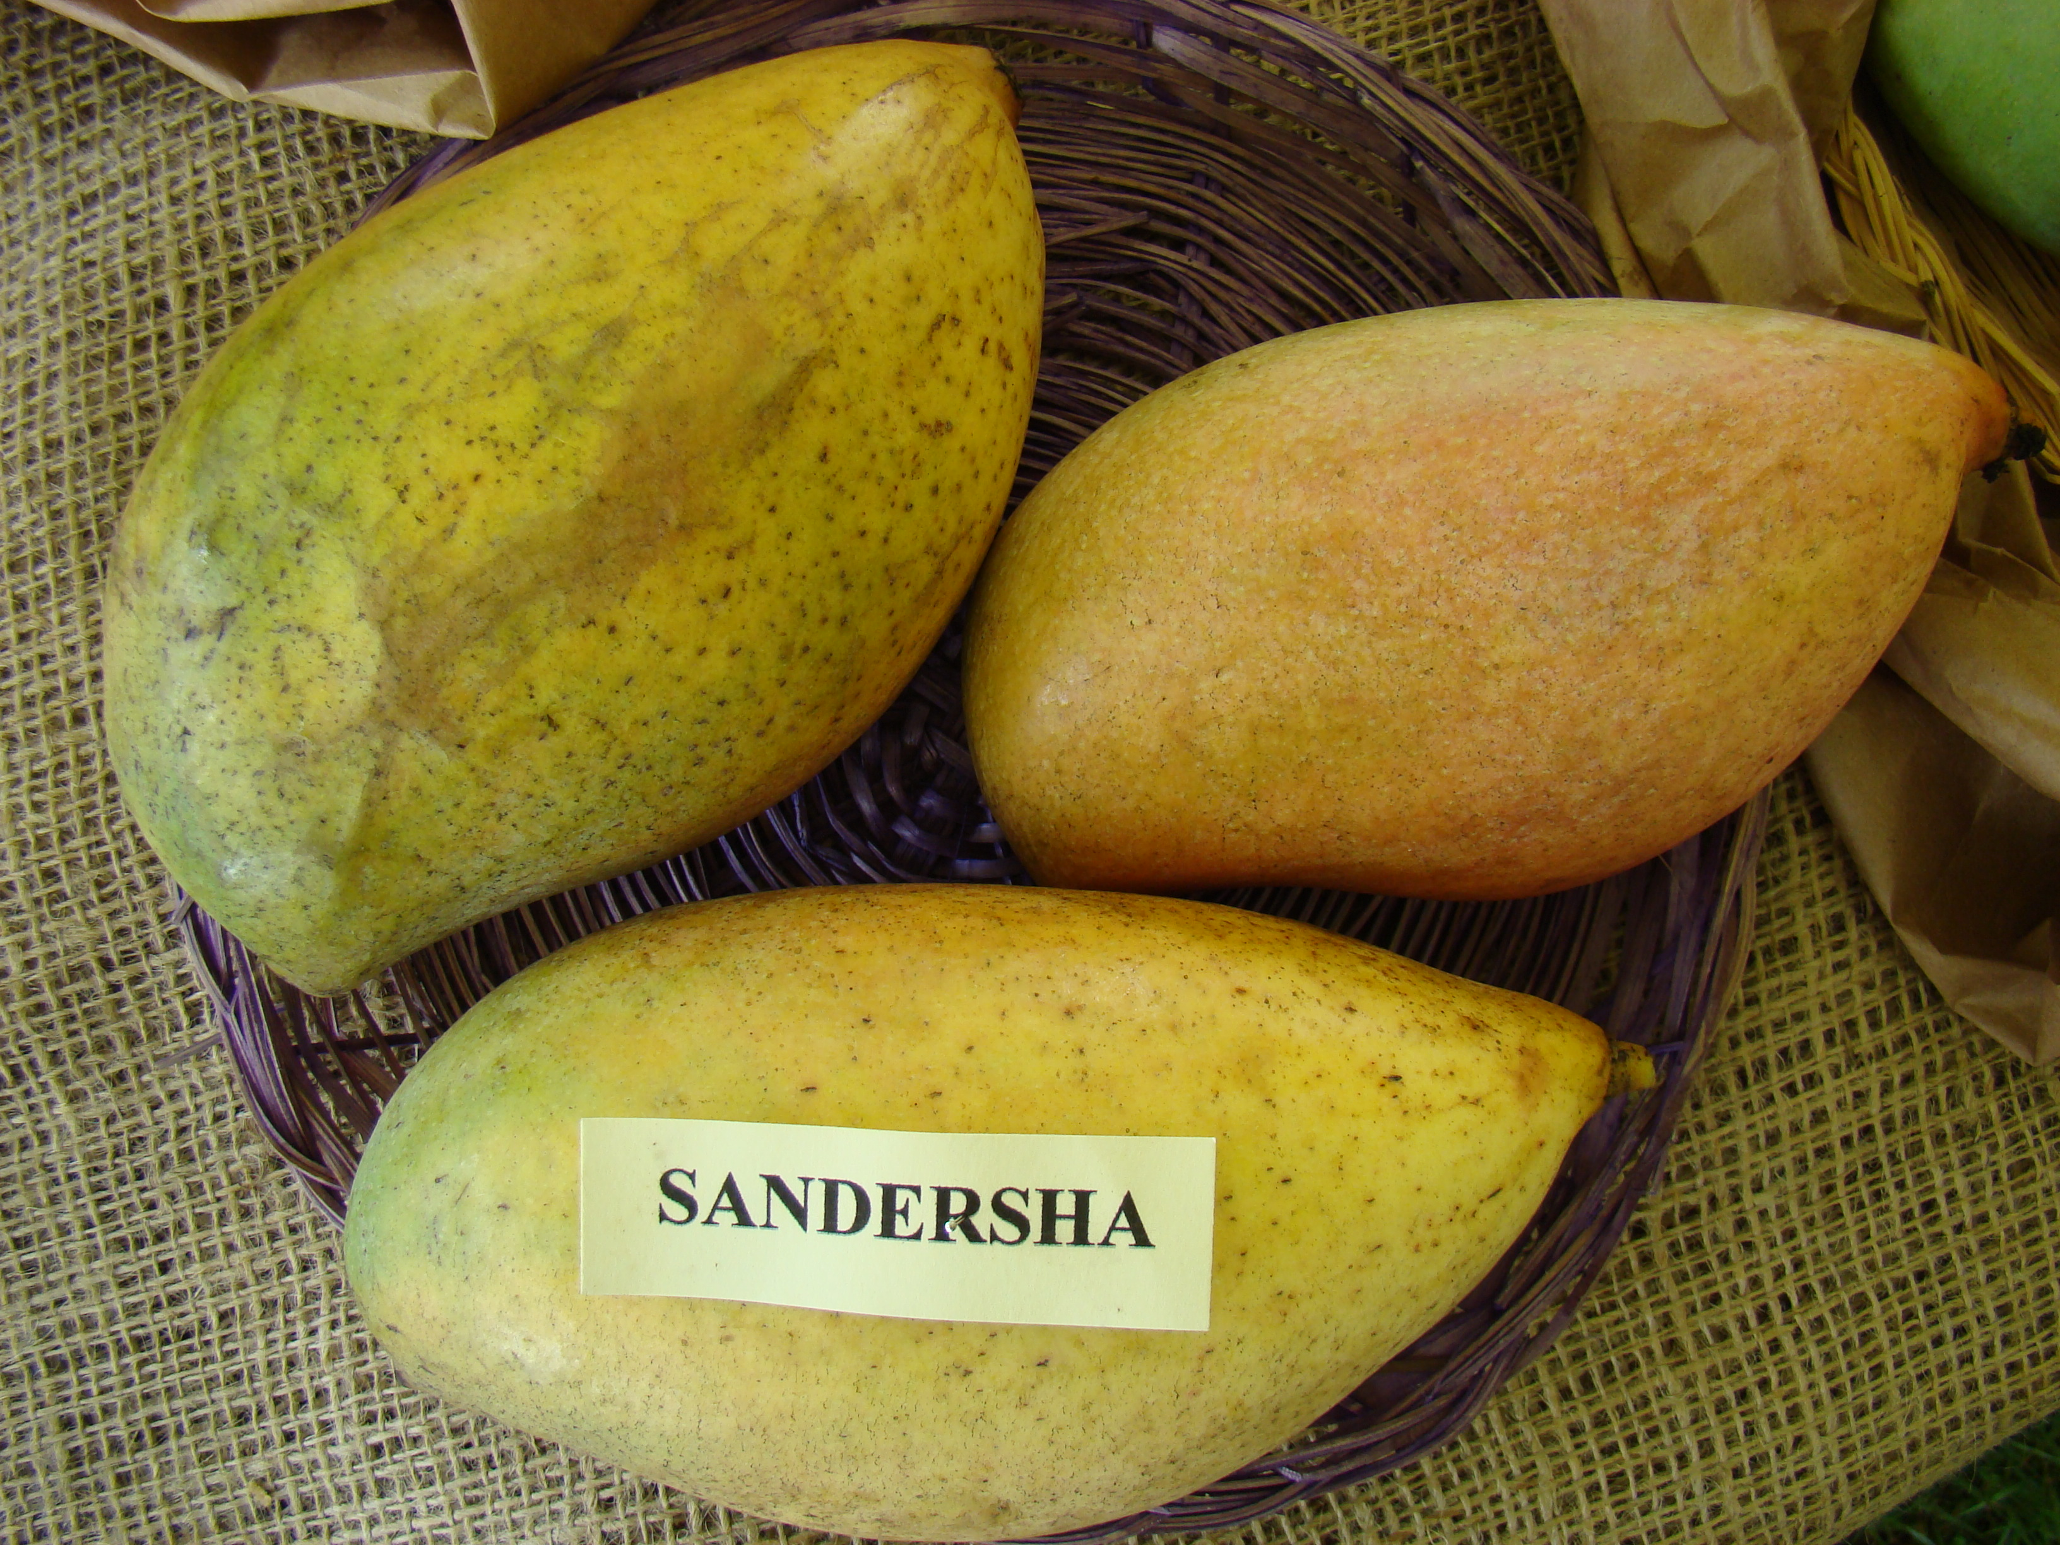

Slide 4
Spinach
Spinach (Spinacia oleracea) is a leafy green flowering plant native to central and western Asia. It is of the order Caryophyllales, family Amaranthaceae, subfamily Chenopodioideae. Its leaves are a common edible vegetable consumed either fresh, or after storage using preservation techniques by canning, freezing, or dehydration. It may be eaten cooked or raw, and the taste differs considerably; the high oxalate content may be reduced by steaming.

Slide 5
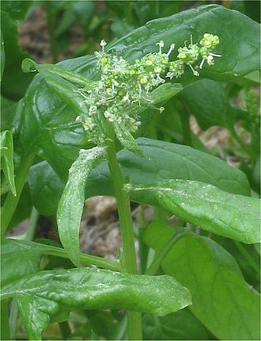

Slide 6
Sources:-
All Pictures and info are obtained from:
https://en.wikipedia.org/

