Slide 1
Flex: A fast Lexical Analyzer Generator
CSE470: Spring 2000
Updated by Prasad

Slide 2
Motivation
Use Flex to perform Text Processing
In structured programming two tasks occur
repeatedly:
  Lexical Analysis: Dividing the input into meaningful units. For a C program the units are variables, constants, keywords, operators, punctuation etc. These units also called as tokens. (Use Flex)
  Parsing: Involves finding the relationship between input tokens. For a C program, one needs to identify valid expressions, statements, blocks, procedures etc. (Use Yacc or Bison)

Slide 3
An Example
Recognizing all keywords of a Language. Probably also want to identify and remove comments.
  /* The following loop computes exponent of
  number */
  int i, number, result;
  result = 1;
  for (i=0; i<power; i++) {
  result = result * number;
  }

Slide 4
About Flex
Flex: Fast Lexical Analyzer Generator.
Produces Lexical Analyzers in a fast and easy manner.
Given a Flex source file, Flex generates an output C source code file lex.yy.c which defines the scanning routine yylex().
Flex source file (say sample.l) should contain rules for identifying tokens in the input.

Slide 5
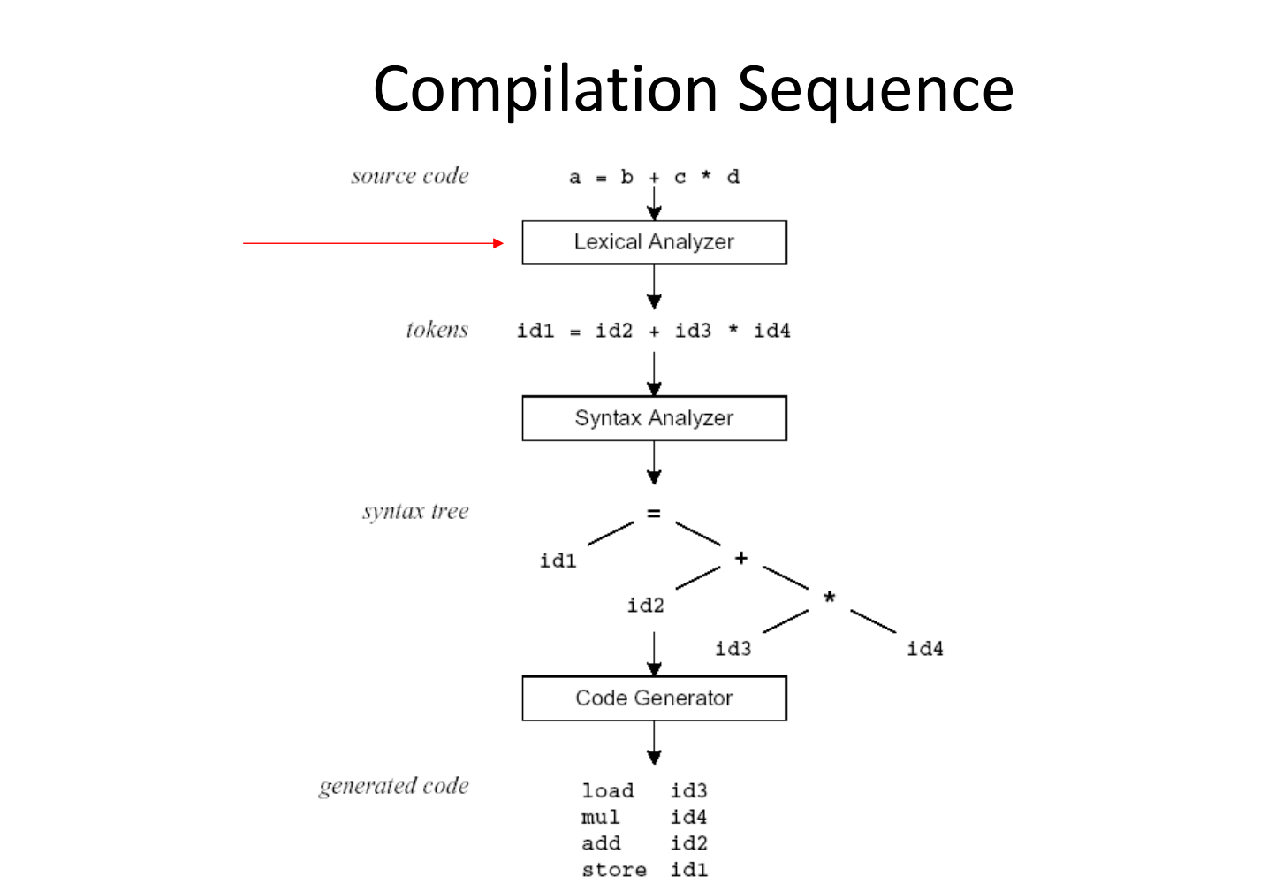

Slide 6
Flex Source File (sample.l)
Flex Compiler (Flex)
Lexical Analyzer Code (lex.yy.c)
C Compiler
Input Text File
Lexical Analyzer executable
Output: Tokens
Parser

Slide 7
Flex Source
Consists of three sections: definitions, rules and user-defined routines.
%{
Declaration Section
%}
Definitions section
%%
Rules Section
%%
User routines Section

Slide 8
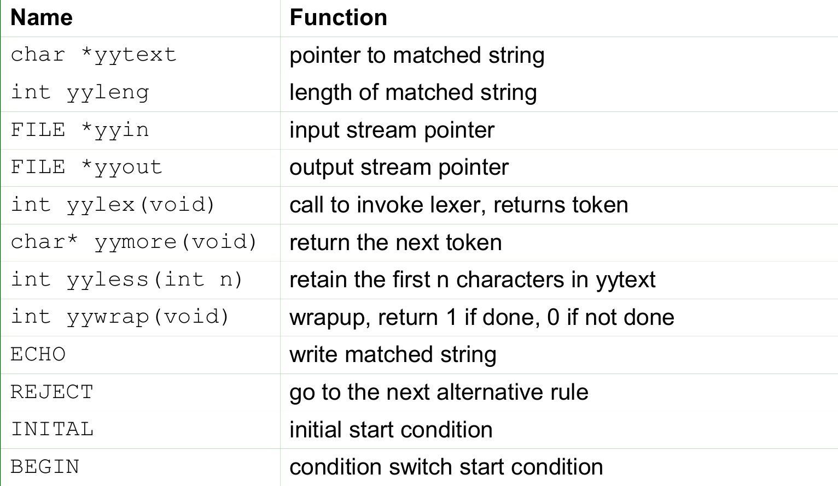

Slide 9
Rules
Format
  <regular-expression> {<actions>}
When a Lexical Analyzer is run (or the scanning routine yylex() is called) it analyzes the input for the occurrences of text patterns that match the regular expressions. When ever it finds one it executes the corresponding action.
Flex stores the matched text in a global string variable called yytext.

Slide 10
Examples:
[0-9]+ { printf(“An integer %s \n”, yytext); }
[a-z][a-z0-9]* { printf(“An identifier %s \n”, yytext);}
if | then | begin | end | function { printf(“A Keyword %s \n”, yytext); }

