Slide 1
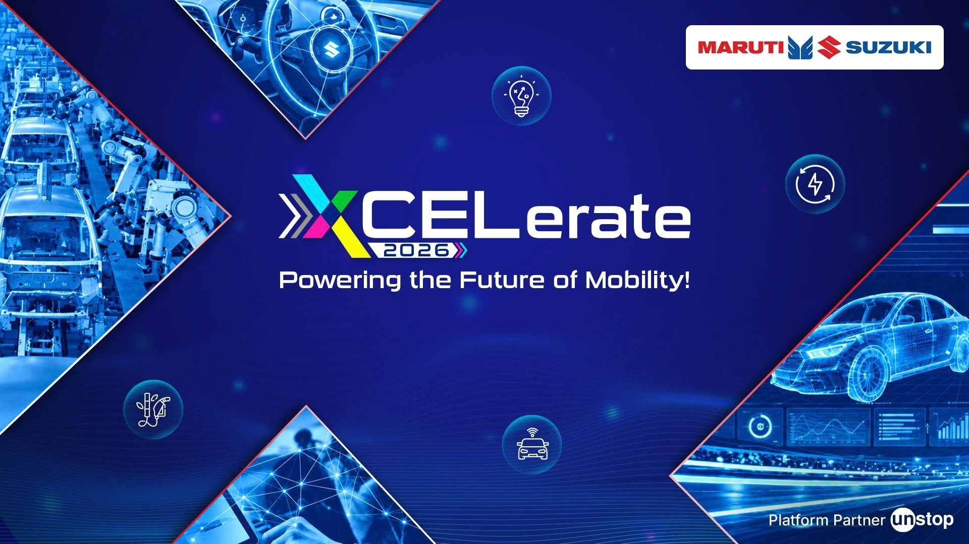

Slide 2





THESIS.
PROBLEM STATEMENT
Design the Ideal Ride-Service Vehicle for India 2035. Determine the optimal vehicle size,
seating configuration, body style, powertrain strategy and digital ecosystem for intra-city,
inter-city, shared and premium mobility services. THE SOLUTION SHOULD MAXIMIZE CUSTOMER
SATISFACTION, DRIVER EARNINGS, FLEET PROFITABILITY AND SCALABILITY ACROSS INDIA.
THE FINDING
THE BUYER
THE DESIGN
Volume is in intra-city. Margin is in airport and commute. They are structurally incompatible — 95 km/day unpredictable hail cannot share a vehicle design with 210 km/day pre-booked depot returns. We did not design for both. We designed for the margin segment.
Fleet operators. Every commercial conversation ends at an operations manager’s desk and that person buys on cost per km and utilisation. Under ₹67/day flat fee, revenue is fixed — only paid kilometres move the number. That makes uptime and depot control more important than range or features.
Sedan: airport fare premium + luggage requires separate boot. B-segment: sub-4-metre keeps GST at 5%, saves ₹1.5L. BEV on LFP: at 200 km/day return-to-base, depot overnight charging cuts energy cost below every alternative. 45 kWh: sized for the duty cycle with 10% reserve at year 8.
MACH1

Slide 3
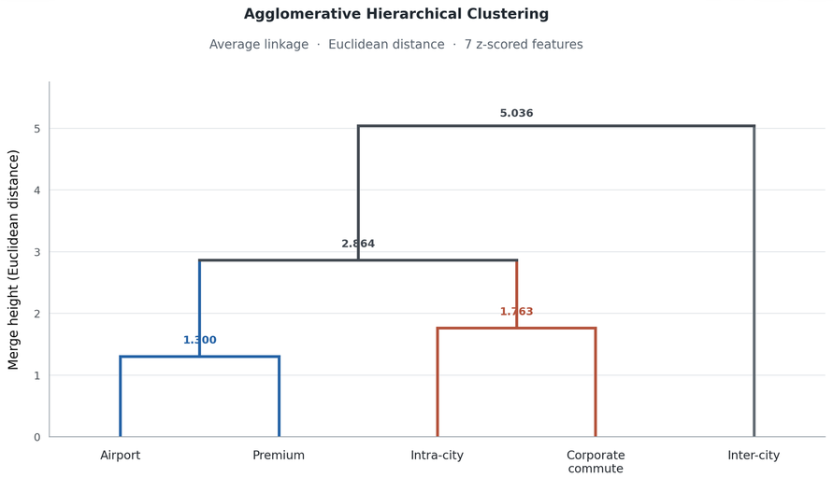
MARKET
WHAT DOES THE MARKET SAY?
WHO IS OUR
AUDIENCE?
WHERE DO WE PITCH?
USE CASE | AVG KM | KM/DAY | TRIPS/DAY | ₹/TRIP | GROWTH | EV SHARE | PRICE SENS.
Intra-city street hail | 12.7 | 95 | 7.5 | 350 | 18% | 10% | 0.85
Daily commute / subscription | 22.0 | 176 | 8.0 | 550 | 24% | 12% | 0.90
Airport transfer | 35.0 | 210 | 6.0 | 600 | 26% | 18% | 0.35
Inter-city / outstation | 280 | 340 | 1.5 | 4,200 | 20% | 5% | 0.40
Premium / shared-premium | 18.0 | 144 | 8.0 | 520 | 28% | 15% | 0.30
FLEET OPERATORS.
India’s ride-service volume is in intra-city.
India’s ride-service margin is in airport and commute.
This matters because they require fundamentally different vehicles.
Every commercial conversation about a fleet vehicle ends at an operations manager's desk, and that person buys on cost per kilometre and utilisation..
Structurally, drivers now choose the platform; operators choose the vehicle.
USE CASE | KM/DAY | GROWTH | EV SHARE | DRIVER ₹/MO | MACH1 FIT
intra-city | 95 | 18% | 10% | 68,250 | weak
premium | 144 | 28% | 15% | 108,160 | moderate
commute | 176 | 24% | 12% | 114,400 | STRONG
airport | 210 | 26% | 18% | 93,600 | STRONG
intercity | 340 | 20% | 5% | 163,800 | weak
REPLACEMENT CAPACITY TARGETED AIRPORT AND CORPORATE TRAVEL:
  EVERA EXPANDED AT DELHI TERMINALS
  GMR HYDERABAD LAUNCHED A 200+ VEHICLE PREMIUM AIRPORT FLEET
  BHARAT TAXI LAUNCHED AT NAVI MUMBAI.
BluSmart’s exit redistributed supply toward
high-utilisation,depot-controlled routes.
THE PRIMARY POSITION
CLUSTER A — AIRPORT + CORPORATE-COMMUTE
RANK | CRITERION | EVIDENCE
1 | Cost per kilometre | every fleet TCO source converges here
2 | Paid km/day (utilisation) | now the binding constraint under flat-fee platform economics
3 | Uptime | charging downtime is the failure mode operators actually fear
4 | Depot control | without controlled overnight charging, EV TCO does not hold
5 | Residual value | BluSmart assumed 10%, realised 26% — our exact target segment
6 | Financeability | CAPEX structure alone is worth ~8 points of EV advantage
7 | Range | near the bottom — 315 km against a 200 km/day duty is ample
  TRIPS ARE PRE-BOOKED → THE VEHICLE'S DAY CAN BE PLANNED
  PICKUP IS A FIXED POINT → DEPOT CHARGING IS SCHEDULABLE OVERNIGHT
  THE DUTY IS PREDICTABLE → THE 45 KWH PACK AND THE 200 KM/DAY SIZING ARE SAFE
  EV SHARE IS ALREADY 18% → THE OPERATOR IS ALREADY ELECTRIFYING THIS LANE
AIRPORT TRANSFERS ARE ALSO THE FASTEST-GROWING TRIP PURPOSE AT 19.14% CAGR, AND UBER BLACK'S TOP TWO USE CASES ARE AIRPORT AND CORPORATE TRAVEL.
WHERE WE DO NOT FIT
INTRA-CITY
  61% OF THE MARKET, BUT WEAKEST FIT FOR E1.
  95 KM/DAY; UNPREDICTABLE HAIL COMPLICATES DEPOT SCHEDULING.
  HIGHEST PRICE SENSITIVITY.
INTER-CITY
  560 KM DRIVEN PER ROUND TRIP FOR 280 KM OF REVENUE.
  LOWEST EV SHARE: 5%.
  EMPTY RETURN TRIPS REDUCE EFFECTIVE UTILISATION AND WEAKEN ECONOMICS.

Slide 4
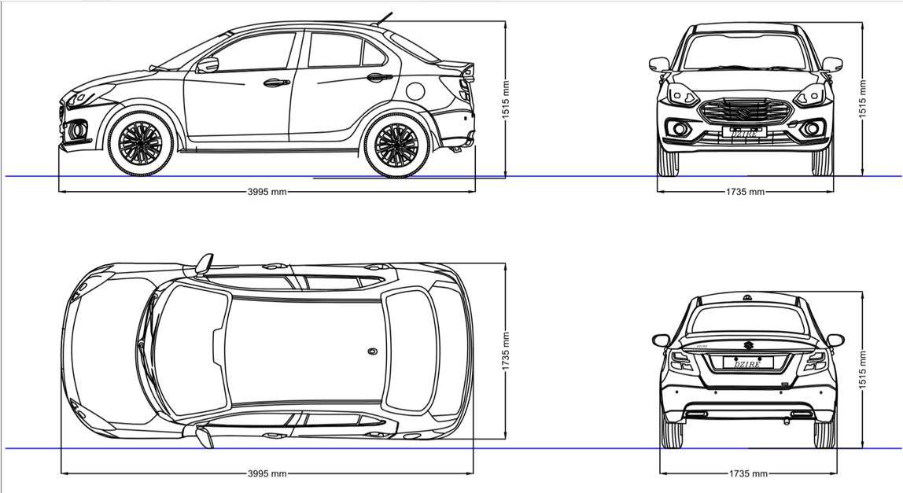
VEHICLE CONCEPT PROPOSAL
Powertrain & Energy
FLEETLINE E1 FEATURE | WHY A FLEET OPERATOR NEEDS IT
SPEC 45 kWh LFP pack, semi-structural CTP | 200 km/day duty with 10% reserve held at year 8
SPEC PMSM 80 bhp, single-speed reduction drive | No shift loss across 62,400 km/yr, and no gearset to maintain
SPEC Liquid-plate cooling, 48 °C cell design point | Holds degradation inside the validated band — passive cooling does not
ADD ⚑ Per-cell pack SoH telematics, over-the-air | DECISIVE — THE ONE THAT EARNS THE WARRANTY. Published LFP studies disagree 3.6× on time-to-80%, so a capacity-retention guarantee is only credible if the pack reports its own degradation
Parameter | FleetLine E1
Body Style | Compact Sedan
Segment | B-segment
Length | 3,995 mm
Width | 1,684 mm
Height | 1,532 mm
Wheelbase | 2,450 mm
Seating | 5-seat, 2-row
Boot Space | 400 L ↑ Tour S
Powertrain | 45 kWh BEV
Fleet Pricing | ~₹14 L (EV)
The Dzire Tour S is India’s gold-standard fleet sedan 5,000 units/month, 40% of all Dzire sales, operators return to it every time. FleetLine E1 does not reinvent this formula. It electrifies it.
🏆 Proven in Indian Fleet — Market Evidence
  Returned to top of sales charts the moment Maruti reopened fleet registrations — operators responded immediately
  40% of all Dzire units go to fleet buyers — 5,000 units/month at steady state
📐 Why These Exact Dimensions Work
  3,995 mm sub-4-meter keeps GST at 5% (vs 18% for ≥4 m) — structural cost advantage of ~₹1.5 L
  2,450 mm wheelbase seats adults without drama and fits every airport bay and city lane
🔧 Why Operators Choose It Over Rivals
  Maruti's 3,614-outlet service network means a cab is never more than a few km from a service point
  Spare parts stocked everywhere — no waiting, no imported components, no downtime
Safety & Liability
FLEETLINE E1 FEATURE | WHY A FLEET OPERATOR NEEDS IT
SPEC L2 ADAS, six airbags, ABS with EBD + CSC | Corner Stability Control matters more on a tall, pack-loaded sedan
ADD 360° HD camera with 2D/3D views | Blind-spot elimination at low speed, and dense-city parking without a spotter
ADD Dashcam recorder (DVR) | 10+ paid hours a day — onboard evidence for disputes, when the driver's account is not enough
Uptime & Reliability
FLEETLINE E1 FEATURE | WHY A FLEET OPERATOR NEEDS IT
ADD Intelligent tyre pressure monitoring | Turns a roadside blowout into a scheduled wheel change. Tyre failure is a leading cause of lost paid hours
Driver Working Conditions
FLEETLINE E1 FEATURE | WHY A FLEET OPERATOR NEEDS IT
ADD 65 W USB-C front + rear wireless phone deck | Two riders, two phones, one shift, no cable hunt between fares
ADD Ventilated front seats | A 12-hour shift is the working condition, not a luxury — heat and fatigue show up as unpaid kilometres
LEGEND
SPEC | Already specified — engineering locked
ADD | Being added — requested by this proposal
⚑ / DECISIVE | The line that converts a spec sheet into a commercial argument

Slide 5
POWERTRAIN STRATEGY
TECHNICAL SPECIFICATIONS
01 — COMPARISON AND JUSTIFICATION
POWERTRAIN
80 bhp continuous / 100 bhp peak - PMSM - Water-cooled
BEV
HEV
PHEV
CNG
BIO CNG
Peak + short duration, continuous rating derates at 45°C ambient
COST/KM
(OPERATOR)
₹6.42
₹9–11
₹8–10
₹7.42–8.34
≈ CNG + supply risk
DRIVE
Single-speed reduction - BEV
REFUELLING READINESS
Depot AC overnight; zero revenue-hour downtime
MOTOR EFFICIENCY
93–97% peak - –2% drop at 45°C
Full — ICE base
Full — ICE base
Best-in-class
Best-in-class
India has roughly 35,000 public charging ports for 5.7 million registered EVs — 160 EVs per port (NITI Aayog index, via Cadmus/Uber).
Public charging is therefore not an operating plan for a fleet. It is a fallback.
BATTERY / RANGE
LFP - 45 kWh - Structural pack
RANGE / UPTIME
315 km real (verified)
Unaffected
Unaffected
~500–600 km real
~500–600 km real
10–90% - 36 kWh usable
SUSTAINABILITY
Best available on a coal-heavy grid
Marginal
Marginal
Methane slip; worse CO2
Genuinely low-carbon but supply immature
3% top and bottom reserved for cycle-life protection
RANGE
263 km claimed - 200 km @ 75% DoD (feet (operating range)
CHOSEN BY REGULATORS
Yes — Delhi gazette 100% by 2030
No
No
No
No
DAILY ENERGY
–25.7 kWh @ 200 km/day - –20–35% with AC load at 45°C
WHY NOT THE ALTERNATIVES?
BEV. LFP. SINGLE-SPEED DRIVE.
PACK THERMAL MGMT
Active liquid cooling - pack maintained ≤45°C
High-mileage taxis favour EVs on total cost of ownership, with CNG as the alternative where infrastructure exists. — CEEW
CHARGE RATE
1C max - 45 kW DC fast charge - CC–CV protocol
BEV offers the lowest operating cost for our 200 km/day depot-based duty cycle, with cheaper energy, lower maintenance, and overnight charging that avoids revenue loss. LFP keeps the battery cost-effective and durable.
200 km/day makes the economics work.
DEPOT CHARGING
11 kW AC - 3-phase - –23 hr overnight window
RATED LIFE
200,000+ km - –3.2 yr at 62,400 km/yr duty cycle
CNG — THE REAL COMPETITOR, AND IT LOSES ON COST
Fleet parity with diesel typically emerges at 120–200 km/day, with 18–24-month payback. Our depot-return duty cycle sits at the favourable end of this range.
BRAKING / CHASSIS
Front: Disc - Rear : Drum
CNG wins refuelling readiness and has a far lower purchase price. It loses because at 200 km/day the running-cost saving is not enough to cover the ₹5.49 lakh capital premium within five years, after which EV wins for the remaining life.
Depot charging eliminates downtime.
ABS - ESC
WHEELS / TIRES
14' alloy - 175/56 R14 tubeless radial
A 36 kWh recharge (10–90%) takes 4.9 hours at 7.4 kW or 3.3 hours at 11 kW—completed overnight, with zero revenue hours lost.
GROUND CLEARANCE
170 mm unladen
BIO-CNG — THE OPTION THAT IS NOT READY
Cheap, scheduled charging protects margins.
SAFETY / COMPLIANCE
Airbags - ABS - Level 2 ADAS
Bio-CNG has the best carbon story of any fuel available, and it is not deliverable at fleet scale in 2035:
  207 CBG plants commissioned as of April 2026, against a government target of 5,000 by 2030
  Only 17 of those 207 are pipeline-connected — the rest move by high-pressure cascade
  Commissioned capacity is ~2 MMTPA against a 15 MMTPA target
  Operating plants run at 20–60% of rated capacity on feedstock inconsistency
  Mandatory blending is only 1% in FY2025-26, rising to 5% by FY2028-29
AIS-156 - AIS-038 Rev.2 - ECE R100
Depot electricity at ₹5.50–9/kWh beats public fast charging at ₹18–24/kWh. Smart off-peak scheduling can cut charging costs by 20–35%, with a feasible 1:3 charger-to-vehicle ratio.
BMS
Cell-level voltage + temperature monitoring
INTERIOR / COMFORT
5-seat - 2row - rear-biased - flat floor (no tunnel)
02 — CHARGING & REFUELING READINESS
PACK SIZING HEADROOM
Rear AC vents - durable leatherette - ventilated front seats
WHY BEV WOULD WORK?
MACH1(EV)
EPS - Full LED - DRL bar - Fog lamps
TIME FOR 36 KWH (10→90%)
FITS OVERNIGHT WINDOW?
200 KM/DAY
34 kWh → 45 kWh
TOP VARIANT
Panoramic sunroof
263 KM/DAY
45 kWh
LUGGAGE
400 L
7.4 KW AC
4.9 h
Yes
300 KM/DAY
51 kWh → 45 kWh
BATTERY FIRST-LIFE
– 15 yr (cycle-life basis)
HEV AND PHEV — STRUCTURALLY UNCOMPETITIVE HERE
11 KW AC
3.3 h
Yes
CORROSION / NVH
Validated for coastal and monsoon deployment
CEEW is unambiguous:
"Petrol-electric hybrid vehicles… are significantly more expensive, mainly due to the high GST and compensation cess (at 43 per cent), making them uncompetitive in this segment against EVs."
The tax treatment alone is disqualifying. Beyond that, both inherit the ICE's full mechanical service burden — the exact cost line where EV gains its advantage — while adding a battery and inverter to a fleet that will keep both.
22 KW AC
1.6 h
Yes
WHAT ACTUALLY HAPPENS WITHOUT DEPOT CHARGING
PRIMARY WEAR ITEM
Bearings
CHARGING ROUTE
COST
SEGMENT
Compact Sedan - B-segment
PUBLIC DC FAST CHARGE
₹18–24 /kWh
"Around two-and-a-half months after… Green SM launched its electric taxi service… drivers said they are spending hours waiting for chargers or going offline to conserve battery… I sometimes come to charge my vehicle on my week-offs." — The Indian Express, 1 Sep 2026, Noida
3,995
1,684
1,532
2,450
DEPOT, OFF-PEAK COMMERCIAL TARIFF
₹5.50–9 /kWh
LENGTH MM
WIDTH MM
HEIGHT MM
WHEELBASE MM
DEPOT + ROOFTOP SOLAR
₹3–5 /kWh

Slide 6





A second chemistry.
A sovereign supply chain.
A calculated bet on 2035.
WHY 2035 DOES NOT SOLVE IT
THE SOVEREIGN’S BET
This is not a naive claim, and it deserves a fair hearing.
Sodium-ion's cost trajectory is real, and layered-oxide sodium cells
genuinely do reach LFP price parity on a five-year view.
IT FAILS ON TIMING AND CERTIFICATION,
NOT ON DIRECTION.
The industry has a default. We have a different thesis.
Sodium-ion need not defeat lithium-ion today. It needs to become a credible alternative by 2035. MACH1 is designed to give it that chance—with LFP as the fallback and the final chemistry decided by cost, supply security and demonstrated performance.
WALL 1 - AVAILABILITY AT SCALE
1. BATTERY INDEPENDENCE IS
STRATEGIC, NOT JUST ECONOMIC.
2. 2035 GIVES THE TECHNOLOGY TIME TO MATURE.
3. A STAGED DECISION KEEPS THE RISK CONTAINED.
Current automotive deployments are 23–25 kWh microcars, not sedan-class vehicles. CATL’s Naxtra has GWh-scale capacity and passenger-car certification, but uses Prussian White—not the layered-oxide chemistry specified for MACH1. These chemistries are not interchangeable drop-in solutions.
Decision: Layered-oxide sodium-ion remains a future option, not a launch-ready cell. LFP remains the fallback unless the specified chemistry reaches the required scale, performance, and certification by 2032–33.
India’s EV supply chain remains heavily dependent on imported lithium-ion cells and materials. Sodium-ion offers a second chemistry—reducing lithium dependence, enabling aluminium current collectors, and creating opportunities for domestic supply-chain control. The goal is not to replace LFP, but to reduce reliance on a single chemistry.
Sodium-ion manufacturing remains small today, but major manufacturers are scaling development, with improved low-temperature performance and growing industrial interest. MACH1 does not bet on sodium-ion winning; it preserves the option.
  By 2032–33: Adopt sodium-ion only if it meets cost, performance, and supply-chain requirements.
  If it falls short: Launch with LFP, the established fallback.
  Design principle: One vehicle architecture, two battery pathways, no dependence on an unproven outcome.
WALL 2 — IT CANNOT BE LEGALLY HOMOLOGATED IN INDIA.
AIS-038 REV.2 AMENDMENT 3, ANNEX IX-K(2), VERBATIM:
"CELLS USED TO MAKE REESS, SHALL BE CERTIFIED AS PER IS 16893-PART 2 AND PART 3 BY NABL ACCREDITED LAB OR BY TEST AGENCY NOTIFIED UNDER CMV RULE 126."
IS 16893-2 AND -3 ARE TITLED "SECONDARY LITHIUM-ION CELLS…". NO AMENDMENT THROUGH AMD 4 HAS ADDED AN ALTERNATIVE-CHEMISTRY CLAUSE OR SCOPE EXEMPTION. NO SODIUM-ION CELL HAS EVER BEEN CERTIFIED TO THEM.
Public funding is moving sodium-ion research towards commercialisation
BROADER NATIONAL POLICY IS CREATING THE CONDITIONS FOR BATTERY-CHEMISTRY DIVERSIFICATION
May 2025 — JNCASR develops a fast-charging sodium-ion cell
Together, these initiatives demonstrate a national effort to reduce dependence on imported battery inputs and build domestic manufacturing capability. Sodium-ion is relevant to that objective because it offers an alternative pathway with a different raw-material profile.
The Department of Science and Technology (DST) publicised research by the Jawaharlal Nehru Centre for Advanced Scientific Research (JNCASR), reporting a sodium-ion battery that charged to 80% in six minutes and achieved more than 3,000 charge cycles in the reported testing.
DECISION
LFP is the launch chemistry. Sodium-ion is the 2036–38 second phase, retained through a dual-chemistry architecture. The issue is not sodium-ion’s potential, but its readiness: it cannot meet the proposed certification timeline. If it cannot be certified, it cannot be delivered.
NATIONAL PROGRAMME ON ADVANCED CHEMISTRY CELL BATTERY STORAGE.
December 2025 — ARCI moves into industrial cell validation
The Ministry of Heavy Industries' PLI scheme has an approved outlay of ₹18,100 crore to build gigascale advanced-chemistry-cell manufacturing in India, with a stated emphasis on domestic value addition. The scheme provides an industrial framework for building battery manufacturing capabilities
The International Advanced Research Centre for Powder Metallurgy and New Materials (ARCI), an autonomous R&D institution under DST, signed an agreement with Voltasun Technologies on 15 December 2025 to supply 80 sodium-ion pouch cells rated at 5 Ah each for industrial-performance evaluation.
Architecture
WHY Detachable, not structural
  Chemistry swap becomes a software change, not a new car
  AIS-038 Clause 2.48: a chemistry change needs full REESS retest either way
  But detachable makes the cell swappable. Structural CTC locks the chemistry forever
  Cost of that optionality: ₹2–3 Cr / 4–6 months vs ₹15–25 Cr / 18–24 months
December 2025 — Government-backed Indo-Israel industrial R&D
NATIONAL CRITICAL MINERAL MISSION
The Technology Development Board (TDB), under DST, entered into an agreement with NOPO Nanotechnologies India under the India–Israel Industrial R&D and Technological Innovation Fund. The project investigates integrating single-walled carbon nanotubes into sodium-ion batteries and developing a proof-of-concept prototype.
Approved in January 2025, the mission provides for ₹16,300 crore in public expenditure over seven years, with an expected ₹18,000 crore of investment from public-sector undertakings and other stakeholders. Its purpose is to strengthen domestic critical-mineral value chains across exploration, mining, processing and recovery.
DIMENSION | DETACHED SEMI-STRUCTURAL CTP | FULL STRUCTURAL CTC
Chemistry change | Cell swap + firmware | Effectively impossible
AIS-038 Clause 2.48 retest | 4–6 months, 2–3 Cr | 18–24 months, 15–25 Cr
Cell standardisation | 256×106×32 prismatic, 102–108s | Chemistry-locked
Repurposing / second life | Straightforward | Very difficult
Body programme impact | None | Full body-in-white retool
April 2026 — Direct support for commercial-scale sodium-ion materials
TDB announced financial assistance to Indigenous Energy Storage Technologies Pvt. Ltd. for commercialisation of hard carbon derived from agricultural and other biomass waste, intended for use as a sodium-ion battery anode material.
This is strategically important because hard carbon is a key sodium-ion input, and the IEA identifies its supply chain as underdeveloped and heavily concentrated in China
ICEA ENERGY STORAGE REQUIREMENTS
India's Central Electricity Authority has estimated an energy-storage requirement of approximately 411 GWh by 2031–32, driven by the need to integrate renewable electricity reliably. The figure was reported in a December 2025 parliamentary response published by the Ministry of Power.
9th September 2026 — NTPC issues a sodium-ion grid-storage pilot EOI
This is one of the clearest current policy signals. NTPC's official tender portal records an Expression of Interest titled “EOI for Setting up A Pilot Project for Development and Installation of a Grid-Connected BESS using Sodium-Ion Battery Technology.”
India is pursuing battery self-reliance and critical-mineral diversification; sodium-ion is emerging as one technology capable of contributing to those goals.
Pack sizing | SoH at year 8 | Design cell temp
44.2 kWh @ 48°C cell | 77.3% — commercially viable past loan payoff | 48°C max under liquid cooling

Slide 7
TOTAL COST OF OWNERSHIP ANALYSIS
0. METHODOLOGY
STEP-BY-STEP COST ANALYSIS
1. CONFIGURATION USED
4. OPERATOR TCO — THREE CITIES
5.SENSITIVITY-
INPUT CHANGE
EV ADVANTAGE
  Define the operating case: Compare both vehicles at 200 km/day over five- and eight-year ownership periods.
  Collect input data: Gather vehicle prices, financing terms, energy efficiency, tariffs, maintenance, insurance, taxes and resale values across three cities.
  Calculate acquisition cost: Use the on-road price for cash purchases or total EMI payments for financed purchases, never both.
  Calculate energy cost: Estimate lifetime electricity and CNG expenditure, accounting for charging losses and applicable tariffs.
  Calculate maintenance and insurance: Include servicing, repairs, tyres, insurance and other relevant operating expenses.
  Assess uptime and lost earnings: Evaluate charging and repair downtime and its potential impact on operating revenue.
  Account for residual value: Estimate and deduct the vehicle's resale value at the end of ownership.
  Calculate TCO and cost/km: Combine ownership and operating costs, subtract residual value, and calculate total cost and cost per kilometre.
  Compare operator and driver economics: Evaluate ownership costs, operating expenses and driver take-home earnings separately.
  Validate and test sensitivity: Verify calculations against external sources and test variations in energy prices, efficiency, daily distance, financing, downtime, resale value and battery replacement.
VEHICLE
MACH1 — BEV, LFP 45 kWh, PMSM 80 bhp continuous, single-speed
CITY
BASIS
EV ₹/km
CNG ₹/km
EV ADV.
BASE (DELHI: ELEC ₹4.50, CNG ₹76/KG, 25 KM/KG)
+14.5%
COMPARATOR
Maruti Dzire Tour S (CNG)
Delhi
Financed 60 mo
5.75
6.73
+14.5%
CNG 22 KM/KG
CITY ONLY, AC ON
DUTY
200 km/day × 26 days × 312 days = 5,200 km/mo · 62,400 km/yr
Delhi
Cash outright
4.63
5.98
+22.6%
+19.5%
CONSUMPTION
12.84 kWh/100 km (verified duty cycle, battery phase
Mumbai
Financed 60 mo
6.47
7.00
+7.6%
CNG 30 KM/KG — HIGHWAY, NOT METRO DUTY
+7.6%
CHARGING
Depot AC overnight, 90% wall-to-battery efficiency
Mumbai
Cash outright
5.35
6.32
+15.3%
GROSS FARE
₹11/km net fare → ₹57,200/month
Bengaluru
Financed 60 mo
6.66
7.25
+8.2%
CNG PRICE ₹76 → ₹90/KG
+21.1%
PLATFORM FEE
₹67/vehicle-day (Ola zero-commission) → ₹1,742/month
Bengaluru
Cash outright
5.45
6.51
+16.4%
CNG RESIDUAL 40% → 45%
+12.8%
NET FARE
₹10.665/km → ₹55,458/month (derived)
Lever 1 — financing structure nearly doubles the advantage. Cash purchase gives +17.5% against financed +8.4%, in the same city, on the same vehicle. The drag is the interest on a ₹14 L asset: roughly ₹3.85 L of interest, against ₹2.33 L on the CNG.
That is a negotiation lever, not a physics one. A fleet operator buying at scale can negotiate a longer tenure, a lower rate, or an EV-specific product. A 7-year tenure moves most of the horizon from "financed" to "cash," and that is worth more than any tariff negotiation we could win.
ELECTRICITY ₹4.50 → ₹8.00 (GENERIC COMMERCIAL)
+7.1%
FINANCING
10% annual, 60 months, no down payment (deck's assumption)
ELECTRICITY
₹4.50 → ₹10.00
+2.9%
HORIZON
5 years (loan) and 8 years (battery-phase horizon)
DISCOUNT RATE
12% nominal annual — a fleet operator's hurdle rate
ELECTRICITY
₹4.50 → ₹12.00 (PUBLIC DC)
−1.4% ✗
ESCALATION
Electricity 4.5% · CNG 3.5% · maintenance 4.0% · insurance 5.0% · residual 4.5%
CITIES
Delhi, Mumbai, Bengaluru — different tariffs, road tax and CNG prices
ELECTRICITY
₹4.50 → ₹18.00
−14.1% ✗
HORIZON
EV ₹/km
CNG ₹/km
EV ADV.no infra
With infra
NPV + infra
EV RESIDUAL 26% → 36% (DECK'S OLD ASSUMPTION)
+20.6%
3. THE COST STACK
DELHI, 5 YEARS, FINANCED (3,4,5)
5yr
5.75
6.73
+14.5%
+6.5%
+6.7%
6yr
5.06
6.34
+20.1%
-
-
CONSUMPTION 12.84 → 15.38 KWH/100 KM (DECK'S FIGURE)
+12.7%
COMPONENT
EV
CNG
EV ADVANTAGE
7yr
4.57
6.05
+24.4%
-
-
8yr
4.20
5.84
+28.0%
+17.4%
+14.6%
WORST CASE STACKED (15.38 + ₹12 + RESID 26%)
−6.4%
On-road (ex-showroom + GST + road tax)
₹12,72,600
₹8,51,488
−₹4,21,112
Lever 2 — hold the vehicle longer.
DELHI, FINANCED. THE CASE ROUGHLY TRIPLES BY YEAR 8 BECAUSE THE LOAN IS REPAID AND THE ASSET KEEPS EARNING. THIS IS THE STRONGEST SINGLE ARGUMENT IN THE DOCUMENT AND IT IS AN OPERATOR ARGUMENT — IT BELONGS TO WHOEVER OWNS THE VEHICLE.
BEST CASE STACKED (12.84 + ₹4.50 + RESID 36%)
+20.6%
Finance (EMI ₹29,743 / ₹18,092 × 60)
₹16,22,339
₹10,85,496
−₹6,99,077
8-YEAR HORIZON
Energy
₹2,00,304
₹9,48,480
+₹7,48,176
+28.0%
Maintenance
₹93,600
₹2,10,000
+₹1,16,400
THREE CONCLUSIONS STAND OUT:
  The EV advantage holds up against measured CNG EFFICIENCY. THE MEASURED BAND LEAVES AN EV ADVANTAGE OF +19.5% TO +11.6%, GIVING THE CASE A REASONABLE MARGIN UNDER THESE ASSUMPTIONS.
  ENERGY PRICES REMAIN THE REAL FRAGILITY. ABOVE ROUGHLY ₹11/KWH, THE EV LOSES ITS ADVANTAGE. DEPOT TARIFFS OF ₹4.50–9.50/KWH SUPPORT THE CASE, WHILE PUBLIC DC CHARGING AT ₹12–24/KWH CAN OVERTURN IT.
  UPTIME IS THE BINDING OPERATIONAL RISK. THE EV HAS 45 HOURS/MONTH OF DOWNTIME HEADROOM, AGAINST A DOCUMENTED 75 HOURS/MONTH LOST TO CHARGER QUEUES (GREENSM). THE CASE THEREFORE DEPENDS ON RELIABLE DEPOT CHARGING, NOT JUST VEHICLE ECONOMICS
2.ECONOMIC BOUNDARY
Insurance
₹2,10,000
₹1,97,400
−₹12,600
INCLUDED
DETAIL
Residual Credit
−₹3,30,876
−₹3,40,595
+₹9,719
ACQUISITION
Ex-showroom, GST, road tax (per vehicle)
Subtotal
₹17,95,367
₹21,00,781
+₹3,05,414
FINANCING
Full EMI stream, 10% / 60 months
Charging infrastructure
₹1,74,000
₹4,500
−₹1,69,500
ENERGY
Tariff × consumption, net of charging losses
Total
₹19,69,367
₹21,05,281
+₹1,35,914
MAINTENANCE
Fleet service cost, net of the EV tyre-wear premium
Cost/Km
₹6.31
₹6.75
+6.5%
FACTOR | KEY ASSUMPTIONS AND CALCULATIONS | KEY RESULTS / BREAK-EVEN THRESHOLDS | IMPLICATION
1. Depot charging | Daily energy: 25.68 kWh; 7.4 kW AC charging takes ~3.86 h. Charger cost: ₹50,000 hardware + ₹30,000 installation + ₹10,000 DISCOM connection, increased to ₹99,000/vehicle for N+1 redundancy. Software and AMC: ₹15,000/year. | Depot off-peak tariffs: ₹5.50–9/kWh; public DC retail: ₹18–24/kWh. At ₹4.50/kWh, EV energy costs ₹0.64/km; at ₹8.50, ₹1.21/km; at ₹12, ₹1.71/km. | Depot charging is essential. The report's ₹12/kWh sensitivity turns negative, and public DC retail tariffs are typically higher. Charger infrastructure must be included in TCO.
2. Vehicle uptime | Baseline downtime: 3.5 h/month—0.5 h queues/port unavailability, 1 h planned maintenance, 1.5 h repairs and 0.5 h charger failure. Net cost of lost operating time: ₹200.46/hour. | Baseline loss: ₹702/month, ₹0.135/km or ₹42,097 over five years. Break-even: 25.4 total downtime hours/month, leaving 21.9 additional hours beyond baseline. A reported ~75 h/month without depot charging produces a −28.4% result. | Reliable depot access is a contractual operating requirement, not an automatic property of the vehicle. Charging queues and repairs can erase savings.
3. Battery replacement risk | Main eight-year case assumes no pack replacement. The report's replacement sensitivity uses an earlier nominal, vehicle-only comparison basis. | No replacement: ₹5.75/km, +14.5% EV advantage. ₹4 lakh replacement: ₹7.04/km, −4.5%; ₹8 lakh: ₹8.32/km, −23.5%; ₹12 lakh: ₹9.60/km, −42.6%. | Even a ₹4 lakh replacement reverses the earlier comparison. Battery warranty, capacity-retention guarantees and replacement terms are critical. Recalculate scenarios on the final NPV-inclusive basis before comparing them with the headline result.
4. Battery life and EFC | Battery-side throughput: 8,012 kWh/year. EFC estimates: 178/year using nominal 45 kWh capacity; 181.3 using usable 44.2 kWh; 197.8 using wall energy divided by nominal capacity. | Consistent calculation gives 178 EFC/year and 16.85 years to 3,000 cycles, versus 197.8 EFC/year and 15.16 years on the published basis. Calendar-ageing estimates range from 3.7 years to 80% capacity under a measured linear model to 13.3 years under a √t model at 40°C. | The published EFC figure overstates cycle throughput by 11.1% because it mixes wall energy with battery capacity. Cycle life does not guarantee service life; calendar ageing may dominate.
INSURANCE
OD premium, actual, EV higher than CNG
CHARGING INFRA-STRUCTURE
Charger capex, installation, DISCOM load sanction, N+1 redundancy, management software, AMC, and replacement at year 5
DOWNTIME
Foregone net earnings, decomposed by cause
RESIDUAL
Credit at end of horizon, escalated
CNG-SIDE INFRA
Periodic cylinder hydro-testing

Slide 8
DRIVER
EARNINGS
RIDER
REVIEWS
driver P&L — fleet-operated vehicle
What riders say about the vehicle
Monthly line | EV | CNG
Gross revenue (₹11 × 5,200 km) | ₹57,200 | ₹57,200
less platform access fee (₹67/day × 26) | −₹1,742 | −₹1,742
less energy | −₹3,338 | −₹15,808
less maintenance | −₹1,560 | −₹3,500
less insurance | −₹3,500 | −₹3,290
Take-home | ₹47,060 | ₹32,860
Advantage | +₹14,200 / month
Annualised | ₹5,64,715 | ₹3,94,320
Five-year cumulative |  | +₹8,51,976
Owner reviews repeat four praises — mileage, low maintenance, service-network reach, ride comfort and four complaints: a basic cabin, no infotainment, no rear AC vents, and a 3-cylinder that feels underpowered. One owner put it plainly: "Only perfect for taxi like Ola or Uber, because safety you have to compromise. For personal I would not prefer."
There is also a brand problem worth naming: owners of the new-generation Dzire note it is"comfortable and looks premium, but still seen as cabs." The taxi image is the stigma.
Maruti Dzire Tour S
Sub-rating | Score
Mileage | 5.0 / 5
Maintenance cost | 4.9 / 5
Performance | 4.8 / 5
Comfort | 4.7 / 5
Safety | 4.1 / 5
Features & styling | 1.2 / 5
gross earnings @ varying fare rates
What riders actually complain about
 | Arithmetic | Result
₹93,600 | ₹18.00/km × 5,200 km/month | ₹93,600
₹114,400 | ₹22.00/km × 5,200 km/month | ₹114,400
COMPLAINT | SHARE
Driver cancelled after learning destination or payment | 74%
Surge pricing | 62%
Long waiting times | 53%
Unclean vehicles | 30%
Driver behaviour | 25%
Safety concerns | 6%
driver P&L — driver-owned vehicle
 | EV | CNG
Take-home during the 60-month loan | ₹20,021 | ₹14,768
Take-home year 6 onward | ₹47,060 | ₹32,860
Advantage during loan | +₹5,252 / month
Advantage after loan | +₹14,200 / month
What the rider evidence says we should change
1. Fix the features gap. The benchmark vehicle scores 1.2/5 on features. An EV programme
is exactly when to add what the CNG generation never got — rear AC vents, a real
infotainment system, connected features. Riders rate tangibility third, but they rate it, and
the incumbent's weakest score is ours to take.
2. Front and rear dashcams as standard. Riders name them as a differentiator on premium EV
services. Cheap to specify, directly addresses safety which is the top stated priority.
3. The boot is a customer feature. Airport transfers are the margin segment, and the Dzire
Tour S manages 382 L. At 400 L we already lead; we should say so in customer terms, not
dimension terms.
ev advantage is a fixed number
LocalCircles surveyed 17,993 respondents across 325 districts (2025):
A separate Bengaluru survey (10,000+ responses) found 85% of Uber users and 93% of Ola users
reported at least one of: cancellations, phone use while driving, surge pricing, unclean cars.
  The EV advantage is ₹14,200 every month, at every fare and every duty level. It does not scale with earnings — it scales with nothing.
  So the same ₹14,200 is worth twice as much in percentage to the lowest-paid driver.A driver on a ₹11/km street fare gains 43%. A driver on a ₹22/km airport run gains 16%. Both get the identical rupees.
  And it barely moves with duty — at 150 km/day the EV take-home is 145% of the CNG's, at 300 km/day it is 141%. The ratio is stable.
How robust is the driver case?
The driver advantage is far more robust than the operator advantage. The operator case is sensitive to charger cost and duty; the driver case survives almost everything, because it is a
difference between two cost stacks, not a margin that can be squeezed.
The uncomfortable customer finding
Fare | EV take-home | CNG take-home | Advantage | As % uplift
₹11/km | ₹47,060 | ₹32,860 | ₹14,200 | +43.2%
₹14/km | ₹62,660 | ₹48,460 | ₹14,200 | +29.3%
₹18/km | ₹83,460 | ₹69,260 | ₹14,200 | +20.5%
₹22/km | ₹1,04,260 | ₹90,060 | ₹14,200 | +15.8%
The rider's top complaint is cancellation, and our vehicle cannot fix it on its own.. A driver cancels because the trip is unprofitable or the destination is awkward. Depot charging and a ₹99,000 charger that stays working make the driver more reliable , that is a real causal chain , but the honest position is that vehicle design moves rider satisfaction at the margin, and the large win is in fleet operations.
Stress test | Result
CNG price rises to ₹200/kg (today ₹76) | Advantages increases drasti
Duty falls from 200 to 150 km/day | +₹10,597 instead of ₹14,200 — still positive
Fare halves to ₹5.50/km (legacy commission) | Advantage still ₹14,200
Platform switches to per-ride commission | No change to the advantage
Where mach1 wins and loses
Rider priority | Evidence | Our position
Reliability | Top SERVQUAL predictor; 74% top complaint is cancellation | Strongest claim. A 21.9 h/month downtime slack and a depot-charging operating model are the mechanism — a vehicle that is not queueing for a charger is a vehicle that shows up
Tangibility / condition | β=.182 predictor; 30% complain of unclean cars | Neutral-to-good. Silence and consistent cabin spec are a genuine upgrade; features are where the Dzire scores 1.2/5, and an EV is the moment to fix that
Empathy / courtesy | β=.263 predictor | Operator-controlled, not vehicle-controlled. Driver economics feeding §4 is the indirect lever
Price fairness | Explains 47.6% of satisfaction variation | EV caps operator cost but does not guarantee a fairer fare to the rider — this needs a platform commitment, and we should not claim it as a vehicle feature
Safety | Top stated priority; 6% formal complaints | Already specified: L2 ADAS, airbags, ABS. Note the fleet reality — rear seatbelt compliance is a behaviour problem, not a hardware one
Quiet / comfort | Most-praised EV attribute | Free win. An EV sedan is quieter than the CNG sedan it replaces, in the segment where noise is already the top complaint
What the platform takes is irrelevant
Platform model | EV take-home | CNG takehome | Advantage
Flat ₹67/day (Ola/Uber/Rapido) | ₹47,060 | ₹32,860 | ₹14,200
Legacy 20% per ride | ₹48,799 | ₹34,600 | ₹14,200
Legacy 25% per ride | ₹48,799 | ₹34,599 | ₹14,200
What We Will Not Claim on the Driver Side
  Not ₹93,600 in take-home earnings. That is gross revenue; take-home is ₹47,060 at the assumed fare. At ₹11/km, it falls to ₹20,021 if the driver also finances the vehicle.
  Not universal driver profitability. Below roughly 60 km/day, one vehicle cannot cover the driver’s fixed costs. This is a utilisation problem, not a powertrain problem.
  Not better income simply because the vehicle drives better. The economic gain comes from a ₹1.24 lakh/month reduction in operating costs.

Slide 9
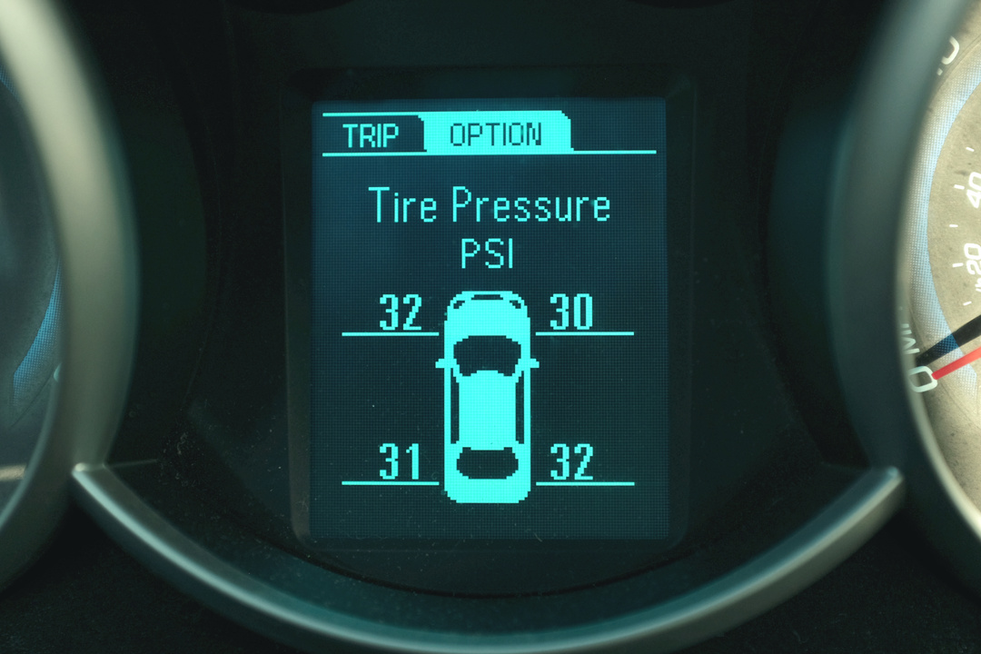
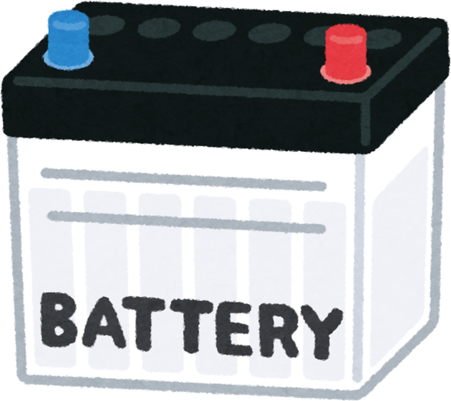







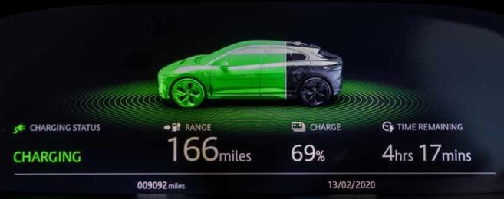

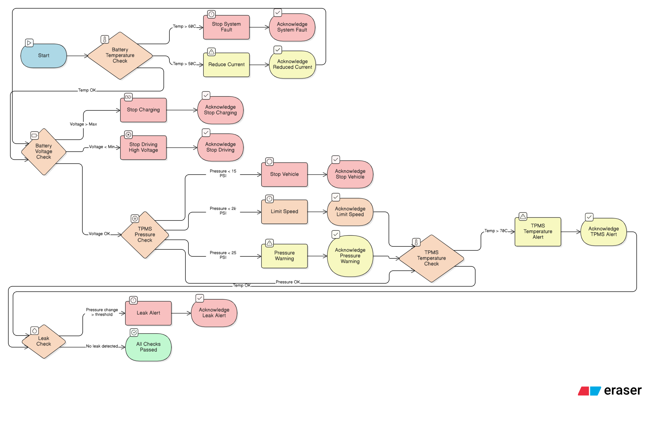
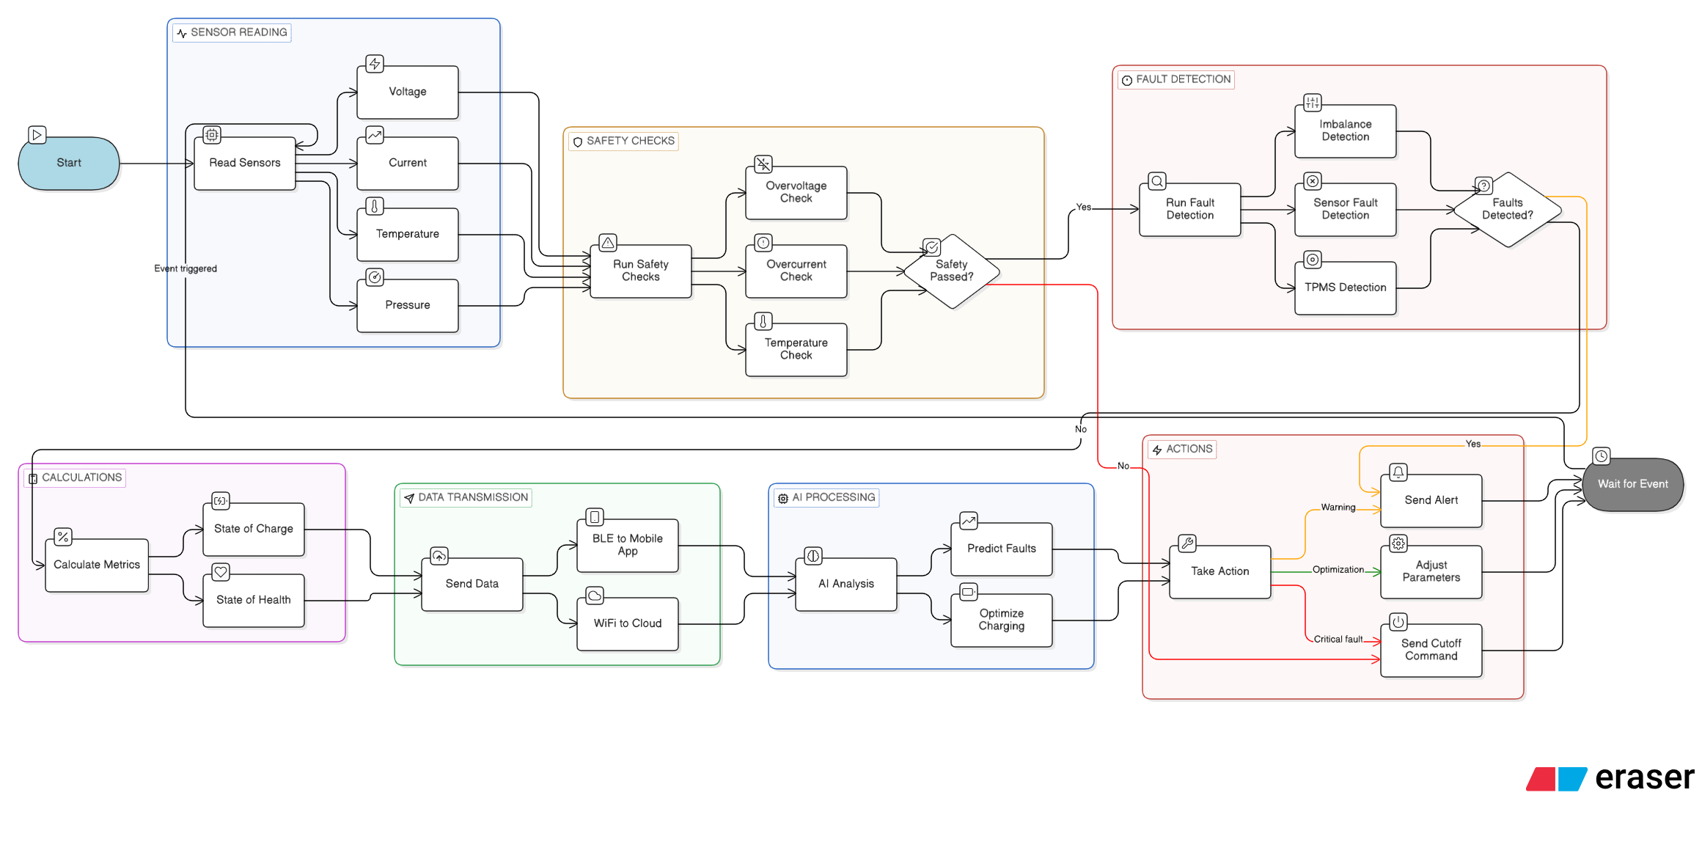
AI & CONNECTED MOBILITY
TIRE PRESSURE MONITORING SYSTEM
SENSE. THINK. ACT.
SYSTEM ARCHITECTURE
  Continuous Monitoring — Pressure and temperature measured per wheel in real time, displayed live on dashboard with per-wheel status.
  Three-Level Threshold — Normal: 32–35 psi, 30–50°C. Warning: below 28 psi or above 60°C. Critical: below 22 psi or above 70°C — VCU alert triggered at each level.
  Leak Detection — Rate of pressure drop monitored continuously. Rapid or gradual loss flagged before reaching critical threshold, logged to VCU and cloud.
  System Value — Correct pressure reduces rolling resistance and extends range. Early detection prevents mid-shift tyre failures on revenue-earning vehicles.
System Workflow
  Sensor Acquisition & Safety Checks
    Read voltage, current, temperature and pressure on each trigger.
    Check overvoltage, overcurrent and temperature limits. If any check fails, bypass AI and immediately initiate the appropriate safety action.
  Fault Detection, Calculations & Data Transmission
    In parallel, detect cell imbalance, implausible sensor readings and abnormal tyre-pressure drops; calculate SOC using current integration and
    SOH using charge–discharge history.
    Transmit data via BLE to the driver's app and Wi-Fi to the cloud for fleet monitoring.
  AI-Based Analysis
    Fault Prediction: Use historical patterns and current readings to identify developing faults, such as cell degradation, temperature drift and bearing wear.
    Charging Optimisation: Adapt charging parameters using SOC and SOH, including lowering the constant-current (CC) limit for degraded cells.
  Action & Repeat
    Respond with a warning, real-time parameter adjustment (charging current or motor torque), or hard cutoff for critical faults.
    Return to the wait state and repeat the cycle on the next trigger.
FAST CHARGING SYSTEM
  Initialization & Safety Check — System verifies battery connection, reads voltage, current and temperature. Charging stops automatically if any parameter is outside safe limits.
  CC Phase — Fixed high current delivered until battery reaches peak voltage. Charges to ~70–80% capacity quickly.
  CV Phase — Voltage held constant, current tapers down to threshold. Prevents overcharging and thermal stress on cells.
  Continuous Monitoring — Parameters tracked throughout. All safety checks remain active. Data logged to VCU and cloud in real time.
SMART FEATURES
  Fleet Monitoring — live dashboard per vehicle: SOC, location, faults, battery status
  Predictive Maintenance — early fault detection, ≥7-day advance warning, 20–30% less downtime
  Smart Dispatch — SOC and location matched to demand, ~15% fewer deadhead kilometres
  Smart Charging — schedule built around shift demand and tariff window, 15–18% lower charging cost
  Remote Diagnostics — faults identified without physical inspection, reduces workshop time
INTEGRATED BATTERY & TYRE SAFETY MANAGEMENT
  Battery Safety: Temperature and voltage thresholds trigger current reduction, charging shutdown, or vehicle cutoff.
  Tyre & Leak Monitoring: TPMS checks pressure, temperature, and sudden pressure drops; unsafe conditions trigger alerts, speed limits, or vehicle stop.
  Fault & Reset Logic: All faults require acknowledgement before reset; checks continuously repeat until all conditions pass.

Slide 10

ROADMAP

Slide 11

SYNTHESIS

