Slide 1
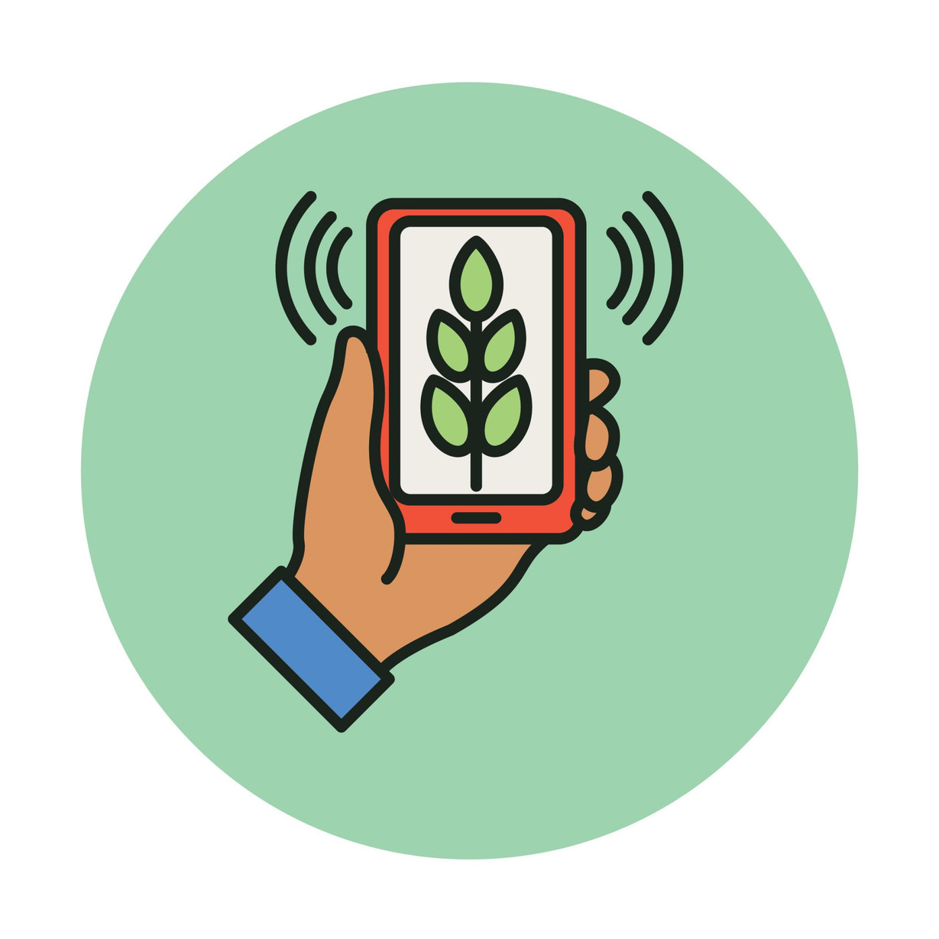

Problem Statement :- Early Crop Diseases Detection and Pest Infestations
Theme :- Agriculture & Rural Development
Solution :- Kisan Rakshak
Discription :- Website to scan Crops and analyse diesease and pest infestations to
suggest Organic and inorganic treatment methods .
Speciality :- Works like Personal Doctor of crops & Progressive tracking of Crop
Team Name :- Tech Freak 0
Notes:
make sih logo lighter

Slide 2

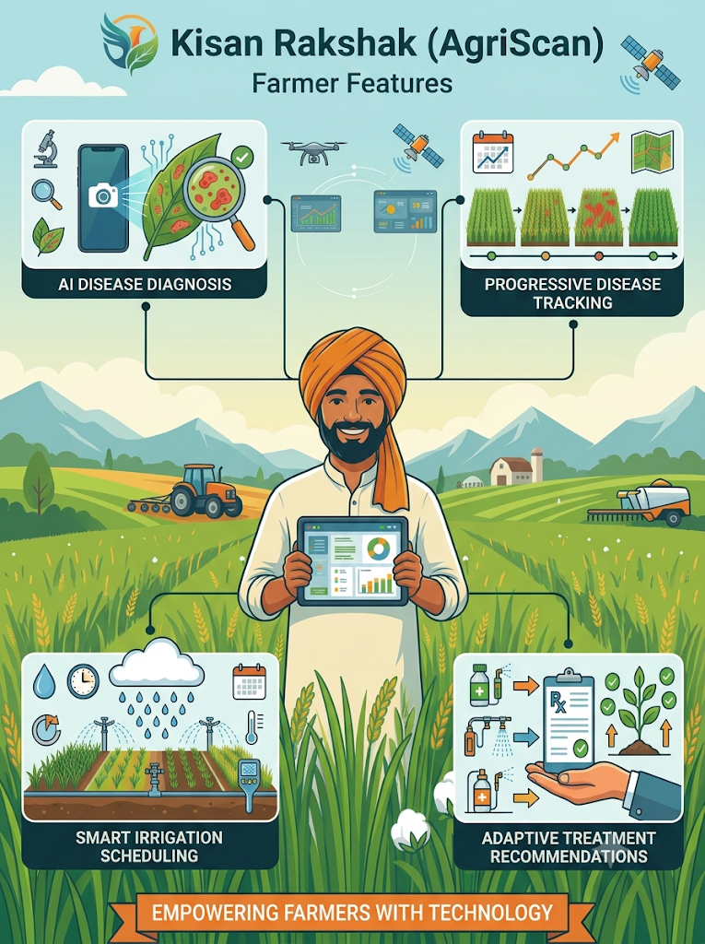
Tech Freak 0
KISAN RAKSHAK
A web platform that helps farmers and field workers to detect crop diseases and pest infestations early using AI, crop images, weather data, location and expert knowledge.
  Farmer and Crop Profiling: Registers farmer details, crop type, geographic location, soil condition and growth stage to contextualize AI image scans and store in a secure database.
  Visual Health Report: Delivers instant disease identification and colour codes alerts .
  Smart Risk Forecasting: Combines weather, crop stage, soil condition and local pest history to predict disease and pest risks before visible damage spreads.
  AI Crop Scanner: Farmers click a photo of their crop or pest → AI instantly identifies disease and suggests remedies.
  Personalized Advisory: Advice regarding specific crop type to keep crop healthy depending on local weather condition, soil health and pest problems.
  Expert Validation Loop: If AI’s result not satisfies farmer,he/she can verify by an agricultural expert to get targeted control measures.
  Monitoring & Alerts: Tracks crop heath after treatment and sends timely alerts for re-infection or other required follow ups.
  Multilingual AI Chatbot: 24/7 assistance in simple local language for crop health queries, subsidies and government programs.
  Geospatial Hotspot Mapping: Identifies disease and pest hostspots on a map, helping farmers and agricultural officials take preventive action in high risk areas.
  Pest trap integration : If a contagious disease is detected in one field,Website sends alert notification to protect their crops before its spreads.
  Weather intelligence: Tracks local weather to predict upcoming rain and storms before they happen and notify the farmers.

Slide 3

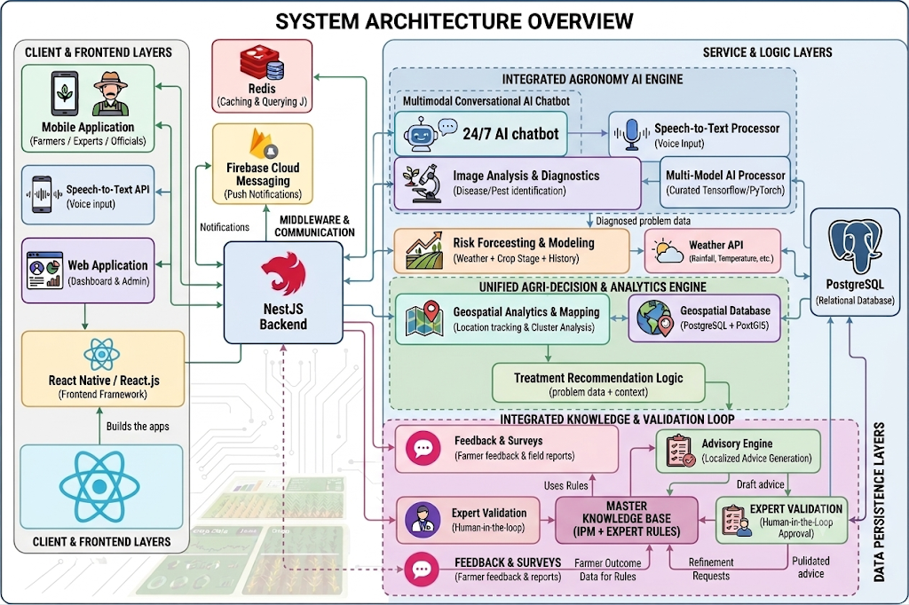











TECHNICAL APPROACH
Tech Freak 0
React.js for web app and React Native for mobile app
For graphical representation of Analytical data such disease trends, risk level and crop statistics.
As a modular and scalable backend framework.
For relational database management.
For storing reports, crop images and backups securely
Secure user authentication and session management.
Real-time chat & updates and live expert advisory.
SMS and app notification for farmers.
Crop diagnosis & personalized advisory.
Integrate weather forecast (IMD)
Caching
3

Slide 4
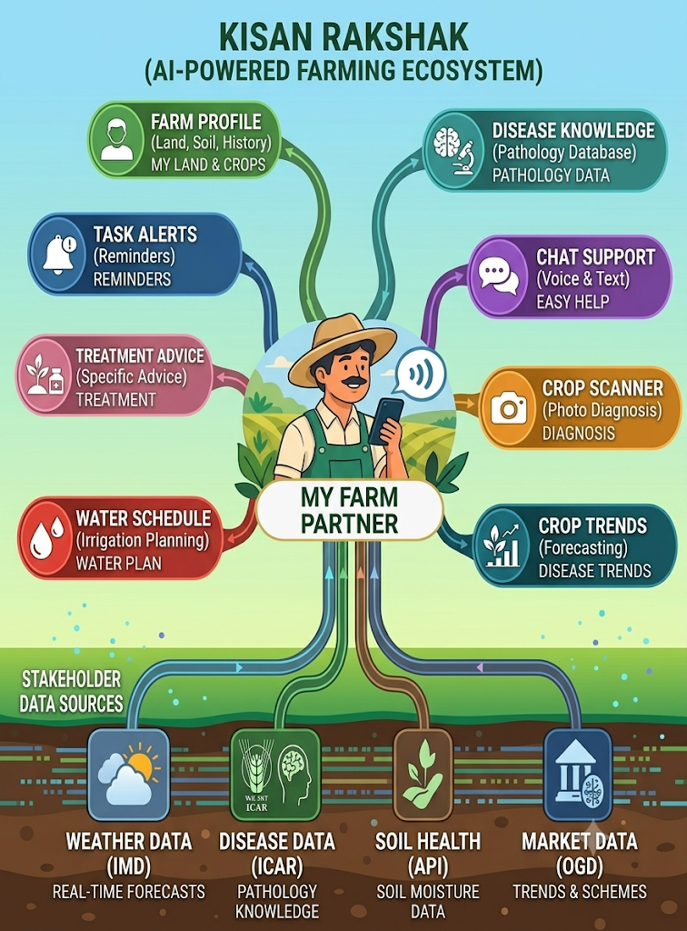

FEASIBILITY AND VIABILITY
Tech Freak 0
Feasibility of the idea
  Website with multilingual voice/text chatbot.
  Instant AI diagnosis backed by human expert validation + secure farmer database
  Integrate weather, soil and crop conditions with scalable cloud backend.
Potential challenges and risks
  Poor rural connectivity & data gaps.
  Low digital literacy & farmer trust barrier.
  Building trust in AI driven device.
Strategies to overcome challenges
  ICAR- validated knowledge base & partner with local champions to build trust.
  Automated SMS & whatsapp alerts (basic fallback).
  Voice and visual multimodal UI & FAQs in their regional language.

Slide 5



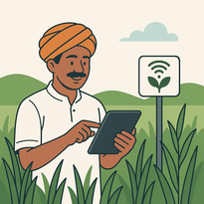
IMPACT AND BENEFITS
Tech Freak 0
Farmers
  Better crop quality, lower losses - it helps farmers protect crop health, improve quality and reduce damage and yield losses.
  Early disease detection and easy guidance - detects crop disease at early stage, allow farmers to take timely actions and prevent major crop losses by taking expert guidance.
  Empower farmers with knowledge -It gives local weather updates and guides farmers on choosing the right, safe pesticides and exact dosages while protecting them from harmful or low-quality chemicals.
Stakeholders
  Agricultural experts/Organizations-They can share their knowledge, validate AI results and reach more farmers through the platform.
  Researchers-Can use agricultural data to study disease patterns and develop better farming solutions.
  Rural economy & agriculture businesses-Increase rural economy by reducing crop losses ,improve farmers’ income and creating opportunities for agricultural businesses to provide better products and services based on local crop needs.
  State-level Agricultural Planning- Helps the government understand crop conditions across the state and develop effective agriculture strategies.
Reduced Crop Loss & Increased Yield
Faster Response & Timely Alerts
Higher Farmer Income & Lower Costs
Sustainable & Green Farming
Smarter Governance & Outbreak
Prevention
Inclusive & Scalable Agricultural
Intelligence
5

Slide 6
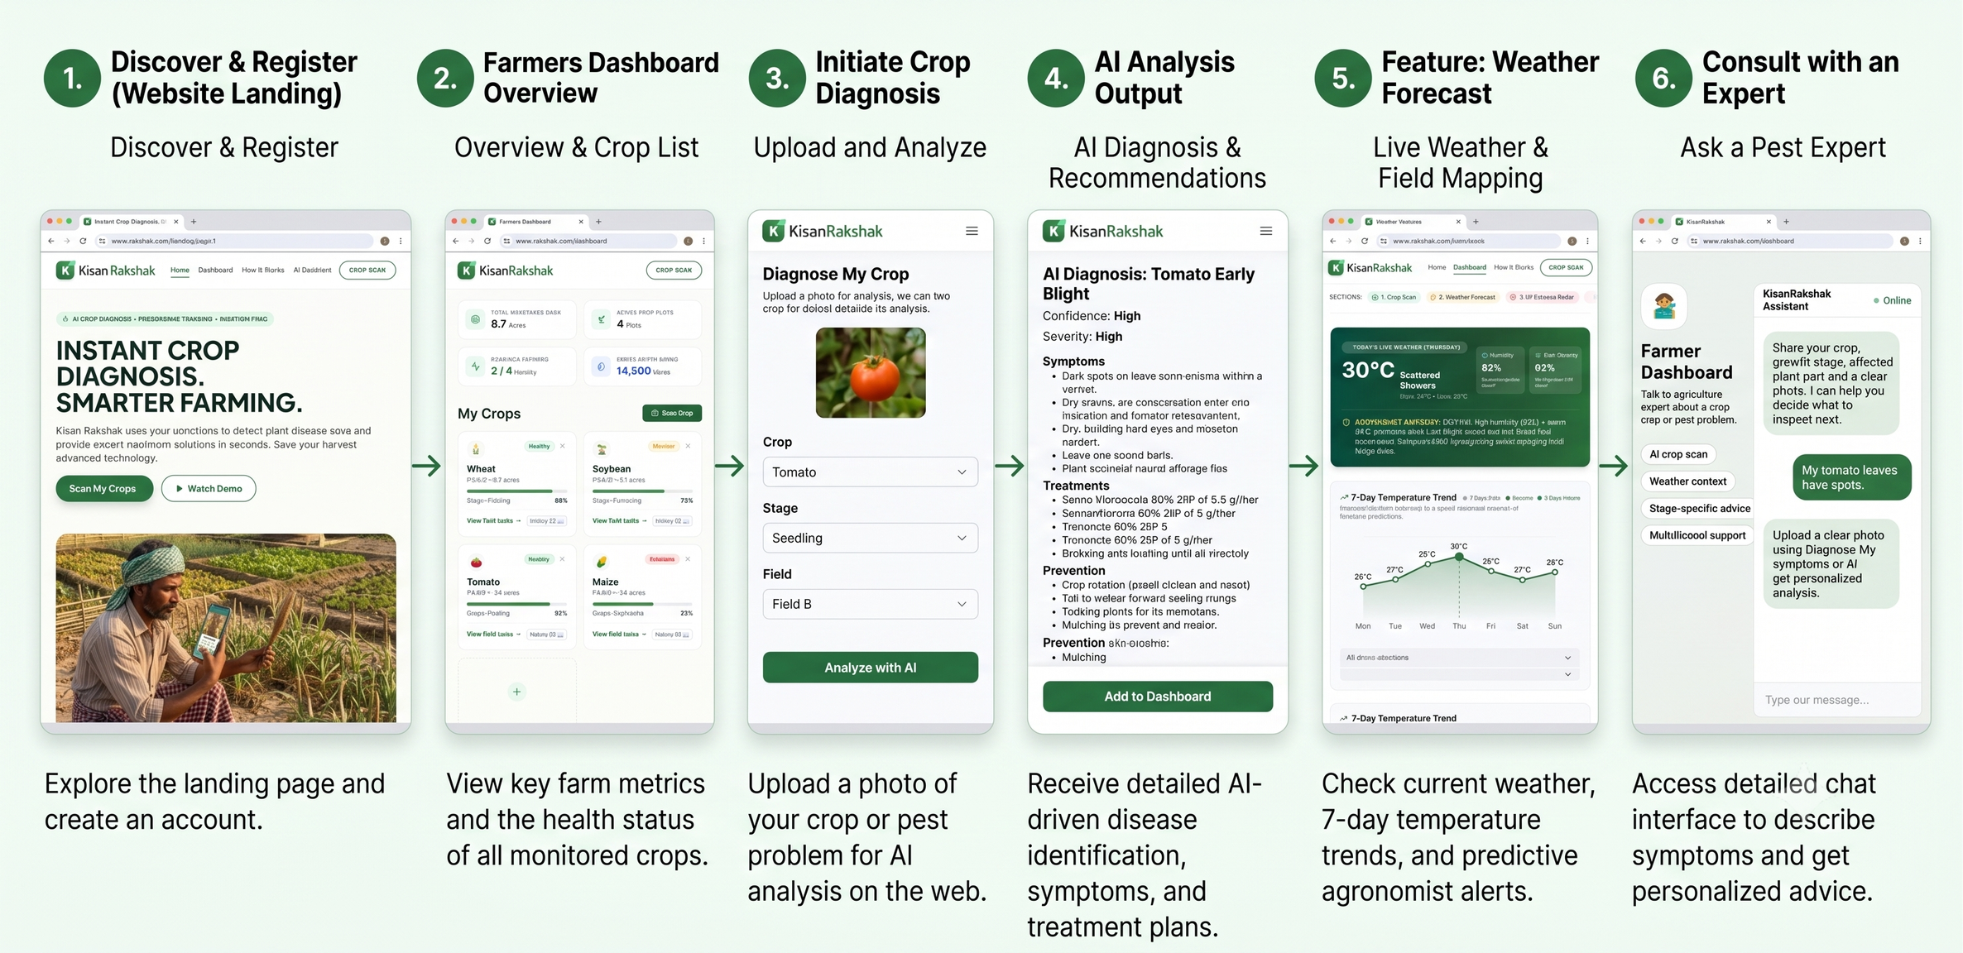
RESEARCH AND REFERENCES
Tech Freak 0
Reasearch papers & Best practices:
  AI-based crop Disease Detection Research
  Multimodal Data Integration in Agriculture
  Real-time Plant Diagnostics studies
Datasets & Resources:
  SAGE Dataset(2026 , Iowa State University)
  Crop Disease Domain Multimodal (CDDM) Dataset
  PlantVillage dataset
  Multi-crop disease Dataset (Mendeley Data,2025)
Github:-
https://github.com/PranavSingh2006-gif/Kisan-Rakshak-agriscan-
6

