Slide 1
Connect 4 ‘in Java’ {
Connect4.java
Minimax.java
[Single Player Game]
< By: Pranav Sitaraman and Alan Shi >
}
Java Final Project

Slide 2
Table Of ‘Contents’ {
01
02
03
Connect4.java
Minimax.java
Basics
< Intro to Project >
Computer Algorithm
< Minimax & Alpha-Beta Pruning >
Frontend
< Built with JavaFX >
}
Java Final Project

Slide 3
01 {
[Basics]
Connect4.java
Minimax.java
< Intro to Project >
}
Java Final Project

Slide 4
Game Play < /1 > {
Connect4.java
Minimax.java
< Connect 4 is a simple game in which the player & computer take turns dropping pieces down a 6x7 board in order to connect 4 in a row >
}
Outline < /2 > {
< Written in Java, with a JavaFX frontend >
}
Java Final Project

Slide 5
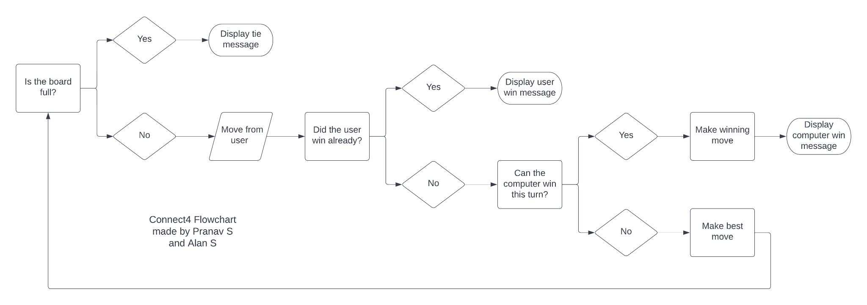
Flowchart; {
Connect4.java
Minimax.java
‘Here you can give a brief description of the topic you want to talk about’
<p For example, if you want to talk about Mercury, you can say that it’s the smallest planet in the entire Solar System >
</p>
}
Java Final Project

Slide 6
Project ‘Breakdown’ {
Connect4.java
Minimax.java
Time Spent
Backend
60%
Frontend
40%
< Developing minimax algorithm to calculate computer move >
< Create JavaFX interface and board animation >
Features
Relatively quick
Played with keyboard
Easy to use UI
}
Java Final Project

Slide 7
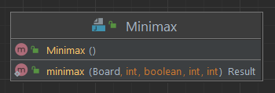
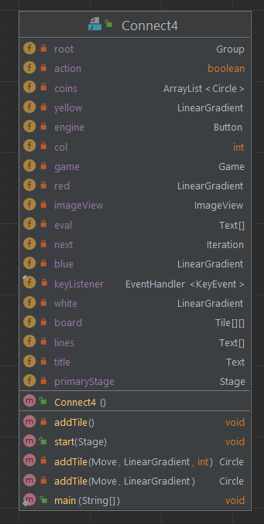
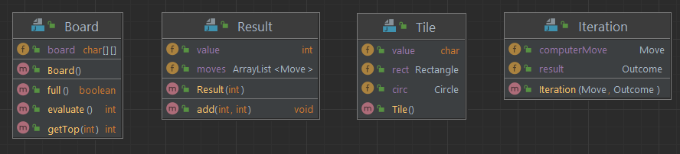
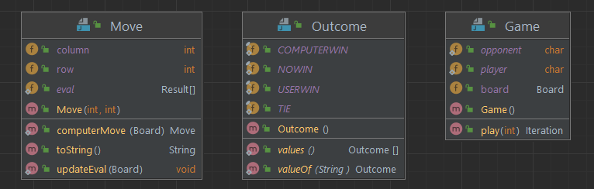
Code
Layout; {
Connect4.java
Minimax.java
</p>
}
Java Final Project

Slide 8
02 {
[Computer Algorithm]
Connect4.java
Minimax.java
< Minimax & Alpha-Beta Pruning >
}
Java Final Project

Slide 9
Computer Algorithm: ‘Minimax’ {
Connect4.java
Minimax.java
Step 01
Depth-first-search (DFS) evaluation structure that alternates maximizing computer evaluation and minimizing player evaluation
Step 02
Currently pruning game-tree below a depth of 9 to produce suitable runtime, but fares better in C++
Step 03
Requires robust evaluation function: current evaluation function is state-based
Step 04
Theoretically perfect but limited by game tree depth and would likely be better if heuristic
}
Java Final Project

Slide 10
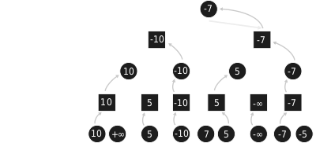
Computer Algorithm: ‘Minimax’ {
Connect4.java
Minimax.java
}
Java Final Project

Slide 11
4,531,985,219,092 {
Connect4.java
Minimax.java
< Potential Game States (Complexity) >
}
Java Final Project

Slide 12
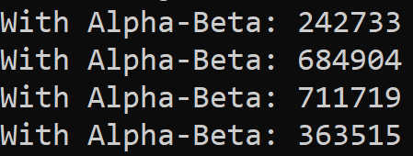
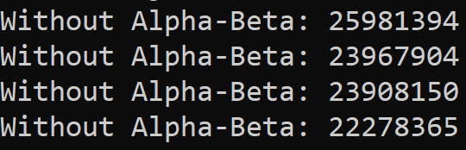
Computer Algorithm: ‘α-β Pruning’ {
Connect4.java
Minimax.java
Step 01
Pruning of the game tree to increase speed if a minimizing node minimizes below its parent’s previous maximum, or vice versa
Step 02
Any smaller values would obviously not be maximized by parent, while larger values would not be minimized by child node
Step 03
Extremely beneficial for performance, results below show comparison at depth 7
}
Java Final Project

Slide 13
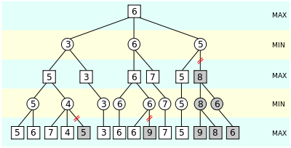
Computer Algorithm: ‘α-β Pruning’ {
Connect4.java
Minimax.java
}
Java Final Project

Slide 14
03 {
[Frontend]
Connect4.java
Minimax.java
< Built with JavaFX >
}
Java Final Project

Slide 15
Features of ‘The Frontend’ {
Connect4.java
Minimax.java
Column Select
Game Play
< Switching between columns with the arrow keys >
< Enter to drop pieces, with smooth animations >
Eval Mode
Game Lines
< Computer evaluation updated and displayed >
< Shows predicted computer ‘lines’ >
}
Java Final Project

Slide 16
The Animation; {
Connect4.java
Minimax.java
Difficulties
< Had a lot of trouble with smooth animations while calculating computer move, as delays blocked the JavaFX thread >
Methods Tried
< Attempted to bind the computer move algorithm to the end of the transition but was unsuccessful >
Solution
< Use of Java CompletableFuture<> to calculate computer move asynchronously on different thread pool >
}
Java Final Project

Slide 17
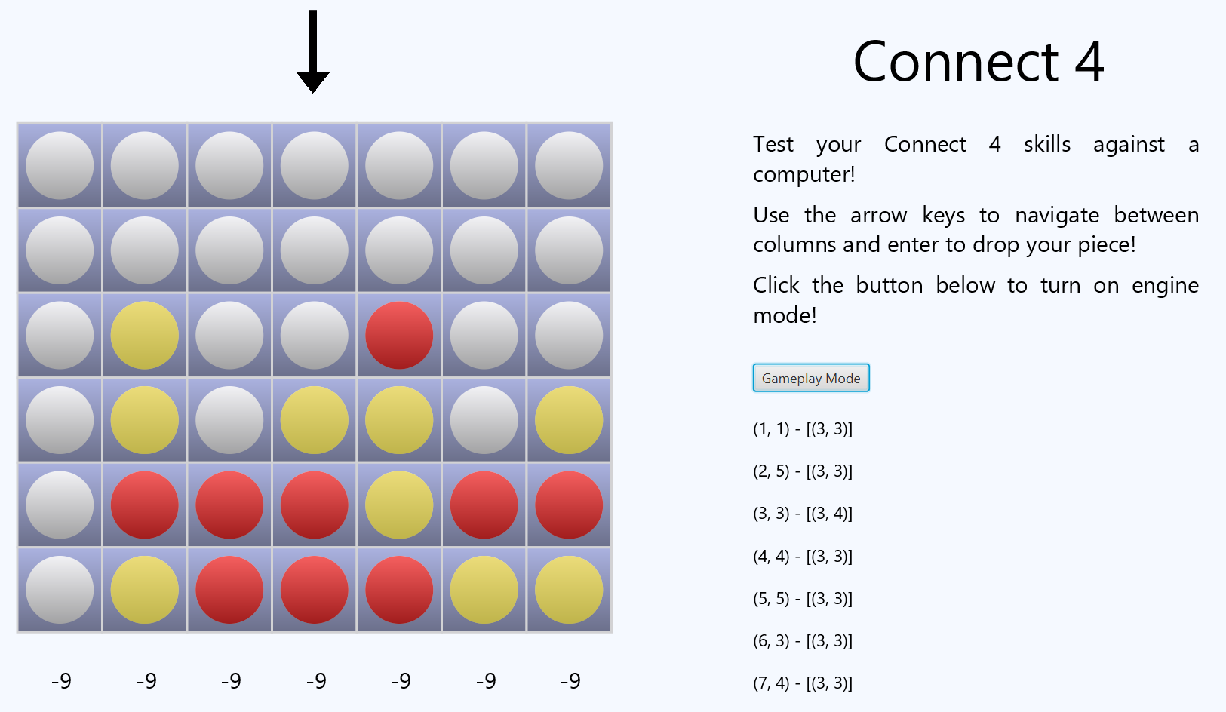
Connect4.java
Minimax.java
Java Final Project

Slide 18
04 {
[Summary]
Connect4.java
Minimax.java
< Summary and Demonstration of our Project >
}
Java Final Project

Slide 19
Future Goals {
< /1 >
< /2 >
Connect4.java
Minimax.java
< Future considerations to improve performance of the computer algoirthm >
Implement more heuristic evaluation algorithm
Use the null-move heuristic algorithm to prune tree
Use iterative deepening of the minimax DFS to explore deeper depths
Cache upper and lower bounds of board states in a transposition table
}
Java Final Project

Slide 20
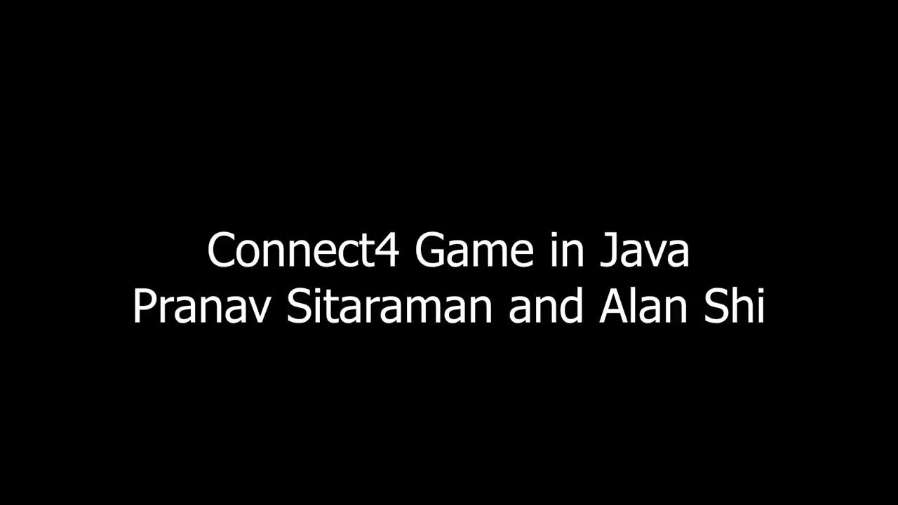
Connect4.java
Minimax.java
< and finally, our app >
Java Final Project

