Slide 1
Air
Underwater: Wet
Pad
Air
Hairs
Water
Capillary bridges
Underwater: Bubble
D_{p}
D_{h}
“Bubble”
“Oil-like Fluid”
Bridge contact within air
Bridge contact in water

Slide 2
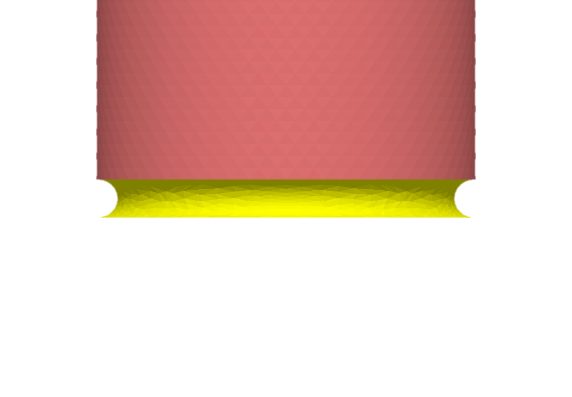

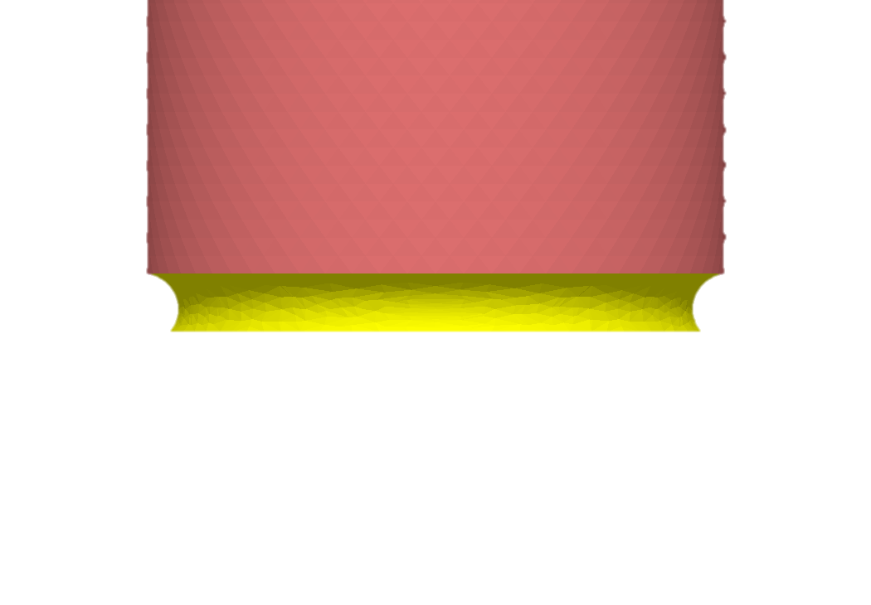
Air
Underwater
High adhesion
Low adhesion
Hydrophillic
γ_{fa} = 27 mN m⁻¹, θ_{fa} = 6°
γ_{fw} = 55 mN m⁻¹, θ_{fw}= 138°
High adhesion
High adhesion
Hydrophobic
γ_{fa} = 27 mN m⁻¹, θ_{fa} = 56°
γ_{fw} = 55 mN m⁻¹, θ_{fw} = 70°

Slide 3
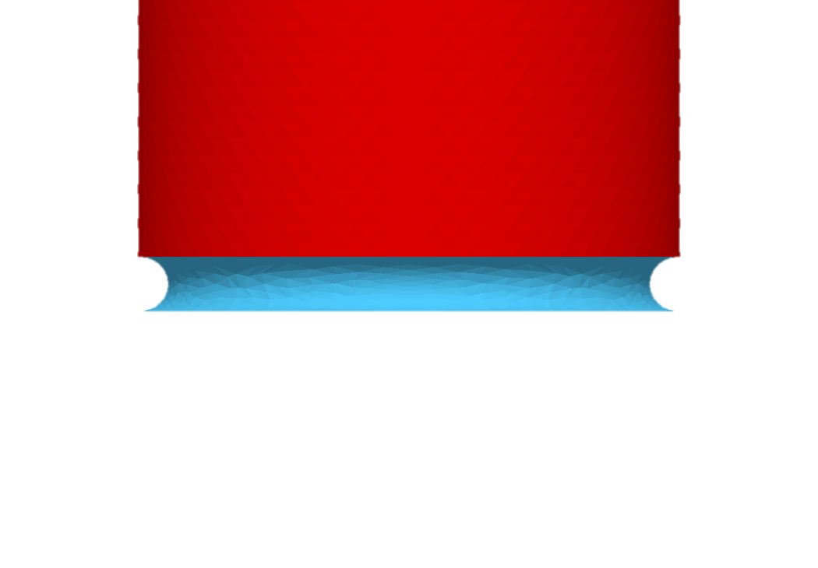
6 deg

Slide 4
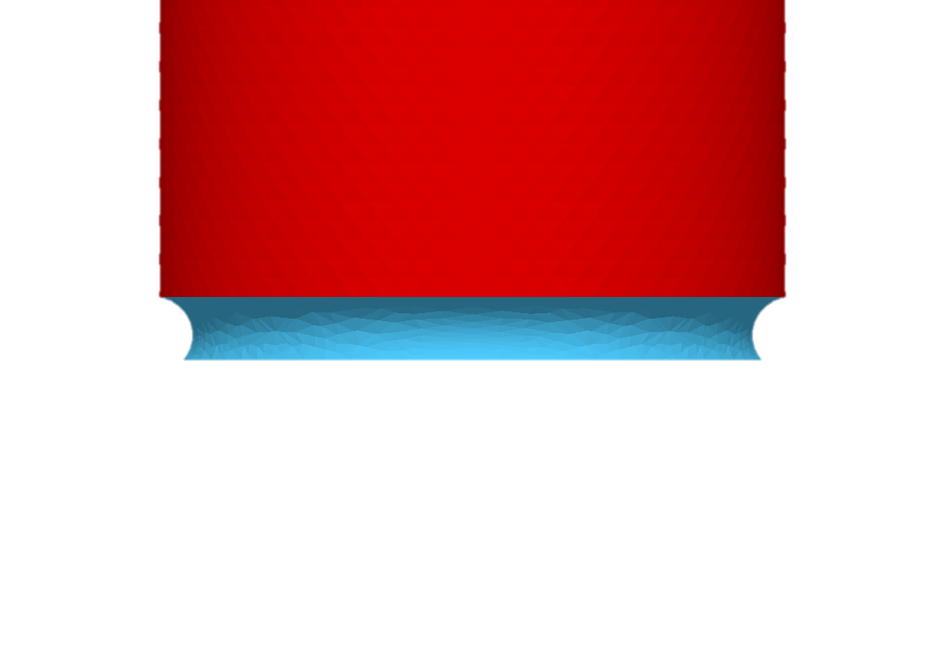
50 deg

Slide 5
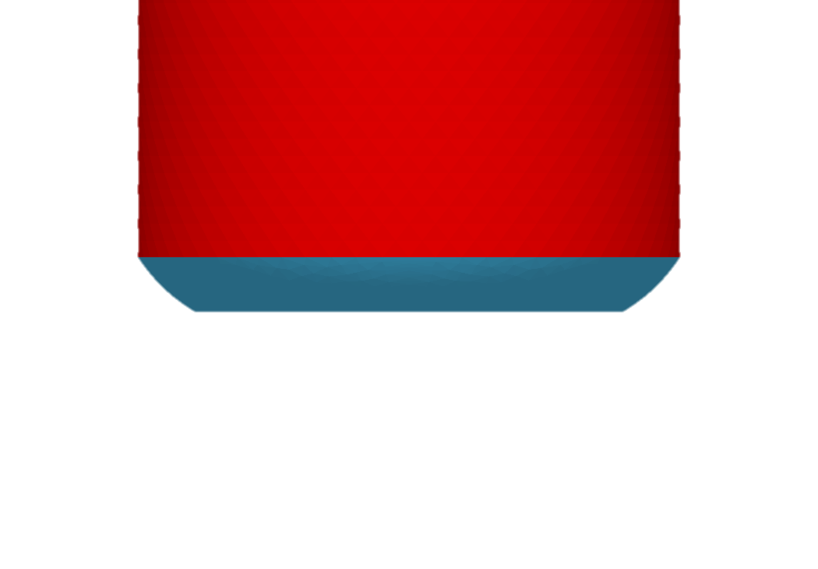
150 deg

Slide 6
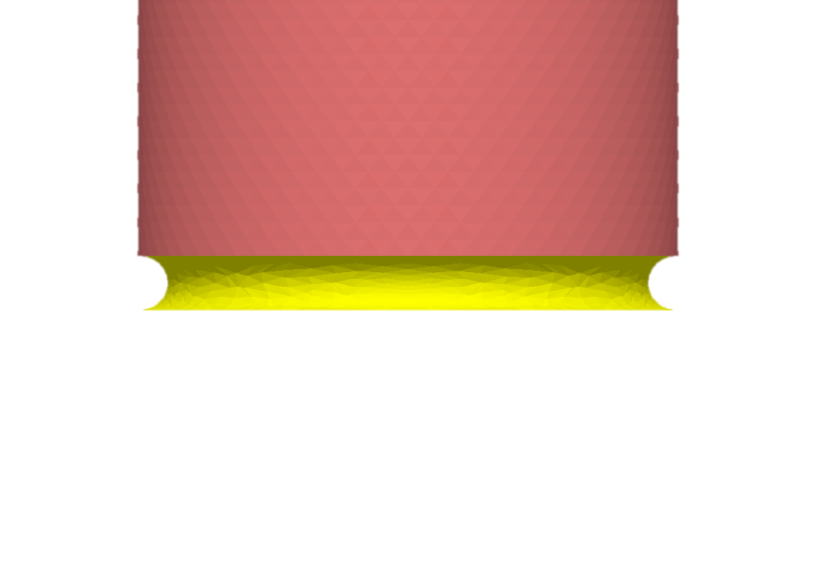
1 deg

