Slide 1
Air
Underwater: Wet
Pad
Air
Hairs
Water
Capillary bridges
Underwater: Bubble
D_{p}
D_{h}
“Bubble”
“Oil-like Fluid”
Bridge contact within air
Bridge contact in water

Slide 2
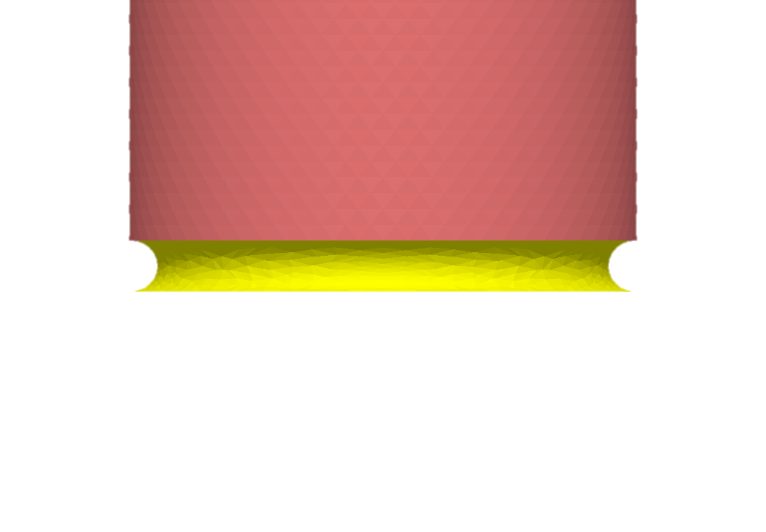

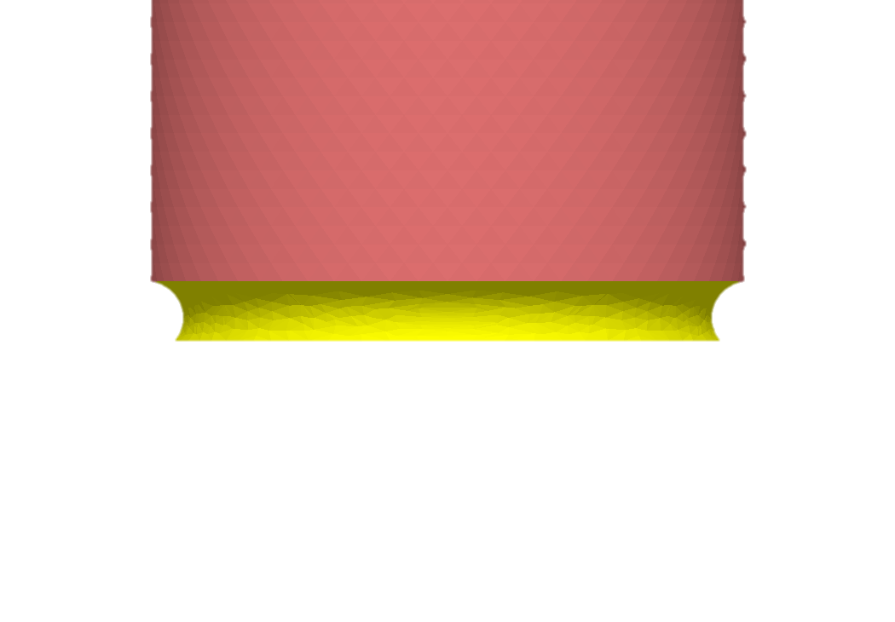
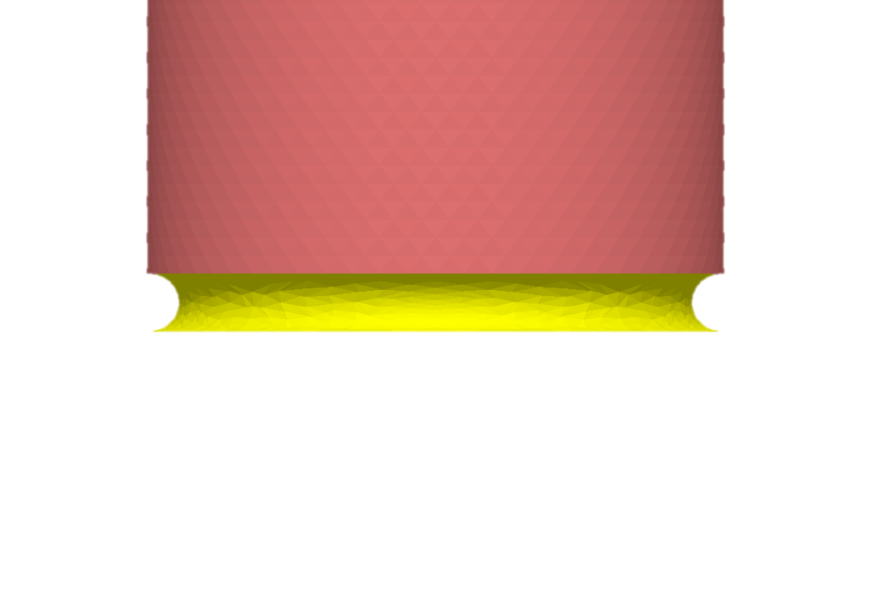
Air
Underwater
High adhesion
Low adhesion
Glass
γ = 24 mN m⁻¹, θ = 6°
γ = 48 mN m⁻¹, θ = 150°
High adhesion
Higher adhesion
PFOTS
γ = 24 mN m⁻¹, θ = 50°
γ = 48 mN m⁻¹, θ = 1°

Slide 3
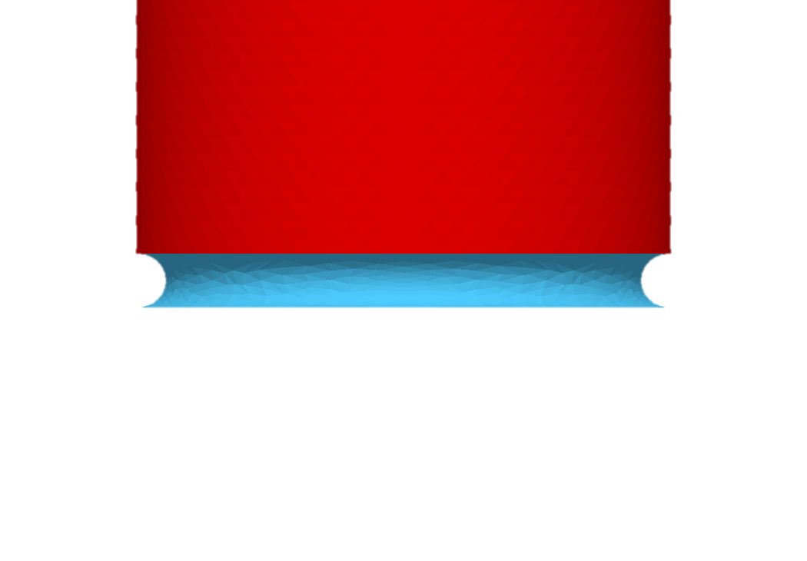
6 deg

Slide 4
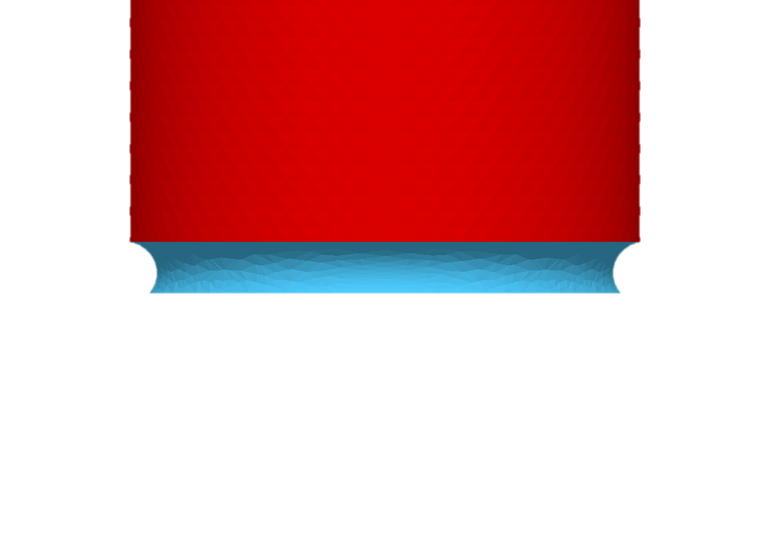
50 deg

Slide 5
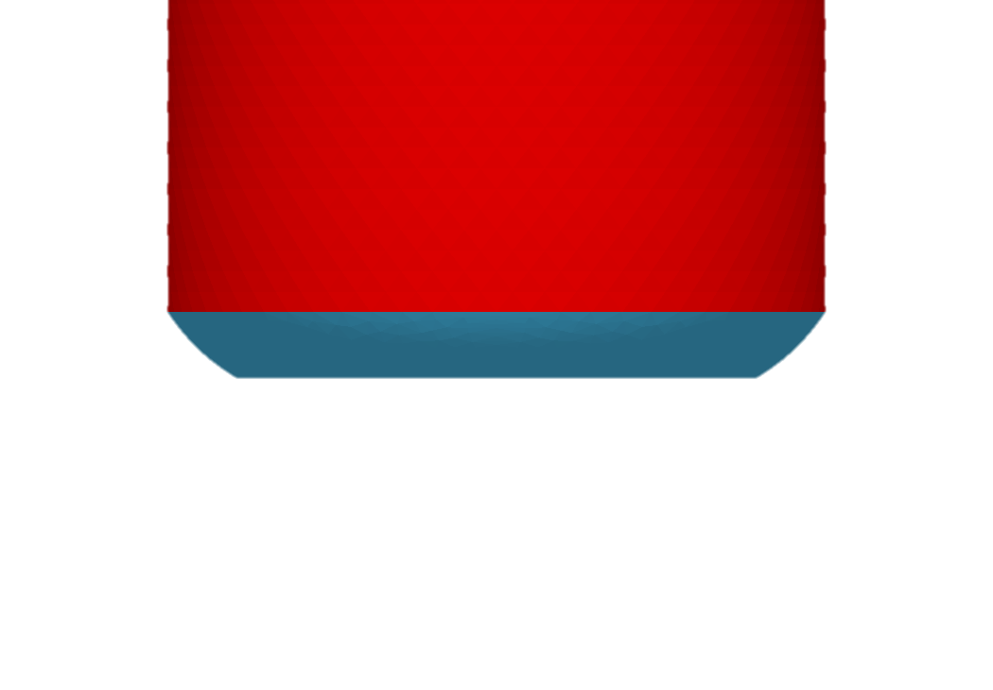
150 deg

Slide 6
1 deg

