Slide 1
Air
Underwater: Wet
Pad
Air
Hairs
Water
Capillary bridges
Underwater: Bubble
D_{p}
D_{h}
“Bubble”
“Oil-like Fluid”
Bridge contact within air
Bridge contact in water

Slide 2
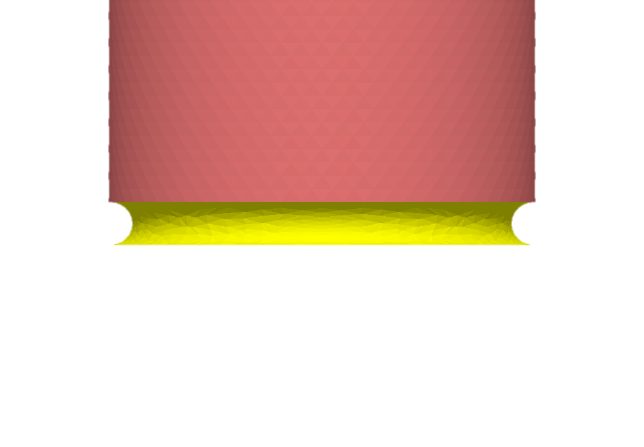

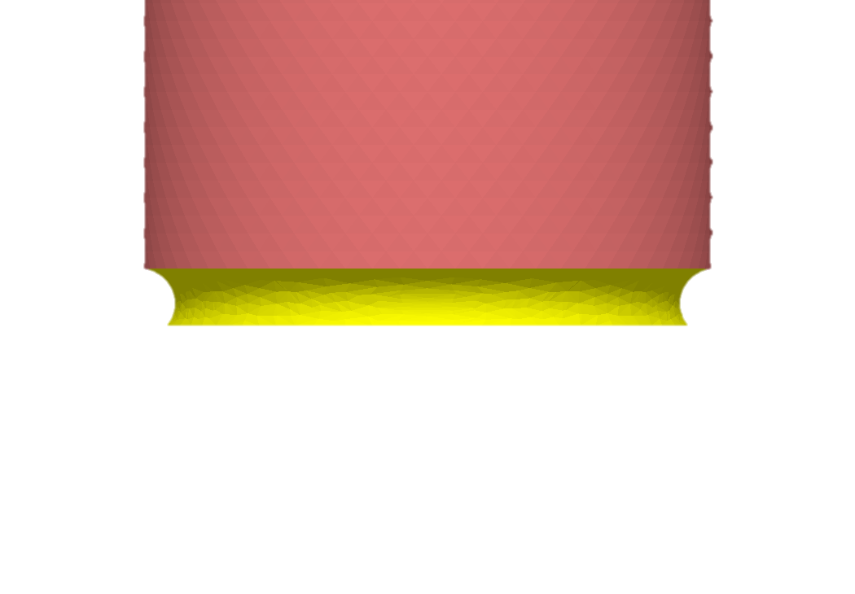
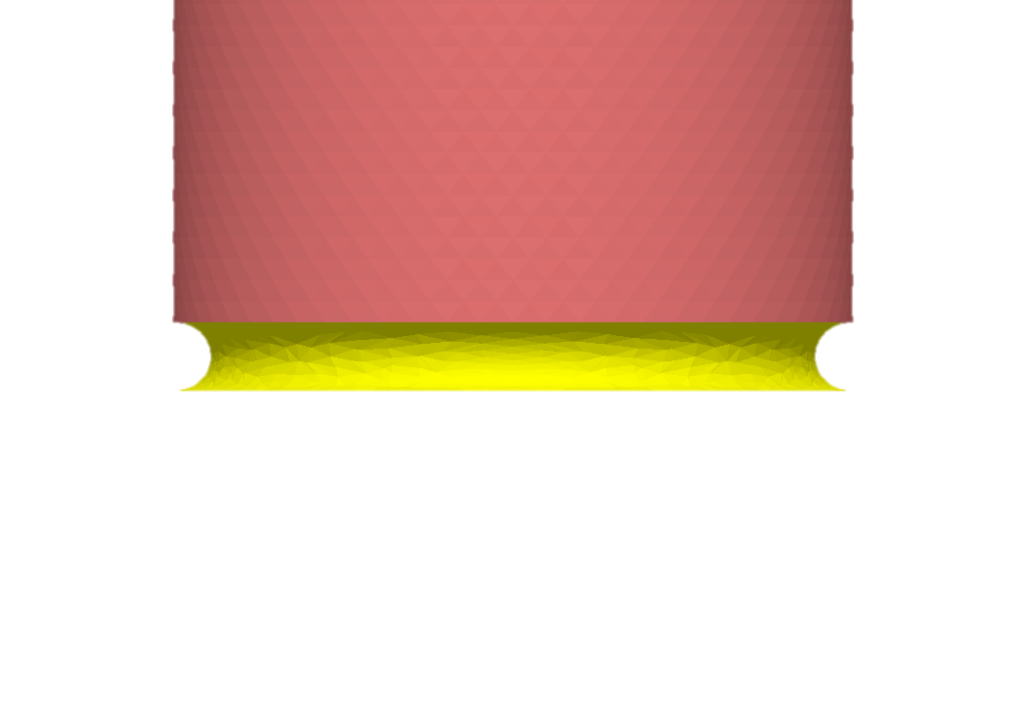
Air
Underwater
Glass
θ = 6°
θ = 150°
PFOTS
θ = 50°
θ = 1°

Slide 3
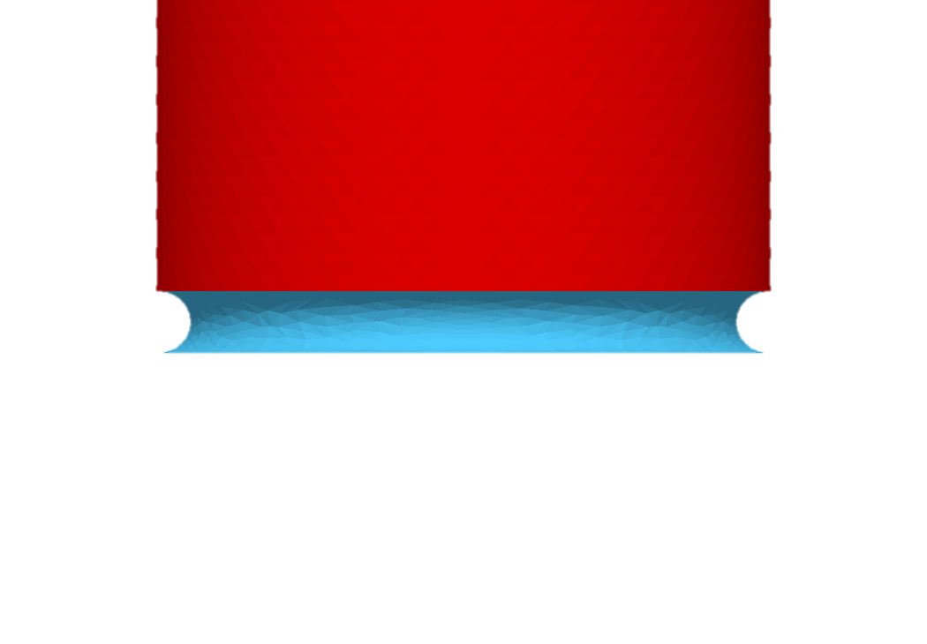
6 deg

Slide 4
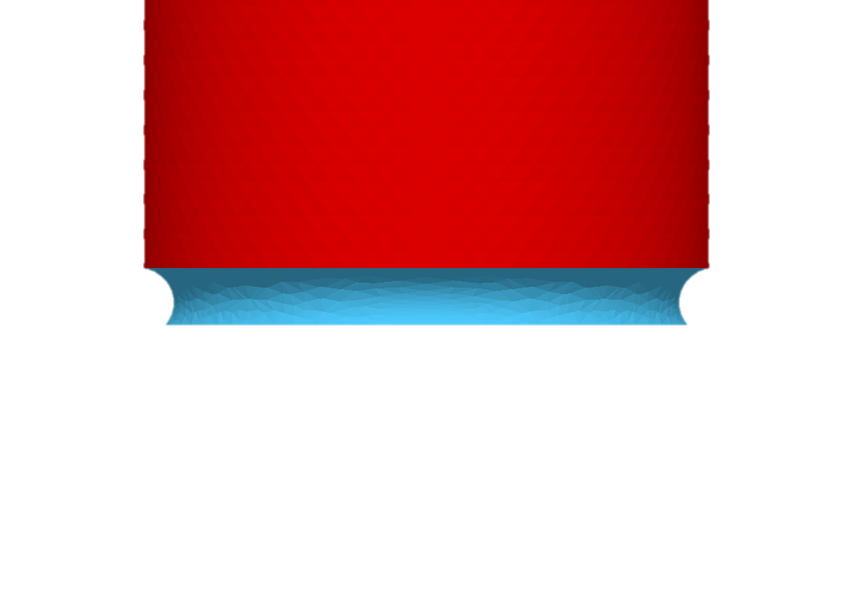
50 deg

Slide 5
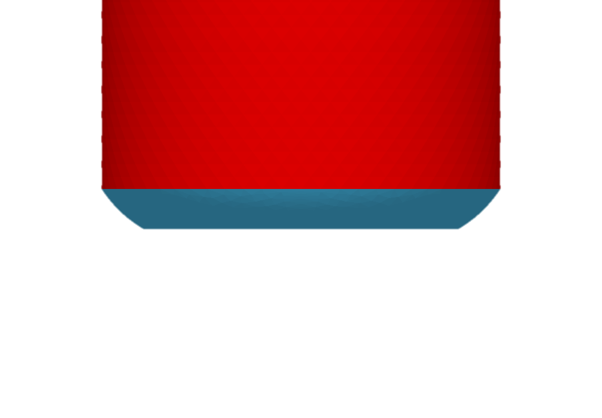
150 deg

Slide 6
1 deg

