Slide 1
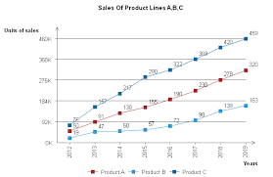
Hello this is Utkarsh

