Slide 1
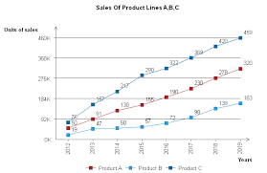
XYZ Turing
ndnakjdnk hdnaj njdakjnkj jndkjankj
id | name | email | age | city
1 | Pranav Pathekar | pranav@example.com | 22 | Wardha
2 | Aarav Sharma | aarav@example.com | 25 | Mumbai
3 | Neha Verma | neha@example.com | 28 | Delhi
4 | Rohan Gupta | rohan@example.com | 24 | Pune
5 | Ananya Iyer | ananya@example.com | 26 | Bangalore

