Slide 1
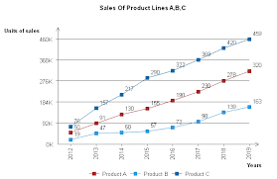
dhahjdbhaj hadiuhaiuh hhadbad hadnjna han dand kjnakj a hdjnahjb bdhbawdb hja jhabhd ha dabdh vahvdh adhagd gahgdahdh gaghdgajd had ahdhgahdg a gd gd agdjh gjha gd hdgajgdjgaiuwiuwduiqodaj aukgaudg kiagkdga gd iqg h ahwuikkwgd ugud uygdiug digwdi uhiukwahdiuhqoodquo dhaikiu ihd iu auiduiag dugdauygdy.

