Slide 1
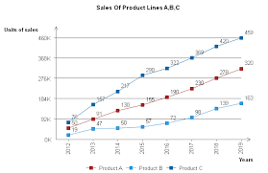
Core finding: In the current setup, GEPA is effectively operating as a feedback and analysis system, not an automatic prompt rewriter. It analyzes performance, provides suggestions, and expects manual prompt updates.

