Slide 1


A PICTURE IS WORTH A THOUSAND WORDS
DORMEASE
“Explore Wisdom Stay Relax”

Slide 2


MS.SWATHY SEKAR ASSISTANT PROFFESSOR MESCE
TEAM MEMBERS
MOHAMMED AJSER
PRANAV V
MOHAMMED SHAMEEL
NIDHA K
PROJECT GUIDE

Slide 3
INTRODUCTION
In today's fast-paced world, finding suitable accommodation can be a significant challenge, especially for students and bachelors relocating to Kerala for educational pursuits or job opportunities.
Our proposed application aims to address these challenges head-on by providing a user-friendly platform tailored to the needs of students and bachelors in and out Kerala. Through intuitive search functionalities and prioritization of affordability, safety, and convenience, our application seeks to streamline the process of finding suitable accommodations.
Our application seeks to empower individuals by providing them with the tools and resources needed to navigate the accommodation landscape in Kerala confidently. Whether they are relocating for university studies or seeking job opportunities in the state, our platform ensures a seamless transition by simplifying the process of finding suitable accommodation.

Slide 4


PROBLEM IDENTIFICATION
Despite Kerala's technical job prominence, finding suitable accommodation remains daunting due to limited availability and high demand
There is an essential need of a platform offering homestays and hostels with search options based on proximity, budget, and amenities

Slide 5

SOLUTION OVERVIEW
Facilitate seamless interaction between users and hosts, including Maps integration, ratings, feedback, and service analysis using a web application
Empower individuals to pursue educational and career goals confidently in Kerala by simplifying the accommodation search process.
To develop a user-friendly application to address accommodation challenges for students and bachelors in Kerala

Slide 6
SOFTWARE REQUIREMENT SPECIFICATION
FUNCTIONAL REQUIREMENTS
User Registration and authentication
Search functionality based on different
criteria like location
Booking process
Payment integration
Admin panel to manage listing , booking
and payments
Display availability of home stay
Responsive design
Secure authentication
NON-FUNCTIONAL REQUIREMENTS
Performance : Response time , Scalability and Reliability
Security
Usability : Accessibility , compatibility
Scalability
Maintainability
Data management

Slide 7
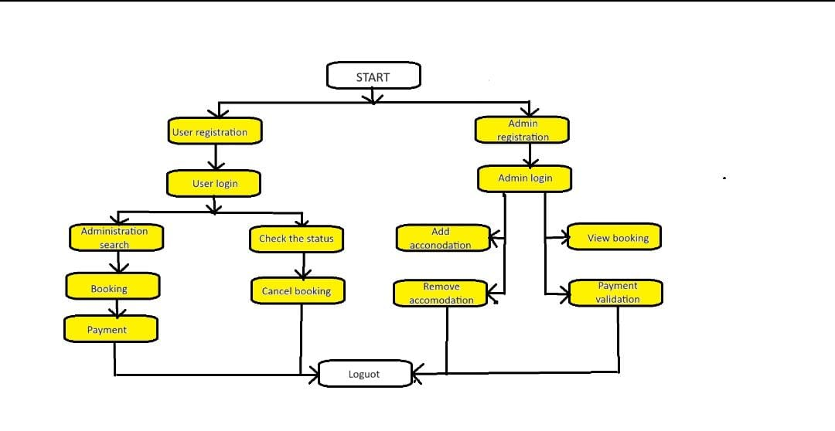
SYSTEM ARCHITECTURE

Slide 8

USER INTERFACE DESIGN
Homepage: Design a visually appealing homepage that provides an overview of available properties, search functionality, and featured listings. Include a prominent search bar and navigation menu for easy access to other sections of the website.
Property Listings: Display property listings in a visually appealing and informative manner, including high-quality images, property details (such as type, size, amenities), availability calendar, pricing information, and reviews/ratings.
Property Details Page: Design a detailed property page that provides comprehensive information about the selected property, including multiple images, descriptions, amenities, location map, availability calendar, pricing breakdown, and booking options.

Slide 9

DATABASE DESIGN
*Users Collection: It contains documents representing users of the booking application. Each document includes fields like username, email, password, and role. The role field defines the user's role, such as "admin" or "customer".
Locations Collection: It Stores information about booking locations or venues as documents. Documents include fields like name, address, capacity, and amenities. Amenities could be represented as an array of strings listing available facilities.
Bookings Collection: It holds documents representing bookings made by users. Each booking document references a user and a location by objectId. Also includes fields for start_datetime and end_datetime to define the booking period.

Slide 10

API DESIGN
Authentication and Authorization: Implement secure methods for users to authenticate and authorize access to the API endpoints, ensuring that only authorized users can make bookings.
Endpoints for CRUD Operations: Create endpoints for users to perform CRUD (Create, Read, Update, Delete) operations on booking resources.
Validation: Implement validation to ensure that data sent to the API is valid and meets specified criteria. For instance, validate input such as date/time format, availability, and user permissions.
Search and Filtering: Allow users to search for bookings based on various criteria such as date, location, user ID, etc.
Error Handling: Provide clear error messages and appropriate HTTP status codes for different error scenarios to help developers troubleshoot issues efficiently.

Slide 11
TESTING & VALIDATION
BACKEND
Unit Testing: Test individual functions, modules, and routes using frameworks like Mocha, Jest, or Jasmine.
Integration Testing: Verify interactions between different components/modules of the backend, including database interactions.
API Testing: Use tools like Postman or Newman to test API endpoints for expected behavior, responses, and error handling.
FRONTEND
Unit Testing: Test React components in isolation using tools like Jest and React Testing Library.
Integration Testing: Verify interactions between components, including state management and data flow.
UI Testing: Use tools like Cypress or Selenium for end-to-end testing to simulate user interactions and validate the user interface.

Slide 12

DATABASE
Unit Testing: Test database interactions and queries using mock databases or in-memory databases like MongoDB Memory Server.
Integration Testing: Verify the integration between the application and the actual MongoDB database, ensuring proper data storage and retrieval.
END-TO-END TESTING
User Flow Testing*: Simulate user actions across the entire application stack to validate end-to-end functionality.
Load Testing: Assess application performance and scalability under different load conditions using tools like JMeter or artillery.

Slide 13
CONCLUSION
Our proposed application, "Simplifying Accommodation Search in Kerala," presents a promising solution to the challenges faced by students and bachelors in finding suitable accommodation in the region. By leveraging modern web technologies and intuitive design, the application aims to streamline the accommodation search process, prioritize affordability and safety, and empower individuals to pursue their educational and career goals with confidence
we have established the viability of the project and identified key considerations for successful implementation. With careful planning, resource allocation, and adherence to regulatory standards, our application holds significant potential to meet the needs of our target audience and make a positive impact on their lives.

Slide 14
.THANK YOU

