Slide 1
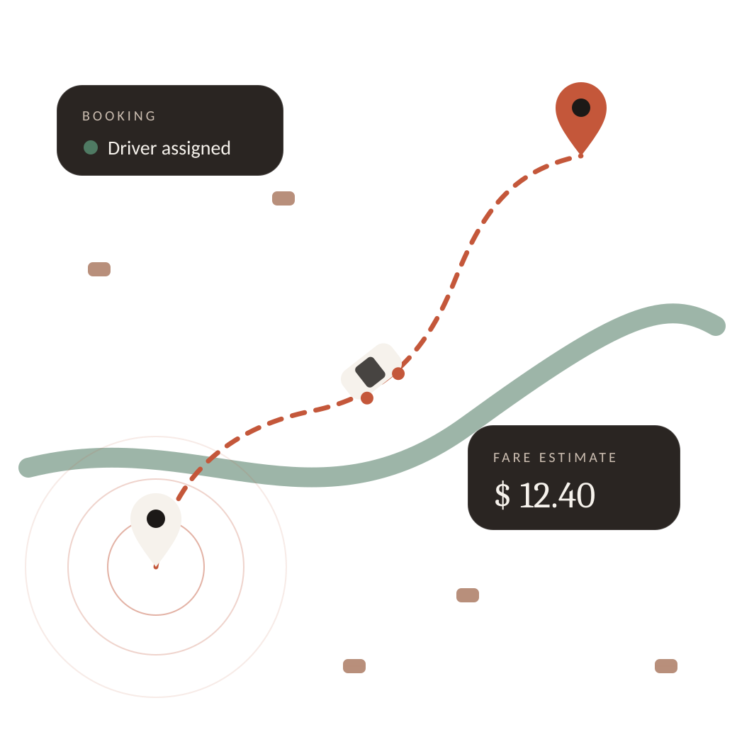
Gig Analytics
23CSE301 MACHINE LEARNING · CAPSTONE REVIEW 2
What a ride is worth, how a booking ends, and which rides make up the work
Team 6
Harsha Vardhan · CB.SC.U4CSE24719
M Pranav · CB.SC.U4CSE24730
S Rahul Kumar · CB.SC.U4CSE24766
Notes:
Introduce the team and the theme: gig drivers care about three things — what a trip pays, whether a booking will be completed, and what kinds of rides they do. Each question is answered with its own dataset and ML track. Review 2 adds Classification Part B, the full clustering track, documentation and the web app.

Slide 2
Three questions, three datasets, three ML tracks
1
REGRESSION
2
CLASSIFICATION
3
CLUSTERING
Uber Fares
Ola & Uber Bookings
NCR Ride Bookings
How much is a trip worth?
Will the booking be completed?
Which kinds of rides make up the work?
10,000 cleaned rows
Target: fare_amount (USD)
10 algorithms · Review 1
10,000 cleaned rows
Target: Booking_Status · 4 classes
Part A (R1) + Part B (R2)
10,000 cleaned rows
Target: no label (unsupervised)
K-Means + Agglomerative · R2
One dataset per track: each notebook, each saved model and each app page uses exactly one dataset, so results are never mixed.
Notes:
Each track has its own Kaggle dataset, sampled and cleaned to 10,000 rows. Datasets are never mixed: every notebook and every app page uses exactly one dataset.

Slide 3
From Review 1 to Review 2
REVIEW 1 · ALREADY ASSESSED
REVIEW 2 · THIS PRESENTATION
Dataset audit, EDA and preprocessing for all tracks
Regression: all 10 algorithms trained and compared
Classification Part A: Logistic Regression, KNN, Naive Bayes, Decision Tree, SVM
1
Classification Part B
Random Forest, AdaBoost, Gradient Boosting, Bagging, MLP — one table of all 10
2
Full clustering track
K-Means and Agglomerative, all three metrics, elbow, dendrogram, PCA, t-SNE
3
Pipeline & repository
Three clean notebooks, README, requirements.txt, saved models
4
Web app (bonus)
Streamlit dashboard: one page per dataset, graphs and live predictions
Notes:
Review 1 covered EDA, preprocessing, the regression track and classification Part A. Review 2 adds the five Part B classifiers with a 10-algorithm comparison, the complete clustering track, documentation, and the Streamlit app for the GUI bonus.

Slide 4
One leak-free pipeline behind every track
1
2
3
4
5
6
Audit & EDA
→
Clean & engineer
→
Split 80 / 20
→
Scale & encode
→
Train & tune
→
Select & export
shape, types, missing values, distributions
Haversine distance, drop post-outcome fields
stratified for classification, random_state = 42
fitted on the training set only, inside a Pipeline
one cell per algorithm, GridSearchCV
repeated CV rule, models saved for the app
WHY IT MATTERS
Scaler and one-hot encoder are refitted inside every cross-validation fold, so no information from validation or test rows leaks into training (guideline 7.1). Every model in a track sees the identical split, so metric comparisons are fair (guideline 7.2).
Notes:
Emphasise leakage control: preprocessing objects live inside scikit-learn Pipelines and are fitted on training data only; during cross-validation they are refitted per fold. Same 80/20 split with random_state 42 everywhere.

Slide 5
Regression recap: Gradient Boosting prices trips best
0.794
test R² · Gradient Boosting Regressor
$2.29
0.748
mean absolute error
repeated-CV R²
Distance (Haversine) carries 98% of the importance. Adding pickup year lifts test R² to 0.815.
Notes:
Regression was assessed in Review 1; shown here only as context. Best model by the two-stage rule: Gradient Boosting, test R² 0.794, MAE $2.29. Random Forest, Gradient Boosting and Decision Tree were tied on repeated CV; the test set broke the tie. Note: Random Forest baseline is 0.7616 here vs 0.7627 in Review 1 because of a newer scikit-learn version.

Slide 6
Classification · Part B
01
Five ensemble and neural-network classifiers on the same Ola & Uber bookings, the same split and the same preprocessing as Part A — then one comparison of all ten.
Notes:
Section A of the Review 2 rubric: 6 marks — Part B implementation, full comparison table, final model selection with tuning and a documented improvement.

Slide 7
Part B: five algorithms, each tuned with GridSearchCV
6
Random Forest
7
AdaBoost
8
Gradient Boosting
Many de-correlated trees on bootstrap samples, majority vote
Re-weights misclassified bookings; stumps vote by accuracy
Shallow trees fitted to the gradient of the log-loss
Best: n_estimators 100 · max_depth 16
Best: n_estimators 50 · learning_rate 0.05
Best: n_estimators 100 · learning_rate 0.1 · depth 3
9
Bagging
10
MLP neural network
SAME CONDITIONS AS PART A
Features: Booking_Value, hour, Vehicle_Type, day_of_week. Stratified 80/20 split, 5-fold stratified CV, scored on weighted F1.
Full decision trees on bootstrap samples (no feature sub-sampling)
Hidden layers + back-propagation, early stopping
Best: 50 trees · max_samples 0.5
Best: hidden (32,) · tanh · alpha 1e-4
Notes:
Explain each Part B algorithm in one line and the hyperparameters the guideline asks to tune: RF n_estimators, AdaBoost n_estimators and learning rate, GBM, Bagging with a decision-tree base estimator, MLP hidden layer sizes and activation. All use the identical preprocessing and split as Part A.

Slide 8
All ten classifiers in one table
Model | Part | Accuracy | Precision | Recall | F1 (weighted) | F1 (macro) | ROC-AUC
Decision Tree ★ | A | 0.582 | 0.457 | 0.582 | 0.486 | 0.229 | 0.480
K-Nearest Neighbors | A | 0.586 | 0.444 | 0.586 | 0.483 | 0.222 | 0.497
Bagging | B | 0.585 | 0.447 | 0.585 | 0.483 | 0.223 | 0.487
Random Forest | B | 0.573 | 0.442 | 0.573 | 0.480 | 0.226 | 0.497
Naive Bayes (Gaussian) | A | 0.622 | 0.434 | 0.622 | 0.477 | 0.194 | 0.493
Gradient Boosting | B | 0.619 | 0.447 | 0.619 | 0.477 | 0.195 | 0.495
Majority-class baseline | – | 0.621 | 0.386 | 0.621 | 0.476 | 0.192 | 0.500
Logistic Regression | A | 0.621 | 0.386 | 0.621 | 0.476 | 0.192 | 0.491
AdaBoost | B | 0.621 | 0.386 | 0.621 | 0.476 | 0.192 | 0.490
MLP Neural Network | B | 0.621 | 0.386 | 0.621 | 0.476 | 0.192 | 0.504
Support Vector Machine | A | 0.617 | 0.446 | 0.617 | 0.476 | 0.193 | 0.505
HOW TO READ IT
Sorted by weighted F1 (the Review 1 metric).
★ = selected model.
Grey row = always predicting “Success”. Every model sits within about 0.01 of it on weighted F1.
Notes:
Rubric A2: a single table of all 10 algorithms on accuracy, precision, recall, F1 and ROC-AUC. Point out the majority-class baseline row and the narrow spread of weighted F1 (0.476–0.486) and ROC-AUC (about 0.48–0.51).

Slide 9
No classifier escapes the class prior
62.1%
of bookings succeed: the always-“Success” baseline
≈ 0.50
ROC-AUC for every model — chance level
0.01
largest |correlation| of any feature with the outcome
Notes:
Key viva point. Booking outcomes depend on driver supply, traffic and surge, which are not in the data. The EDA showed near-identical outcome mixes across vehicle types, hours and weekdays, and correlations of about 0.01. So all ten models cluster around the class prior, and ROC-AUC is about 0.5. We report this honestly against the majority-class baseline instead of quoting accuracy alone.

Slide 10
Final model: chosen by a rule declared in advance
SELECTION RULE
1
Shortlist
top 5 by GridSearch CV weighted F1
2
Repeated CV
5 folds × 3 repeats on training data
3
Tie group
within 0.005 of the best: DT, RF, KNN, Bagging
4
Tie-break
highest test weighted F1 → Decision Tree
+0.024 weighted F1 for Random Forest (0.457 → 0.481); 4 of 10 models improved by tuning.
Notes:
Rubric A3: best model with justification, tuning applied, improvement documented. The rule was fixed before looking at the test set to avoid picking a lucky split. Decision Tree (max_depth 12, min_samples_leaf 10) wins the tie-break. Random Forest gained the most from tuning.

Slide 11
Where the errors are, and what re-weighting does
Actual ↓ Predicted → | Cust. cancel | Driver cancel | No driver | Success
Cust. cancel | 5 | 15 | 0 | 175
Driver cancel | 8 | 26 | 5 | 330
No driver | 3 | 17 | 3 | 171
Success | 30 | 78 | 5 | 1129
EXPERIMENT · CLASS_WEIGHT = BALANCED
0 → 0.23
0.62 → 0.24
minority-class recall (Logistic Regression)
accuracy (Logistic Regression)
Re-weighting makes the model start flagging cancellations, but most flags are wrong because the features carry little signal. Which setting is better is a business choice: is a missed cancellation costlier than a false alert? The app shows class probabilities rather than a single label.
Decision Tree, 2,000 test bookings. Diagonal = correct. Almost every booking is predicted “Success”.
Notes:
Confusion matrix of the selected Decision Tree: 1,129 of 1,242 successes are correct, but recall on the cancellation classes is very low. The class_weight experiment trades accuracy for minority recall — useful to discuss trade-offs in the viva.

Slide 12
Clustering · NCR rides
02
10,000 completed rides grouped without labels on fare, distance, turnaround times and the two ratings. K-Means vs Agglomerative clustering.
Notes:
Section B of the rubric: 8 marks — both algorithms fitted, all three metrics plus elbow and dendrogram, PCA plots for both, t-SNE for at least one.

Slide 13
Choosing k: the elbow decides when silhouette is flat
k = 3
chosen for both algorithms
Rule (declared in advance): silhouette decides only if it varies by ≥ 0.02 across k. Here it varies by just 0.008, so its maximum at k = 10 would be noise at the edge of the search range; the elbow (largest bend in inertia) gives k = 3.
Notes:
Elbow curve is mandatory for K-Means. The silhouette curve is almost flat, which itself says the data has weak cluster structure. Using a pre-declared rule avoids cherry-picking k.

Slide 14
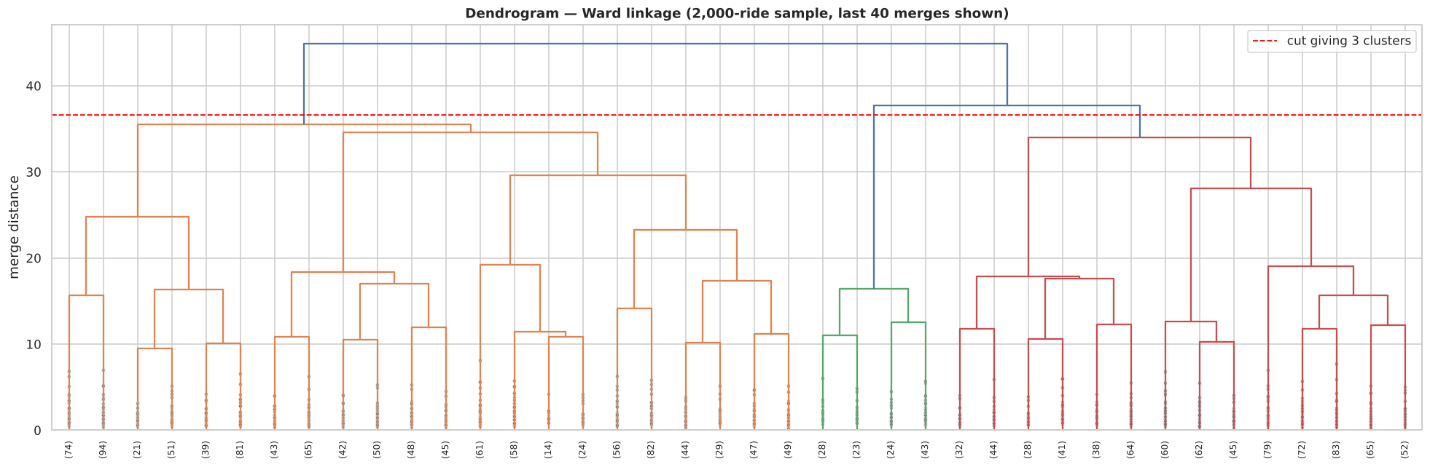
Agglomerative clustering: dendrogram and linkage choice
Linkage | Silhouette | Calinski-H. | Smallest cluster
ward ★ | 0.095 | 989 | 1,755 rides
complete | 0.091 | 838 | 1,521 rides
average | 0.141 | 15 | 2 rides
single | 0.252 | 3 | 1 ride
Single linkage looks best on silhouette, but it puts 9,998 of 10,000 rides in one cluster. Ward is chosen: the best Calinski-Harabasz among linkages whose smallest cluster holds at least 5% of rides.
Notes:
Dendrogram (Ward, 2,000-ride sample, last 40 merges) with the cut that gives 3 clusters. Four linkages compared on all 10,000 rides. Single linkage's 'high' silhouette is an artefact of one giant cluster — a good viva point about reading metrics critically.

Slide 15
K-Means wins on all three mandatory metrics
SILHOUETTE
DAVIES-BOULDIN
CALINSKI-HARABASZ
higher is better
lower is better
higher is better
0.129
0.095
2.22
2.61
1,309
989
K-Means
Agglomerative (ward)
K-Means
Agglomerative (ward)
K-Means
Agglomerative (ward)
Verdict: K-Means (k = 3) is selected. Silhouette ≈ 0.13 is modest: the rides form a continuum, so clusters are best read as useful profiles rather than natural types. Agreement between the two algorithms: ARI = 0.18.
Notes:
Rubric B2: Silhouette, Davies-Bouldin and Calinski-Harabasz for both algorithms. K-Means is better on all three. Be honest that 0.13 silhouette means weak separation — the features are nearly uniform and uncorrelated.

Slide 16
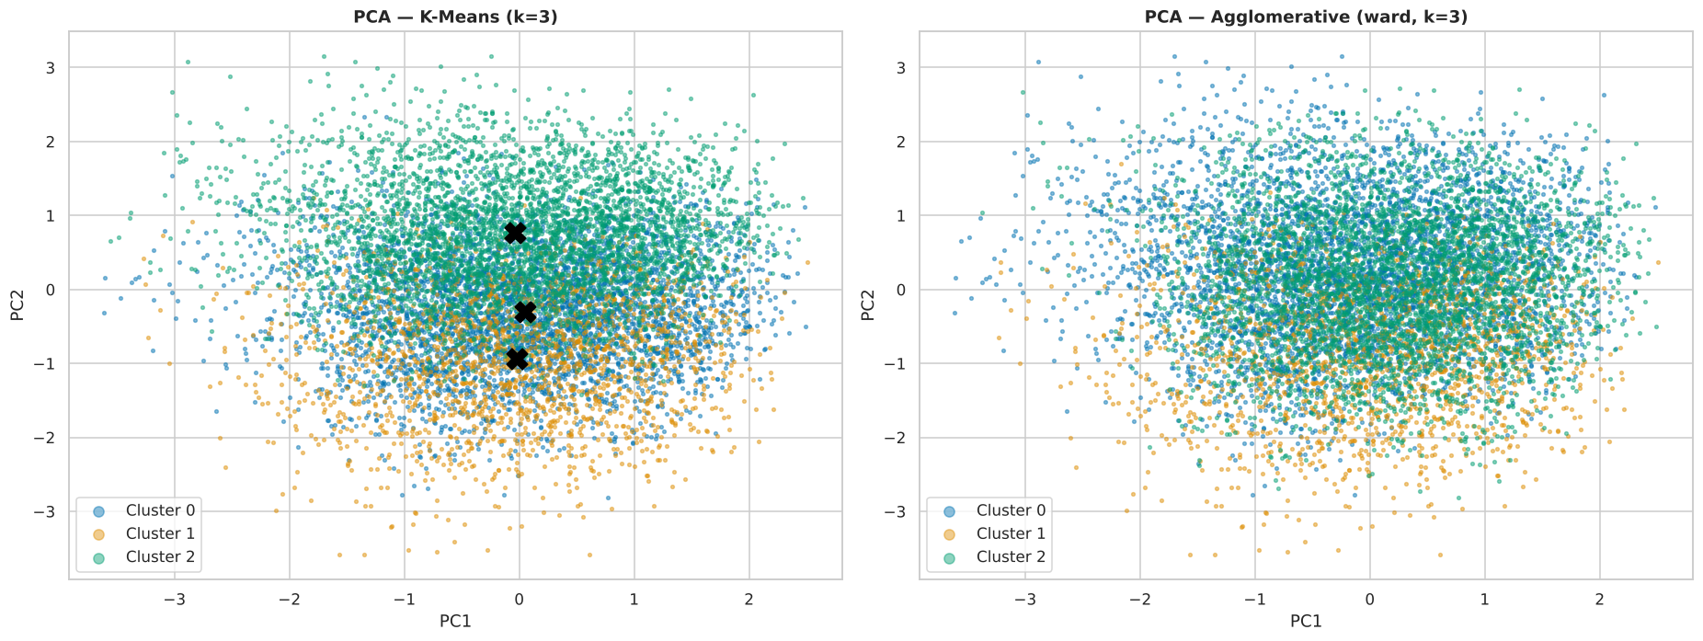
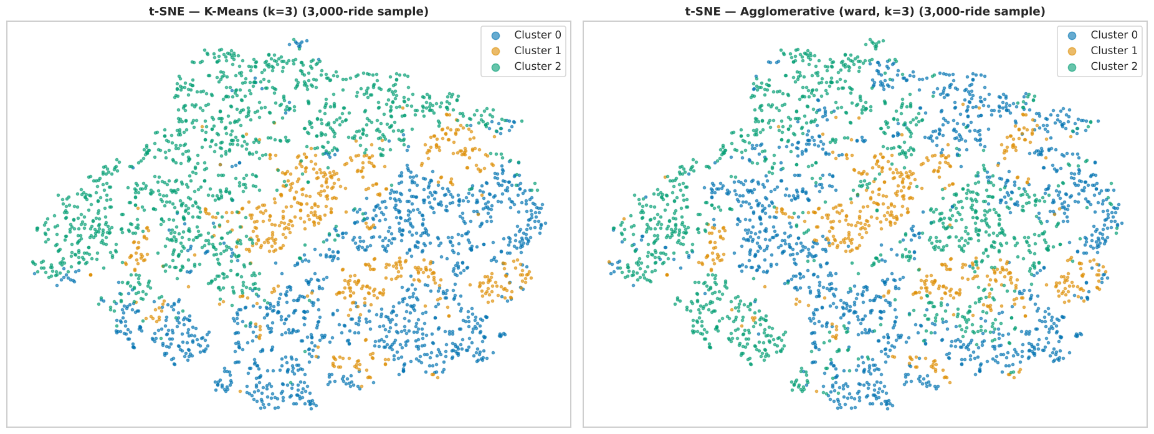
Seeing the segments: PCA for both algorithms, t-SNE
PCA 2-D (34% of variance) · left K-Means, right Agglomerative
t-SNE on a 3,000-ride sample · same two algorithms
Reading the plots: PCA keeps only 34% of the variance, so the segments overlap in 2-D; t-SNE preserves local neighbourhoods and shows the three groups more clearly.
Notes:
Rubric B3: PCA scatter for every algorithm (mandatory) and t-SNE for at least one (we show both). PCA only captures 34% of variance, so clusters overlap in 2-D; t-SNE separates them more clearly.

Slide 17
Three ride segments a driver would recognise
SEGMENT 0 · 4,030 RIDES
SEGMENT 1 · 1,971 RIDES
SEGMENT 2 · 3,999 RIDES
Quick turnaround
Low-rated drivers
Slow turnaround
22.4 min
3.54 ★
37.9 min
Avg CTAT · low turnaround time, well-rated drivers
Driver Ratings · every other feature close to average
Avg CTAT · long turnaround time, well-rated drivers
Fare ₹504 · 25.5 km · driver 4.39
Fare ₹494 · 26.7 km · driver 3.54
Fare ₹512 · 26.6 km · driver 4.41
Post-hoc check: segments do not line up with vehicle type or payment method (ARI ≈ 0.00). They are driven by service-time and rating behaviour, not by the service class — labels were used only after fitting.
Notes:
Profiles are cluster means of the original features. CTAT is the average customer turnaround time in minutes. Fare and distance are almost identical across segments; what separates rides is turnaround time and driver rating.

Slide 18
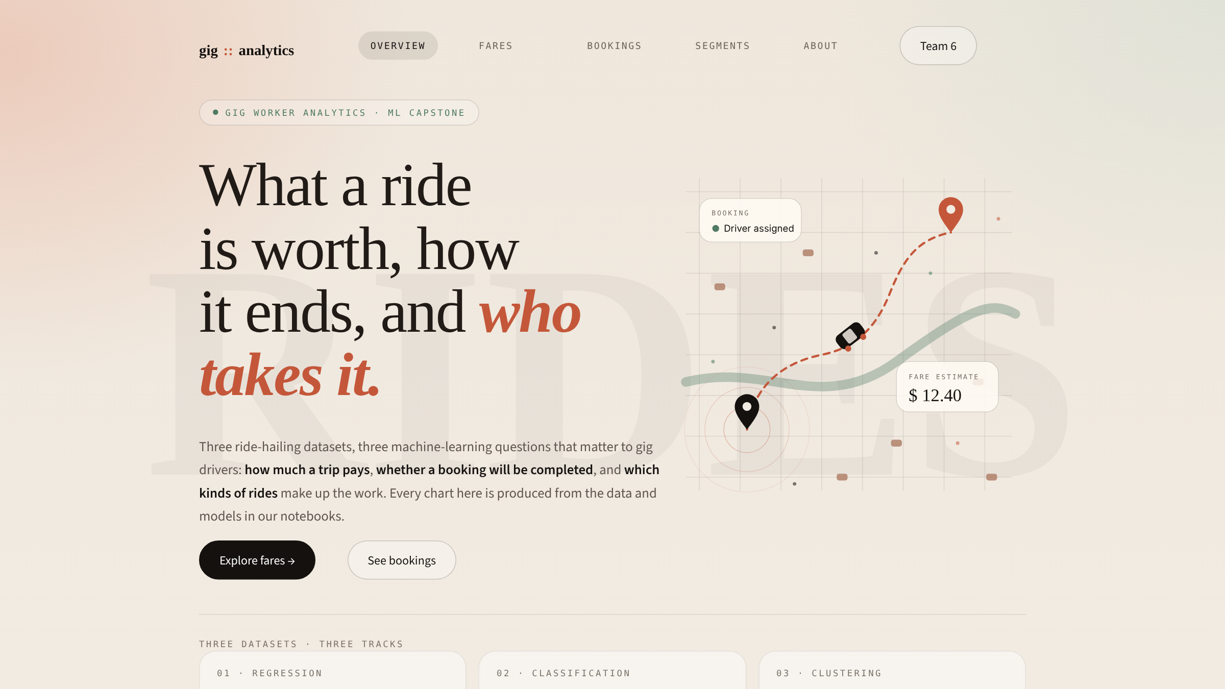
The web app: one page per dataset
1
Overview
the three questions and each track's best model
2
Fares · Bookings · Segments
dataset charts, full algorithm comparison, best-model diagnostics
3
Try it
each page accepts inputs and returns a prediction from its own model
4
Built with
Streamlit + Plotly, reads the models saved by the notebooks
Notes:
Bonus criterion: a working web interface that accepts inputs and returns predictions. Demo: open Fares, change distance; open Bookings and show class probabilities; open Segments and move the sliders. Run with: streamlit run app/app.py.

Slide 19
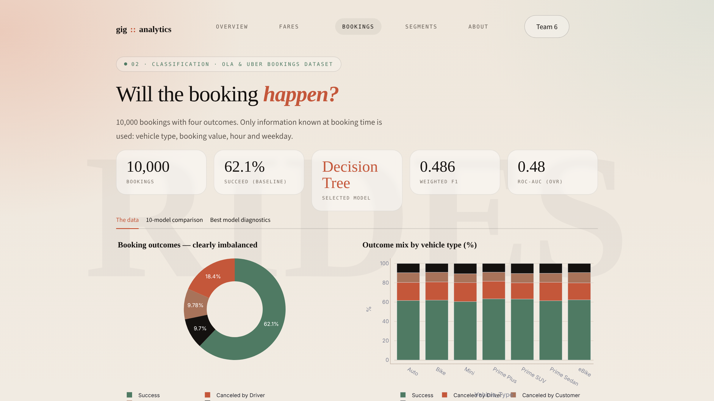
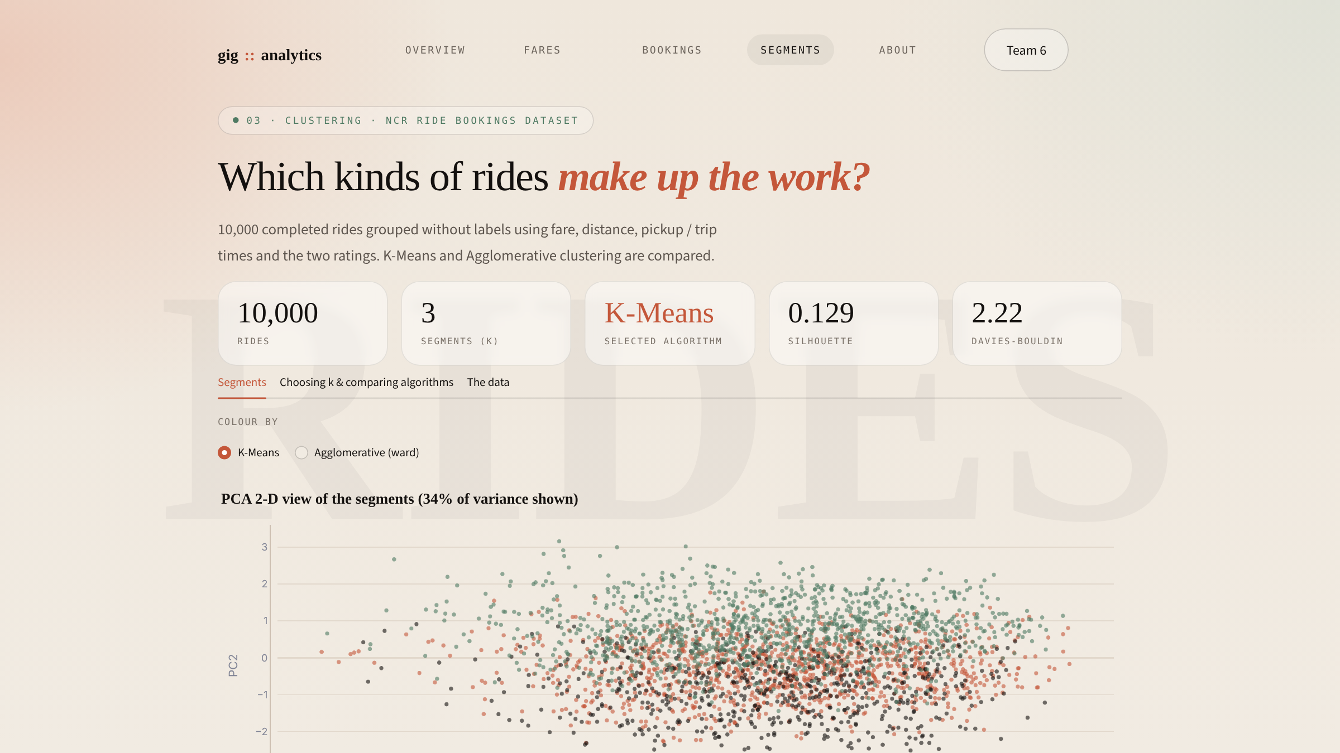
Inside the app: bookings and segments
Bookings page · KPIs, outcome mix, 10-model comparison
Segments page · PCA view, profiles, live segment assignment
Run it: streamlit run app/app.py · every chart is generated from the cleaned CSVs and the results saved by the notebooks.
Notes:
Each page is tied to exactly one dataset and one model, so nothing is mixed. Every chart is generated from the cleaned CSVs and the saved results.

Slide 20
What we learned, and what comes next
1
Fares are predictable
2
Booking outcomes are not
3
Rides form soft segments
Gradient Boosting: R² 0.794, MAE $2.29
Distance does almost all the work
+ pickup year → R² 0.815
All 10 classifiers ≈ class prior
ROC-AUC ≈ 0.5 for every model
Missing: supply, surge, traffic
K-Means, k = 3, best on all metrics
Segments driven by turnaround & rating
Silhouette 0.13: a continuum
NEXT STEPS
Add driver-supply, surge and zone data to the booking model · retrain the fare model with the year effect · try density-based clustering (DBSCAN / HDBSCAN) · deploy the app publicly on Streamlit Community Cloud.
Notes:
Summarise one finding per track and the honest limitations. Next steps map directly onto the weaknesses we found.

Slide 21
Questions?
THANK YOU
Notebooks, models, data and app are in the repository
notebooks/ regression · classification · clustering
app/app.py streamlit run app/app.py
README.md setup, results and how to run
Notes:
Invite questions. Likely viva questions: why weighted F1, why the baseline, why k = 3, why Ward, why scaling for KNN/SVM/K-Means, how leakage was avoided.

