Slide 1
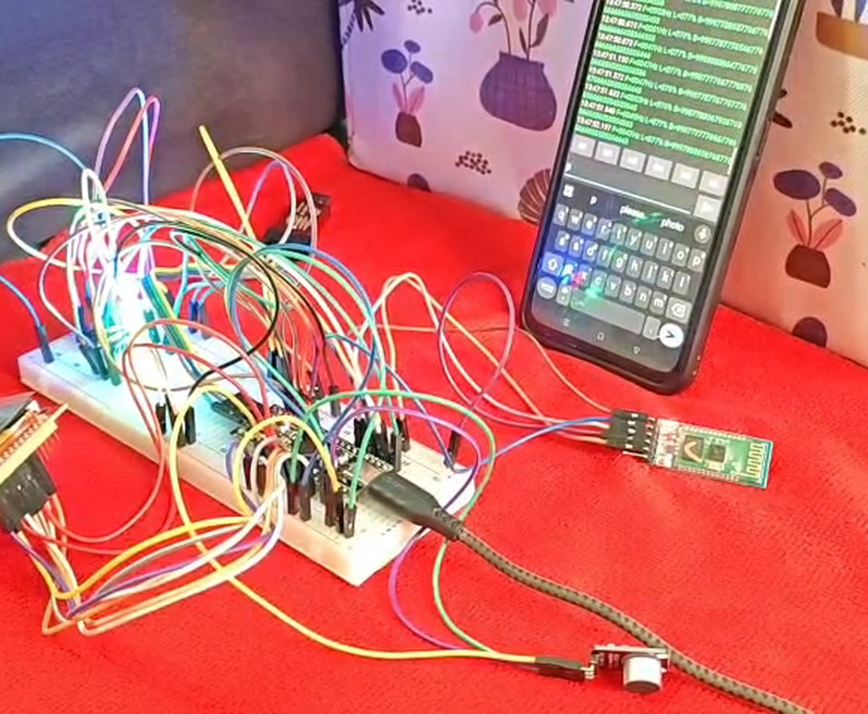
EMBEDDED SYSTEMS · CASE STUDY
Real-Time Audio
Spectrum Analyzer
A 512-point FFT on an STM32F401 Black Pill, shown live on a TFT and streamed to a phone over Bluetooth.
STM32F401
Keil uVision 5
CMSIS · no HAL
GROUP 2
J Harshith
CB.SC.U4CSE24721
Jason Richards
CB.SC.U4CSE24722
Pranav Machireddy
CB.SC.U4CSE24730
Rajeev Lochan
CB.SC.U4CSE24731
Notes:
Introduce yourself and the project: a real-time audio spectrum analyzer built on the STM32F401 Black Pill using register-level CMSIS code in Keil uVision 5. Say it shows live frequency bars on a TFT and also streams the data to a phone over Bluetooth.

Slide 2
CONTENTS
What this presentation covers
1
Aim & idea
2
Hardware
3
Circuit
The problem and what the system does
Parts used and why each one is needed
How everything is wired to the board
4
Signal chain
5
Firmware
6
Results
Sampling, window, FFT and log bars
Interrupts, UI, TFT and Bluetooth
Live demo, specs, conclusion
REAL-TIME AUDIO SPECTRUM ANALYZER · STM32F401
02 / 15
Notes:
Walk through the six parts quickly. About 1 minute.

Slide 3
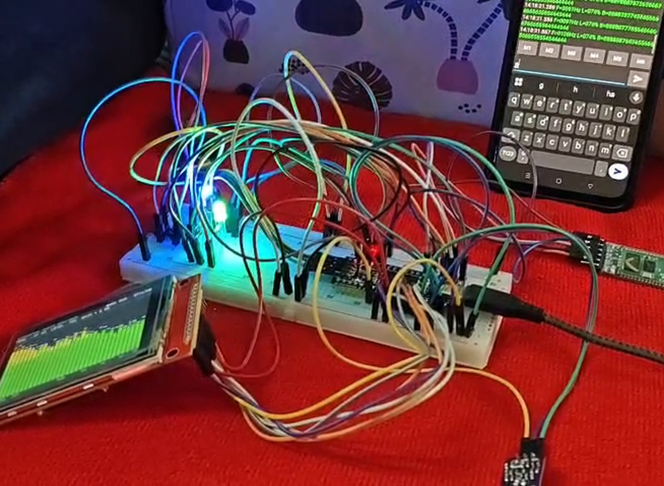
AIM & IDEA
Make sound visible, in real time
A microphone picks up sound. The microcontroller samples it, finds which frequencies are present and how strong they are, and draws them as moving bars.
Capture
Sample audio at a steady 16 kHz using a timer-triggered ADC.
1
Analyse
Convert time samples to a frequency spectrum with a 512-point FFT.
2
Display
Show 32 log-spaced bars on the TFT with peak frequency and level.
3
Stream
Send the same data to a phone through an HC-05 Bluetooth module.
4
REAL-TIME AUDIO SPECTRUM ANALYZER · STM32F401
03 / 15
Notes:
State the aim: a standalone spectrum analyzer with no PC needed. Four goals: capture, analyse, display, stream. All done at register level with CMSIS, no HAL.

Slide 4
SYSTEM OVERVIEW
From sound wave to pixels
1
2
3
4
MAX4466
→
TIM2 + ADC1
→
FFT engine
→
Outputs
Microphone amplifier
16 kHz sampling
512 points
TFT + Bluetooth
Analog audio on PA1
12-bit, timer triggered
Window → FFT → bars
SPI1 and USART1
31.25 Hz
frequency resolution
32 ms
per 512-sample block
≈ 30 fps
bar refresh target
Data flow: the ADC interrupt only collects samples; all heavy maths runs in the main loop.
REAL-TIME AUDIO SPECTRUM ANALYZER · STM32F401
04 / 15
Notes:
Explain the four stages left to right. The key design idea: interrupts stay short, the main loop does the FFT and drawing.

Slide 5
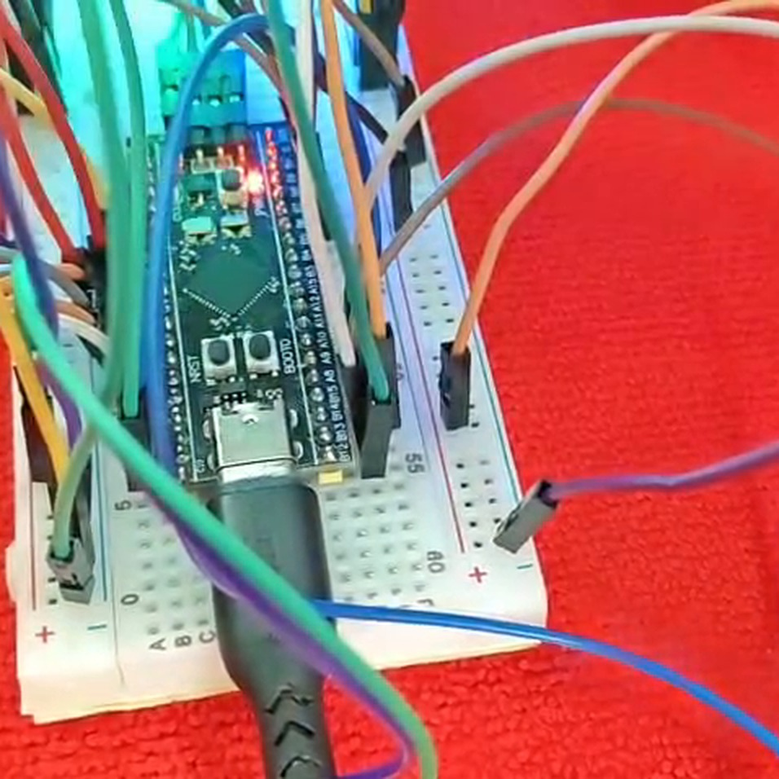
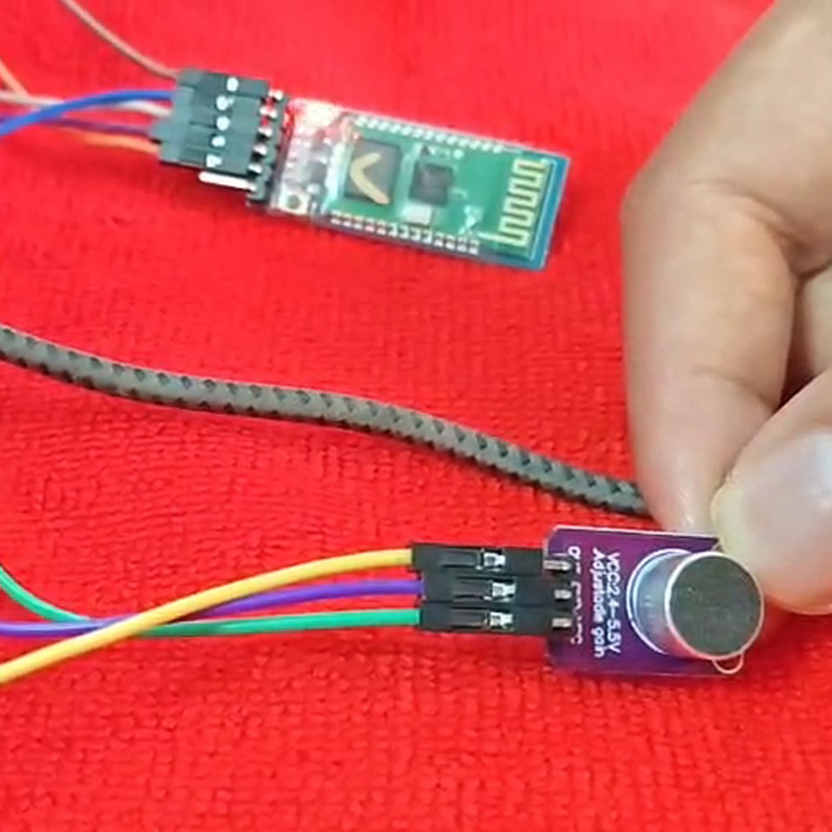
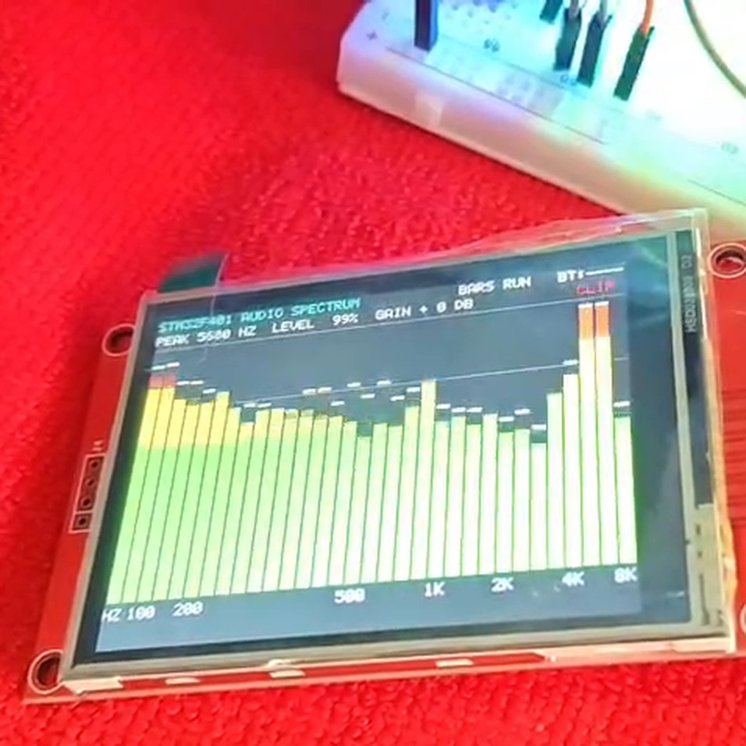
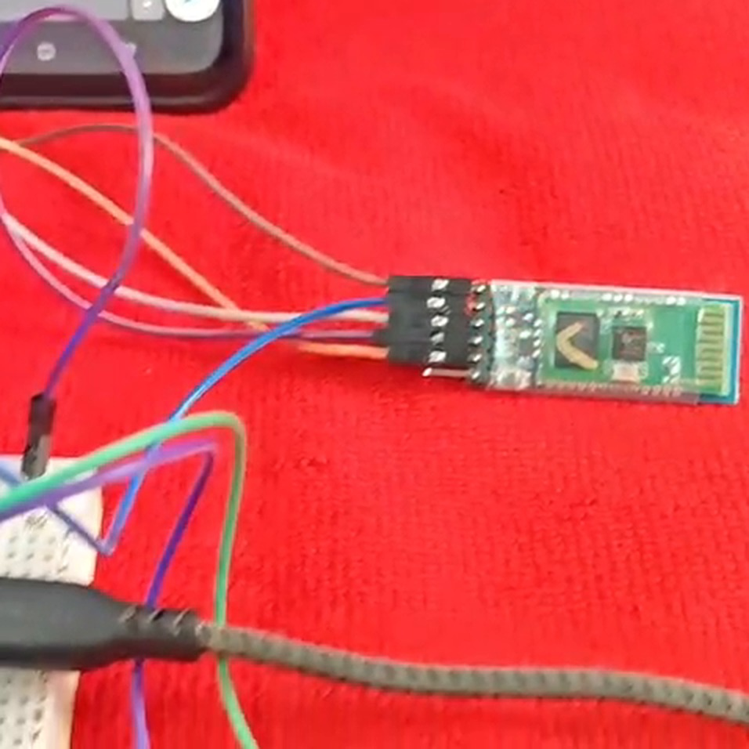
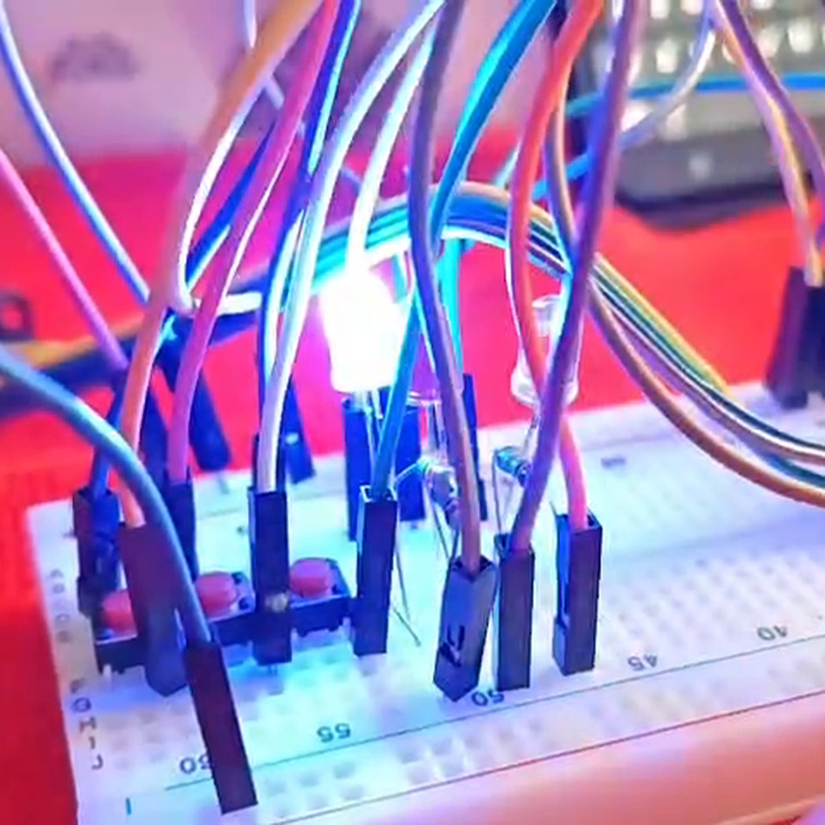
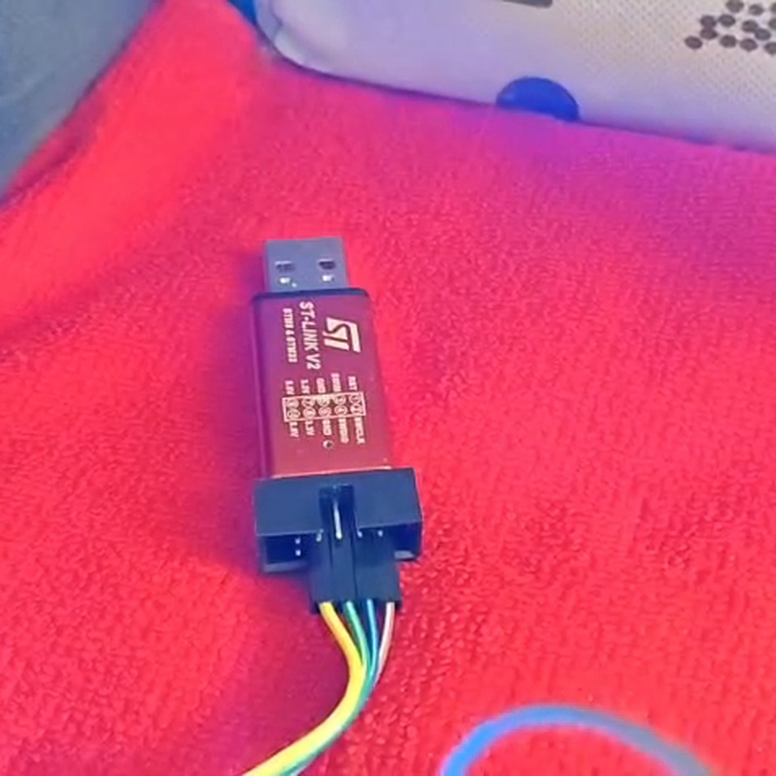
HARDWARE
Parts used and why
STM32F401 Black Pill
84 MHz Cortex-M4F with FPU; fast enough for a real-time FFT.
MAX4466 microphone
Adjustable-gain amplifier gives a clean analog signal to the ADC.
ILI9341 TFT (SPI)
320×240 colour display for the live bars and readouts.
HC-05 Bluetooth
Serial link to a phone terminal at 9600 baud.
Buttons + 3 LEDs
Mode, pause and grid control; red, green and blue status LEDs.
ST-Link V2
Flashes and debugs the firmware from Keil uVision.
REAL-TIME AUDIO SPECTRUM ANALYZER · STM32F401
05 / 15
Notes:
Hold up or point to each part in the video. Add breadboard, jumpers, resistors (220 ohm for LEDs) and capacitors for supply decoupling.

Slide 6
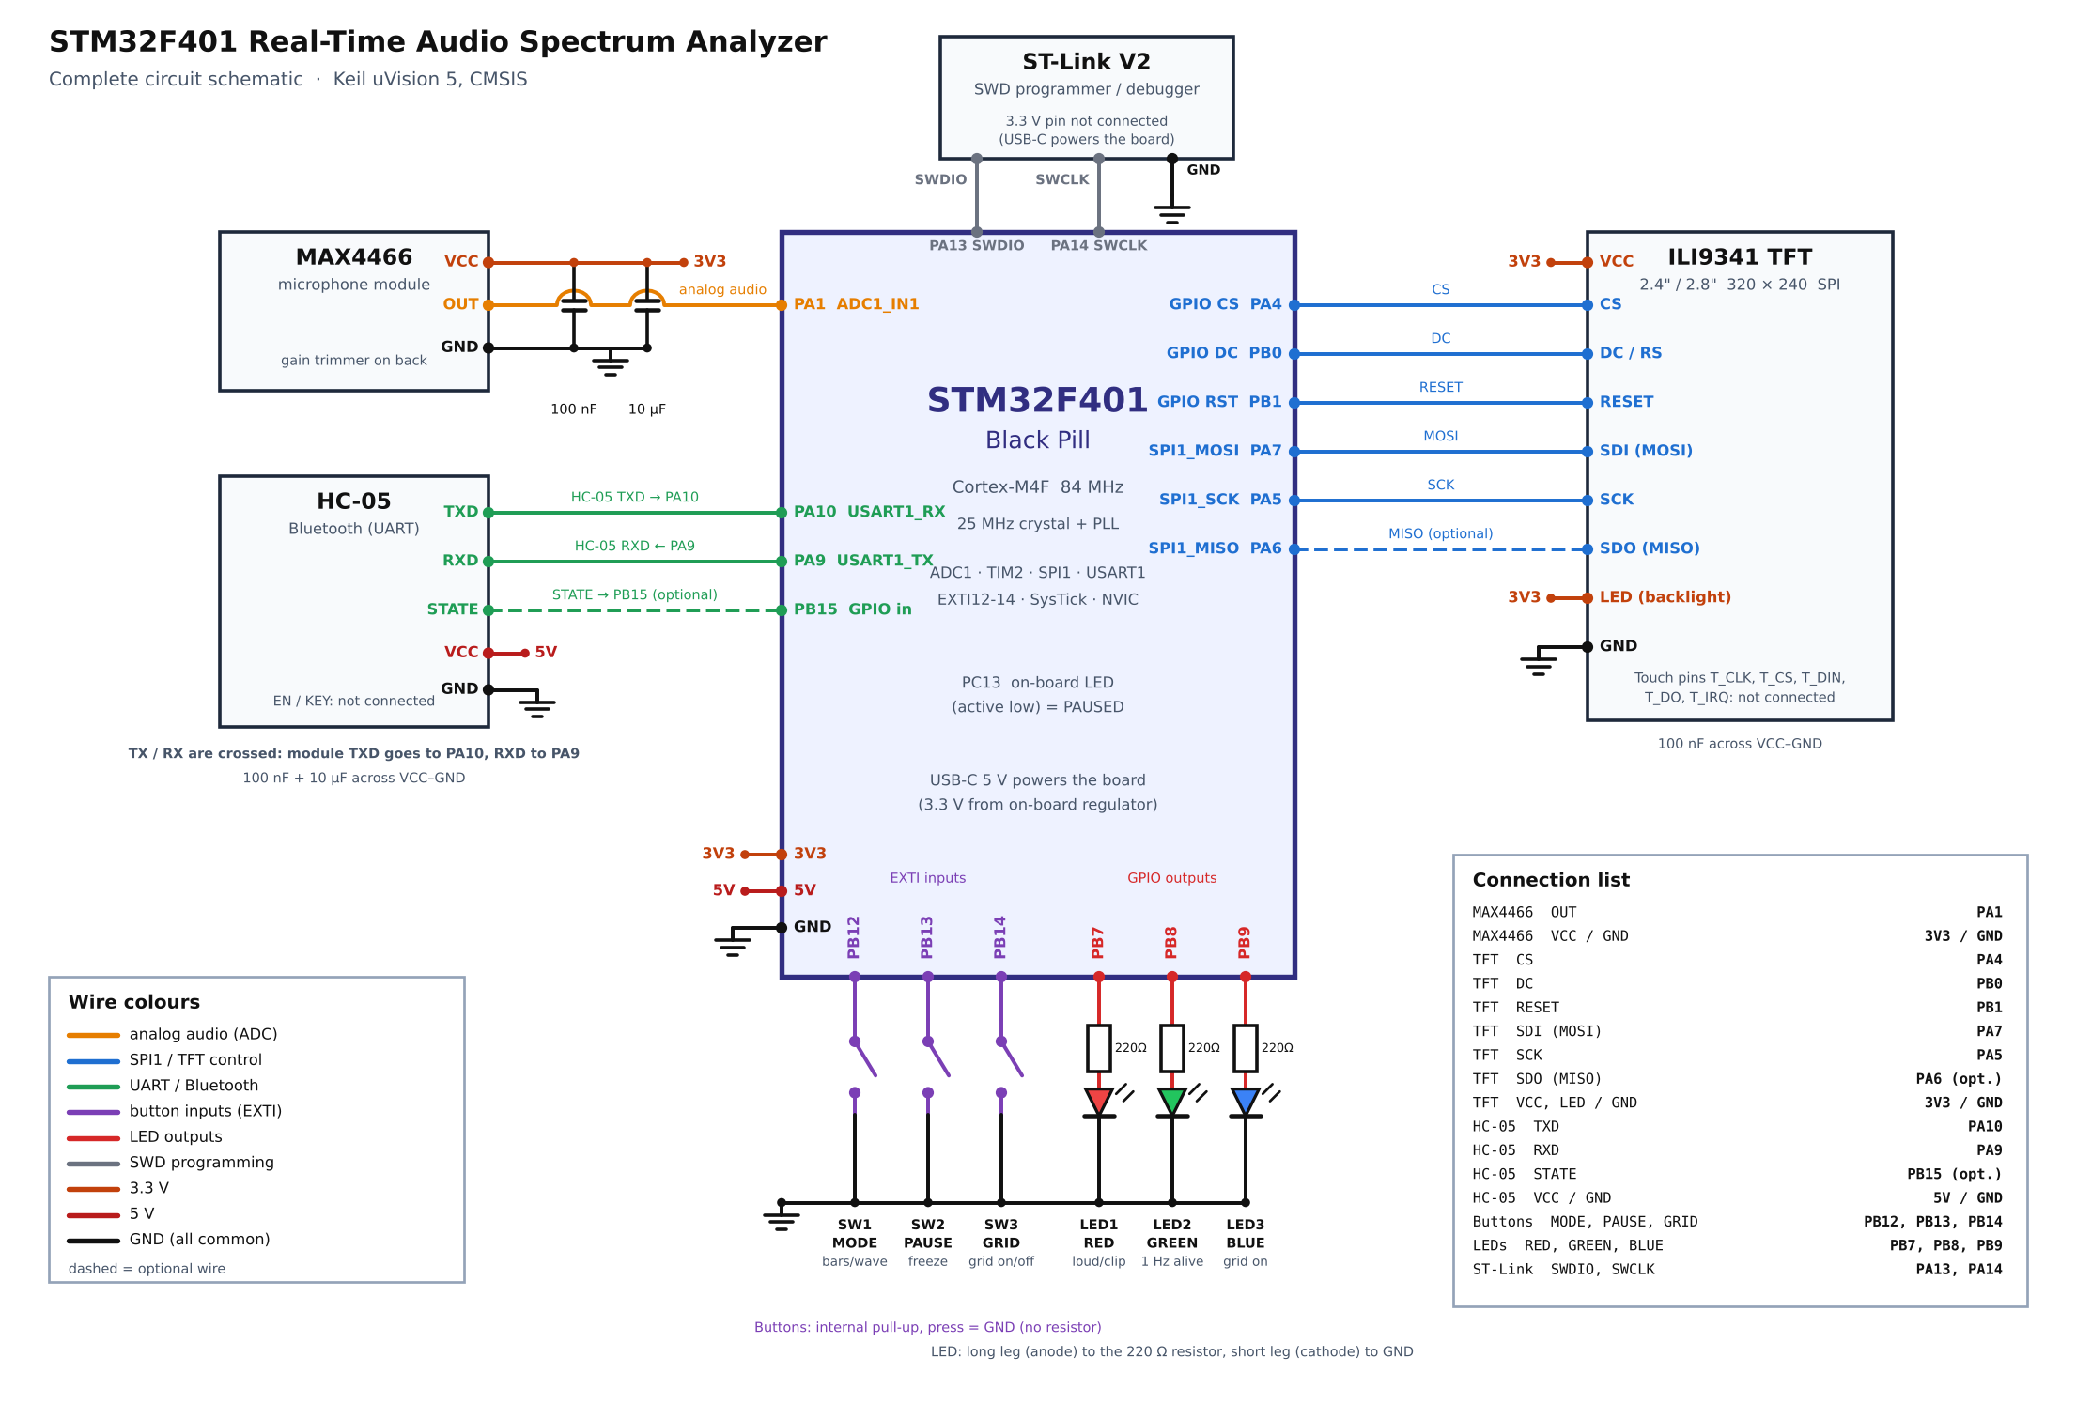
CIRCUIT
How everything connects
Signal | Pin | Used for
Mic OUT | PA1 (ADC1 ch1) | Audio input
TFT | SPI1 @ 10.5 MHz | Display data
HC-05 TX / RX | PA10 / PA9 | USART1, 9600 baud
Buttons | PB12 · PB13 · PB14 | Mode · pause · grid
LEDs | PB7 · PB8 · PB9 | Red · green · blue
On-board LED | PC13 | On = paused
Common ground between all modules; MAX4466 and HC-05 are powered from the board's supply.
REAL-TIME AUDIO SPECTRUM ANALYZER · STM32F401
06 / 15
Notes:
Use the schematic to explain each connection. Mic output to PA1; HC-05 on USART1; TFT on SPI1; buttons and LEDs on GPIOB.

Slide 7
CLOCK & SAMPLING
A steady 16 kHz sample clock
84 MHz
16 kHz
12-bit
System clock
Sample rate
ADC resolution
25 MHz crystal → PLL (M=25, N=336, P=4)
TIM2 ARR = 5249 gives a 16 kHz trigger
ADC1 channel 1, 84-cycle sampling time
8 kHz
512
31.25 Hz
Bandwidth
Samples per block
Bin width
Nyquist limit = sample rate ÷ 2
Collected in the ADC end-of-conversion ISR
Sample rate ÷ FFT size = 16000 ÷ 512
Why a timer? Timer-triggered sampling gives exact, jitter-free spacing between samples, which the FFT needs.
REAL-TIME AUDIO SPECTRUM ANALYZER · STM32F401
07 / 15
Notes:
Bandwidth is 8 kHz because fs = 16 kHz and Nyquist says the highest usable frequency is fs/2. Bin width = fs/N = 31.25 Hz. A block of 512 samples takes 32 ms to collect.

Slide 8
SIGNAL PROCESSING
Five steps from samples to bars
1
2
3
4
5
DC removal
Hann window
512-pt FFT
Log bars
dBFS + peak
Subtract the mean so the 1.65 V bias does not hide real signals.
Tapers block edges to reduce spectral leakage.
Radix-2 FFT in place, using the Cortex-M4 FPU.
Magnitudes grouped into 32 log-spaced bars, 31 Hz to 8 kHz.
Level in dB full scale; parabolic interpolation for the peak.
Log spacing matches hearing: low notes get more bars than the crowded high end.
REAL-TIME AUDIO SPECTRUM ANALYZER · STM32F401
08 / 15
Notes:
Explain each step in one sentence. Mention that the peak frequency readout on the TFT uses parabolic interpolation so it is finer than the 31.25 Hz bin width.

Slide 9
FIRMWARE
Interrupts do little, the main loop does the work
Handler | Priority | What it does
ADC_IRQHandler | 1 | Stores each sample; flags a full 512-sample block
SysTick_Handler | 2 | 1 ms tick for timing, LED blink, debounce
USART1_IRQHandler | 3 | Moves Bluetooth bytes through ring buffers
EXTI15_10_IRQHandler | 4 | Records a button edge; debounce happens later
MAIN LOOP
Wait for a full block
Run FFT and build bars
Redraw only changed pixels
Poll buttons, send Bluetooth report
25 ms
button confirm
150 ms
lockout
250 ms
Bluetooth report
REAL-TIME AUDIO SPECTRUM ANALYZER · STM32F401
09 / 15
Notes:
NVIC priorities: ADC 1 (most urgent so no samples are lost), SysTick 2, USART1 3, EXTI 4. ISRs are kept very short.

Slide 10
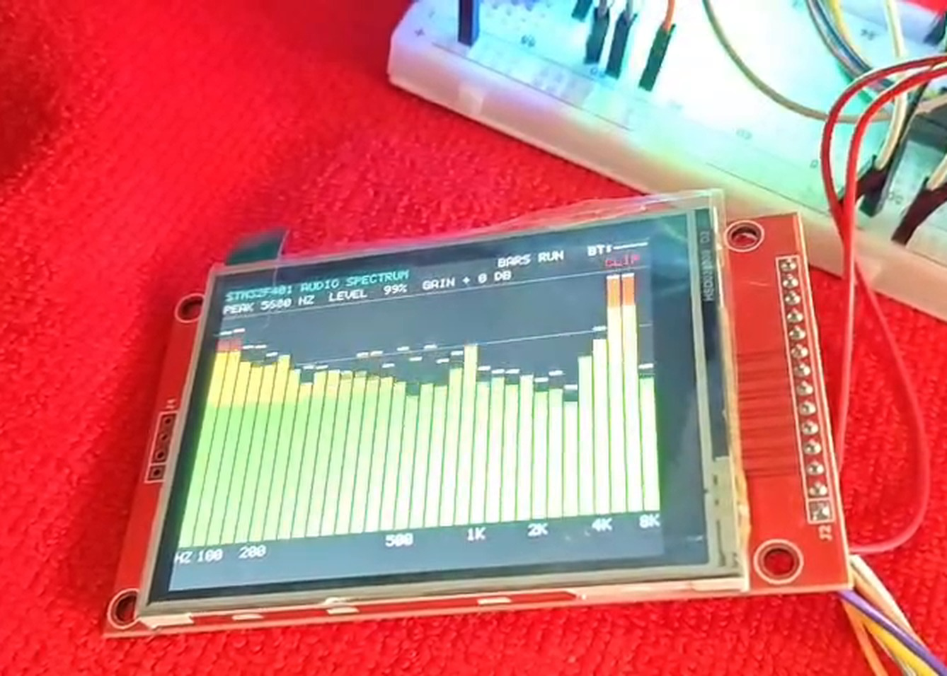
DISPLAY
Live spectrum on the TFT
SPI1 at 10.5 MHz
Fast pixel writes to the ILI9341 controller.
1
Incremental redraw
Only bars that changed are repainted; a full redraw takes about 117 ms.
2
Colour-coded bars
Green for low, yellow for mid, red for high level, with falling peak caps.
3
Status line
Peak frequency, level percent, gain and Bluetooth state.
4
REAL-TIME AUDIO SPECTRUM ANALYZER · STM32F401
10 / 15
Notes:
Point out the bars, the peak line at the top, and the HZ axis labels under the bars. Redrawing only changed bars keeps the display smooth.

Slide 11
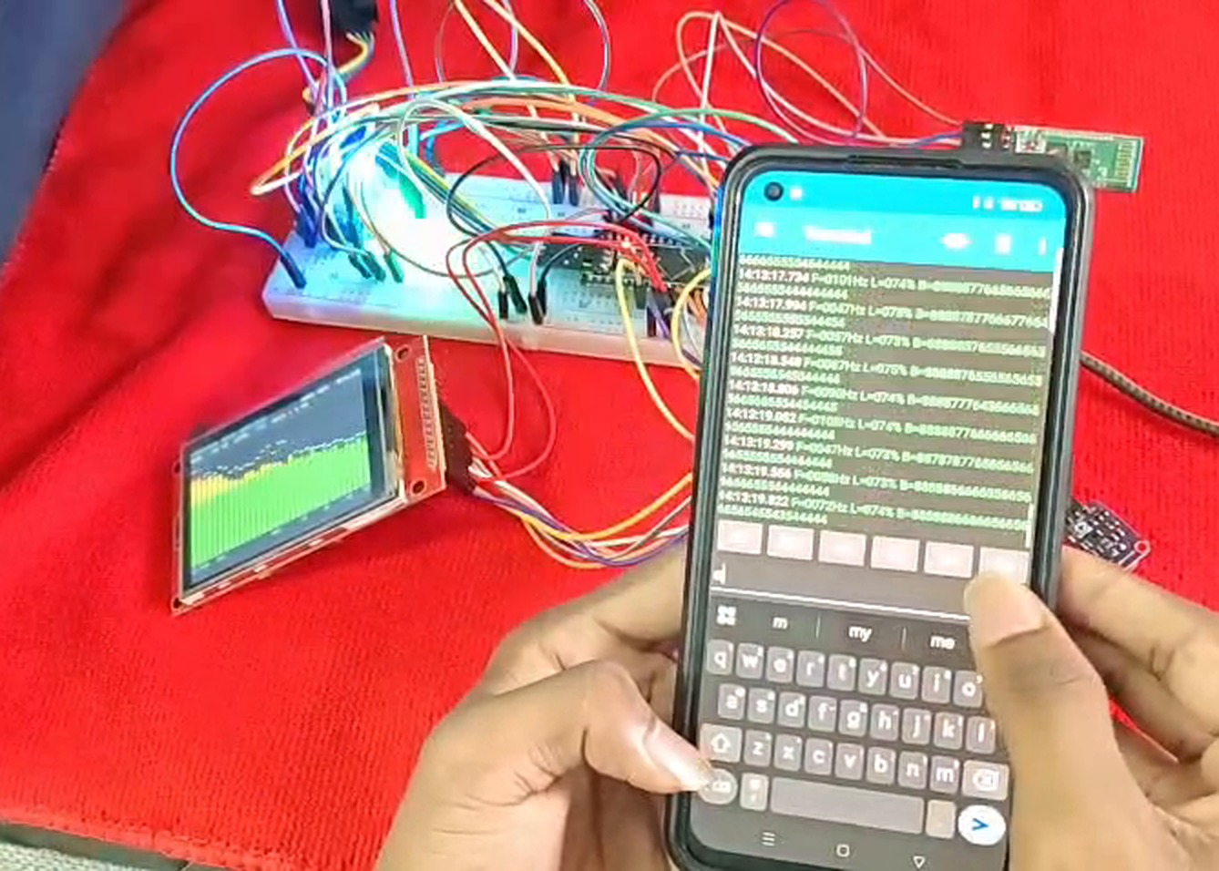
CONTROLS & BLUETOOTH
Buttons, LEDs and the phone link
Control | Action
Button 1 (PB12) | Bars ↔ waveform
Button 2 (PB13) | Freeze / resume
Button 3 (PB14) | Grid on / off
Red LED | Loud sound or clipping
Green LED | Blinks: firmware alive
Blue LED | Grid is on
Phone commands: M mode · P pause · G grid · + / − gain · ? help
REAL-TIME AUDIO SPECTRUM ANALYZER · STM32F401
11 / 15
Notes:
Explain that the HC-05 runs at 9600 baud. The phone sends single letters to control the analyzer and receives a spectrum report four times a second.

Slide 12

RESULTS
What the working system shows
Full setup
Live bars
Bluetooth report
Board, mic, TFT, HC-05 and phone together.
Speech and tones appear at the right frequencies.
Spectrum data arrives on the phone terminal.
✓
Bars follow sound
✓
Buttons respond
✓
Bluetooth works
REAL-TIME AUDIO SPECTRUM ANALYZER · STM32F401
12 / 15
Notes:
This is where you refer to the demo video. Play a tone or speak, show the bars react, press each button, and show the phone terminal.

Slide 13
KEY FIGURES
Specifications at a glance
Parameter | Value | Parameter | Value
MCU | STM32F401, 84 MHz Cortex-M4F | FFT size | 512 points, radix-2
Sample rate | 16 kHz (TIM2 → ADC1 trigger) | Window | Hann
ADC | 12-bit, channel 1 (PA1) | Resolution | 31.25 Hz per bin
Bandwidth | 8 kHz (Nyquist) | Display bars | 32, log-spaced 31 Hz–8 kHz
Block time | 32 ms per 512 samples | TFT link | SPI1, 10.5 MHz
Bluetooth | HC-05, USART1, 9600 baud | Gain steps | −12 to +24 dB in 6 dB steps
Written at register level with CMSIS in Keil uVision 5: no HAL, no RTOS, no external DSP library.
REAL-TIME AUDIO SPECTRUM ANALYZER · STM32F401
13 / 15
Notes:
A quick reference slide. Useful if the examiner asks about bandwidth, resolution or sampling.

Slide 14
CONCLUSION
What we built and what comes next
ACHIEVED
FUTURE SCOPE
Real-time 512-point FFT on a Cortex-M4F
Exact 16 kHz sampling with timer-triggered ADC
Smooth 32-bar display with peak and level readout
Bluetooth control and streaming to a phone
Short, safe interrupts with debounced buttons
Use DMA for sampling to free the CPU
Higher sample rate for a wider bandwidth
Larger FFT for finer frequency resolution
Save spectra to an SD card
Touch screen controls on the TFT
Result: a working, standalone spectrum analyzer that senses, analyses and displays sound in real time.
REAL-TIME AUDIO SPECTRUM ANALYZER · STM32F401
14 / 15
Notes:
Give the simple conclusion: the system captures, analyses and displays audio spectra in real time, and the design keeps interrupts short. Then mention the future scope.

Slide 15
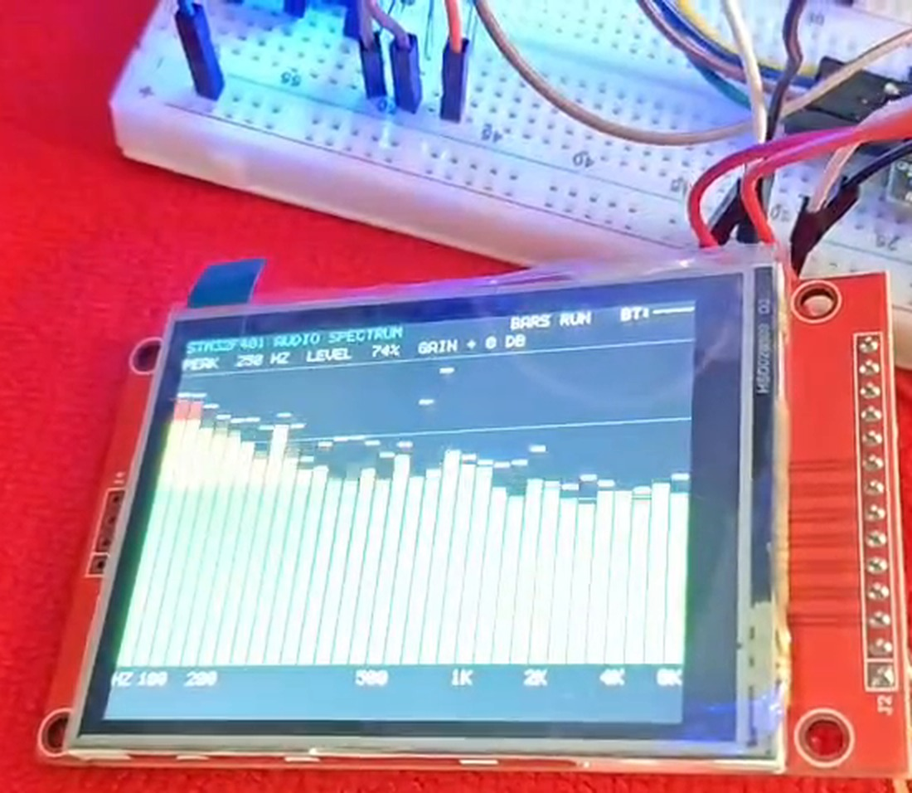
THANK YOU
Questions?
Real-Time Audio Spectrum Analyzer on STM32F401 Black Pill
GROUP 2
J Harshith
CB.SC.U4CSE24721
Jason Richards
CB.SC.U4CSE24722
Pranav Machireddy
CB.SC.U4CSE24730
Rajeev Lochan
CB.SC.U4CSE24731
Demo video and source code: [GitHub link]
REAL-TIME AUDIO SPECTRUM ANALYZER · STM32F401
15 / 15
Notes:
Thank the audience and invite questions.

