Slide 1
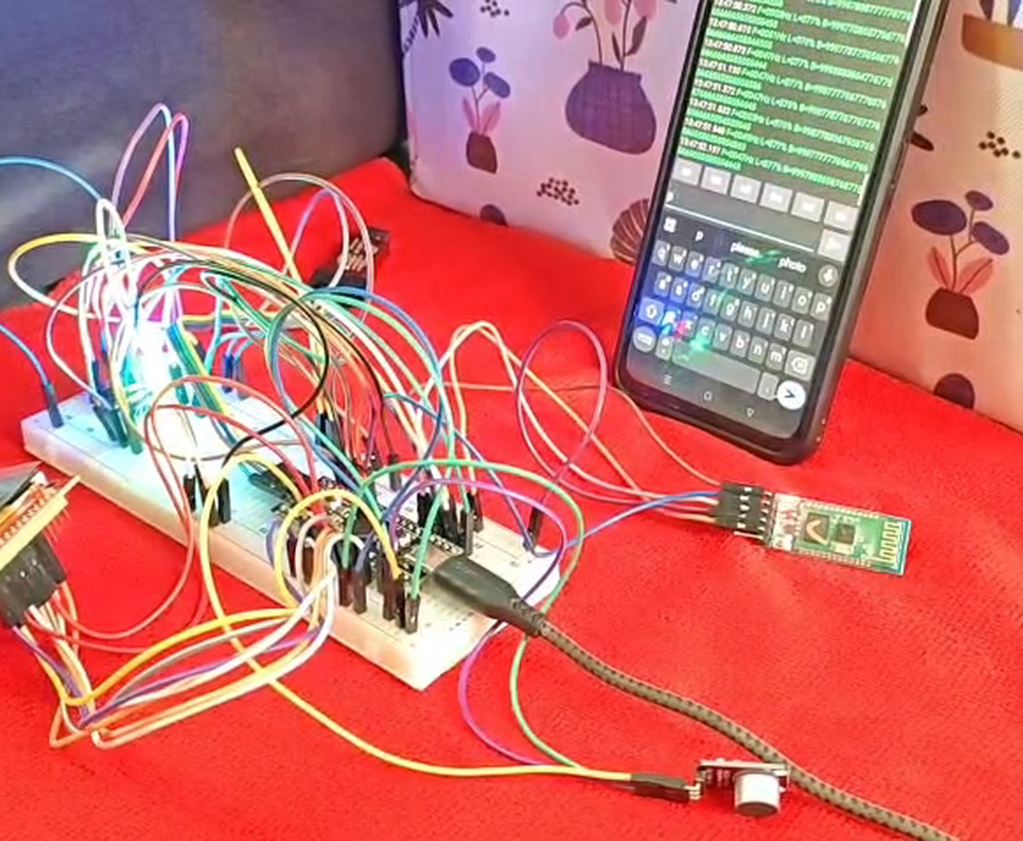
EMBEDDED SYSTEMS · CASE STUDY
Real-Time Audio
Spectrum Analyzer
A 512-point FFT on an STM32F401 Black Pill, shown live on a TFT and streamed to a phone over Bluetooth.
STM32F401
Keil uVision 5
CMSIS · no HAL
GROUP 2
J Harshith
CB.SC.U4CSE24721
Jason Richards
CB.SC.U4CSE24722
Pranav Machireddy
CB.SC.U4CSE24730
Rajeev Lochan
CB.SC.U4CSE24731
Notes:
Introduce yourself and the project: a real-time audio spectrum analyzer built on the STM32F401 Black Pill using register-level CMSIS code in Keil uVision 5. Say it shows live frequency bars on a TFT and also streams the data to a phone over Bluetooth.

Slide 2
CONTENTS
What this presentation covers
1
Aim & idea
2
Hardware
3
Circuit
The problem and what the system does
Parts used and why each one is needed
How everything is wired to the board
4
Signal chain
5
Firmware
6
Results
Sampling, window, FFT and log bars
Interrupts, UI, TFT and Bluetooth
Live demo, specs, conclusion
REAL-TIME AUDIO SPECTRUM ANALYZER · STM32F401
02 / 16
Notes:
Walk through the six parts quickly. About 1 minute.

Slide 3
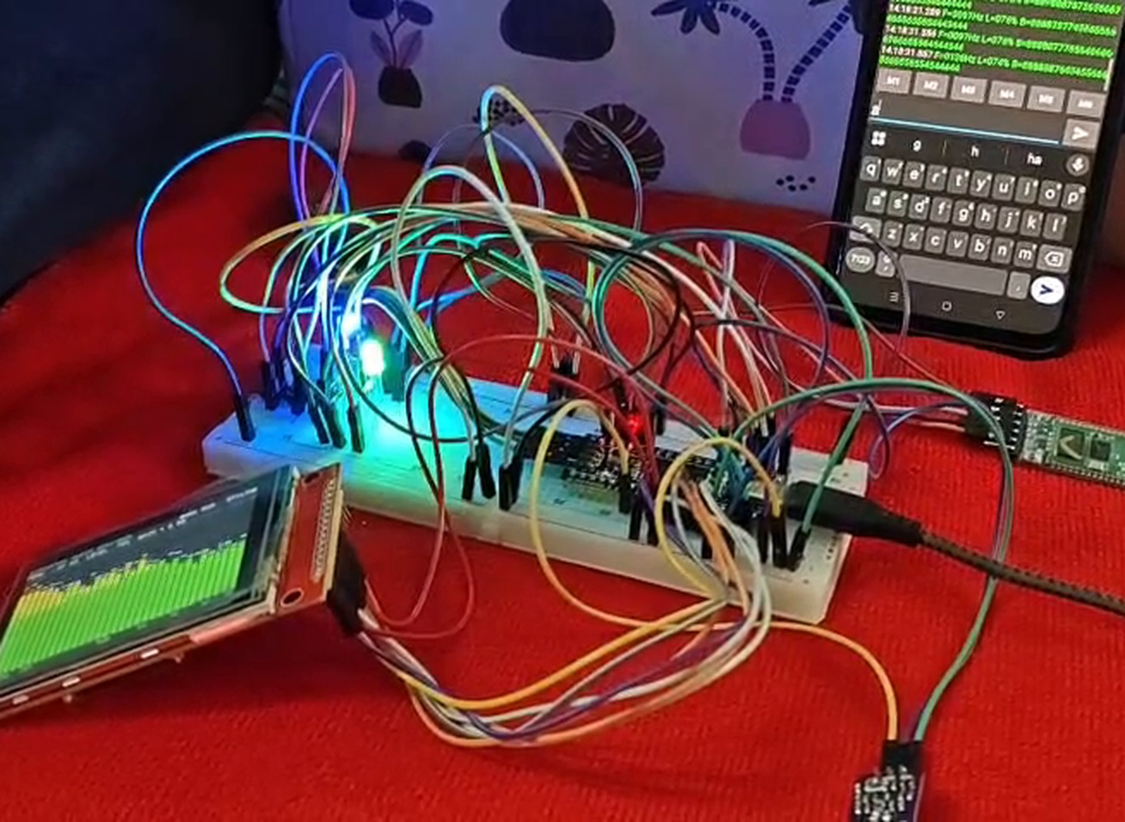
AIM & IDEA
Make sound visible, in real time
A microphone picks up sound. The microcontroller samples it, finds which frequencies are present and how strong they are, and draws them as moving bars.
Capture
Sample audio at a steady 16 kHz using a timer-triggered ADC.
1
Analyse
Convert time samples to a frequency spectrum with a 512-point FFT.
2
Display
Show 32 log-spaced bars on the TFT with peak frequency and level.
3
Stream
Send the same data to a phone through an HC-05 Bluetooth module.
4
REAL-TIME AUDIO SPECTRUM ANALYZER · STM32F401
03 / 16
Notes:
State the aim: a standalone spectrum analyzer with no PC needed. Four goals: capture, analyse, display, stream. All done at register level with CMSIS, no HAL.

Slide 4
SYSTEM OVERVIEW
From sound wave to pixels
1
2
3
4
MAX4466
→
TIM2 + ADC1
→
FFT engine
→
Outputs
Microphone amplifier
16 kHz sampling
512 points
TFT + Bluetooth
Analog audio on PA1
12-bit, timer triggered
Window → FFT → bars
SPI1 and USART1
31.25 Hz
frequency resolution
32 ms
per 512-sample block
≈ 30 fps
bar refresh target
Data flow: the ADC interrupt only collects samples; all heavy maths runs in the main loop.
REAL-TIME AUDIO SPECTRUM ANALYZER · STM32F401
04 / 16
Notes:
Explain the four stages left to right. The key design idea: interrupts stay short, the main loop does the FFT and drawing.

Slide 5
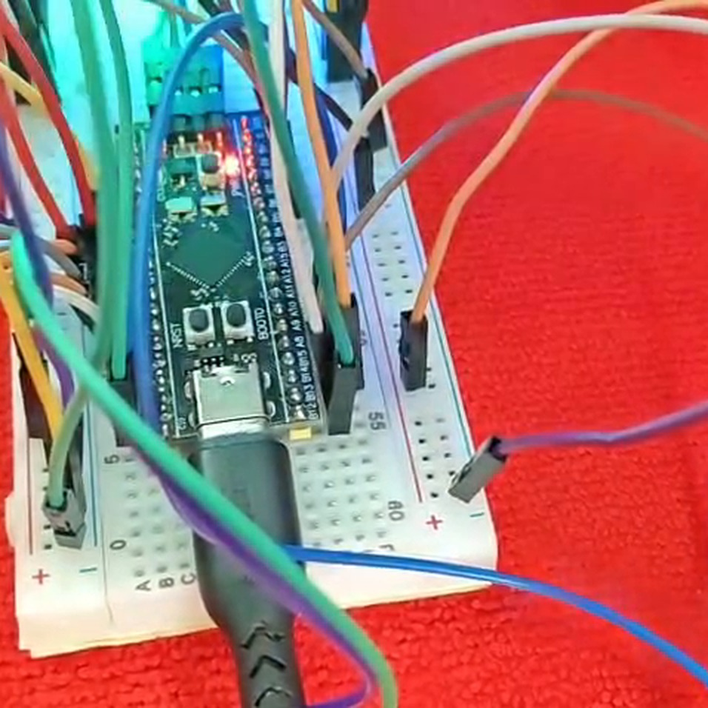
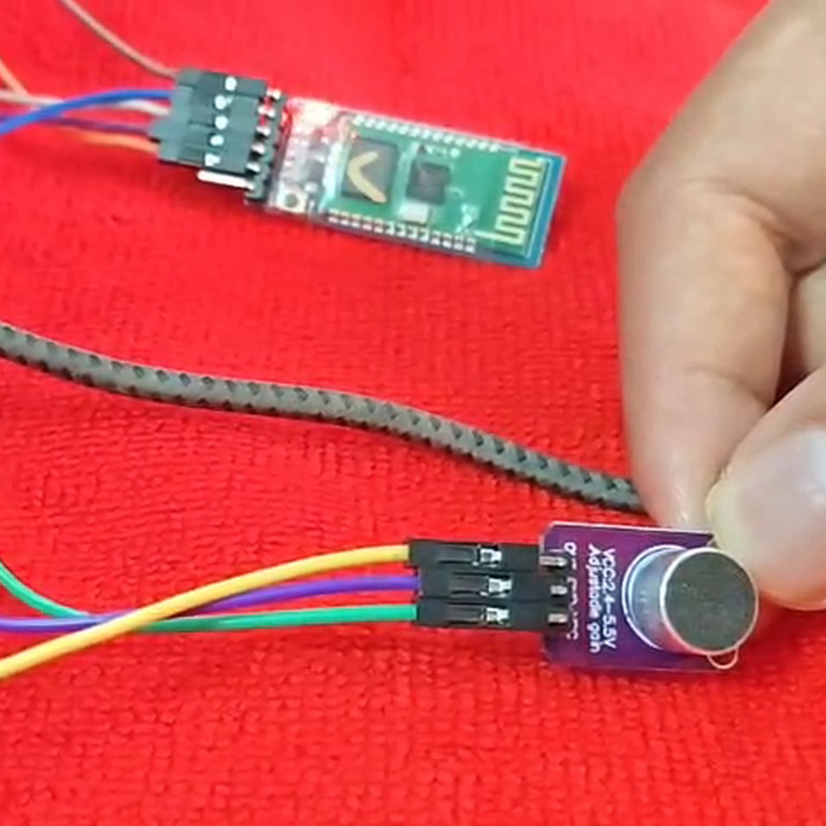
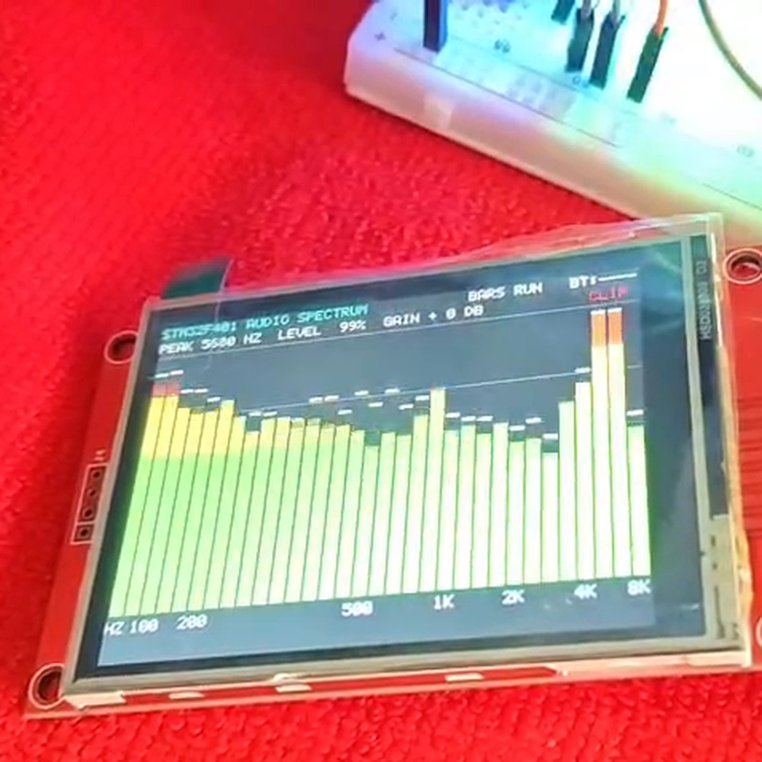
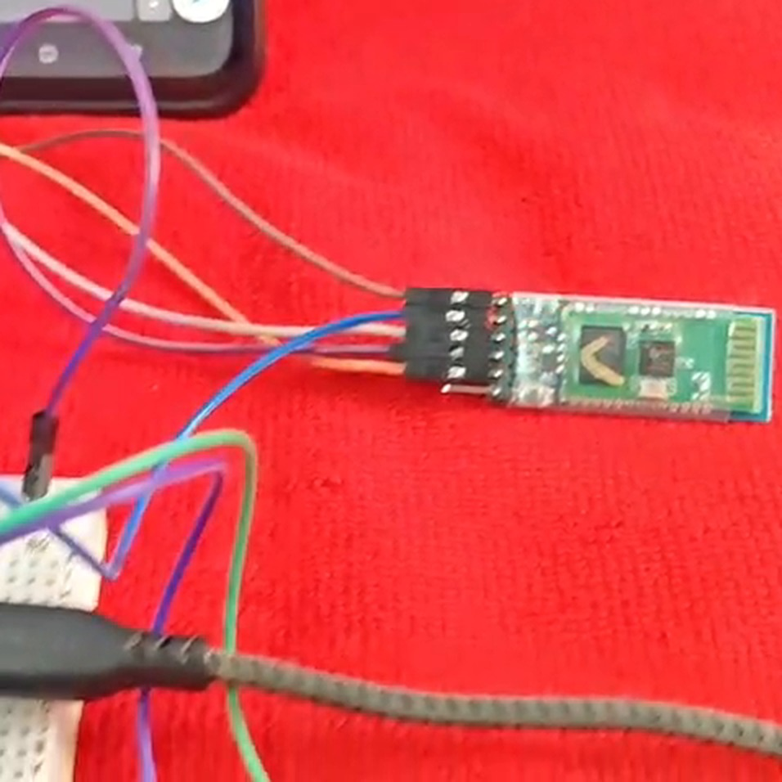
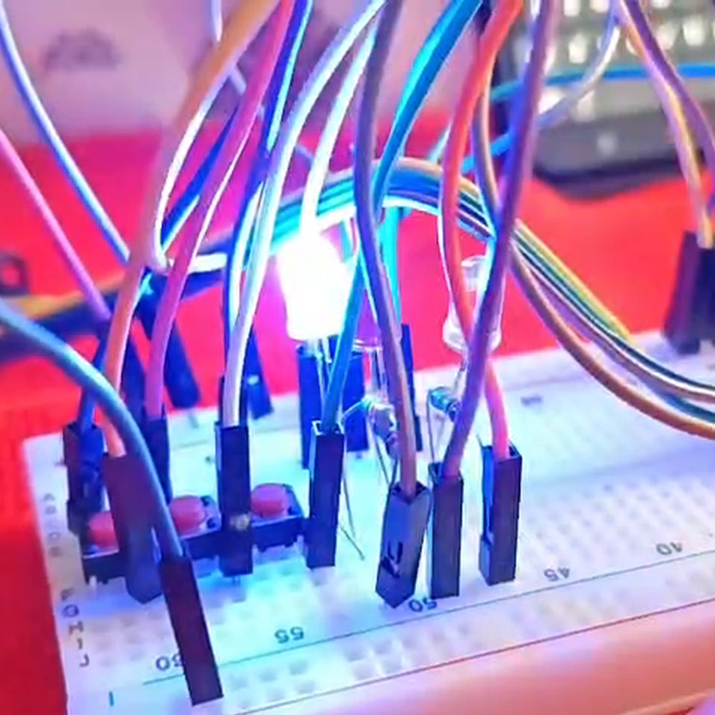
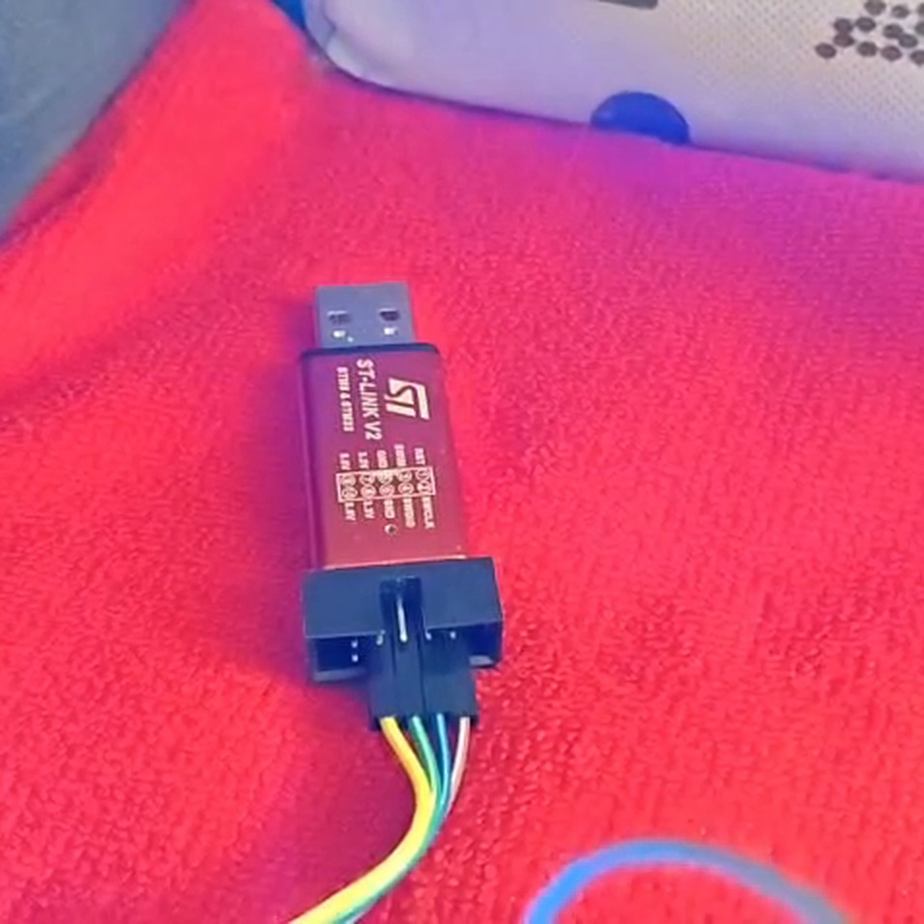
HARDWARE
Parts used and why
STM32F401 Black Pill
84 MHz Cortex-M4F with FPU; fast enough for a real-time FFT.
MAX4466 microphone
Adjustable-gain amplifier gives a clean analog signal to the ADC.
ILI9341 TFT (SPI)
320×240 colour display for the live bars and readouts.
HC-05 Bluetooth
Serial link to a phone terminal at 9600 baud.
Buttons + 3 LEDs
Mode, pause and grid control; red, green and blue status LEDs.
ST-Link V2
Flashes and debugs the firmware from Keil uVision.
REAL-TIME AUDIO SPECTRUM ANALYZER · STM32F401
05 / 16
Notes:
Hold up or point to each part in the video. Add breadboard, jumpers, resistors (220 ohm for LEDs) and capacitors for supply decoupling.

Slide 6
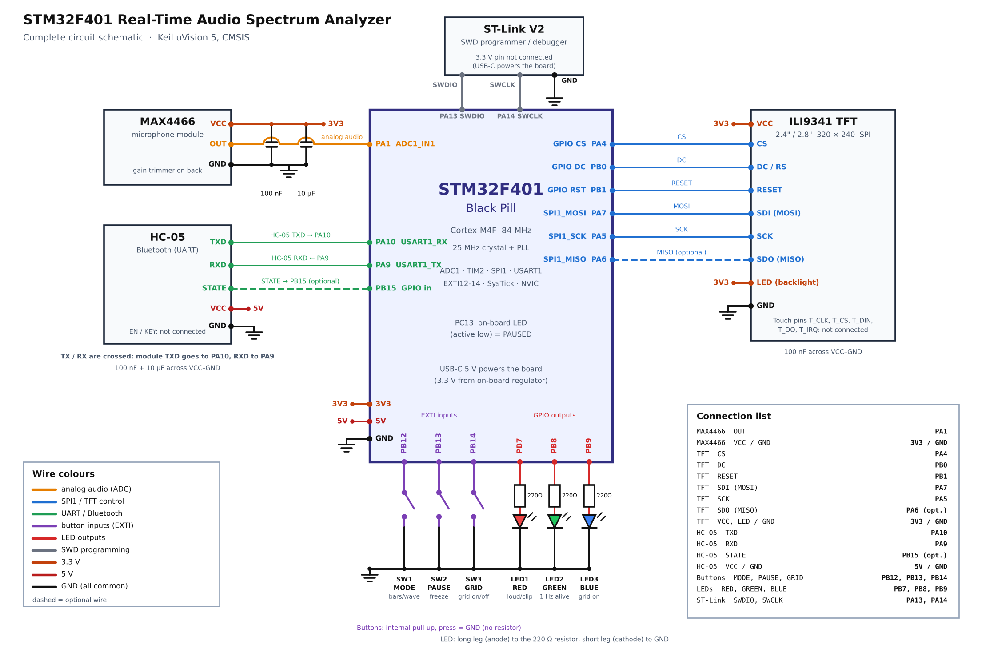
CIRCUIT
How everything connects
Signal | Pin | Used for
Mic OUT | PA1 (ADC1 ch1) | Audio input
TFT | SPI1 @ 10.5 MHz | Display data
HC-05 TX / RX | PA10 / PA9 | USART1, 9600 baud
Buttons | PB12 · PB13 · PB14 | Mode · pause · grid
LEDs | PB7 · PB8 · PB9 | Red · green · blue
On-board LED | PC13 | On = paused
Common ground between all modules; MAX4466 and HC-05 are powered from the board's supply.
REAL-TIME AUDIO SPECTRUM ANALYZER · STM32F401
06 / 16
Notes:
Use the schematic to explain each connection. Mic output to PA1; HC-05 on USART1; TFT on SPI1; buttons and LEDs on GPIOB.

Slide 7
CLOCK & SAMPLING
A steady 16 kHz sample clock
84 MHz
16 kHz
12-bit
System clock
Sample rate
ADC resolution
25 MHz crystal → PLL (M=25, N=336, P=4)
TIM2 ARR = 5249 gives a 16 kHz trigger
ADC1 channel 1, 84-cycle sampling time
8 kHz
512
31.25 Hz
Bandwidth
Samples per block
Bin width
Nyquist limit = sample rate ÷ 2
Collected in the ADC end-of-conversion ISR
Sample rate ÷ FFT size = 16000 ÷ 512
Why a timer? Timer-triggered sampling gives exact, jitter-free spacing between samples, which the FFT needs.
REAL-TIME AUDIO SPECTRUM ANALYZER · STM32F401
07 / 16
Notes:
Bandwidth is 8 kHz because fs = 16 kHz and Nyquist says the highest usable frequency is fs/2. Bin width = fs/N = 31.25 Hz. A block of 512 samples takes 32 ms to collect.

Slide 8
SIGNAL PROCESSING
Five steps from samples to bars
1
2
3
4
5
DC removal
Hann window
512-pt FFT
Log bars
dBFS + peak
Subtract the mean so the 1.65 V bias does not hide real signals.
Tapers block edges to reduce spectral leakage.
Radix-2 FFT in place, using the Cortex-M4 FPU.
Magnitudes grouped into 32 log-spaced bars, 31 Hz to 8 kHz.
Level in dB full scale; parabolic interpolation for the peak.
Log spacing matches hearing: low notes get more bars than the crowded high end.
REAL-TIME AUDIO SPECTRUM ANALYZER · STM32F401
08 / 16
Notes:
Explain each step in one sentence. Mention that the peak frequency readout on the TFT uses parabolic interpolation so it is finer than the 31.25 Hz bin width.

Slide 9
FIRMWARE
Interrupts do little, the main loop does the work
Handler | Priority | What it does
ADC_IRQHandler | 1 | Stores each sample; flags a full 512-sample block
SysTick_Handler | 2 | 1 ms tick for timing, LED blink, debounce
USART1_IRQHandler | 3 | Moves Bluetooth bytes through ring buffers
EXTI15_10_IRQHandler | 4 | Records a button edge; debounce happens later
MAIN LOOP
Wait for a full block
Run FFT and build bars
Redraw only changed pixels
Poll buttons, send Bluetooth report
25 ms
button confirm
150 ms
lockout
250 ms
Bluetooth report
REAL-TIME AUDIO SPECTRUM ANALYZER · STM32F401
09 / 16
Notes:
NVIC priorities: ADC 1 (most urgent so no samples are lost), SysTick 2, USART1 3, EXTI 4. ISRs are kept very short.

Slide 10
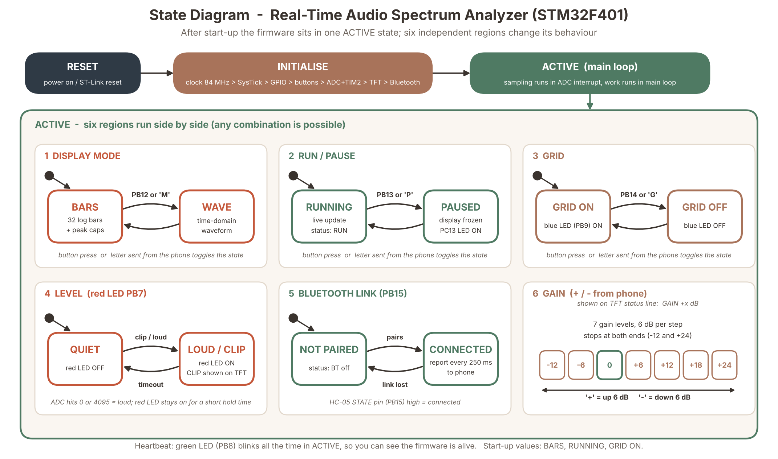
SYSTEM DESIGN
State diagram: how the system behaves
REAL-TIME AUDIO SPECTRUM ANALYZER · STM32F401
10 / 16
Notes:
Reset, then initialisation, then one ACTIVE state. Inside ACTIVE six regions work side by side: display mode (PB12/M), run or pause (PB13/P), grid (PB14/G), loud level (red LED), Bluetooth link (PB15) and gain (+/-). Start-up values: bars, running, grid on, gain 0 dB.

Slide 11
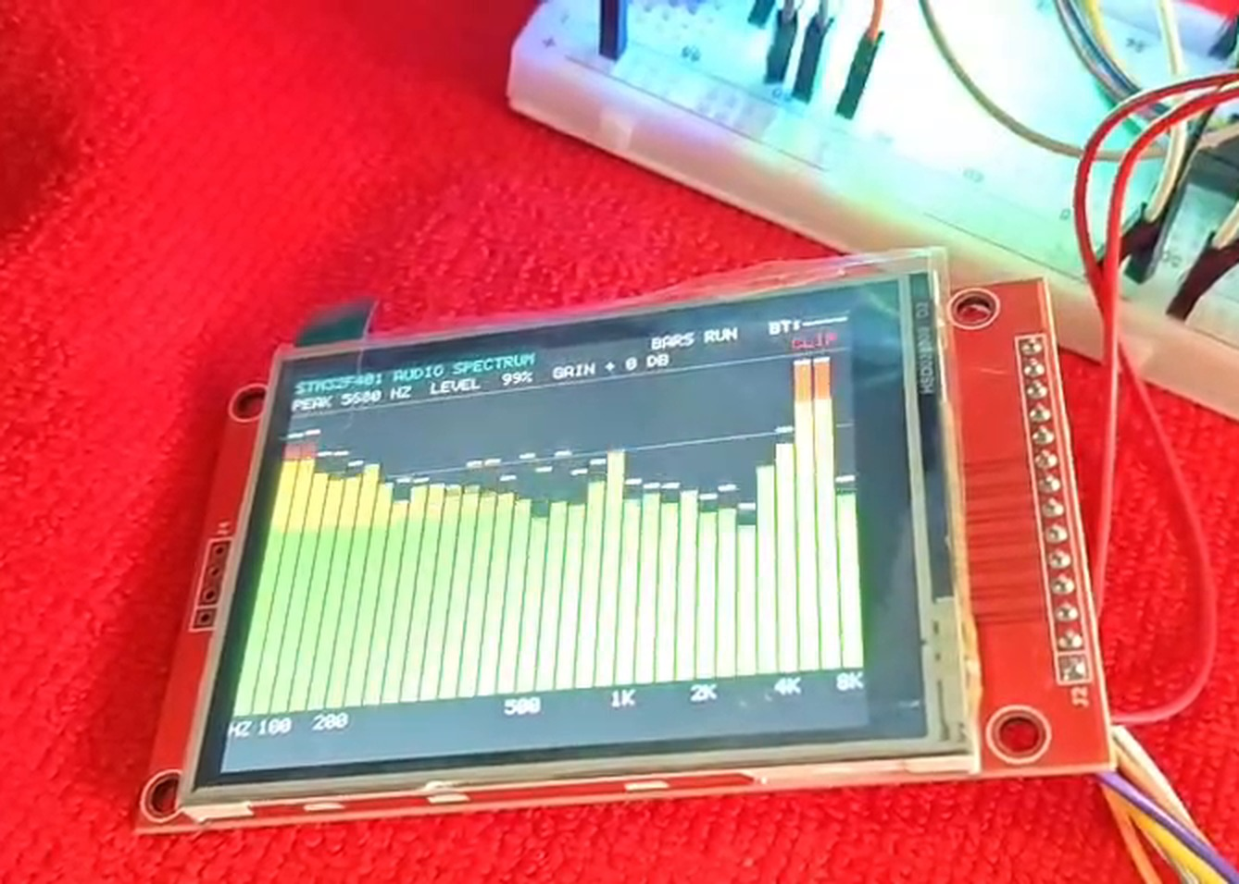
DISPLAY
Live spectrum on the TFT
SPI1 at 10.5 MHz
Fast pixel writes to the ILI9341 controller.
1
Incremental redraw
Only bars that changed are repainted; a full redraw takes about 117 ms.
2
Colour-coded bars
Green for low, yellow for mid, red for high level, with falling peak caps.
3
Status line
Peak frequency, level percent, gain and Bluetooth state.
4
REAL-TIME AUDIO SPECTRUM ANALYZER · STM32F401
11 / 16
Notes:
Point out the bars, the peak line at the top, and the HZ axis labels under the bars. Redrawing only changed bars keeps the display smooth.

Slide 12
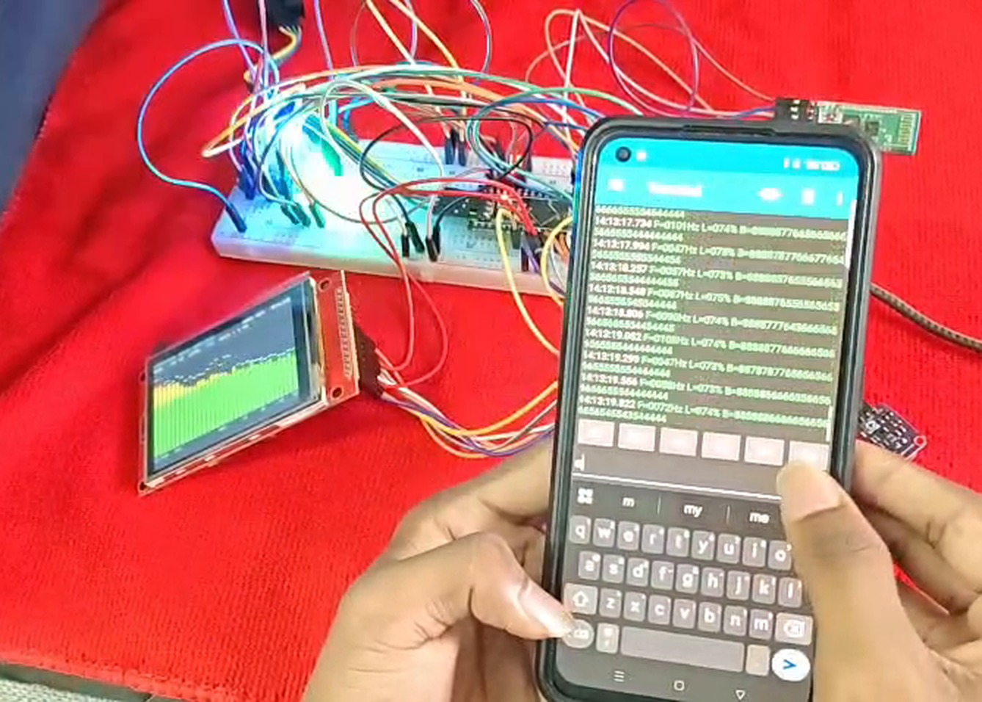
CONTROLS & BLUETOOTH
Buttons, LEDs and the phone link
Control | Action
Button 1 (PB12) | Bars ↔ waveform
Button 2 (PB13) | Freeze / resume
Button 3 (PB14) | Grid on / off
Red LED | Loud sound or clipping
Green LED | Blinks: firmware alive
Blue LED | Grid is on
Phone commands: M mode · P pause · G grid · + / − gain · ? help
REAL-TIME AUDIO SPECTRUM ANALYZER · STM32F401
12 / 16
Notes:
Explain that the HC-05 runs at 9600 baud. The phone sends single letters to control the analyzer and receives a spectrum report four times a second.

Slide 13

RESULTS
What the working system shows
Full setup
Live bars
Bluetooth report
Board, mic, TFT, HC-05 and phone together.
Speech and tones appear at the right frequencies.
Spectrum data arrives on the phone terminal.
✓
Bars follow sound
✓
Buttons respond
✓
Bluetooth works
REAL-TIME AUDIO SPECTRUM ANALYZER · STM32F401
13 / 16
Notes:
This is where you refer to the demo video. Play a tone or speak, show the bars react, press each button, and show the phone terminal.

Slide 14
KEY FIGURES
Specifications at a glance
Parameter | Value | Parameter | Value
MCU | STM32F401, 84 MHz Cortex-M4F | FFT size | 512 points, radix-2
Sample rate | 16 kHz (TIM2 → ADC1 trigger) | Window | Hann
ADC | 12-bit, channel 1 (PA1) | Resolution | 31.25 Hz per bin
Bandwidth | 8 kHz (Nyquist) | Display bars | 32, log-spaced 31 Hz–8 kHz
Block time | 32 ms per 512 samples | TFT link | SPI1, 10.5 MHz
Bluetooth | HC-05, USART1, 9600 baud | Gain steps | −12 to +24 dB in 6 dB steps
Written at register level with CMSIS in Keil uVision 5: no HAL, no RTOS, no external DSP library.
REAL-TIME AUDIO SPECTRUM ANALYZER · STM32F401
14 / 16
Notes:
A quick reference slide. Useful if the examiner asks about bandwidth, resolution or sampling.

Slide 15
CONCLUSION
What we built and what comes next
ACHIEVED
FUTURE SCOPE
Real-time 512-point FFT on a Cortex-M4F
Exact 16 kHz sampling with timer-triggered ADC
Smooth 32-bar display with peak and level readout
Bluetooth control and streaming to a phone
Short, safe interrupts with debounced buttons
Use DMA for sampling to free the CPU
Higher sample rate for a wider bandwidth
Larger FFT for finer frequency resolution
Save spectra to an SD card
Touch screen controls on the TFT
Result: a working, standalone spectrum analyzer that senses, analyses and displays sound in real time.
REAL-TIME AUDIO SPECTRUM ANALYZER · STM32F401
15 / 16
Notes:
Give the simple conclusion: the system captures, analyses and displays audio spectra in real time, and the design keeps interrupts short. Then mention the future scope.

Slide 16
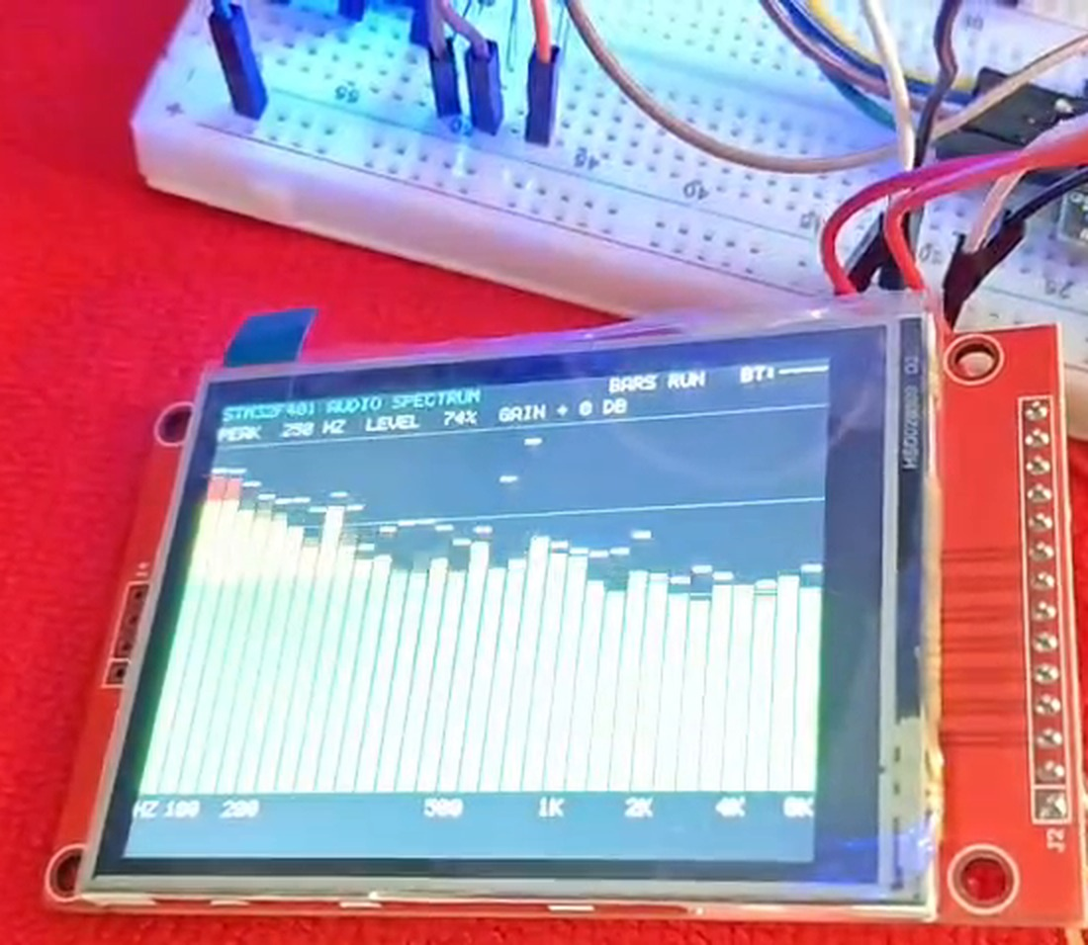
THANK YOU
Questions?
Real-Time Audio Spectrum Analyzer on STM32F401 Black Pill
GROUP 2
J Harshith
CB.SC.U4CSE24721
Jason Richards
CB.SC.U4CSE24722
Pranav Machireddy
CB.SC.U4CSE24730
Rajeev Lochan
CB.SC.U4CSE24731
Demo video and source code: [GitHub link]
REAL-TIME AUDIO SPECTRUM ANALYZER · STM32F401
16 / 16
Notes:
Thank the audience and invite questions.

